Slide 1

Beneath the label: Unsatisfactory compliance with ESRB, PEGI, and IARC industry self-regulation requiring loot box presence warning labels by video game companies
Leon Y. Xiao
28–29 June 2023
CAGR 2023, London, England
Email: lexi@itu.dk
Twitter: @LeonXiaoY
Paper: https://doi.org/10.1098/rsos.230270
Website: https://sites.google.com/view/leon-xiao/
Notes:
Thank you very much for coming to this presentation. I’m Leon Xiao

Slide 2

Conflict of interest
Full: https://sites.google.com/view/leon-xiao/about/conflict-of-interest
  I worked for a technology company that has a video game business.
  I worked with a law firm that advise the video game industry.
  I received research grants derived from ‘regulatory settlements applied for socially responsible purposes’ received by the UK Gambling Commission.
  I have contributed to research enabled by data access provided by the video game industry.
  I received conference travel and attendance support from the organisers of the 13th Nordic SNSUS Conference, which received gambling industry sponsorship.
  I have been invited to advise policymakers and regulators, which may affect my views of them as individuals and their actions.

Slide 3
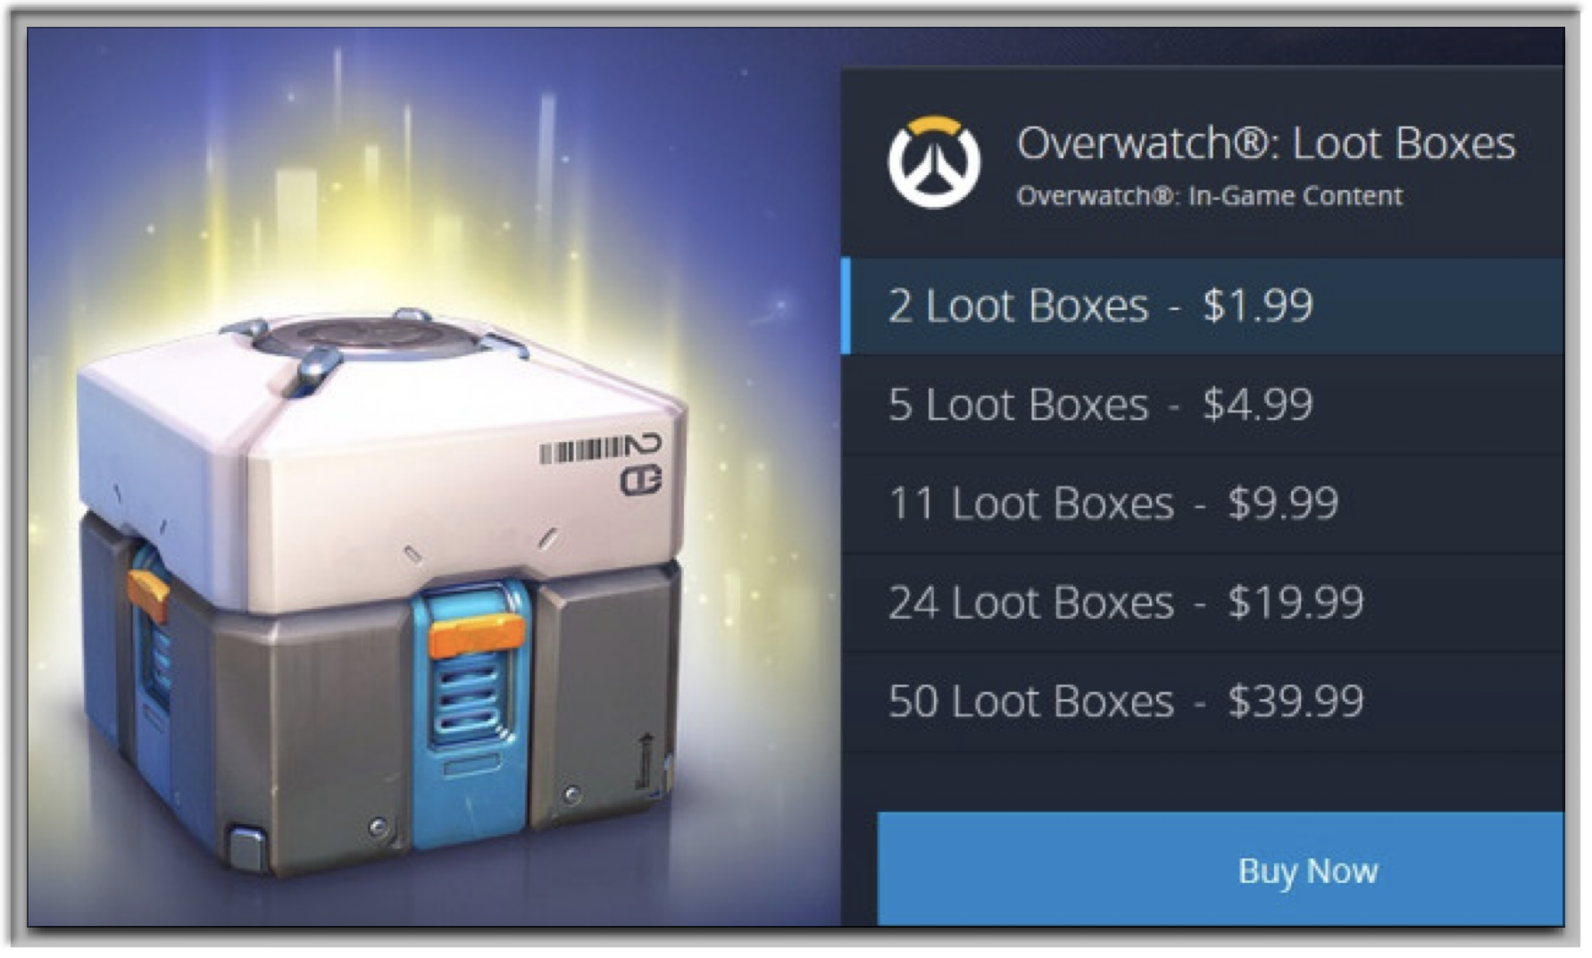
What is a loot box?
Virtual items in video games that contain randomised rewards.
Some loot boxes are purchased with money. Others are obtained for free.
Conceptually similar to gambling.
Loot box purchasing is positively correlated with problem gambling.
Subject to public controversy and regulatory scrutiny.
© Blizzard Entertainment
Notes:
I will start with briefly setting out the subject of my research because it is through researching this topic that I thought about open science and reproducibility in a game analysis context.
I am sure many of you are familiar with this concept, but I research loot boxes. Loot boxes are these gambling-like mechanics in video games that players can purchase using real-world money to obtain randomised rewards.
Loot boxes are therefore conceptually similar to gambling and links have been found between disordered gambling and loot box spending.
Given potential harms, specifically, players overspending money on loot boxes. These mechanics have been the subject of public controversy and regulatory scrutiny.

Slide 4

Prevalence of loot boxes
Amongst the 100 highest-grossing iPhone games?
59% contained loot boxes in the UK 🇬🇧 in 2019.
77% contained loot boxes in the UK 🇬🇧 in mid-2021.
As did 91% in China 🇨🇳 in mid-2020.
© Supercell Oy
Notes:
Accordingly, it is very important for us to know the prevalence of loot boxes amongst the most popular video games. Do they appear only in a few well known and prominent video games, or do they appear more generally amongst many games?
Zendle et al. sought to answer that question in early 2019. They conducted an analysis of the 100 highest-grossing iPhone games and found a loot box prevalence rate of 59%, meaning that 59 of the 100 games were identified as having contained at least one loot box.
This information has been very influential. The Spanish gambling regulator has, for example, relied upon this to argue that loot boxes are prevalent and therefore potentially deserving of regulatory intervention in Spain. I am highlighting this to show that game studies, and particularly game analysis, now potentially have direct impact on policymaking. Not only do we care as researchers, but others, such as parents of child players, are also interested in the results that we produce. Game analysis potentially has implications beyond academia.

Slide 5
UK’s current regulatory position
Department for Digital, Culture, Media and Sport (DCMS) of the UK Government:
  “Our view is that it would be premature to pursue legislation with regards to loot boxes without first pursuing enhanced industry-led protections” (para. 32)
Refused to change the definition of gambling and thereby regulate all paid loot boxes as a form of gambling.
  Citing, inter alia, wanting to avoid “dramatically [increasing] the scope and costs of running the Gambling Commission…” (para. 36).
Notes:
So, how can loot boxes be regulated?
There are several potential ways to do this, and restricting players from purchasing loot boxes, in other words, an outright ban, is only one of many different potential approaches.
*next slide*
Another less restrictive approach, that retains players’ autonomy to purchase loot boxes and preserves video game companies’ existing commercial interests, has been adopted as law in China. This law requires companies to disclose the exact probabilities of obtaining the potential rewards from their loot boxes.

Slide 6
How effective has pre-existing industry self-regulation been?
🤔

Slide 7

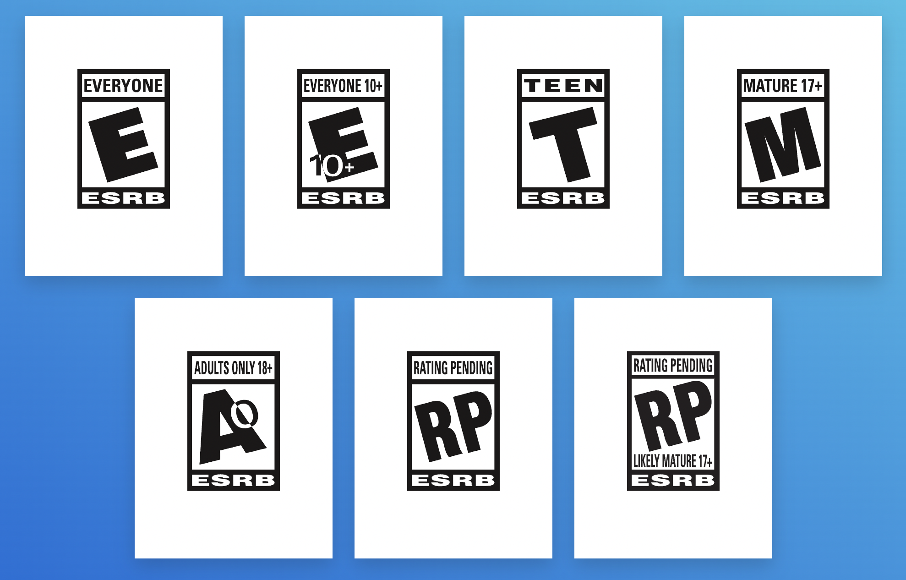
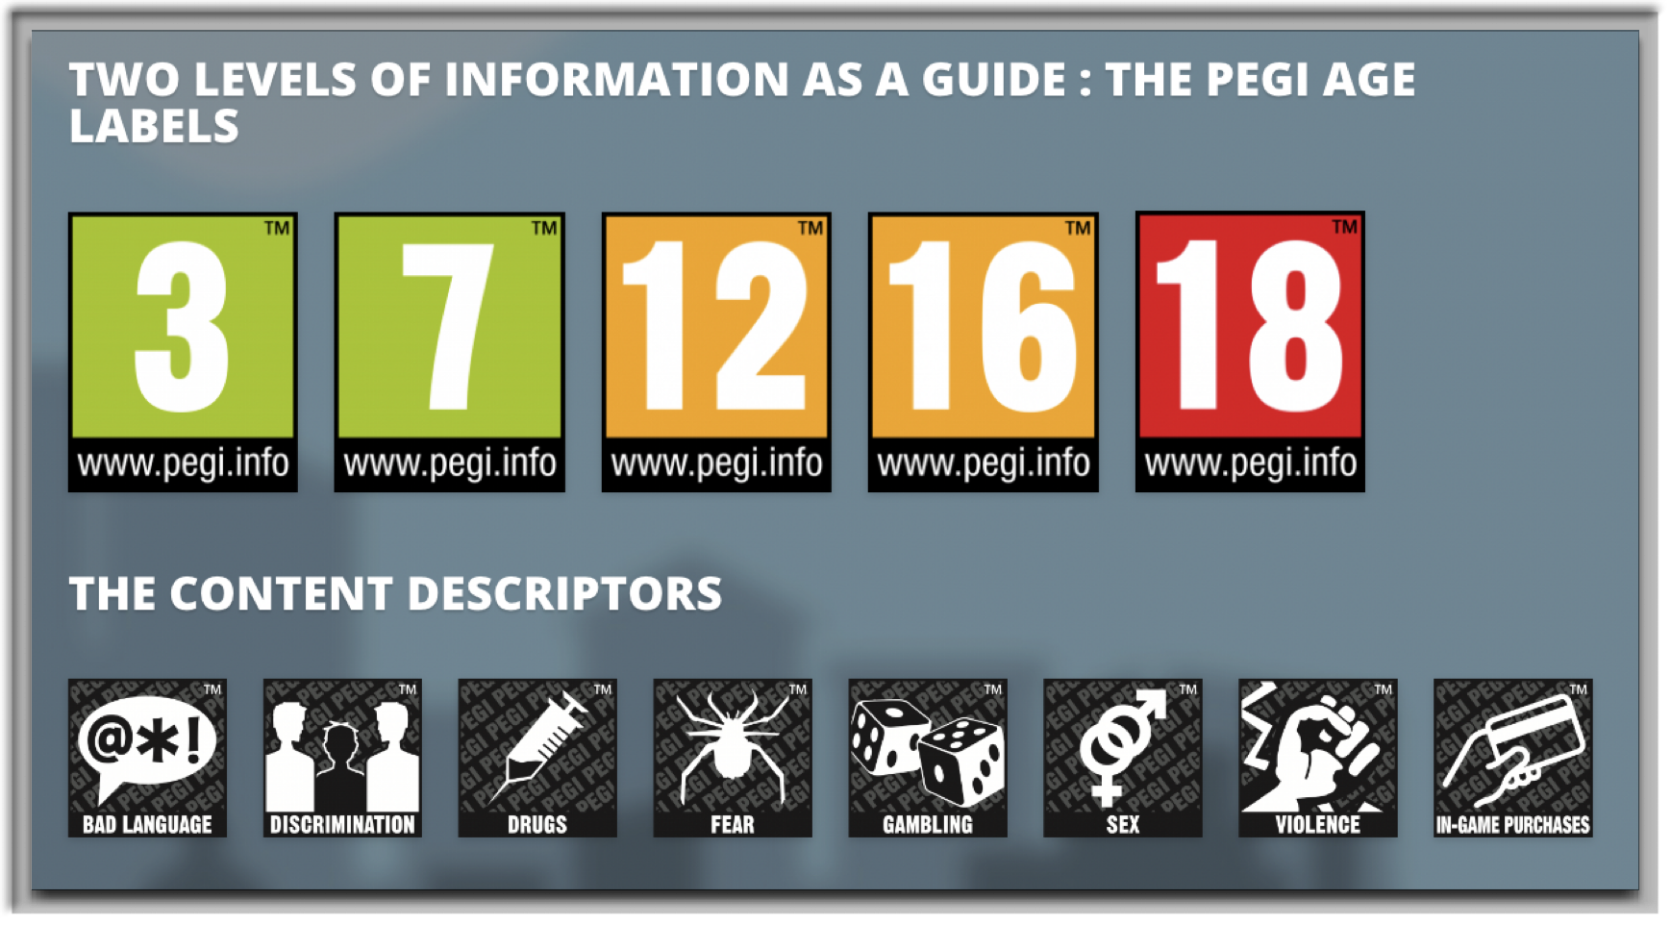
The ESRB and PEGI
The ESRB (Entertainment Software Rating Board) provides age ratings to video games depending on content, e.g., violence, in North America.
PEGI (Pan-European Game Information) performs the same function in Europe.
© ESRB
© PEGI
Notes:
The research question that I seek to answer with this study is:
Genshin Impact/原神 still appeared in the highest-grossing list in Belgium, which bemused me.

Slide 8
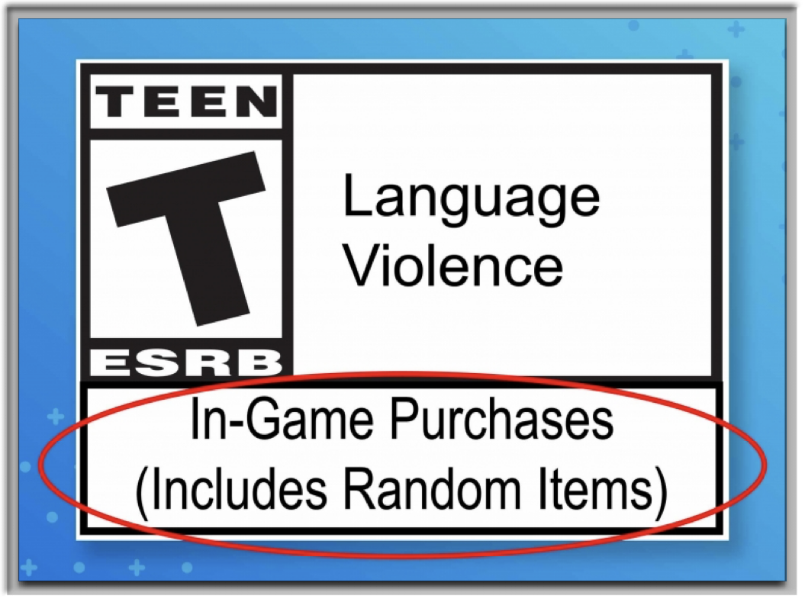

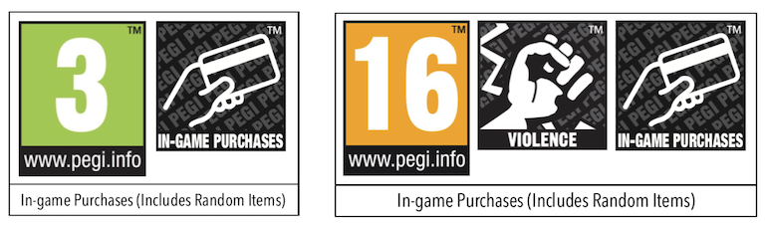
ESRB’s and PEGI’s self-regulation
“… many game consumers and enthusiasts (not necessarily parents) [asked] the ESRB to include additional information to identify games that include randomized purchases.”
“The In-Game Purchases (Includes Random Items) Interactive Element was developed in response to those requests.”
“By including more specificity about the randomized nature of the in-game purchases, consumers can make more informed decisions when purchasing or downloading a game, instead of finding out after the fact.”
© ESRB
© PEGI
Notes:
The research question that I seek to answer with this study is:
Genshin Impact/原神 still appeared in the highest-grossing list in Belgium, which bemused me.

Slide 9


How to find the label? (On the back…)
🔍
© PEGI & Electronic Arts
Notes:
The research question that I seek to answer with this study is:
Genshin Impact/原神 still appeared in the highest-grossing list in Belgium, which bemused me.

Slide 10
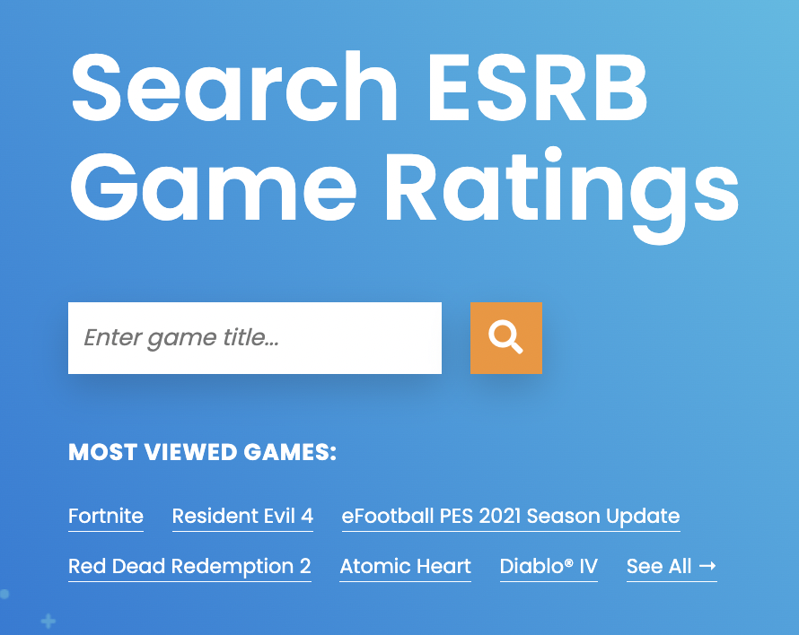
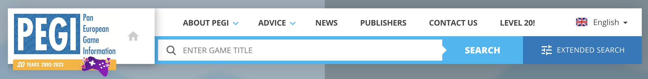
Study 1: ESRB vs PEGI
ESRB and PEGI separately assessed games.
There should be consistency as to whether games supposedly contained loot boxes.
© PEGI & ESRB
Notes:
The research question that I seek to answer with this study is:
Genshin Impact/原神 still appeared in the highest-grossing list in Belgium, which bemused me.

Slide 11
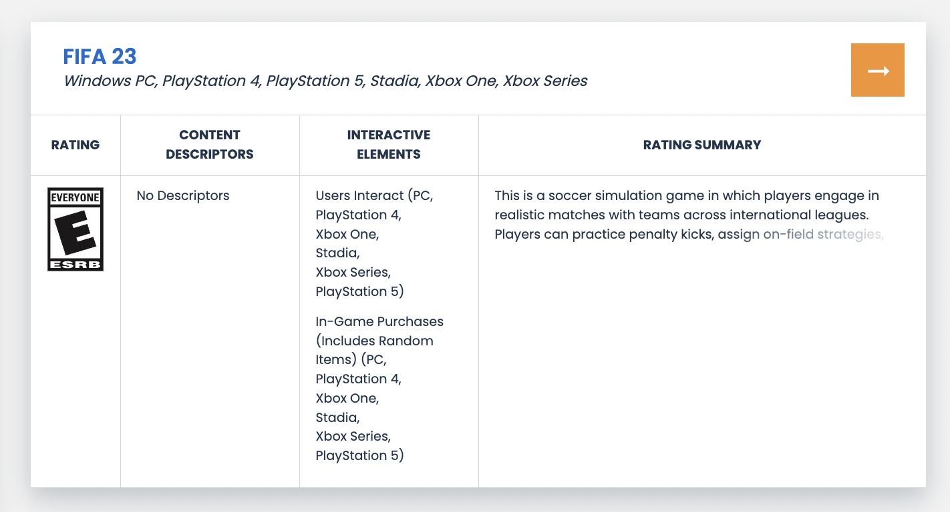
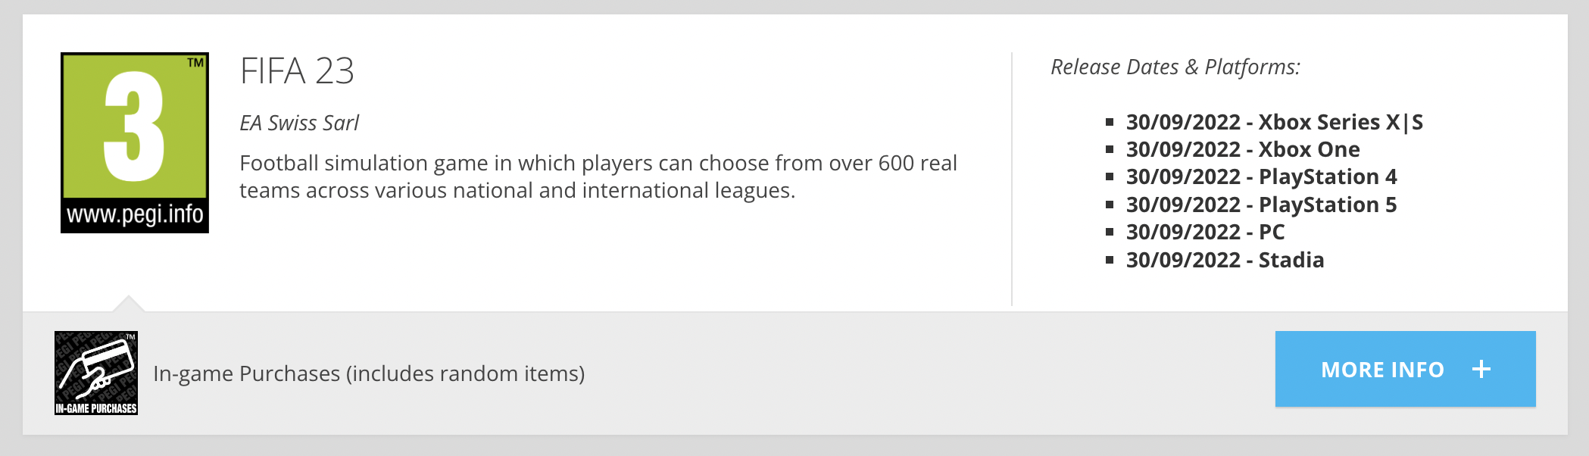
© ESRB
© PEGI
Notes:
The research question that I seek to answer with this study is:
Genshin Impact/原神 still appeared in the highest-grossing list in Belgium, which bemused me.

Slide 12
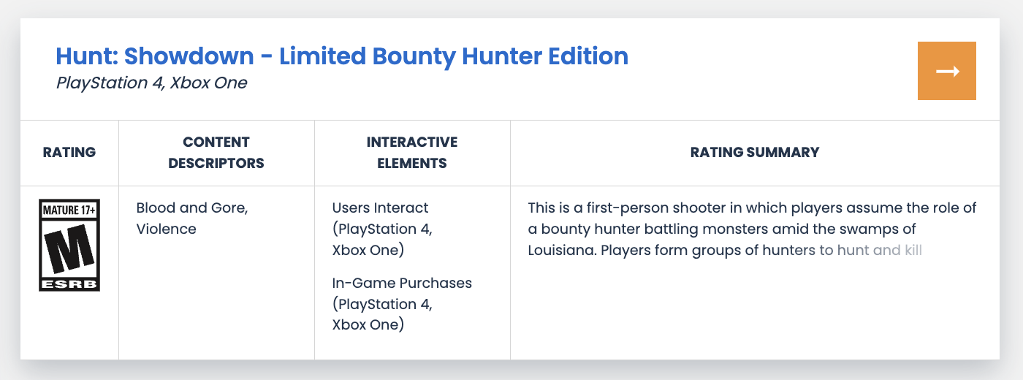
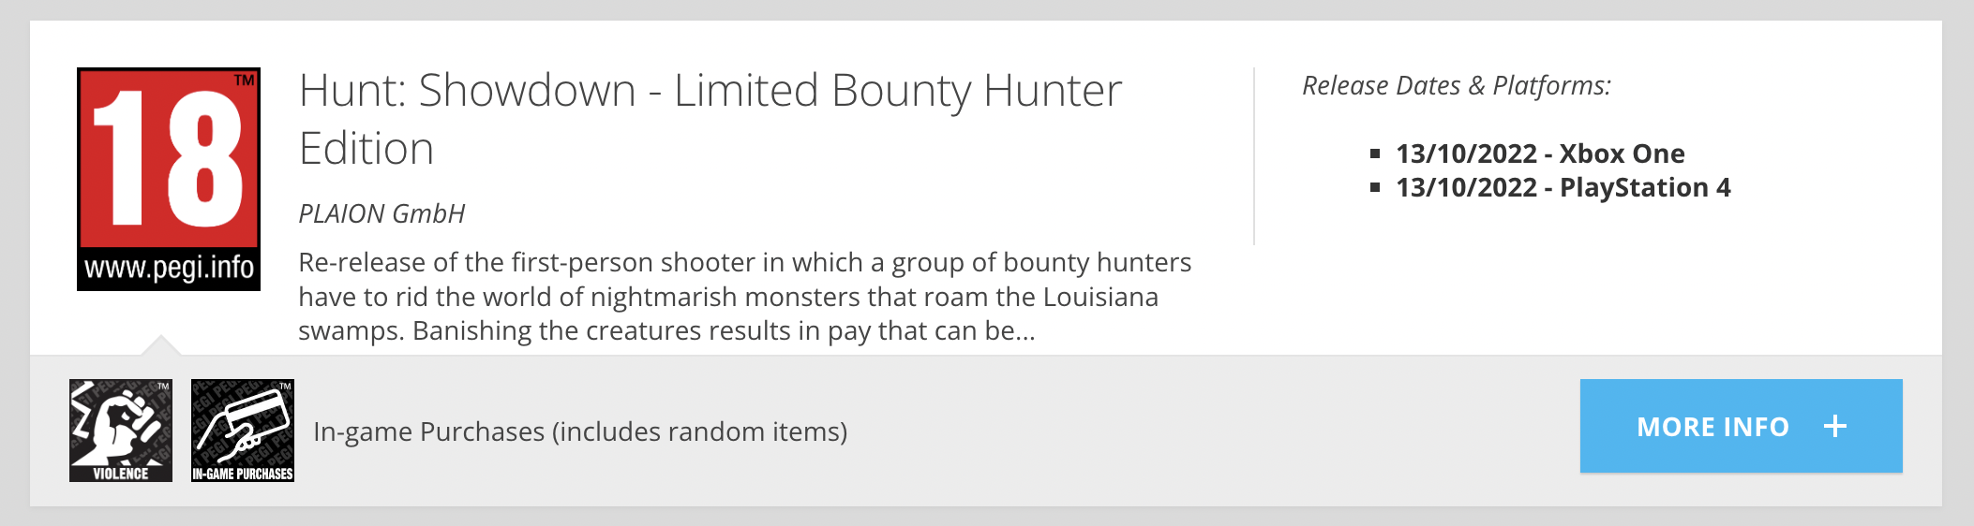
😓
© ESRB
© PEGI
Notes:
The research question that I seek to answer with this study is:
Genshin Impact/原神 still appeared in the highest-grossing list in Belgium, which bemused me.

Slide 13
ESRB vs PEGI
Pitted the two age rating organisations against each other to cross-check…
  …rather than waste resources playing the games myself to check whether the games contained loot boxes.
Compared the labelling status of games using the respective search tools after data scraping.
Notes:
So, how can loot boxes be regulated?
There are several potential ways to do this, and restricting players from purchasing loot boxes, in other words, an outright ban, is only one of many different potential approaches.
*next slide*
Another less restrictive approach, that retains players’ autonomy to purchase loot boxes and preserves video game companies’ existing commercial interests, has been adopted as law in China. This law requires companies to disclose the exact probabilities of obtaining the potential rewards from their loot boxes.

Slide 14
ESRB and PEGI rating inconsistencies
31 games total:
26 games were duly labelled by both but
5 games were missing the label from one of either organisation.
Consistency rate of 83.9%
  Lower than the preregistered satisfactory consistency rate of 95%.
Don’t know how many games were missing the label from both.
  Diablo Immortal turned out to be such a game that disclosed to neither…
Notes:
So, how can loot boxes be regulated?
There are several potential ways to do this, and restricting players from purchasing loot boxes, in other words, an outright ban, is only one of many different potential approaches.
*next slide*
Another less restrictive approach, that retains players’ autonomy to purchase loot boxes and preserves video game companies’ existing commercial interests, has been adopted as law in China. This law requires companies to disclose the exact probabilities of obtaining the potential rewards from their loot boxes.

Slide 15

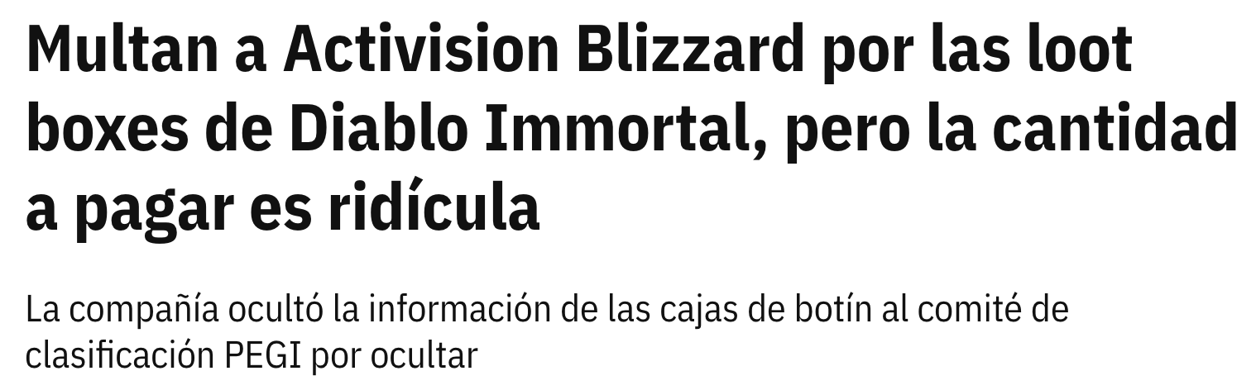

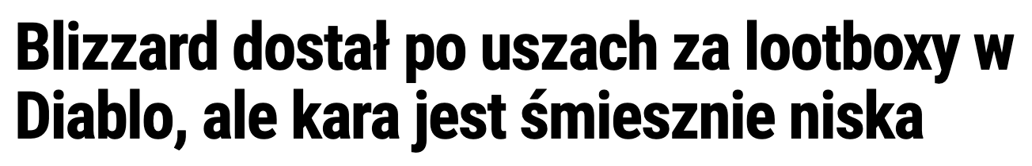
PEGI enforcement actions
Following my study, PEGI fined two companies €5,000 each for failing to disclose loot box presence during the rating process.
Diablo Immortal, one of the games fined, made over €480 million in the 1 year since release, so the fine was 0.001% of the earnings. 🙃

Slide 16

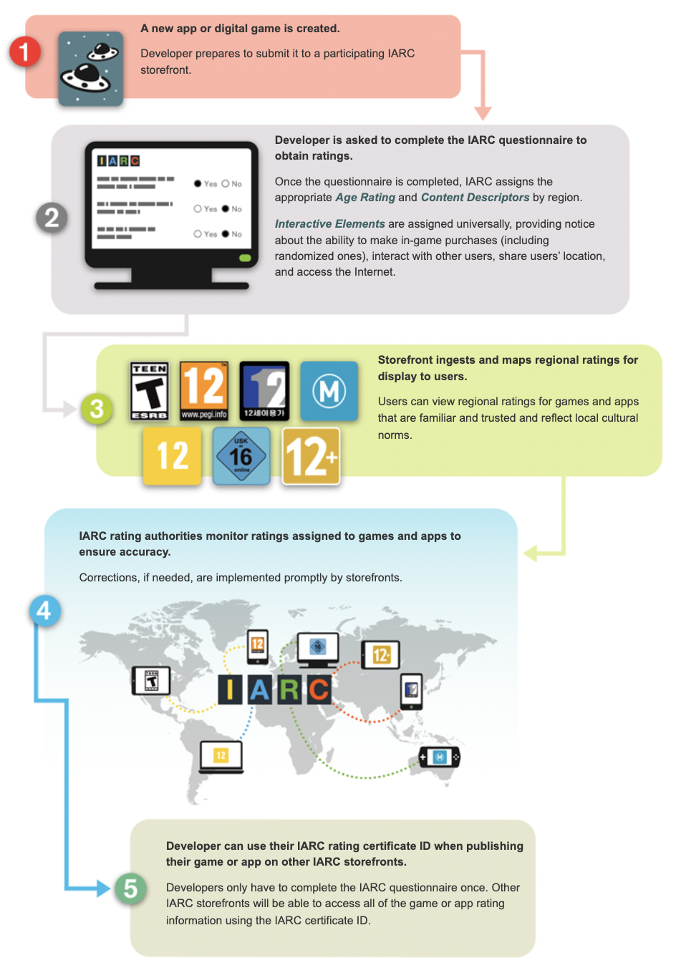
IARC
© IARC
The IARC (International Age Rating Coalition) is a simplified system that allows game companies to obtain multiple age ratings that are used in different territories for digitally delivered games simultaneously.
Notes:
The research question that I seek to answer with this study is:
Genshin Impact/原神 still appeared in the highest-grossing list in Belgium, which bemused me.

Slide 17

IARC
© IARC
“IARC rating assignments also include content descriptors and interactive elements, identifying games and apps that … offer in-app/game purchases (as well as those that are randomized)…”
Notes:
The research question that I seek to answer with this study is:
Genshin Impact/原神 still appeared in the highest-grossing list in Belgium, which bemused me.

Slide 18
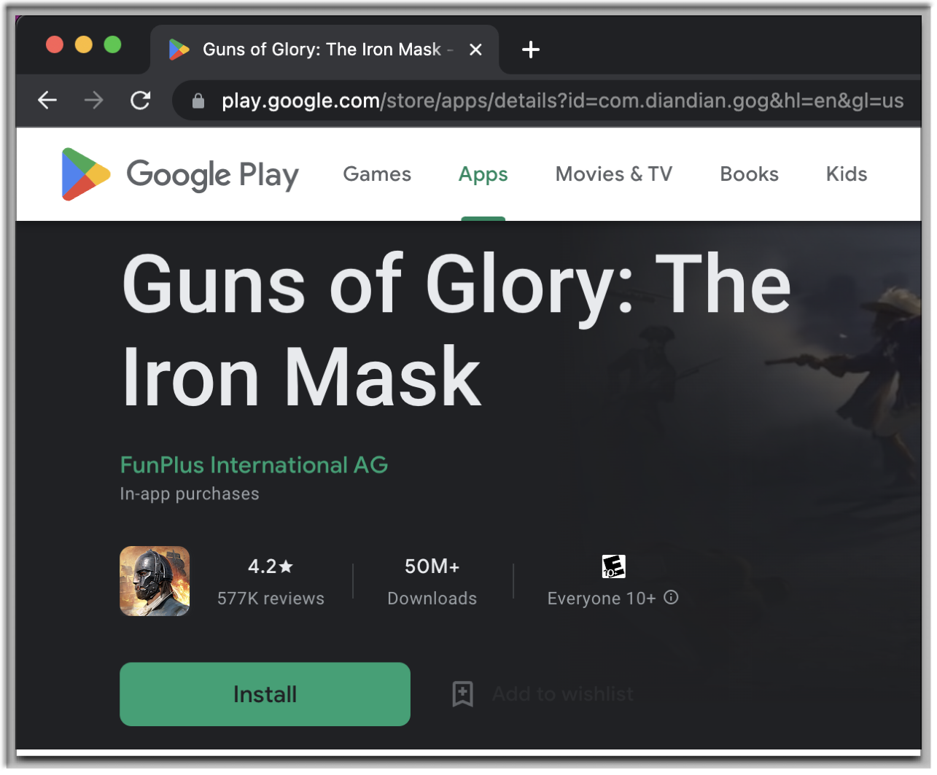

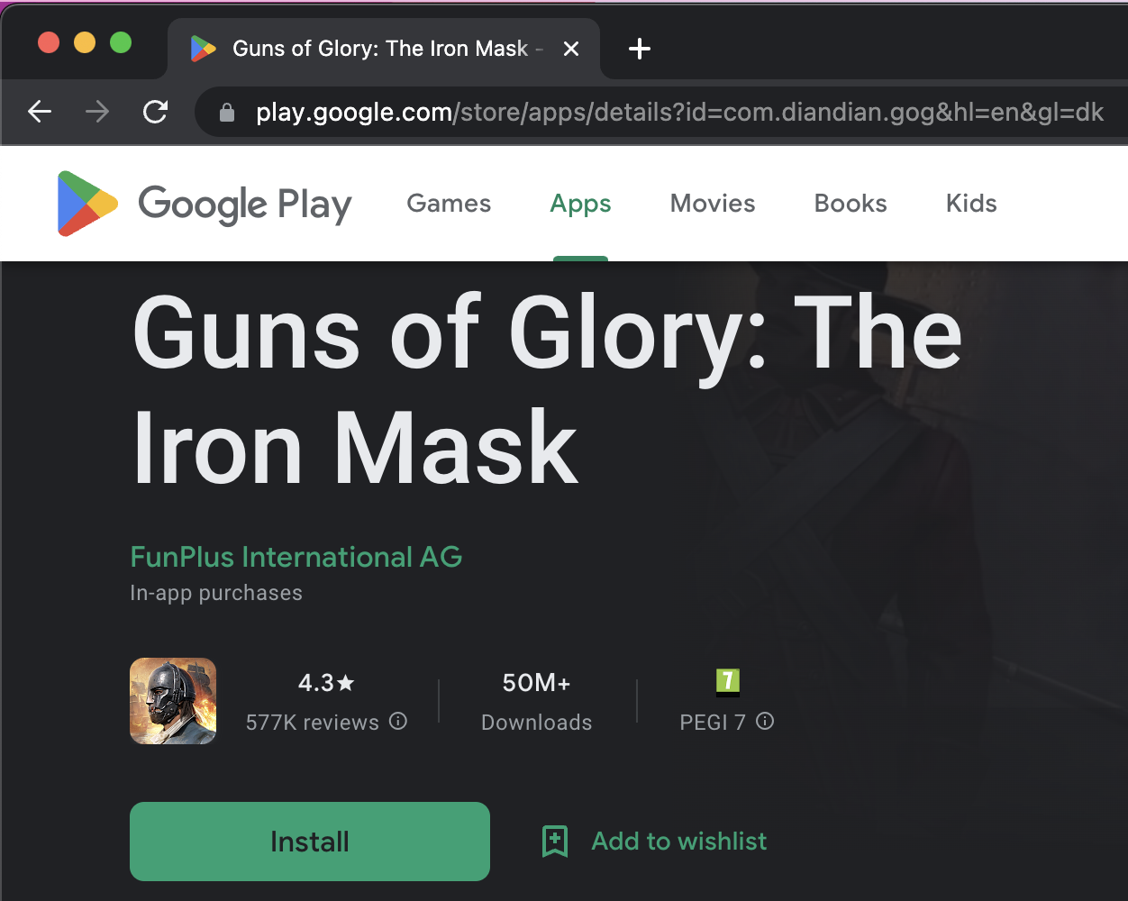
IARC on the Google Play Store
© Google, FunPlus International AG, ESRB, PEGI, IARC
Notes:
The research question that I seek to answer with this study is:
Genshin Impact/原神 still appeared in the highest-grossing list in Belgium, which bemused me.

Slide 19
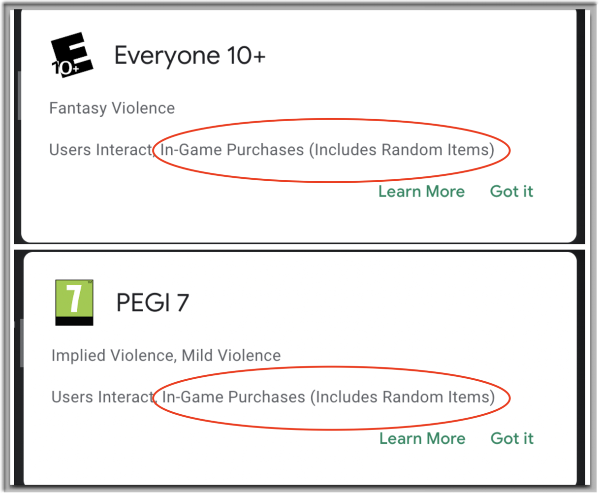
IARC on the Google Play Store
🇺🇸
US Store:
ESRB Rating
🇩🇰
Danish Store:
PEGI Rating
© Google, FunPlus International AG, ESRB, PEGI, IARC
Notes:
The research question that I seek to answer with this study is:
Genshin Impact/原神 still appeared in the highest-grossing list in Belgium, which bemused me.

Slide 20
IARC on the Google Play Store
71 of 100 popular games containing loot boxes did not attach the label.
ESRB: “Google Play didn’t update to the IARC version with IGPR until February 2022.”
🙄
77 of 84 games that I suggested for labelling have since been labelled.

Slide 21
IARC on the Google Play Store
PEGI’s official response:
Sheer volume of content on the Google Play Store described as a ‘challenge.’ No solution proposed.
‘we don’t have these issues with other storefronts.’
🤔

Slide 22
IARC on other stores
Storefront | Number of available games | Number of labelled games | Compliance rate
Epic Games Store | 14 | 1 | 7.1%
Microsoft Store for Windows and Xbox | 55 | 49 | 89.1%
Nintendo eShop | 24 | 13 | 54.2%
PlayStation Store | 37 | 26 | 70.3%
🤡

Slide 23
The ESRB/PEGI does not work…?
Under experimental conditions, “consumers do not appear to understand the ESRB/PEGI loot box warning.”
— Garrett, Drummond, Lowe-Calverley, & Sauer (https://doi.org/10.1016/j.chb.2022.107534)
© ESRB
© PEGI
Notes:
The research question that I seek to answer with this study is:
Genshin Impact/原神 still appeared in the highest-grossing list in Belgium, which bemused me.

Slide 24
Industry self-regulation = meh…
Consumers cannot trust either industry self-regulatory (i) probability disclosures or (ii) loot box presence warnings.
Industry self-regulation must not be assumed to ‘work’ effectively.
We need to critically think about and plan to assess the efficacy of industry promises, given the conflicts of interest.
‘We’ = researchers, policymakers, regulators, and non-industry stakeholders

Slide 25
Thanks for listening! Questions?
Full paper published at Royal Society Open Science and all underlying data are publicly available: https://doi.org/10.1098/rsos.230270.
Email: lexi@itu.dk
Twitter: @LeonXiaoY
LinkedIn: https://www.linkedin.com/in/leon-xiao/
Website: https://sites.google.com/view/leon-xiao/
Notes:
Thank you for listening! I’ll take questions now, but if you have any further questions after the Q&A session, please get in touch with us using any of these methods.

