Slide 1


Gambling after COVID-19: Insights from an Australian sample
Dr Aino Suomi
Director
ANU Centre for Gambling Research
CAGR conference
29 June 2023

Slide 2
Conflict of interest (COI) and acknowledgments
Declaration of COI: I declare that no conflict of interest in relation to this paper.
5-year COI: I have received funding from multiple sources, including philanthropic organisations, and Australian federal and state/territory government departments including the Victorian Responsible Gambling Foundation and the ACT Gambling and Racing Commission (through hypothecated taxes from gambling revenue).
Acknowledgments: Co-authors Dr Jeff Kim, Dr Markus Hahn, & Social Research Centre
Notes:
Well-established literature on the early impacts of COVID-19 pandemic on gambling behaviours.
17 studies from March to May 2020 showed an overall reduction in gambling frequency and expenditure (Hodgins et al., 2021).
Predictors of increased gambling during the first lockdown included male gender, young age, higher problem gambling severity, and a history of mental health concerns (Hodgins et al., 2021).
These relationships were also evident in studies published in 2022, where data was collected in 2021, particularly around risk factors of problem gambling severity and younger age (Quinn et al., 2022).

Slide 3
Gambling and COVID19
Reduction in gambling frequency and expenditure during COVID-19
Early evidence (2020) shows predictors of gambling increase
Male gender,
Younger age,
Higher problem gambling severity,
Poor mental health history
Problem gambling severity and younger age remain significant predictors of gambling during later lockdowns (2021 data)
Notes:
Well-established literature on the early impacts of COVID-19 pandemic on gambling behaviours.
17 studies from March to May 2020 showed an overall reduction in gambling frequency and expenditure (Hodgins et al., 2021).
Predictors of increased gambling during the first lockdown included male gender, young age, higher problem gambling severity, and a history of mental health concerns (Hodgins et al., 2021).
These relationships were also evident in studies published in 2022, where data was collected in 2021, particularly around risk factors of problem gambling severity and younger age (Quinn et al., 2022).

Slide 4

Australian context for COVID19
2020-2022: particularly strict social restriction measures
venue closures,
cancellation in sports
reduction in racing events
Limited evidence shows increase in online gambling
Data beyond 2020-2021 is needed to ascertain the longer-term impacts of the pandemic on gambling
Notes:
Initial studies on gambling during COVID-19
A majority of studies assessing the impact of COVID gambling are from the first wave of the pandemic. Given that many countries only lifted their pandemic restrictions in late 2022, data beyond this is needed to ascertain the longer-term impacts of the pandemic on gambling.
The longer-term implications of both the reduction in overall gambling, and the increase in some vulnerable groups are unclear, and this information is important to understand where public health interventions and policy is needed to adjust to these changes. In addition, hardly any studies have examined participation in different gambling activities during the later stages or following the pandemic.
In Australia, where the current data was collected there were particularly strict social restriction measures in place for extended periods of time, that resulted in venue closures particularly restricting high yield gambling activities such as casino and electronic gaming machine (EGM) gambling throughout 2020, 2021, and to some extent in early 2022 (ref). In addition, the cancellation of sports, and racing events reduced the amount of sports betting opportunities available for the punters.

Slide 5
Research questions
What proportion of Australians gambled across gambling risk categories 2019, 2020, 2021, and 2023, overall and by activity (EGM play, race betting, lottery games, sports betting)
What proportion of at-risk gamblers in Australia participated in EGM play, race betting, lottery games, sports betting in 2019, 2020, 2021 and 2023
What factors were related to low-risk gambling transitions between 2021 and 2023?
Notes:
We know from previous research that problem gambling is associated with a number of negative family dynamics including xxx
Theres a quite a bit of research on affected others of gamblers and we know that their wellbeing is negatively impacted, and children of problem gamblers are often bundled in with other affected others like spouses, or even friends. There is a reason to believe that children are more vulnerable to adult problem gambling.
Recently, parental problem gambling has been also classified as a major adverse childhood experience, alongside parental substance use, neglect and different forms of abuse.

Slide 6
ANUPoll data
GAMBLING QUESTIONS: April 2019 (n = 2,054), November 2020 (n = 3,029), October 2021 (n = 3,474), and January 2023 (n = 3,370).
n=2950 longitudinal data at least 2 timepoints.
 |  | 2019 | 2020 | 2021 | 2023
Gender | Female | 53.1 | 55.6 | 55.8 | 55.9
Age | 18 to 24 | 4.3 | 2.7 | 3.7 | 4.1
 | 25 to 34 | 11.8 | 11.4 | 11.4 | 11.5
 | 35 to 44 | 14.6 | 15.5 | 14.5 | 16.3
 | 45 to 54 | 18.0 | 16.3 | 16.3 | 16.3
 | 55 to 64 | 19.6 | 20.5 | 20.1 | 19.9
 | 65 to 74 | .21.1 | 21.4 | 23.0 | 21.6
 | 75+ | 10.4 | 12.3 | 11.1 | 10.3
Notes:
ANUPoll is an approximately quarterly survey of Australian public opinion.
Between April 2020 and January 2023, the ANUpoll series had a particular focus on COVID-19 outcomes.
Life in Australia (LinA) is a longitudinal, probability-based panel infrastructure where a broadly representative sample of Australian adults are invited to participate in monthly surveys either online or through Computer Assisted Telephone Interviewing (CATI). Since October 2017 the ANUpoll series of surveys has been collected through LinA, with seven waves of data collection between October 2017 and January 2020.
Between April 2020 and January 2023, the ANUpoll series had a particular focus on COVID-19 outcomes, with 14 waves of data collection as part of the ANU Centre for Social Research and Methods, COVID-19 Impact Monitoring series.
Description of participants here (basic demos etc from 2019 wave.)
https://srcentre.com.au/our-research/life-in-australia-study
¹https://srcentre.com.au/our-research/life-in-australia-study
Measures
All measures here reported in the current study, PGSI, gambling activities. Categorisations to 5 PGSI groups, including non-gamblers, and ‘risky’ (PGSI 1+) gambling, and separately to ‘high risk gambling’ (PGSI 3+)

Slide 7
Measures & Analysis
Problem Gambling Severity Index
5 PGSI groups, including non-gamblers,
‘risky’ gambling (PGSI 1+)
‘high risk’ gambling’ (PGSI 3+)
Loneliness scale, Psychological Distress (K6), demographics
Cross-sectional data in 2019, 2020, 2021, and 2023 by
PGSI category and overall
Gambling activities EGMs, Racing, Sportsbetting, Lottery
Longitudinal data examining post-COVID19 transitions
Trajectory modelling for low-risk gamblers
Notes:
Measures
All measures here reported in the current study, PGSI, gambling activities. Categorisations to 5 PGSI groups, including non-gamblers, and ‘risky’ (PGSI 1+) gambling, and separately to ‘high risk gambling’ (PGSI 3+)
Data in the paper is weighted to population benchmarks.

Slide 8
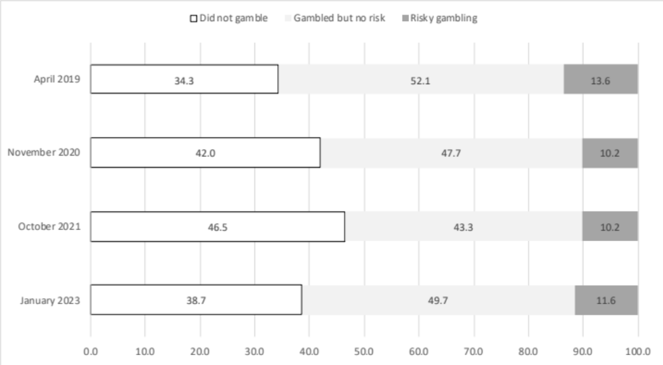
Gambling participation 2019, 2020, 2021 and 2023
Graph X: Cross-sectional proportions of Australians who did not gamble, gambled without negative consequences, and those who gambled at risky levels (PGSI 1+) in 2019, 2021 and 2023.
Notes:
There is now well-established body of literature on the early impacts of COVID-19 pandemic on gambling behaviours.
17 studies from March to May 2020 showed an overall reduction in gambling frequency and expenditure (Hodgins et al., 2021).
Despite this general population trend, predictors of increased gambling during the first lockdown included male gender, young age, higher problem gambling severity, and a history of mental health concerns (Hodgins et al., 2021).
These relationships were also evident in studies published in 2022, where data was collected in 2021, particularly around risk factors of problem gambling severity and younger age (Quinn et al., 2022).

Slide 9
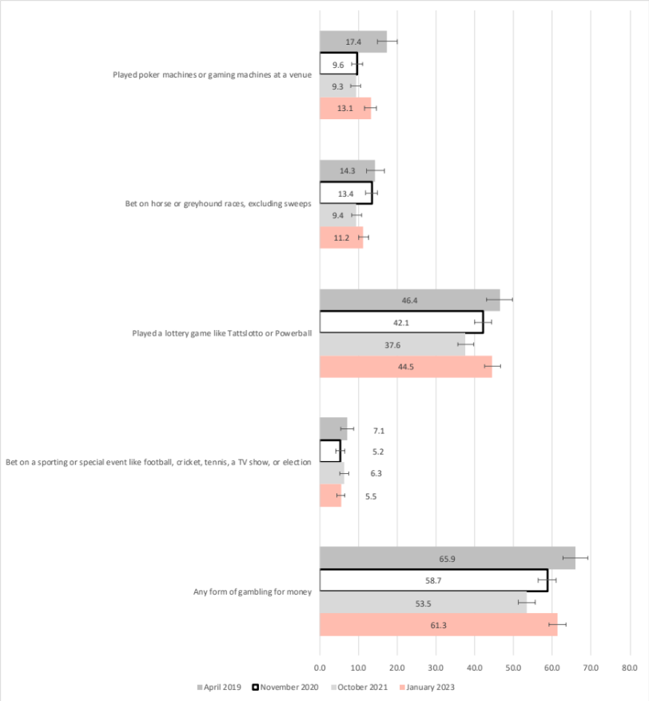
Gambling Participation by activity, overall
Poker machines at a venue (slots)
Races (dogs, horses)
Lottery
Sports or special event betting
Any form of gambling for money
0 20 40 60 80
= April 2019
= November 2020
= October 2021
= January 2023
Graph XXX: Participation in gambling activities in 2019, 2020, 2021, and 2023
Notes:
There is now well-established body of literature on the early impacts of COVID-19 pandemic on gambling behaviours.
17 studies from March to May 2020 showed an overall reduction in gambling frequency and expenditure (Hodgins et al., 2021).
Despite this general population trend, predictors of increased gambling during the first lockdown included male gender, young age, higher problem gambling severity, and a history of mental health concerns (Hodgins et al., 2021).
These relationships were also evident in studies published in 2022, where data was collected in 2021, particularly around risk factors of problem gambling severity and younger age (Quinn et al., 2022).
Take-home Points:
Poker/Gaming Trends
Horse/Greyhound Trends
Lottery Trends
Sporting/Event Trends
Overall Trends

Slide 10
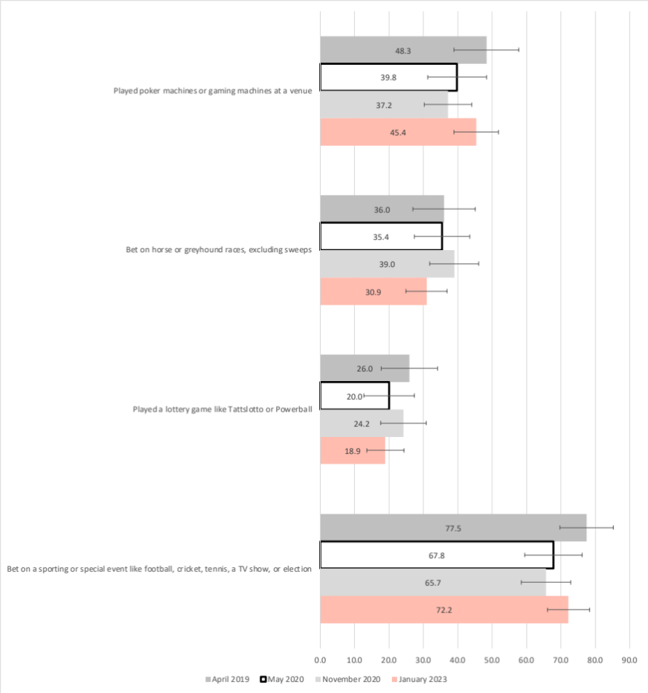
Participation by activity for PGSI 1+
Poker machines at a venue
Races (dogs, horses)
Lottery
Sports or special event betting
0 20 40 60 80
= April 2019
= November 2020
= October 2021
= January 2023
Graph XXX: Participation in gambling activities in 2019, 2020, 2021, and 2023
Notes:
There is now well-established body of literature on the early impacts of COVID-19 pandemic on gambling behaviours.
17 studies from March to May 2020 showed an overall reduction in gambling frequency and expenditure (Hodgins et al., 2021).
Despite this general population trend, predictors of increased gambling during the first lockdown included male gender, young age, higher problem gambling severity, and a history of mental health concerns (Hodgins et al., 2021).
These relationships were also evident in studies published in 2022, where data was collected in 2021, particularly around risk factors of problem gambling severity and younger age (Quinn et al., 2022).
Take-home Points:
Poker/Gaming Trends
Horse/Greyhound Trends
Lottery Trends
Sporting/Event Trends
Overall Trends

Slide 11
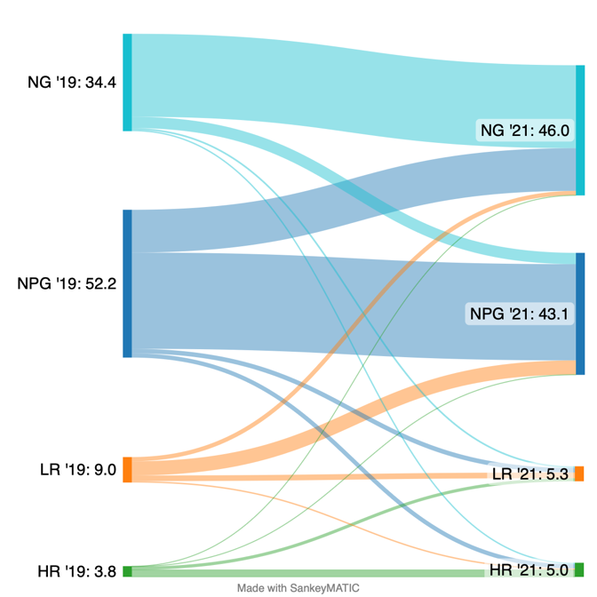
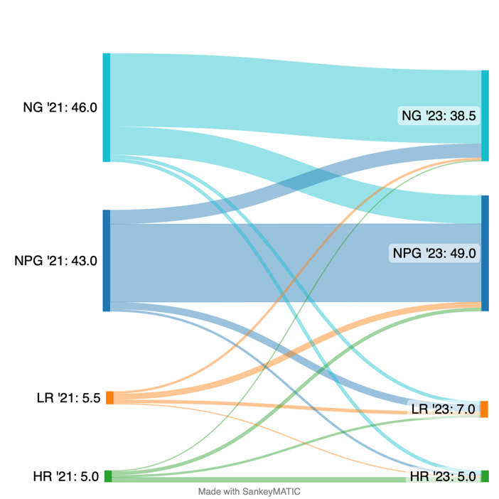
Gambling risk transitions
2019 to 2021
Gambling risk transitions
2021 to 2023
2019 2021 2023
Years
Graph XX: Proportions (%) of Australians between 2019 and 2021, and 2021 to 2023 transitioning between non-gamblers (NG), non-problem (NPG), low risk (LR) and high risk (HR) (percentages do not match Graph X due to missing data).
Notes:
There is now well-established body of literature on the early impacts of COVID-19 pandemic on gambling behaviours.
17 studies from March to May 2020 showed an overall reduction in gambling frequency and expenditure (Hodgins et al., 2021).
Despite this general population trend, predictors of increased gambling during the first lockdown included male gender, young age, higher problem gambling severity, and a history of mental health concerns (Hodgins et al., 2021).
These relationships were also evident in studies published in 2022, where data was collected in 2021, particularly around risk factors of problem gambling severity and younger age (Quinn et al., 2022).
Take-home Points:
NG: Stable
NPG: Stable
LR: Variable
HR: Stable
2021? Implications for reducing gambling harm / participation…

Slide 12
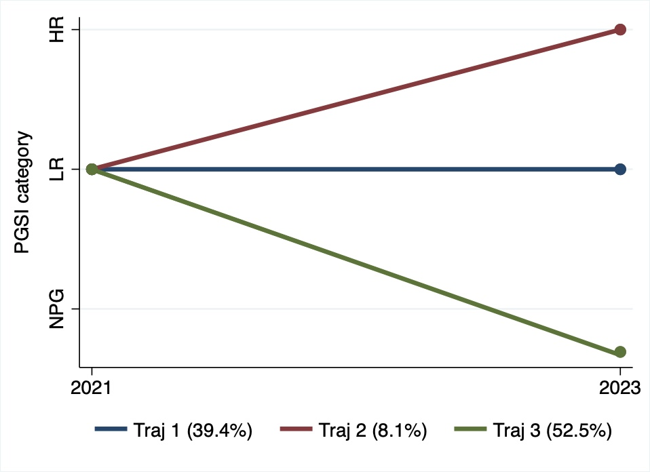
Low risk gambling transitions
2021-2023
Notes:
There is now well-established body of literature on the early impacts of COVID-19 pandemic on gambling behaviours.
17 studies from March to May 2020 showed an overall reduction in gambling frequency and expenditure (Hodgins et al., 2021).
Despite this general population trend, predictors of increased gambling during the first lockdown included male gender, young age, higher problem gambling severity, and a history of mental health concerns (Hodgins et al., 2021).
These relationships were also evident in studies published in 2022, where data was collected in 2021, particularly around risk factors of problem gambling severity and younger age (Quinn et al., 2022).
Take-home Points:
Poker/Gaming Trends
Horse/Greyhound Trends
Lottery Trends
Sporting/Event Trends
Overall Trends

Slide 13
Trajectory groups from Low Risk gambling (preliminary)
Group 1: stable low risk gambling (40%)
  More not completed high school
  No children
Group 2: increase to high risk gambling (8%)
  More unemployed in 2023
  Loneliness, Psychological Distress in 2021
Group 3: decrease to NPG/NG (52%)
  Financial hardship in 2021
  More employed in 2023
  More tertiary educated

Slide 14

Summary
Gambling returning to pre-COVID19 levels, overall
High levels of gambling risk stayed at high risk during and post-COVID19
Risky gamblers show a different pattern
Employment status and psychosocial factors associated w/patterns for low risk gamblers

Slide 15

Thank you
  Dr Aino Suomi
  Aino.Suomi@anu.edu.au

