Slide 1
Just-In-Time Adaptive Interventions: Providing ‘in-the-moment’ support for gamblers
Current Advances in Gambling Conference
June 28-29, 2023
Prof Nicki Dowling
School of Psychology, Deakin University
Email: nicki.dowling@deakin.edu.au

Slide 2
Disclosure of Potential Conflict of Interest Statement
Disclosure of potential conflict of interests:: I have no potential conflicts of interest to declare in relation to this presentation. My 3-year declaration of interest statement is as follows: I have received research funding from the Swedish Gambling Research Council, the Victorian Responsible Gambling Foundation, the New South Wales Office of Responsible Gambling, the Health Research Council of New Zealand, Gambling Research Australia, and the New Zealand Ministry of Health. I have not knowingly received research or consultancy funding from the gambling, tobacco, or alcohol industries or any industry-sponsored organisation.
Funding: The development and evaluation of GamblingLess: In-The-Moment is a collaboration between Deakin University and its partner organisations (University of Auckland, Turning Point, and 2and2 [app developers]), funded by the NSW Government’s Responsible Gambling Fund.
Acknowledgements: Chief Investigators (Dr Stephanie Merkouris, A/Prof Simone Rodda, Dr George Youssef, Prof Dan Lubman), Research Fellows (Dr Anna Thomas, Dr Chris Greenwood, Dr Kathleen Bagot, Dr Chloe Hawker, Hannah Portogallo, Dr Mingjun Yang, Stephanie Dias, George Loram, and Natalia Booth), 2and2 (Anna Goldfeder, Randy Olan, Colin Walker, Arun Ramalingam, Leon Young, Toby Wong), Turning Point (Rick Loos), gambling stakeholders who took part in the user testing, NSW Office of Responsible Gambling (John McInerney, Rhonda Blackett, Natalie Wright) and participants of the current trial.
Notes:
Before we start, I’d like to acknowledge that I don’t have any potential conflicts of interest to declare in relation to this presentation.
I’d also like to take this opportunity to acknowledge our partner organisations in this project. This includes the University of Auckland, Turning Point, and 2and2, who are our app developers. This project was funded by the NSW Government’s Responsible Gambling Fund in Austrlalia.
I’d also like to acknowledge the support from the other Chief Investigators and the many people who have supported this project so far. This includes the gambling stakeholders who took part in user testing, as well as the gamblers who are currently participating in the trial.

Slide 3

Mobile Health (mHealth) Interventions
The use of mobile and wireless technologies for health promotion
Have extended support for health behaviour change beyond standard treatment contexts
Have many advantages
Generally take the form of reminders, health or motivational messages and supportive content
Can supplement traditional interventions or be employed as “stand-alone” interventions
Can be “pull” or “push” interventions
Notes:
So… Let’s start by looking at mobile health interventions generally.
mHealth interventions use mobile and wireless technologies for health promotion.
They’re generally used to extend support for health behaviour change beyond what standard treatments can provide.
They have many advantages. For example, they’re highly accessible and available. And they can overcome some of the geographic, financial, or social barriers people face when they’re seeking help. This means that they have a unique potential to meet the needs of “hard to reach” or underserved populations - which can include people who are unable or unwilling to participate in other forms of treatment.
They’re also generally convenient and portable. And they can offer anonymity.
And importantly, they’re potentially cost-effective treatments that we can turn into even more efficient and effective treatments.
mHealth interventions generally take the form of reminders, health or motivational messages, or supportive content.
They can either supplement traditional interventions. Or they can be used as stand-alone interventions.
They can be “pull” interventions – by this, we mean that they’re initiated by people when THEY feel like they need support. Or they can be “push” interventions – in which a computer-based protocol (which is decided by us) decides when and how people should be offered support.
Our team has developed a suite of mobile and online gambling intervention products. Most recently, this includes a couple of Just-In-Time Adaptive Interventions.

Slide 4
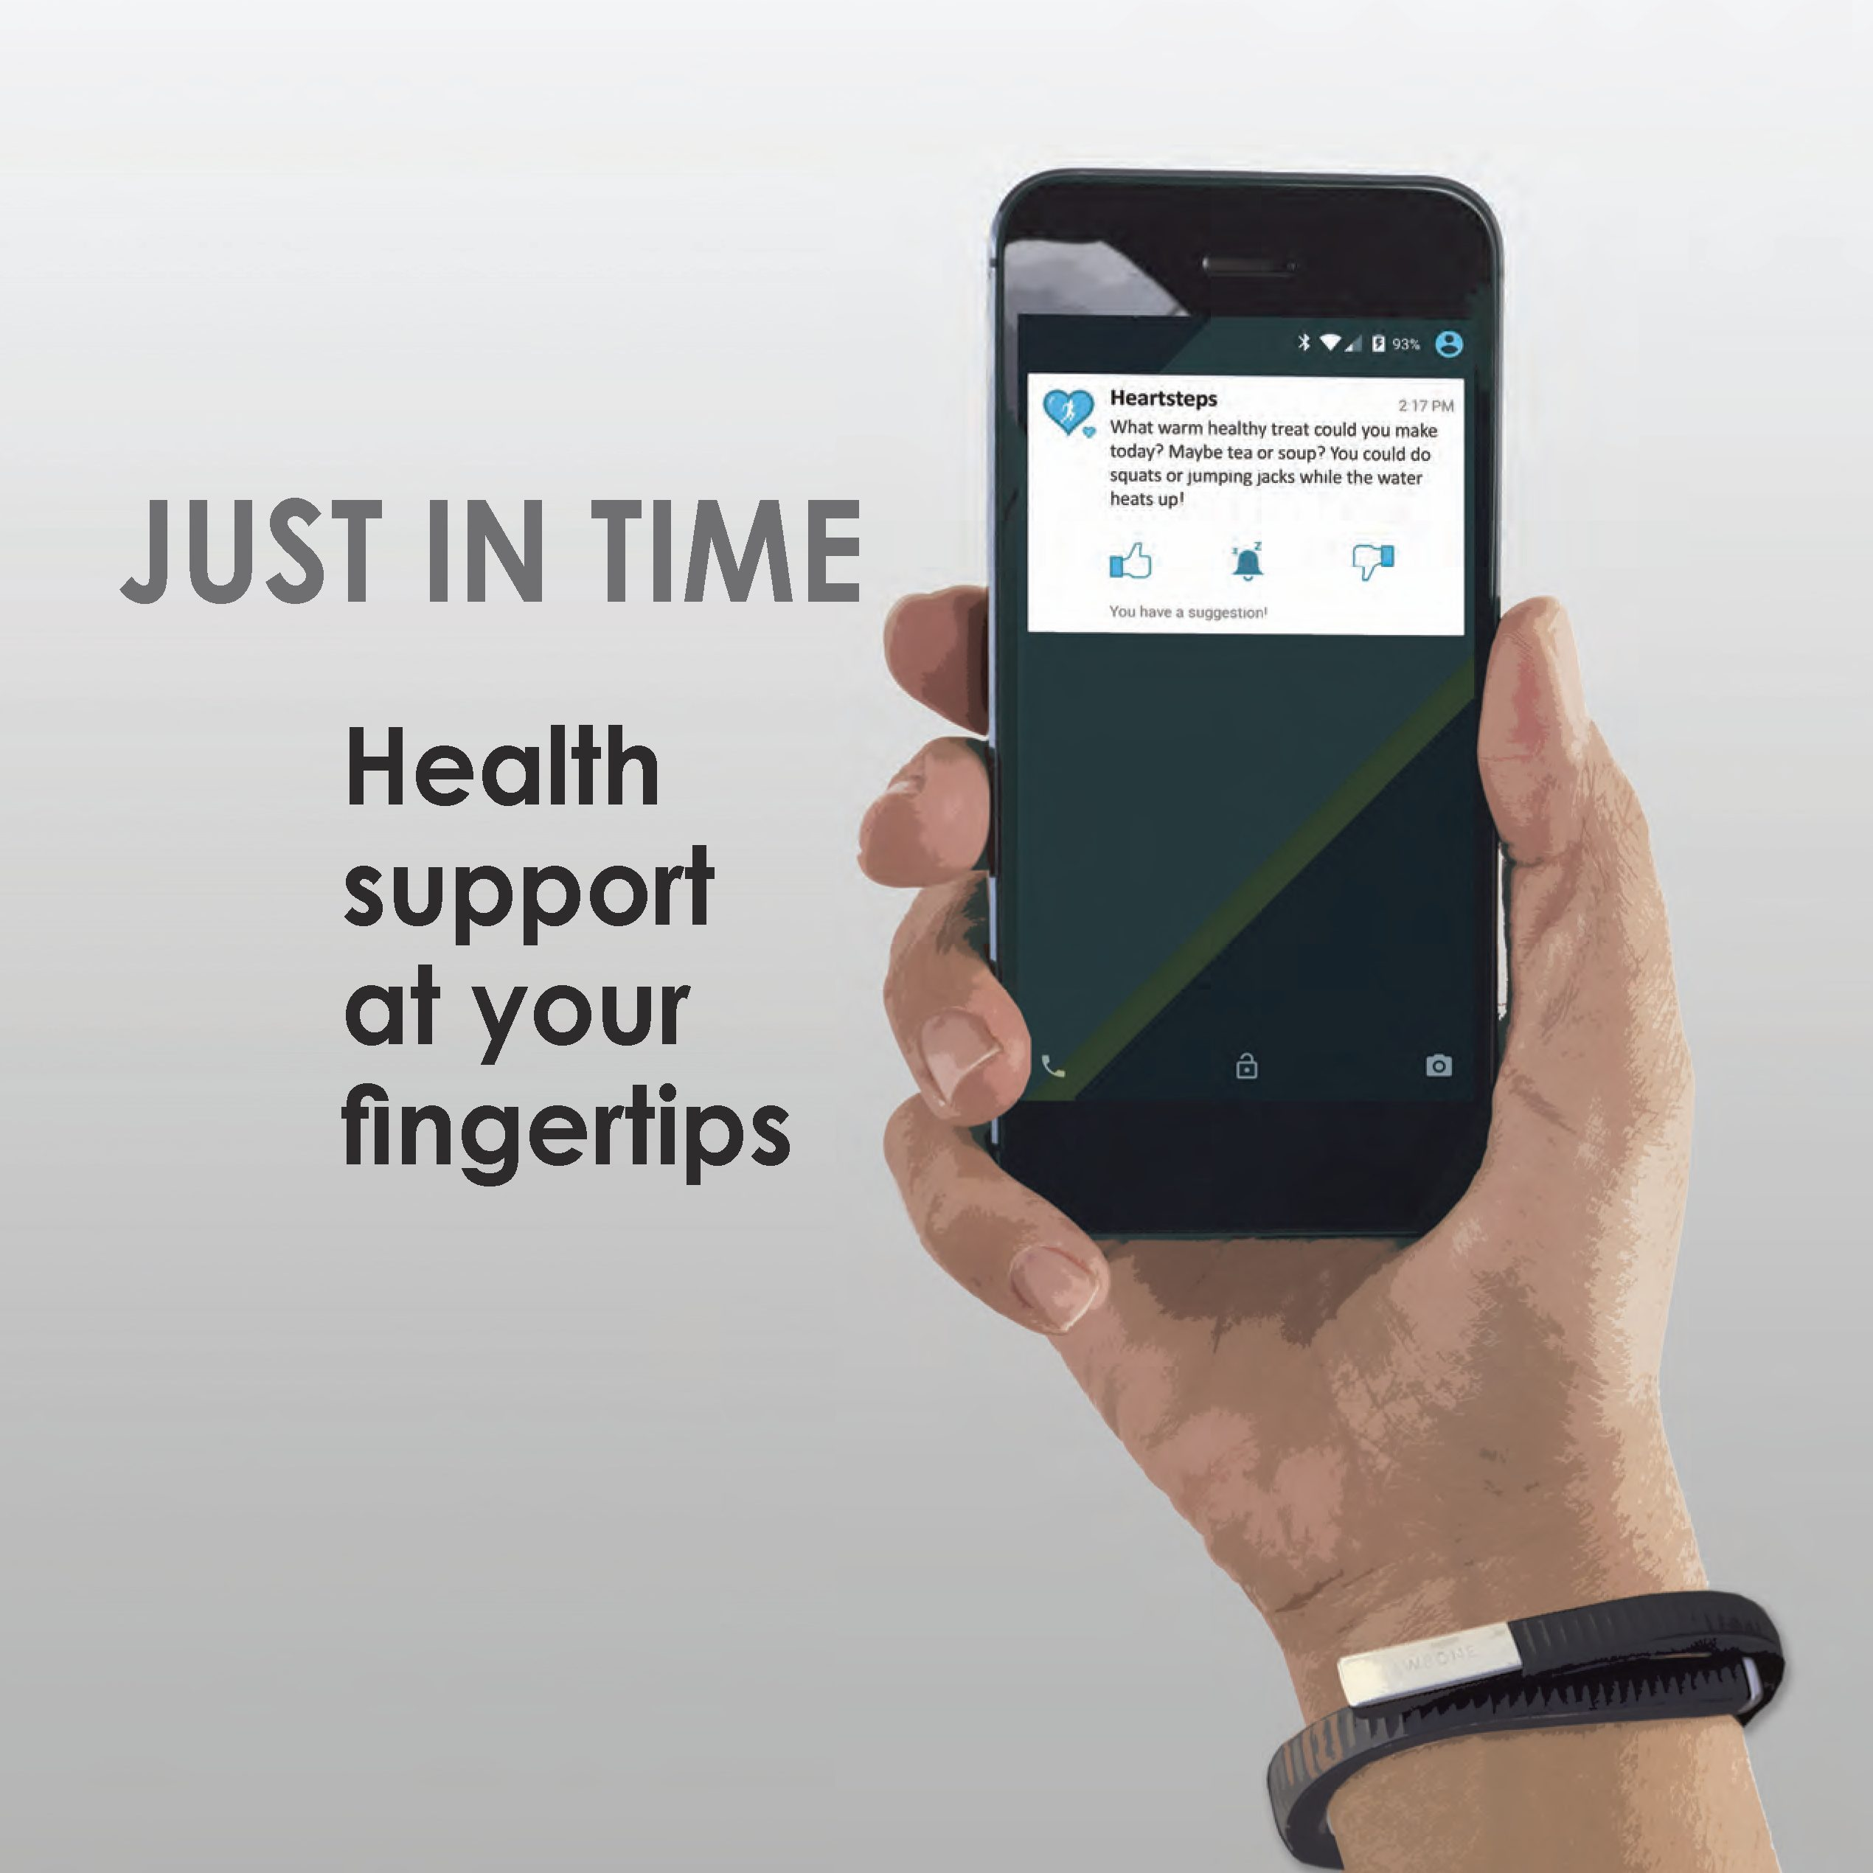
Just-In-Time Adaptive Interventions (JITAIs)
Push m-health interventions that address dynamically changing individual needs by providing the type and amount of support required, at the right time, and only when needed
Overall aim is to prevent negative health outcomes and/or promote positive health outcomes
  State of vulnerability and/or state of opportunity
  State of receptivity
Continuously monitor rapidly changing factors, such as behaviour, mood, thoughts, location and social context, in real-time, using mobile and wireless technologies (e.g., wearable sensors, ecological momentary assessments)
Notes:
So – what are these exactly?
Just-In-Time Adaptive Interventions are “push” mHealth interventions that dynamically and individually tailor support to a person’s needs. They provide the right amount of support whenever and wherever it’s needed.
The Just-in-time component refers to providing the right type, timing, and amount of support. The adaptive component refers to using dynamic assessment information to repeatedly select this support.
Sometimes these treatments are called ecological momentary interventions or EMIs – but only if they are dynamically and individually tailored.
The overall aim of these interventions is to either prevent negative health outcomes or promote positive health outcomes – or both. They provide support when people are in a state of vulnerability or a state of opportunity, or both. A state of vulnerability is when people are susceptible to negative health outcomes. A state of opportunity is when people are susceptible to positive behaviour change. People also need to be in a state of receptivity – and by this, we meant that they’re able and willing to receive, process, and use the support that’s provided.
Just-In-Time Adaptive Interventions decide on the support that’s needed by continuously monitoring states that can rapidly change over time – so things like our behaviour, our mood, our thoughts, our location, or our social context.
They collect this information using mobile and wireless technologies. This can include wearable sensors or sensors on our mobile phones that collect information on us, like a GPS that collects information on our geographical location; or a wearable sensor that measures our heart rate. They can also collect this information using Ecological Momentary Assessments or EMAs – which are like short mini-surveys that we can fill out on our phones.

Slide 5
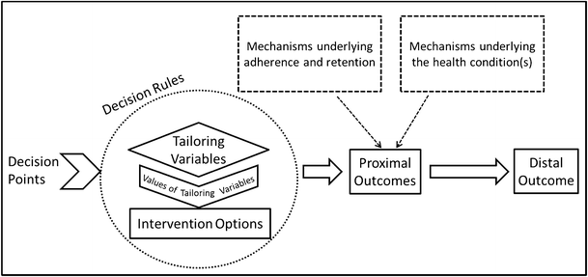
JITAI Framework: Key Components
Decision points: points in time at which intervention decisions are made
Intervention options: potential type, dose, timing, and delivery mode of support that can be delivered at any given decision point
Tailoring variables: data about the individual’s internal state or ecological context that are employed to decide when and/or how to intervene
Decision rules: A specification of which intervention option to offer, for whom, and when at each level of the tailoring variable.
Distal outcome: the ultimate, long-term goal
Proximal outcomes: the clearly defined near-time, short-term goals
Notes:
Effective just-in-time adaptive interventions appear simple to the people receiving them. But they’re based on a set of complex components.
A scientific framework has been developed to guide the design of these interventions. This framework describes four key components that play an important role:
decision points: which are the points in time at which intervention decisions are made – it might be three times a day; it might be ten times a day; or it may be once a week;
intervention options: are the potential type, dose, timing, and delivery mode of support that can be delivered at any given decision point; these interventions can take the form of reminders, health or motivational messages, or supportive content
tailoring variables: are the data about a person’s internal state or ecological context that are employed to decide when and/or how to intervene; so, for example, heart rate might be a tailoring variables that indicates that a stress management activity is necessary
decision rules: which specify which intervention option to offer, for whom, and when at each level of the tailoring variables – so, for example, you might offer very low-intensity support when heart rate increases slightly; but a more intensive intervention when heart rate increases a lot
These components are guided primarily by the distal outcome, which is the ultimate, long-term goal of the intervention. But they’re also guided by proximal outcomes, which are the clearly defined, near-time, short-term goals of the intervention.
The framework organises these components into three areas:
defining the problem,
defining just-in-time in the context of the problem, and
formulating the adaptation strategy.
This all sounds a bit confusing, right? But bear with me… because hopefully, this will all become a bit clearer later on in the presentation when I describe how we used this framework to develop one of our interventions.
.

Slide 6
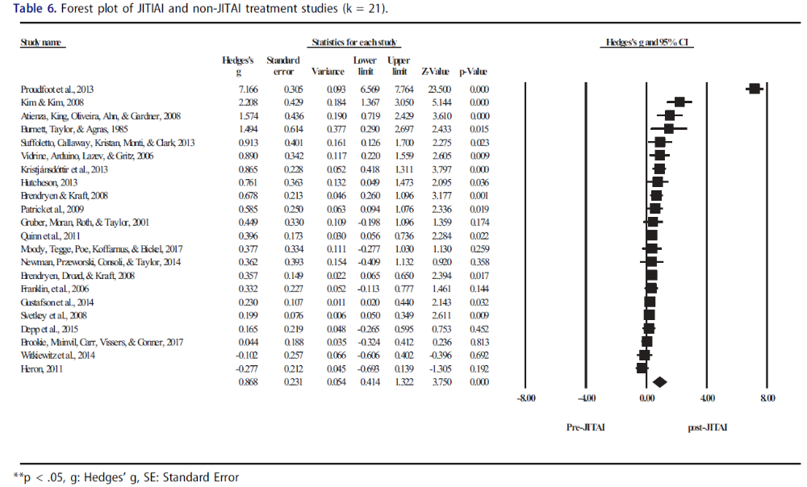
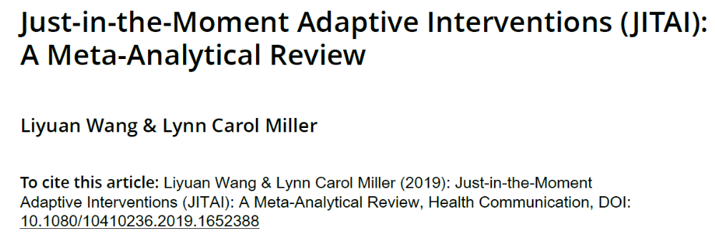
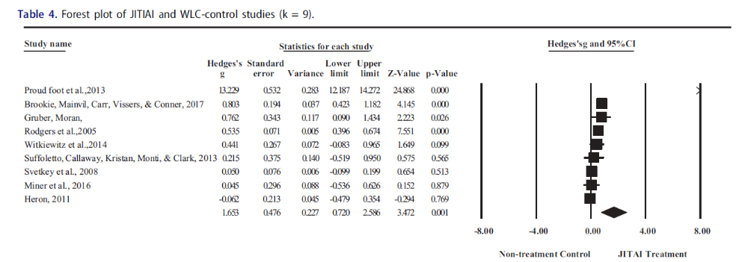
Efficacy of JITAIs
Notes:
Just-In-Time Adaptive Interventions have been effective in supporting behaviour change across several health domains.
As we can see here in this meta-analysis, these interventions were much more effective than waitlist-control conditions…

Slide 7
Efficacy of JITAIs
Notes:
…and also much more effective than tailored interventions that weren’t delivered as Just-In-Time Adaptive Intervention.
Just-In-Time Adaptive Interventions are also particularly well-suited to the treatment of addictive behaviours. This is because episodes of drinking, substance use, or gambling are complex and dynamic. And the triggers of these episodes include discrete but fluctuating states – like urges – or events that are either occurring or not occurring – like high-risk situations.
In fact, there’s now growing evidence that these interventions are feasible, acceptable, and effective across the addictions.

Slide 8
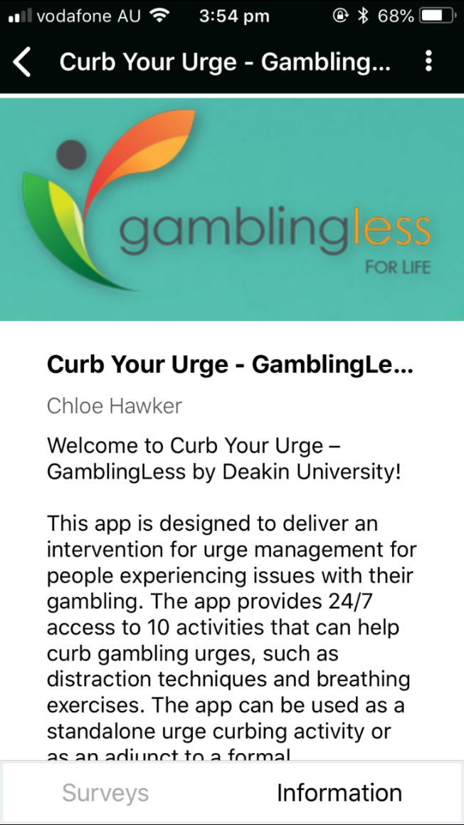
GamblingLess: Curb Your Urge
Employs EMAs to collect dynamic information to deliver adaptive interventions in real time
Notes:
But Just-In-Time Adaptive Interventions targeting gambling behaviour have been a bit slow to develop.
There are two apps that send notifications to people when they’re close to, or go into, a gambling venue. These apps use geographic sensors, including GPS.
Two other apps have used EMAs to collect dynamic information to deliver tailored interventions.
The first translates in English to Game Control – don’t make me test my French please! This is a publicly available app that hasn’t been evaluated yet. It provides personalised feedback to help gamblers stick to their time and expenditure limits.
The second is one of our apps called GamblingLess: Curb Your Urge. This intervention is informed by the relapse prevention model. A couple of times a day, it uses EMAs to ask people to rate the intensity of their gambling urge right now. People who indicate they are having a strong urge are delivered an urge management activity. People can also access the activities anytime they’re having a gambling urge. The aim is to prevent an urge from transitioning into a gambling episode.
Our pilot study of Curb Your Urge revealed promising findings. We found a 70% reduction in the average number of gambling episodes and urges during the treatment period. At the one-month follow-up, there were medium-to-large reductions in gambling symptom severity – as well as a range of other outcomes, like gambling frequency, expenditure, urges, and self-efficacy. Nearly half of the participants reported recovery or improvement in gambling symptom severity at follow-up.

Slide 9
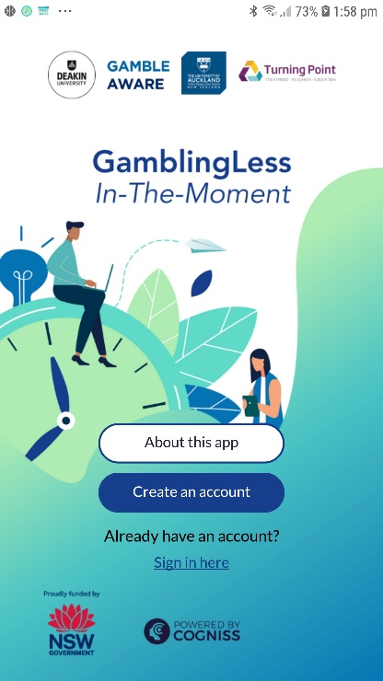
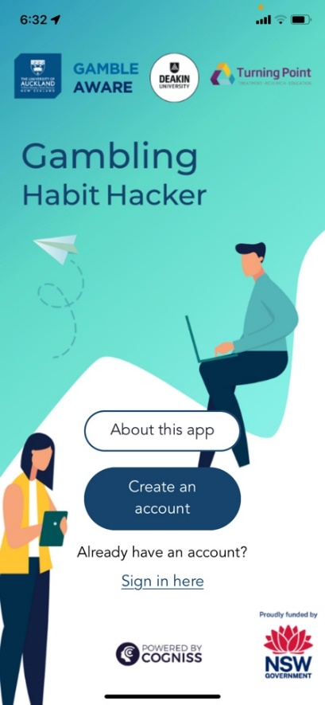
Our New Gambling JITAIs
Notes:
So… in June 2019, the NSW Government funded us to develop and evaluate two additional Just-In-Time Adaptive Interventions.
This project involves a multidisciplinary team with behaviour change expertise. These include clinical and social psychology, implementation science, biostatistics, research design, and technology developers.
The first app is called GamblingLess: In-The-Moment, which builds on the Curb Your Urge app. It’s the latest in our suite of theoretically-informed and evidence-based online and mobile gambling interventions.
The second is called Gambling Habit Hacker. This app is part of a broader program of Simone Rodda’s work in NZ investigating implementation planning for addictive behaviours.
In the remainder of this presentation, I’ll focus on the decisions we made to develop GamblingLess: In-The-Moment.
.

Slide 10
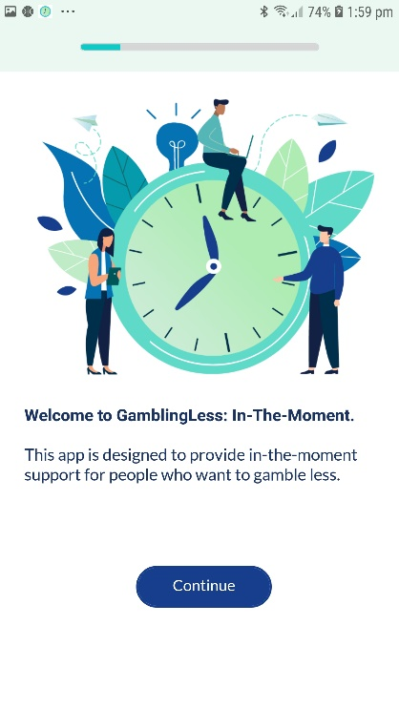
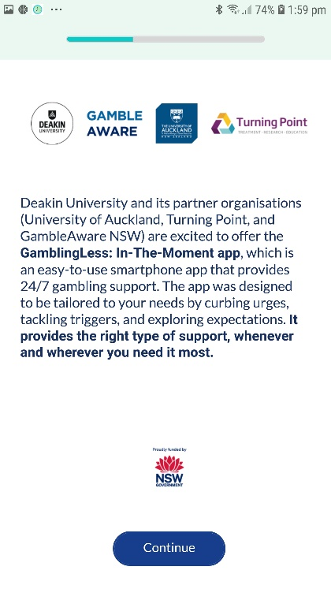
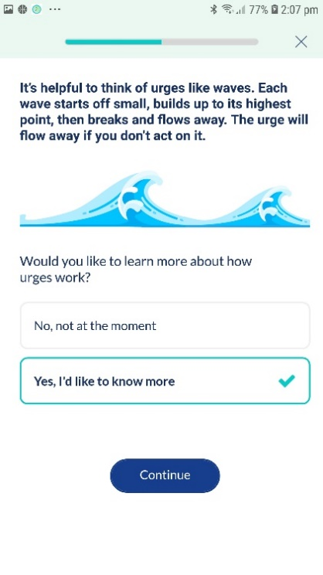
GamblingLess: In-The-Moment
Welcome page
About this app
Psychoeducation
Employs decision rules specifying that individuals who are in a high state of receptivity and report a state of cognitive vulnerability characterised by high craving intensity, low self-efficacy, or positive outcome (tailoring variables) in EMAs sent during three semi-random times a day (decision points), are delivered tailored cognitive-behavioural and third-wave interventions targeting these cognitive processes (intervention options).
Notes:
So, here’s a broad overview of the interventions.
First, it’s targeted to people who want to quit or gamble less.
It specifies that people who are available for treatment and report a state of cognitive vulnerability in EMAs sent three times a day are delivered an intervention activity. In this app, cognitive vulnerability is characterised by high craving intensity, low self-efficacy, or positive outcome expectancies.
It aims to reduce gambling symptom severity in the longer term. And it aims to reduce the likelihood of gambling episodes in the short term by improving craving intensity, self-efficacy, and expectancies.
This intervention is intended for use as a standalone OR adjunctive treatment during periods of active gambling. Or as a relapse prevention tool during recovery.

Slide 11
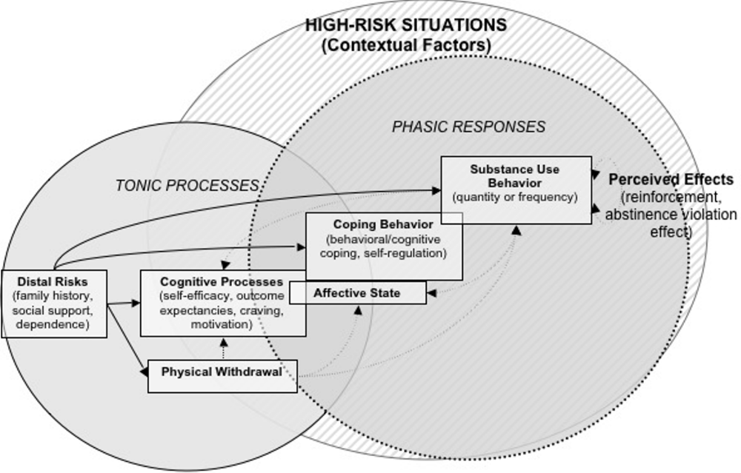
Theory of Behaviour Change
Reformulated relapse prevention model was employed to guide the development of GamblingLess: In-The-Moment
Model emphasises the complex, multidimensional, and dynamic factors that determine who is vulnerable for relapse
Phasic responses include cognitive processes (cravings, self-efficacy, outcome expectancies, and motivation) and affective states
Momentary coping responses also serve as phasic events to determine whether a high-risk situation culminates in a lapse
Cognitive processes are relevant and useful intervention targets and mechanisms of change for gambling JITAIs
Notes:
Theories of behaviour change are pretty limited in their ability to guide the construction of Just-In-Time Adaptive Interventions. Theories that explain the emergence of state of vulnerability or opportunity as a dynamic process in which stable and transient factors interact are most helpful.
For this reason, we used the reformulated relapse prevention model to guide the development of In-The-Moment.
This theory emphasises the complex, multidimensional, and dynamic interaction between various triggers that interact to determine the likelihood that someone will relapse.
In this model, tonic processes are distal risks or stable background factors that provide the foundation for the possibility of relapse. So these processes determine WHO is vulnerable for relapse. These include factors like family history, social support, and dependence.
In contrast, phasic responses are proximal or situational processes that fluctuate over time and contexts. These factors can activate lapses. So these responses determine WHEN relapse will occur. Coping responses in the moment can also be phasic responses because they can determine whether a high-risk situation results in a lapse.
In this model, cognitive processes can be both tonic processes and stable processes. Cognitive processes that are relatively stable over time are tonic processes. These include outcome expectancies and global self-efficacy. But cognitive processes that fluctuate over contexts and time are conceptualised as phasic responses. These include urges or cravings. But also transient changes in expectancies and self-efficacy.
There’s now considerable evidence that cognitive processes play a role in gambling behaviour as tonic processes. There’s less evidence that they play a role as phasic responses. But our EMA research does indicate that they are also associated with the likelihood of subsequent gambling episodes in real-time.
Taken together, these findings suggest that cognitive processes are relevant and useful intervention targets for Just-In-Time Adaptive Interventions.

Slide 12
Defining the Problem
Distal and proximal outcomes
Distal outcome
Gambling symptom severity
Primary proximal outcomes
Gambling episodes
Secondary proximal outcomes
Craving intensity
Self-efficacy
Positive outcome expectancies
Distal outcome: the ultimate, long-term goal
Proximal outcomes: the clearly defined near-time, short-term goals (at the subsequent EMA)
Notes:
In this second part of the presentation, I’m going to discuss how we made the decisions that were necessary to design GamblingLess: In-The-Moment.
The first step was to identify the target population. We decided this should be people who want to quit or gamble less. But this includes moderate- and low-risk gamblers because this intervention makes treatment so accessible.
The next step was to identify the distal outcome. In the relapse prevention model, the distal outcome is relapse. In this project, we operationalised this as the severity of gambling symptoms.
The next step was to identify the proximal outcomes. We selected gambling lapses as the primary proximal outcome because it’s an intermediate version of the distal outcome. But we operationalised this as gambling episodes.
And finally, we selected cognitive processes as secondary proximal outcomes because they represent our hypothesised processes of change. These included craving intensity, self-efficacy, and expectancies.

Slide 13
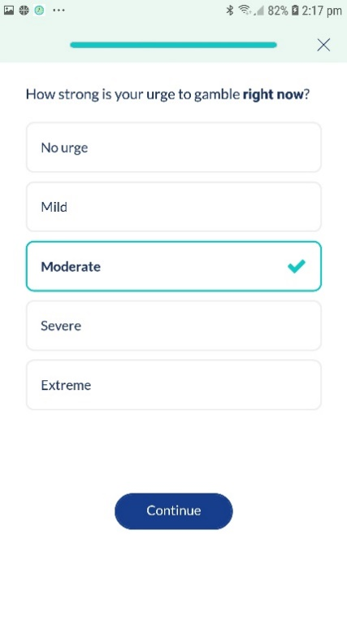
Defining Just-In-Time in the Context of the Identified Problem
Decision points
Decision points: points in time at which intervention decisions are made
EMAs delivered through the app three times a day at random times during pre-specified periods: morning (8:30am-11:00am), afternoon (1:00pm-3:30pm), and evening (5:30pm-8:00pm)
Notes:
So, now for the decision points…
GamblingLess: In-The-Moment uses EMAs to collect in-the-moment information on internal states and ecological contexts. These EMAs also collect information on whether the person has gambled since they last completed an EMA, as well as their gambling expenditure. People are prompted via push notifications on their phones to complete each EMA through the app. Each EMA takes only about 1 minute to complete.
Unfortunately, we don’t have much information about how our proximal outcomes are ordered and related over time. We therefore had to consider how we thought the process of reducing gambling symptom severity unfolds over time. We thought that the cognitive processes might be pretty transient - but we wanted to avoid assessment burden and cognitive overload. On top of that, gambling episodes occur less frequently, which suggests that a less frequent EMA protocol might be ok.
Se we decided to select decision points at random times during three pre-specified periods each day – that is, in the morning, in the afternoon, and in the evening. We’re aware that this might mean that we might important opportunities for support by excluding night-time decision points. But we wanted to make sure that people were available and receptive to receiving support.

Slide 14
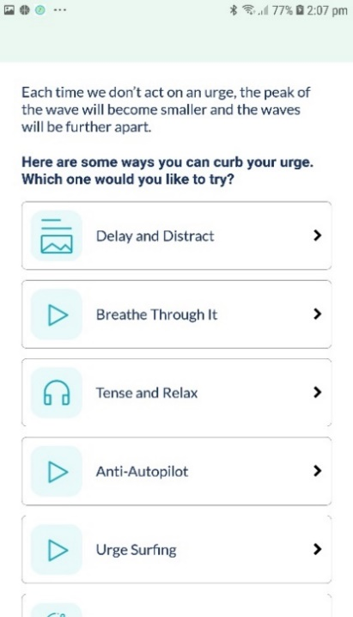
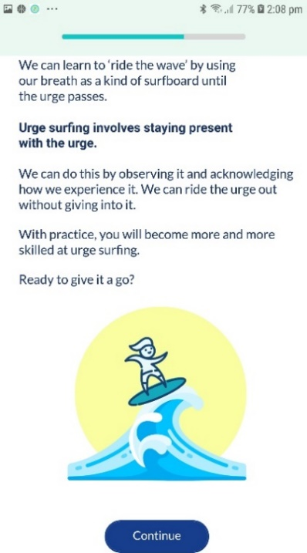
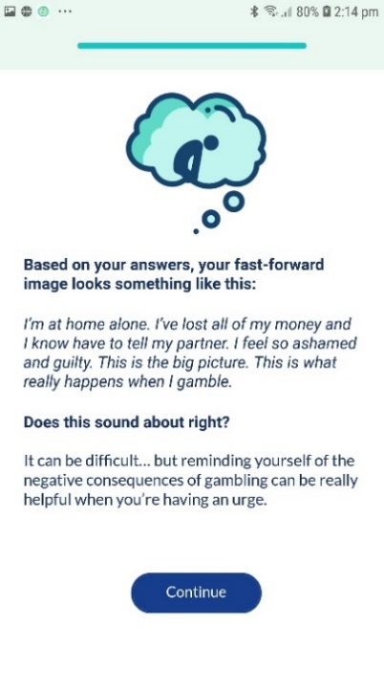
Defining Just-In-Time in the Context of the Identified Problem
Intervention options
Intervention options: potential type, dose, timing, and delivery mode of support that can be delivered at any given decision point
Interactive CBT and third-wave activities informed by the RP model
Intervention Option 1: Curbing Cravings
Intervention Option 2: Tackling Triggers
Intervention Option 3: Exploring Expectancies
Notes:
Then it was time for the fun part – developing our interventions.
The intervention options we developed are informed by the relapse prevention model, as well as our previous work. They were designed to target cravings, self-efficacy, and expectancies.
We ended up with 53 activities in total across three intervention modules. The first module is Curbing Cravings, which comprises ten craving management activities. The second is Tackling Triggers, which comprises 25 activities to enhance self-efficacy across five high-risk situations – which are financial pressures, unpleasant emotions, social pressure to gamble, testing control over gambling, and conflict with others. And the final module is Exploring Expectancies, which comprises 18 activities to reduce positive outcome expectancies – which relate to excitement, escape, and winning money.
These activities are all cognitive, behavioural, or third-wave – which includes mindfulness and acceptance strategies. Most activities took less than 5 minutes to complete.
We selected activities based on their appropriateness for repeated just-in-time delivery. We focused on engagement, participant literacy, inclusiveness, and user preferences.
Activities were interactive and gamified using multimedia delivery strategies - like video, audio, personalised feedback, quizzes, open-ended items, and multiple-choice items. We indicated that delivery strategy so people could make activity selections that were appropriate to where they were and who they were with.
We minimised intervention fatigue by developing activities that are intuitive, easy to navigate, and maintain an optimal level of challenge.

Slide 15
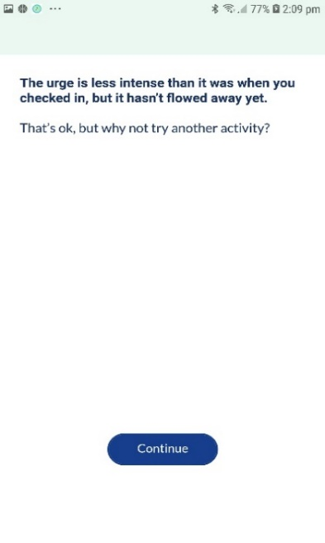
Formulating the Adaptation Strategy
Tailoring variables
Tailoring variables: data about the individual’s internal state or ecological context that are employed to decide when and/or how to intervene
Additional EMA items to explore under what conditions the JITAI is most effective
Momentary craving intensity, self-efficacy, and positive outcome expectancies
GL-ITM tailors the type, timing, and amount of support
Notes:
Next came the tailoring variables…
You might remember that these variables measure information that’s used to make decisions about when and how to intervene.
The tailoring variables for GamblingLess: In-The-Moment include momentary craving intensity, self-efficacy, and expectancies. These are measured by EMA because this is the gold standard in collecting information about internal states. Each of these are measured using single items and determine which intervention module each person will be delivered after each EMA.
The app tailors the TYPE of intervention content – that is whether the person receives activities targeting cravings, self-efficacy, or expectancies.
It also tailors the TIMING of support – to when people are especially in need of support. But also when people are unreceptive or don’t need support or when providing support may be unsafe, inconvenient or unethical - via a “snooze” function.
And finally, it tailors the AMOUNT of support – via an intervention loop. In this loop, people who don’t require additional support after an activity will end their interaction with the app. But people who still need support after an activity are offered additional support. The loop continues until the person no longer requires support or closes the app.
We also included additional items in the EMA that aren’t tailoring variables, but measure a range of factors so that we can explore the conditions under which the intervention is most effective. These include psychological distress, readiness to change, subjective alcohol intoxication, impulsivity, social context, and gambling availability in terms of financial capacity and geographical location.

Slide 16
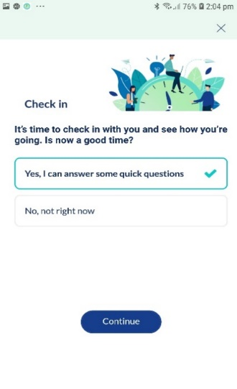
Formulating the Adaptation Strategy
Decision rules
Decision rules: A specification of which intervention option to offer, for whom, and when at each level of the tailoring variable
Expressed as a series of conditional statements
Participants who exceed the cut-point on more than one tailoring variables are randomly allocated to an intervention
A “provide nothing” intervention option is also used when individuals do not access the intervention
Deliberately set low eligibility thresholds for each tailoring variable
Individuals who exceed the cut-point of score of one or more are eligible for an intervention
Notes:
And finally, the decision rules - which are what tie everything together.
Generally speaking, there’s a decision rule for each decision point. This is because decision rules systematically link the tailoring variables and the intervention options together. Remember, our tailoring variables are the cognitive processes.
Most Just-In-Time Adaptive Interventions use decision rules that are expressed as conditional statements. For example, a decision rule might be: if the craving intensity score is greater than 1, then a craving management activity is recommended.
We didn’t have much to go on when we were trying to identify cut-points for GamblingLess: In-The-Moment. That is, we really don’t know the levels of each cognitive process at which an intervention is likely to be helpful versus unnecessary.
So, we’ve deliberately set low eligibility thresholds. That is, people will be eligible for a tailored intervention when they score more than 0 out of 4 on any of the cognitive processes. So, for example, if a person endorses any level of craving, they get the Curbing Cravings module. We know that this might mean that some people get an intervention when they might not need it. But it WILL make sure that everyone gets an intervention when they need it. And it will also help us to identify what might be appropriate cut-points we can use in the future.
We know that some people will be eligible for more than one intervention. We decided that these people will be randomly allocated to a tailored intervention. This is because the relapse prevention model doesn’t presume that some cognitive processes are more influential than others.
People who don’t exceed the cut-point for any of the cognitive processes aren’t eligible for any intervention. Instead, they get an encouraging message.

Slide 17
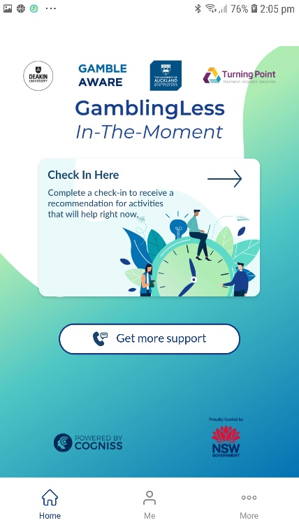
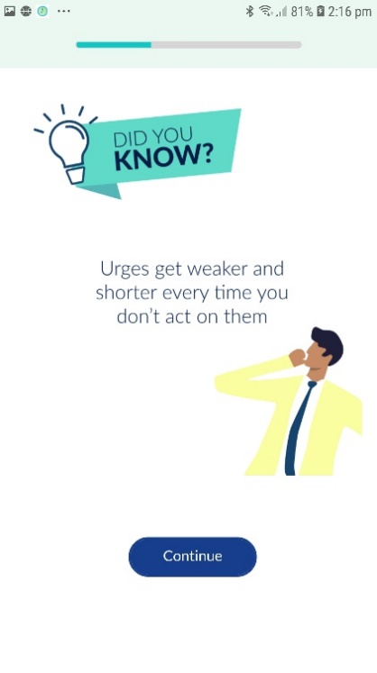
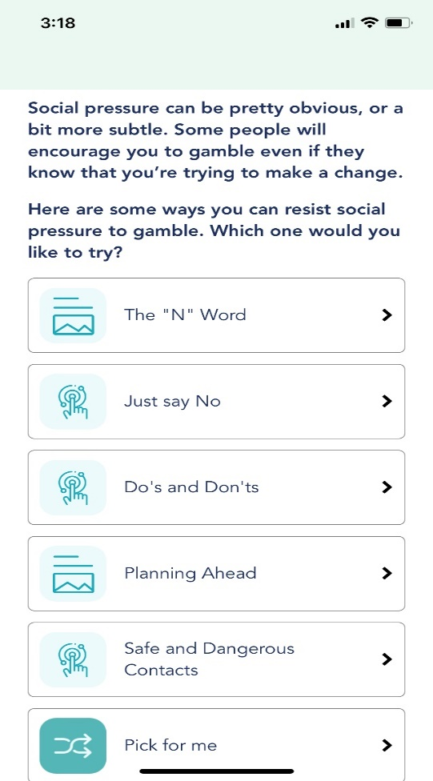
Other App Features
Get More Support
Did You Know?
Pick For Me
Home page
“Did You Know?”
Pick For Me
Notes:
The app also includes a couple of other notable features.
First, the home page includes quick links to the Check In Here, Get More Support, and More features.
The Check In Here quick link allows people to complete an EMA within the allowed 2-hour time window.
The Get More Support quick link provides click-to-call and click-to-email functions to helpline and online specialist gambling services. This function is also available on each dashboard. This feature allows people to escalate the support they receive, including immediate crisis support.
The More quick link provides trial and app information.
Other app features include the Did You Know? feature, which delivers brief passive psychoeducational messages prior to each activity.
And there’s a Pick For Me feature on each menu that randomly selects an activity for the user.

Slide 18
User Testing
Tailored interventions (modules)
Curbing Cravings
Ease of completion | 8.85
Helpfulness | 7.46
Tackling Triggers
Ease of completion | 8.00
Helpfulness | 7.23
Exploring Expectancies
Ease of completion | 8.15
Helpfulness | 7.00
13 gambling stakeholders testing the app functions as intended over a 3-day period
Onboarding
Clarity of app description | 8.00
Understanding of what was required | 7.08
Ease of trial sign up | 6.77
EMAs
Relevance | 7.38
Ease of completion | 7.38
Clarity of activity explanations and instructions | 8.69
Relevance of activities based on check-in information | 7.23
Helpfulness of “Did You Know?” messages | 8.46
Helpfulness of Get More Support option | 8.85
Helpfulness of “Pick for Me” option | 8.62
Mobile App Rating Scale subscale scores
Engagement | 3.57
Functionality | 3.62
Aesthetics | 3.85
Information | 3.99
Overall App Quality | 3.75
Subjective Quality | 4.21
Perceived Impact | 3.40
Notes:
After we developed the app, we tested it with 13 gambling clinicians, researchers, and consumers.
As part of this evaluation, the stakeholders completed the Mobile App Rating System or MARS, which measures the overall quality of the app, including its engagement, functionality, aesthetics, and information. It also measures the subjective quality and perceived impact of the app.
The stakeholders rated GamblingLess: In-The-Moment over the minimum acceptability score of 3 for all MARS subscales. This suggests that the stakeholders found the app acceptable.
All intervention modules were rated highly in terms of ease of completion and helpfulness. Stakeholders also highly rated the helpfulness of specific features, including the Get More Support, Pick for Me, and Did You Know? functions.

Slide 19
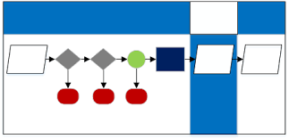
Microrandomised Trials (MRTs)
Participants randomly allocated to receive the interventions (vs no intervention at each relevant decision point
Goal is to optimise JITAIs by assessing the effect of intervention components
MRTs have significant advantages over RCTs
Cutting-edge experimental design specifically developed to evaluate and optimise JITAIs
Notes:
I’m going to now move onto our trial. We’re going to employ a 28-day Micro-Randomised Trial or MRT.
The MRT is an experimental design that has been specifically developed to evaluate Just-In-Time Adaptive Interventions.
MRTs facilitate the optimisation of these interventions – which means deciding how we can make them more effective, efficient, and scalable.
They have significant advantages over randomised controlled trials because participants essentially act as their own control group.
They provide a strong capacity for us to infer causality and much more statistical power.
In our MRT, each person is randomly allocated to receive a tailored intervention or no intervention at each EMA.
With three EMAs each day across a 28-day period, each person will be randomised up to 84 times.
At each EMA, participants will have a 75% chance of receiving a tailored intervention and a 25% chance of receiving no intervention.
.

Slide 20

Evaluation: Research Questions
Secondary Research Questions
Which type of intervention option is most beneficial at a time of cognitive vulnerability? Is the delivery of one intervention option (targeting cravings, self-efficacy, or positive outcome expectancies) more likely to reduce the probability of a subsequent gambling episode than the other intervention options?
Under what conditions is the delivery of an intervention option most beneficial? How do time-variant (EMA) factors (time of day, time of week, craving intensity, self-efficacy, positive outcome expectancies, psychological distress, impulsivity, subjective alcohol intoxication, readiness to change, gambling availability [financial, location], social context) and time-invariant (pre-intervention survey) factors (gambling symptom severity, gambling frequency, gambling expenditure, gender, age) influence the intervention effect on the probability of a subsequent gambling episode?
How do the proximal effects of intervention options change over time as the treatment progresses? How does the effect of a tailored intervention on the probability of a subsequent gambling episode change over the course of the 28-day MRT?
Primary Aim
To explore whether, compared to the delivery of no intervention, the delivery of a tailored intervention reduces the probability of a subsequent gambling episode (primary proximal outcome) and improves craving intensity, self-efficacy, and positive outcome expectancies (secondary proximal outcomes).
Notes:
Our MRT will answer four critical scientific questions so that we can optimise the intervention.
Our primary aim is to explore whether it’s worthwhile to deliver a tailored intervention option at a time of cognitive vulnerability.
If we get enough data, secondary research questions include:
Which type of intervention option is most beneficial at a time of cognitive vulnerability?
Under what conditions is the delivery of an intervention option most beneficial? AND
How do the proximal effects of intervention options change over time as the treatment progresses?
Over 200 participants were recruited using convenience sample across Australia. We began recruitment in April this year and will finish the t-month follow-up evaluations in August.

Slide 21
Onboarding Protocol
Initial onboarding
App download, consent, create account, app description
Primary Research Question: Compared to the delivery of no intervention, does the delivery of a tailored intervention at a time of cognitive vulnerability reduce the probability of a subsequent gambling episode?
Pre-intervention survey
Descriptive/covariate measures; Primary outcome: gambling symptom severity; Secondary outcomes: frequency, expenditure, craving severity, self-efficacy, expectancies
28-day MRT
EMA delivery
EMA delivered 3x daily at random times during pre-specified periods
EMA
Primary proximal outcome: gambling episodes; Secondary proximal outcomes: craving intensity, self-efficacy, expectancies
Decision points
Tailoring variables
Craving intensity, self-efficacy, expectancies
Decision rules
Snooze function
“Provide nothing” option when participants are not in a state of receptivity
Intervention eligibility (tailoring variable/s > 0)
Micro-randomization protocol
Intervention ineligibility (all tailoring variables = 0)
Encouraging message
No intervention control condition (25% chance)
Encouraging message
Tailored intervention condition (75% chance)
Curbing Cravings, Tackling Triggers or Exploring Expectancies
Eligible for 2 intervention options: 37.5% chance of either option
Eligible for 3 intervention options: 25% chance of any option
Post-intervention EMA item
Decision rules
Intervention eligibility (post- intervention EMA item > 0)
Feedback message
Intervention loop
Intervention ineligibility (post- intervention EMA item = 0)
Encouraging message
Post-intervention
Post-intervention and six-month follow-up surveys
Primary outcome: gambling symptom severity; Secondary outcomes: gambling behavior (frequency and expenditure), craving severity, self-efficacy, expectancies
Acceptability evaluation
Post-intervention survey items, app usage indices, qualitative interviews
Intervention content on-demand
Via participant-initiated EMAs
Notes:
On this slide is an overview of the whole trial.
In blue, you can see the MRT.
We’re also supplementing the MRT with a within-group follow-up evaluation and an acceptability evaluation. You can see an overview of these evaluations in the large white box at the bottom of the screen.
The within-group evaluation will allow us to explore longer-term outcomes in terms of gambling symptom severity, which is the primary outcome. As well as gambling frequency and expenditure, cravings, self-efficacy, and expectancies.
The acceptability evaluation will be informed by items in the post-intervention survey, app usage and engagement indices, and semi-structured interviews.

Slide 22
Preliminary Results
Sample: 66% male, 65% pokies, 54% track betting, 88% moderate to severe gambling problems
MRT primary proximal outcomes: No significant difference on subsequent gambling episode or expenditure between control and intervention (or intervention option)
MRT secondary proximal outcomes: Tacking Triggers significantly increased self-efficacy (p=0.031) and non-significant trend for Exploring Expectancies to reduce positive outcome expectancies (p=0.052)
MRT interactions: Some moderation effects
Within-group evaluation: All measures significantly changed from baseline to post-treatment and 6-month follow-up
Clinical significance (gambling symptom severity at follow-up): 38% recovered, 27% improved, 31% unchanged, 3% deteriorated

