Slide 1
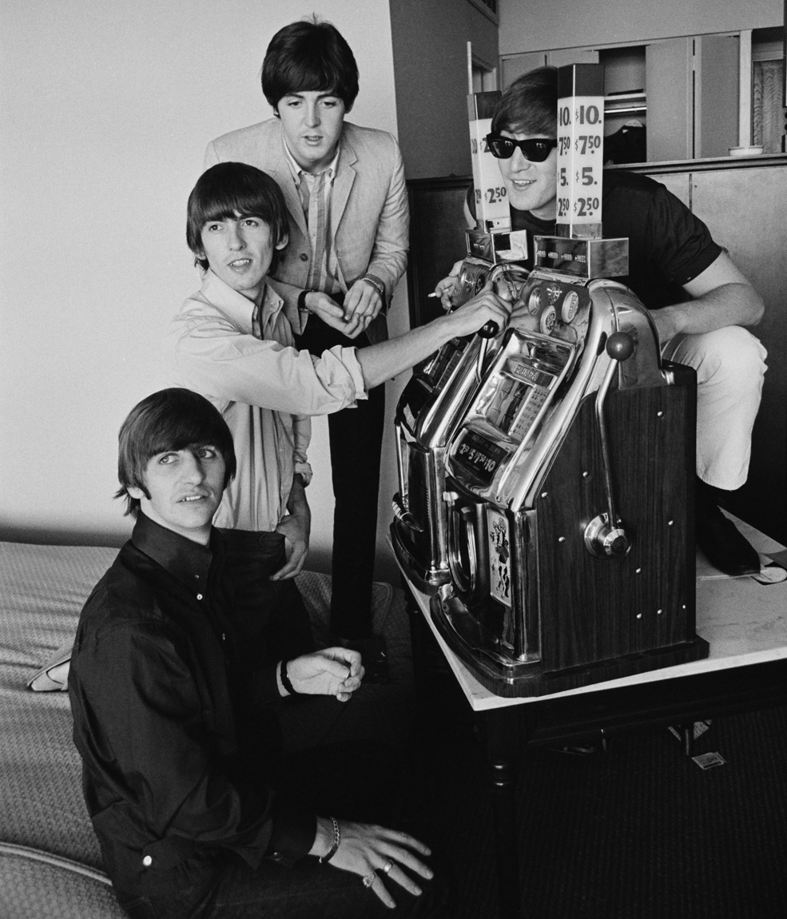



Losses Disguised as Wins Evoke Neural Activity Associated with Reward Processing in a Simulated Machine Gambling Task
————
Dan Myles
Notes:
Intro Dan
Presenting one of my PhD studies. this is currently under review at Psychophysiology, and my thesis currently under exam.
I am now employed as an associate advisor with the Behavioural Insights Team, in Sydney.

Slide 2
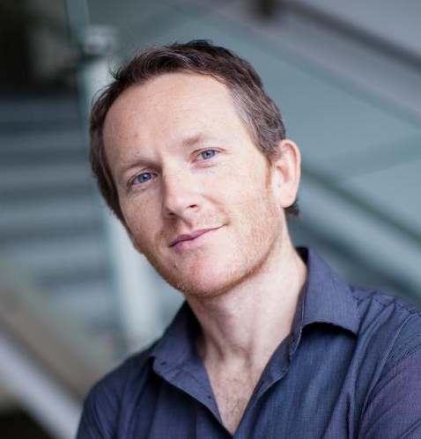



Adrian Carter
Murat Yücel
Kerry O’Brien
Stefan Bode
Notes:
My PhD has been supervised by Adrian Carter, Murat Yücel, Kerry O’Brien, Stefan Bode
Stefan Bode was the senior author on this paper, and he contributed substantially to the design of the research.

Slide 3
Declaration of Interests
_________
The present study, and my PhD project were supported by a Gambling Research Capacity Grant from the New South Wales Office of Responsible Gambling. I have also been supported by an Australian Government Research Training Program PhD Scholarship. The Office of Responsible Gambling, is an office within the New South Wales Department of Health, and derives resources in part through hypothecated taxes on gambling revenue.
None of the authors involved in this study have knowingly received research funding from the gambling, tobacco, or alcohol industries, nor from any industry-sponsored organisation, or any other commercial entity that may stand to gain or lose financially through the publication of this manuscript. None of the authors have any personal financial interest in these industries.
Notes:
I have received support from the Australian Government Research Training Program as well as a Gambling Research Capacity Grant, from
the Office of Responsible Gambling, this office sits within the New South Wales State Department of Health and derives resources in part through taxes on gambling revenue.
None of the authors involved in this study, myself included, have knowingly received funding from any commercial entity that may stand to gain or lose financially through the conduct of this research.

Slide 4
What are “losses disguised as wins?”
_________
Notes:
LDWs are notorious design feature of electronic gambling machines (or E-G-Ms). I’ve found that the best way to explain this feature of EGM design is to demonstrate it. So here’s a slot machine…

Slide 5
4
6
9
9
K
9
24
22
10
2
18
12
16
14
21
10
9
20
1
1
9
8
17
15
19
9
10
13
K
K
K
11
3
Q
23
25
5
7
LINES
BET
TOTAL BET
WIN
$0.01
10
$0.01
$0.00
$0.01
$0.02
$0.03
$0.04
$0.05
$0.08
$0.09
$0.06
$0.07
$0.10
$0.11
$0.12
$0.13
$0.14
$0.15
$0.16
$0.17
$0.18
$0.19
$0.20
$0.21
$0.22
$0.23
$0.24
$0.25
$0.26
$0.27
$0.28
$0.29
$0.30
$0.31
$0.32
$0.33
$0.34
$0.35
$0.36
$0.37
$0.38
$0.39
$0.40
$0.41
$0.42
$0.43
$0.44
$0.45
$0.46
$0.47
$0.48
$0.49
01
$0.50
PLAY
–
+
–
+
10
9
Q
10
Q
9
Q
10
10
10
9
10
Q
9
K
9
K
10
Q
10
K
K
Q
Q
10
9
10
9
Q
Q
10
9
9
9
Q
Q
10
10
9
K
Q
K
Q
10
Q
9
9
10
Q
10
Q
10
Q
9
9
Q
9
9
9
K
Q
10
10
10
10
9
K
9
10
Q
Q
10
10
10
Q
K
9
Q
Q
Notes:
Most modern EGMs have 5 reels. (ACTION)
A win occurs when at least three symbols line up from left to right.
In this case our three brains return have returned (ACTION) 50c win on a 1c bet.

Slide 6
4
6
24
22
10
2
18
12
16
14
21
20
1
1
9
8
17
15
19
13
11
3
23
25
5
7
LINES
BET
TOTAL BET
WIN
06
$0.01
$0.06
$0.01
$0.02
$0.03
$0.04
01
$0.05
02
03
04
05
PLAY
PLAY
–
+
–
+
Notes:
Many modern machines also allow simultaneous wagers across a number of different reel positions.
This means that in addition to the centre most line, we could also place a bet along the top, (A)
or the bottom.
(A) This continues across an increasingly bewildering set of zigzagging patterns.

Slide 7
4
6
24
22
10
2
18
12
16
14
21
20
1
1
9
8
17
15
19
13
11
3
23
25
5
7
LINES
BET
TOTAL BET
WIN
06
07
08
09
10
11
12
13
14
15
16
17
18
19
20
21
22
23
24
25
$0.01
$0.08
$0.09
$0.07
$0.10
$0.11
$0.12
$0.13
$0.14
$0.15
$0.16
$0.17
$0.18
$0.19
$0.20
$0.21
$0.22
$0.23
$0.24
$0.25
$0.06
$0.00
PLAY
PLAY
–
+
–
+
Notes:
With each new line we are increasing our total bet.
(SLIDE) So that if we place a bet on all 25 lines we would now be spending a total .25 cents.

Slide 8
4
6
24
22
10
2
18
12
16
14
21
20
1
1
9
8
17
15
19
13
11
3
23
25
5
7
LINES
BET
TOTAL BET
WIN
25
$0.01
$0.25
$0.00
x
=
PLAY
PLAY
–
+
–
+
Notes:
(SLIDE) So that if we place a bet on all 25 lines we would now be spending a total .25 cents.
(ACTION) However the 1c multiplier is still used to calculate winnings. So despite the higher total bet, the payback for a win on any single line remains the same.
SLIDE Betting on multiple lines…

Slide 9
4
6
Q
10
24
22
10
2
18
12
16
14
9
Q
Q
21
\
20
1
9
1
9
8
17
15
19
Q
13
11
3
23
Q
9
25
5
7
LINES
BET
TOTAL BET
WIN
25
$0.01
10
$0.25
$0.02
$0.03
$0.04
$0.05
$0.08
$0.09
$0.06
$0.07
$0.10
$0.11
$0.12
$0.13
$0.14
$0.15
$0.01
$0.00
PLAY
–
+
–
+
10
9
Q
10
Q
9
Q
10
10
10
9
10
Q
9
K
9
K
10
Q
10
K
K
Q
Q
10
9
10
9
Q
Q
10
9
9
9
Q
Q
10
10
9
K
Q
K
Q
10
Q
9
9
10
Q
10
Q
10
Q
9
9
Q
9
9
9
K
Q
10
10
10
10
9
K
9
10
Q
Q
10
10
10
Q
K
9
Q
Q
Notes:
Betting on multiple lines (SLIDE) allows for a novel outcome that I’ll demonstrate through another bet.
AS YOU CAN SEE THIS PARTICULAR SPIN HAS RETURNED A 15 CENT PAYOUT ON THE ACE OF SPADES.
But…
(SLIDE)

Slide 10
4
6
24
X
22
10
2
18
12
16
14
Q
9
21
\
20
1
1
9
8
17
15
19
Q
9
13
11
3
23
25
5
7
LINES
BET
TOTAL BET
WIN
25
$0.01
$0.25
$0.15
-
PLAY
$0.25
–
+
–
+
- $0.10
Notes:
Although we won $0.15 cents on this outcome we initially gambled $0.25 cents. (ACTION): That is we have actually lost .10 cents (ACTION).
To be clear, slot machines are not required to display the net return to player, only the payback amount. (SLIDE)

Slide 11
4
6
24
X
22
10
2
18
12
16
14
Q
9
21
\
20
1
1
9
8
17
15
19
Q
9
13
11
3
23
25
5
7
LINES
BET
TOTAL BET
WIN
25
$0.01
$0.25
$0.15
PLAY
–
+
–
+
Notes:
Despite loss -> in many jursidictions these events are accompanied by musical fanfares and animations that closely resemble those following genuine gains. Although this is not the case in the UK, following the introduction of new technical standards in 2021. I have ~thoughts~ about UK regulation that you can ask me about if you are interested.
Mike Dixon and colleagues at the University of Waterloo have described this type of event as a loss disguised as a win. Because of the way the machine presents these net losses in a manner that closely resembles genuine winning outcomes
and that this encourages consumers to incorrectly categorise these events as true wins.

Slide 12
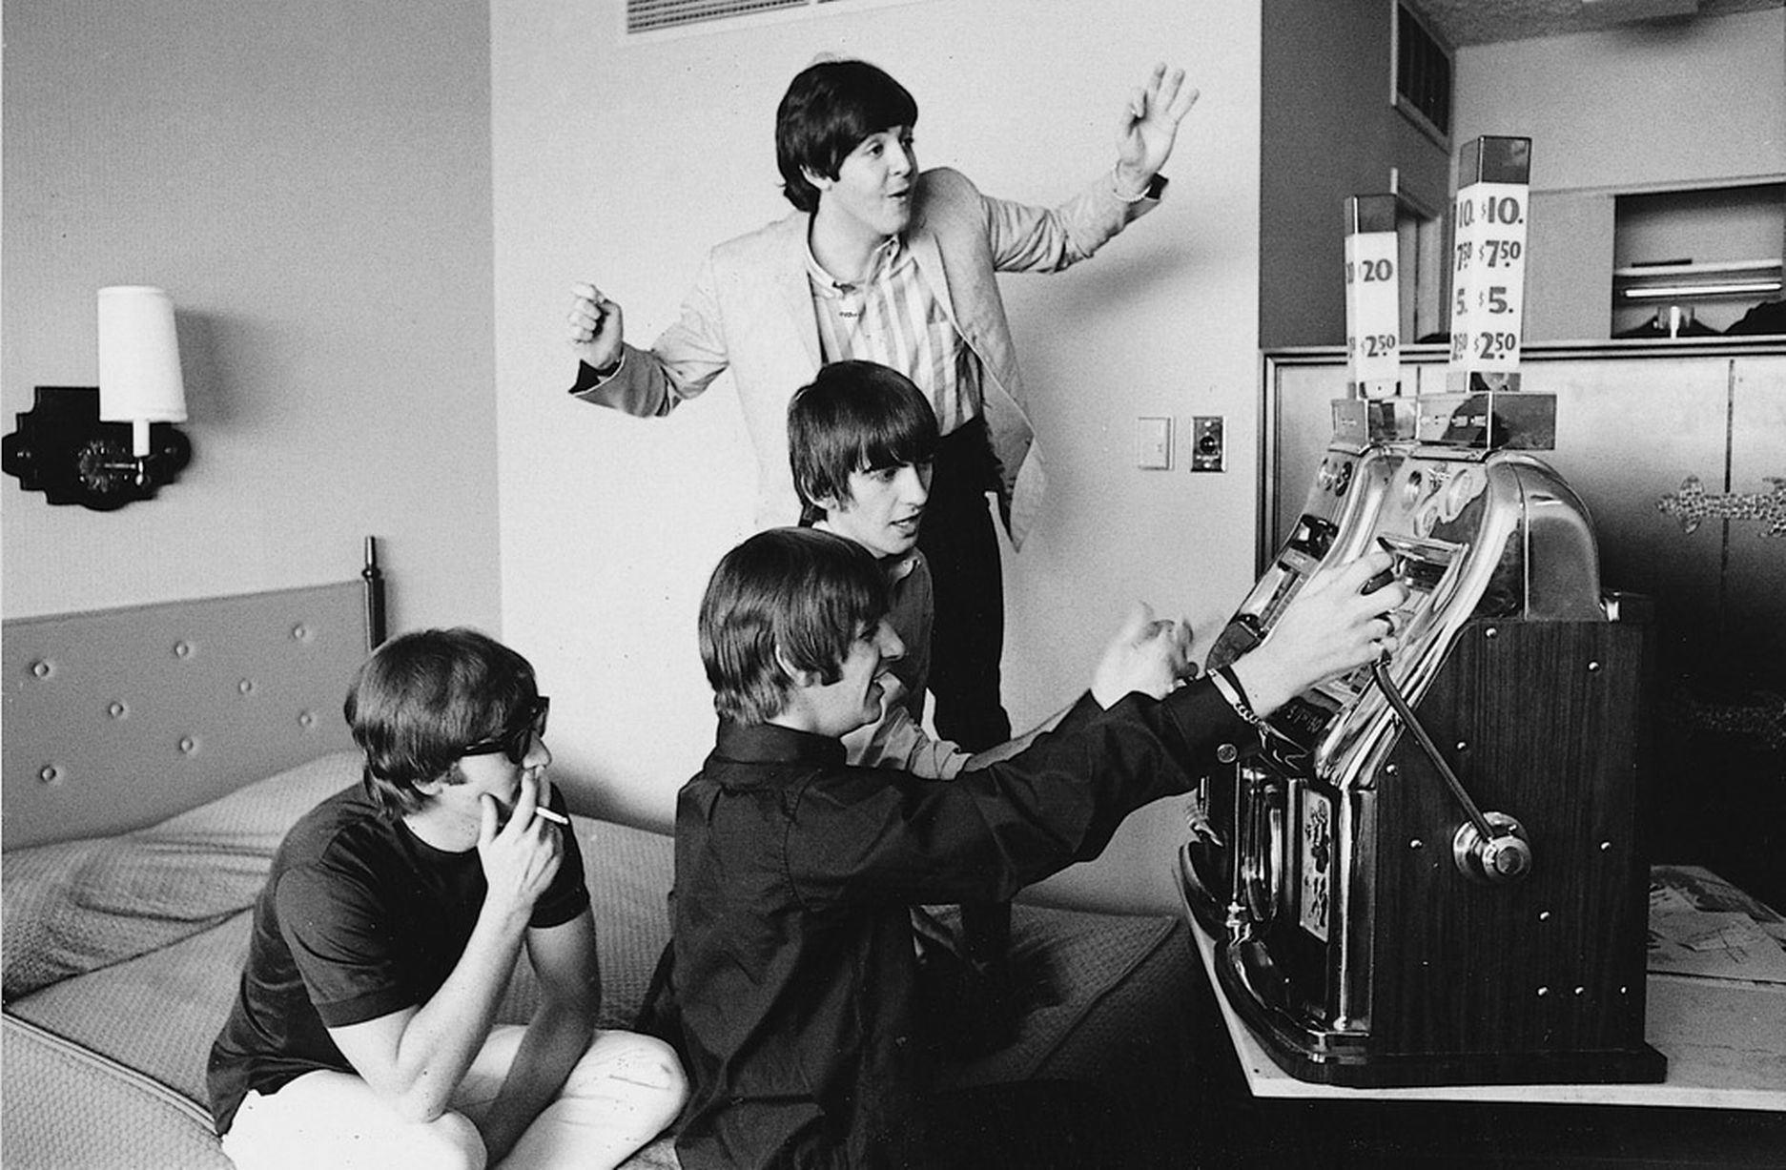
Do Consumers View LDWs as Wins?
Researchers at the Gambling Research Laboratory at the University of Waterloo have now reported over 10 experiments consistent with these concerns.
  Experienced and novice gamblers overestimate the frequency at which they won more than they wagered when asked following a session of EGM gambling that included LDWs.
  For a meta analytic review see: Graydon et al., 2021
Notes:
There is now a fair amount of behavioural evidence in this space.
Dixon and colleagues have reported a really nice straightforward demonstration that LDWs may be mistaken as gains.
The key findings is that participants tend to overestimate the frequency at which they won more than they wagered when asked following a session of EGM gambling that included LDWs. This same tendency is not observed control conditions where LDWs are absent from the design.
This finding has now been replicated across numerous lab studies, and online, and overserved in both experienced and novice gamblers.

Slide 13
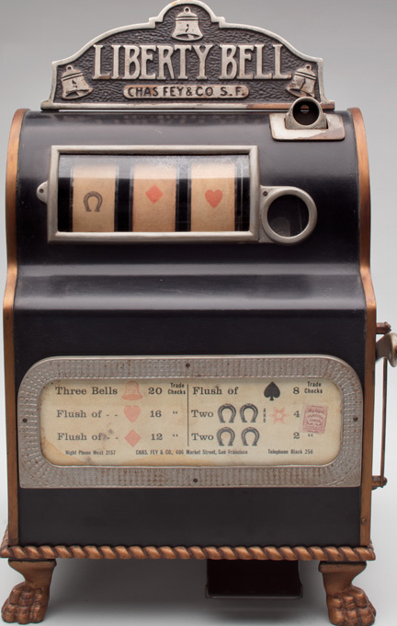
Reward
Punishment (Extinction)
Notes:
The central concern is that mistaking these losses for wins will adjust the ratio of rewarding to aversive outcomes, [ACTION]. Increasing the frequency of positive reinforcement, while [action] reducing the incidence of perceived loss, making make for shorter and less frequent losing streaks.
This intensified schedule of random reinforcement would likely contribute to the addictive potential of these products, despite little or no change to financial expectation or house edge.
A key premise of this argument is that LDWs are able to act as positive reinforcers, or reward.
Cognitive neuroscience offers a whole toolset of methodologies to test just that.

Slide 14
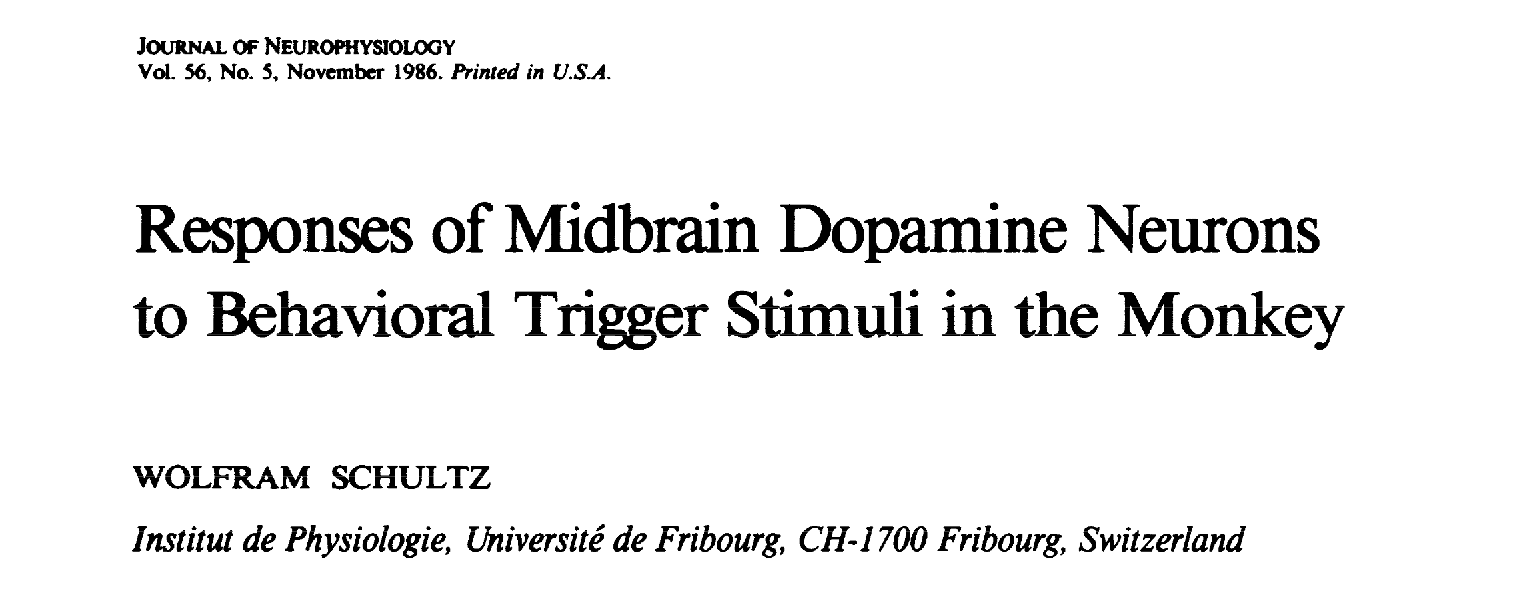
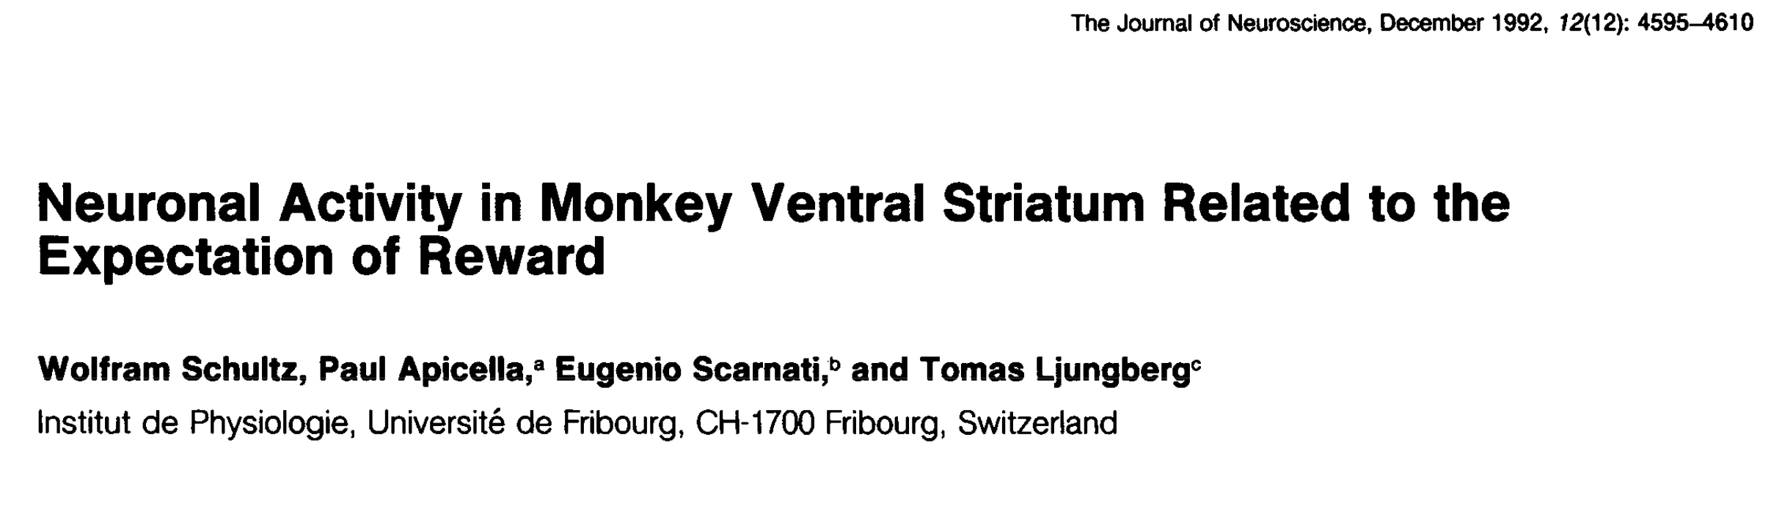
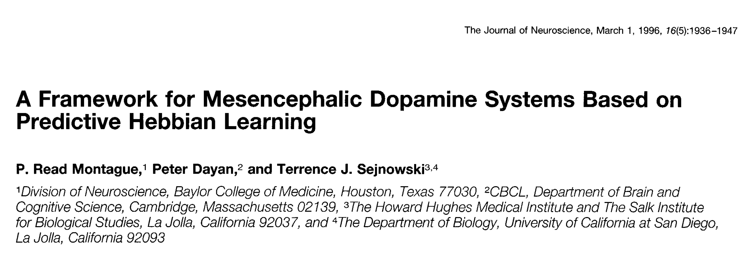
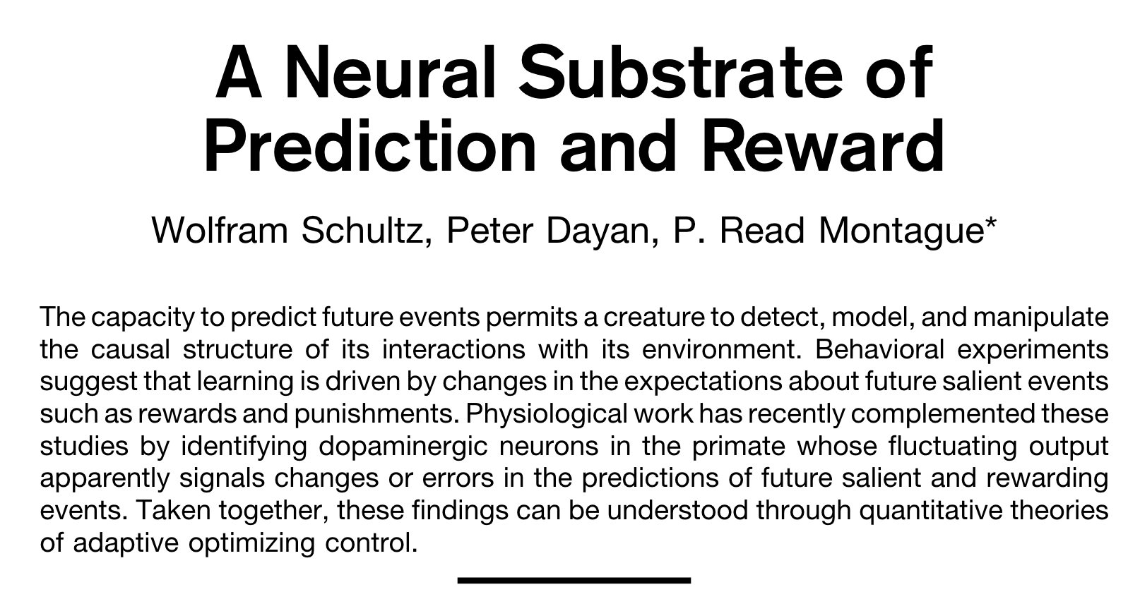
Notes:
The last few decades we have learnt a great deal about how the brain responds to reward presentation, prediction, and uncertainty.

Slide 15
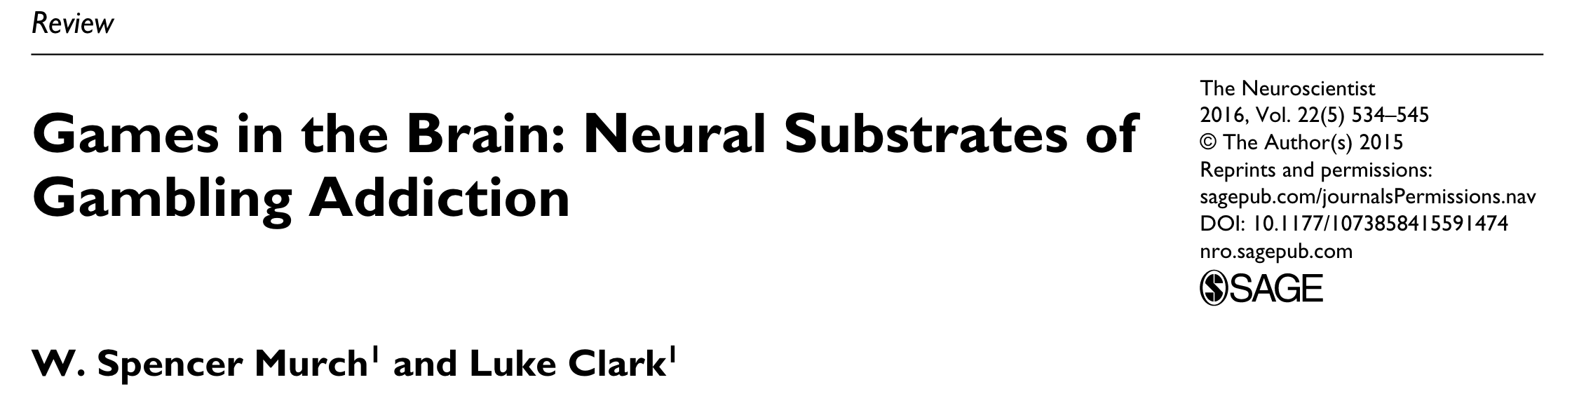
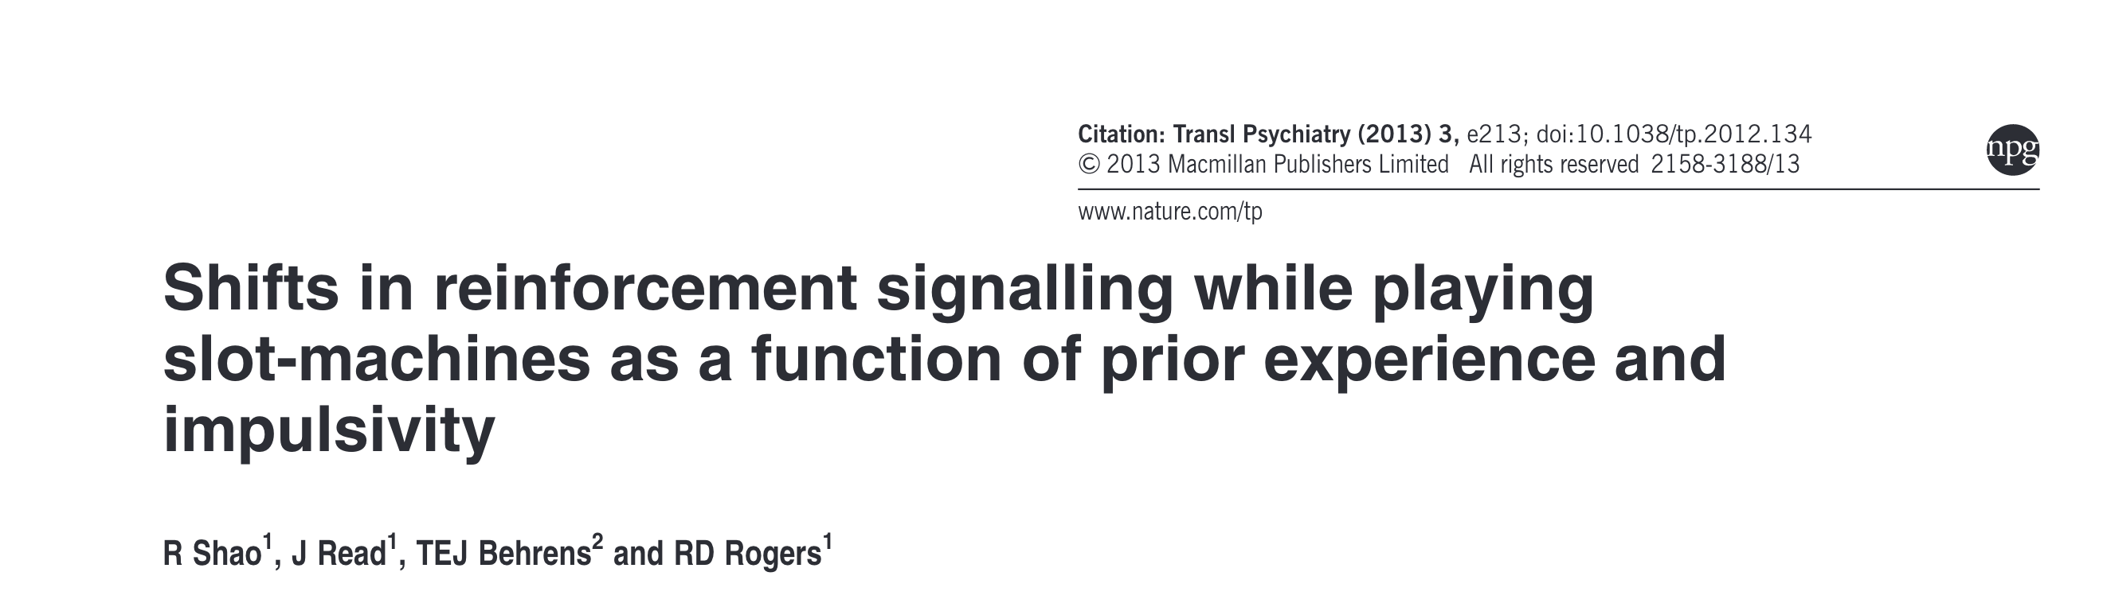
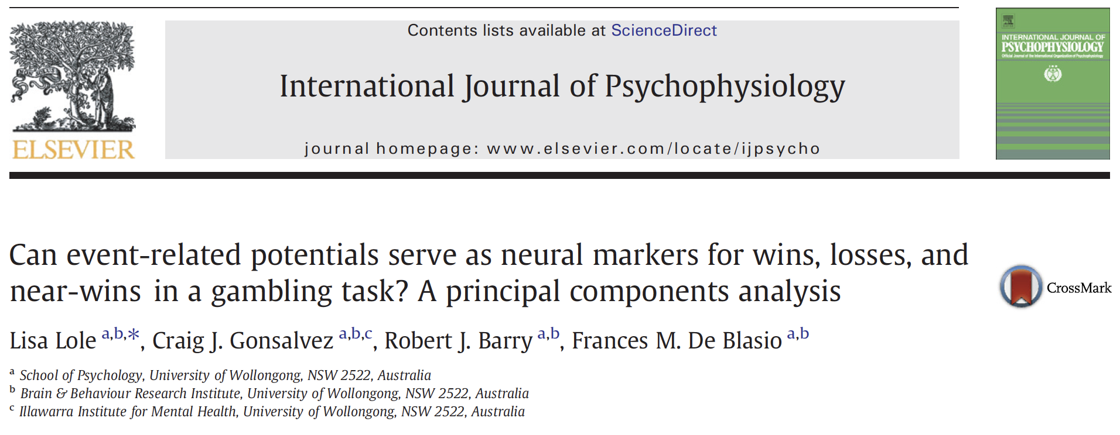
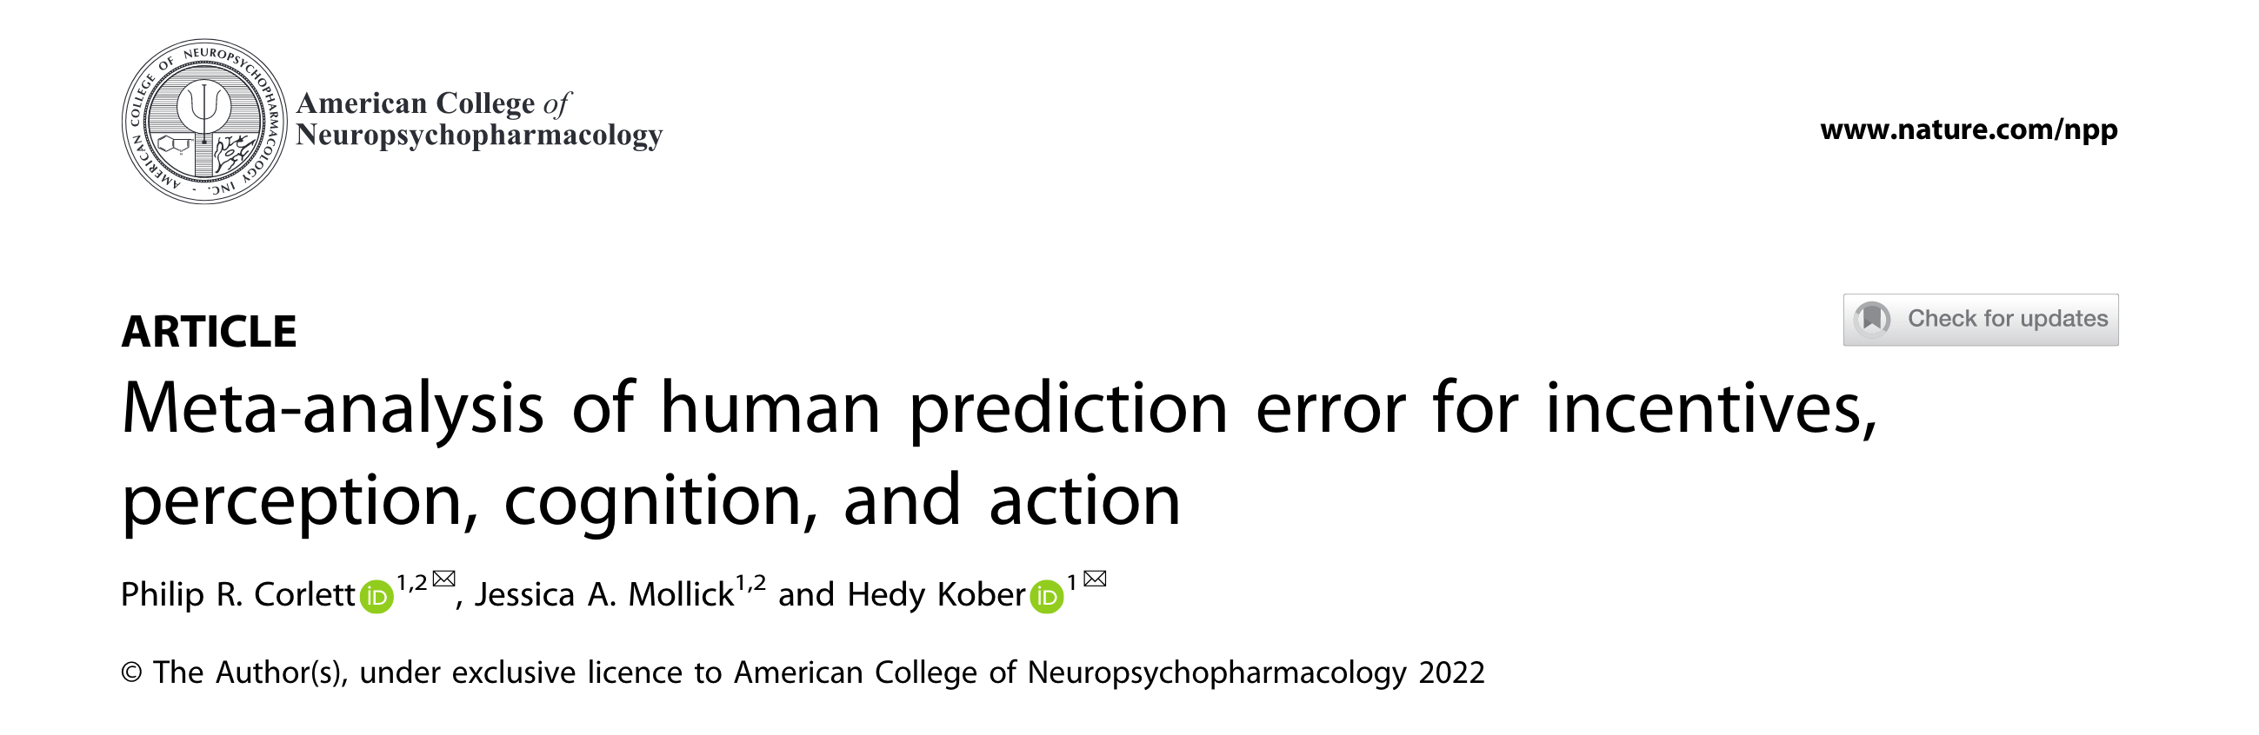
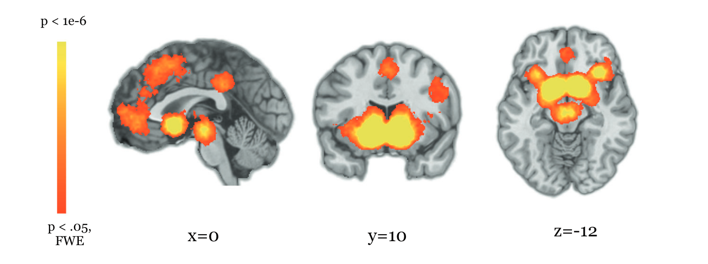
Notes:
If LDWs are genuinely rewarding,
then given what we now know about how the brain responds to reward presentation, including small gambling wins–we should expect to observe similar activity following both small wins and LDWs. We should also expect this activity to differ to sbsent from that following clear losses.
This would provide a novel line of evidence to assess the claim that these events inflate the rate of reinforcement during gambling, and could be a contributing factor in the development of harmful gambling.

Slide 16
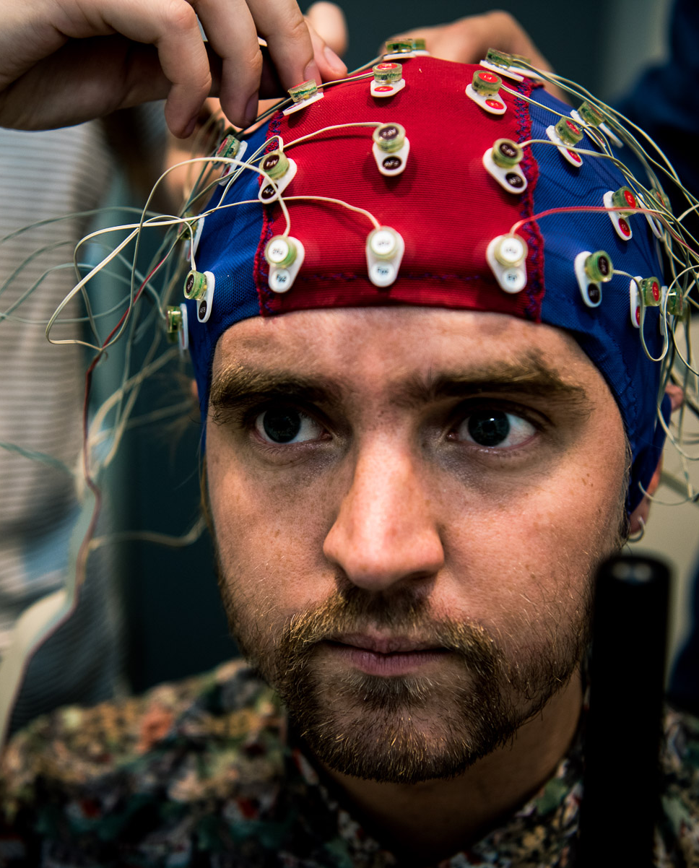
Study Design
_________
Within-groups EEG ERP study
32 Participants
Participants were paid in cash for their winnings
Participants were presented with a gambling task that
included wins, losses and LDWs
Primary Measure:
Reward Positivity Event Related Potential
Notes:
So that's what we did.
On the right is an image of me on the right wearing an EEG electrode cap. This procedure involves placing numerous electrodes on the scalp to measure brain activity.
In very broad terms EEG is a non-invasive method for measuring small changes in electrical charge that occurs as a result of the cumulative activity of groups of neurons in outer regions of the brain

Slide 17
Study Design
_________
Within-groups EEG ERP study
32 Participants
Participants were paid in cash for their winnings
Participants were presented with a gambling task that
included wins, losses and LDWs
Primary Measure:
Reward Positivity Event Related Potential
Notes:
Our study employed a within groups design. So all participants received same procedures.
We recruited 32 participants, 29 of whom were university students.
Participants completed a computer-based gambling task that was purpose built for this study to mimic essential features of the presentation of LDWs in slot-style EGMs. I will demonstrate this task shortly.
Participants were paid in cash for any credits remaining at the end of the study. Median payout $16.76.

Slide 18
Study Design
_________
Within-groups EEG ERP study
32 Participants
Participants were paid in cash for their winnings
Participants were presented with a gambling task that
included wins, losses and LDWs
Primary Measure:
Reward Positivity Event Related Potential
Notes:
Our primary outcome measure reward positivity event-related potential.
An event-related potential is particular type of EEG method, where the EEG signal is time-locked to an event of interest and averaged together over repeated observations.
The reward positivity refers to averaged EEG signal, that has been time-locked to the moment that feedback is presented about the outcome of a task or gamble.

Slide 19
Study Design
_________
Within-groups EEG ERP study
32 Participants
Participants were paid in cash for their winnings
Participants were presented with a gambling task that
included wins, losses and LDWs
Primary Measure:
Reward Positivity Event Related Potential
Notes:
This measure is maximal at frontocentral electrodes (in yellow), approximately 200 - 350 ms following feedback presentation. It is typically reported as the difference between the averaged signal following gains and losses.

Slide 20

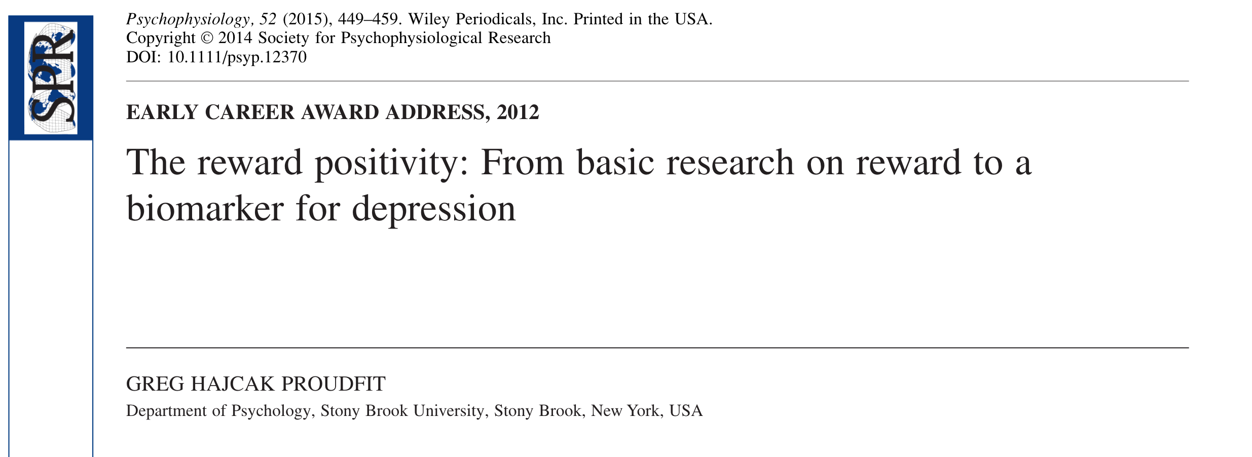
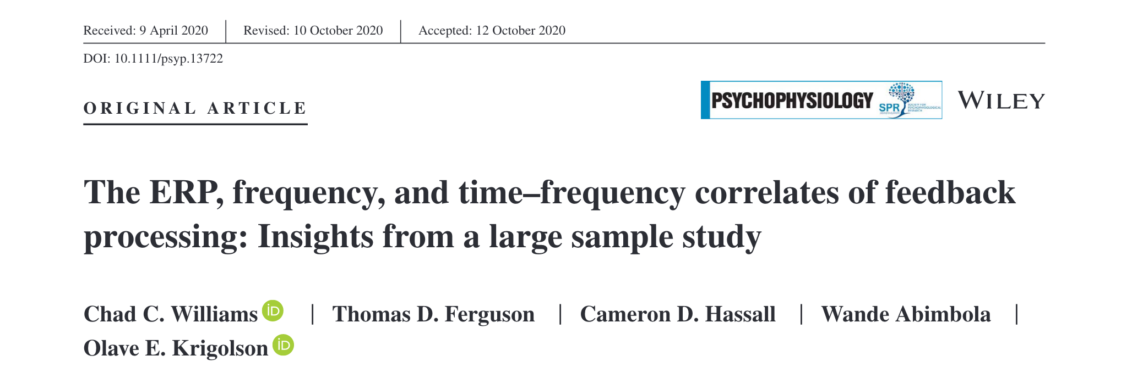
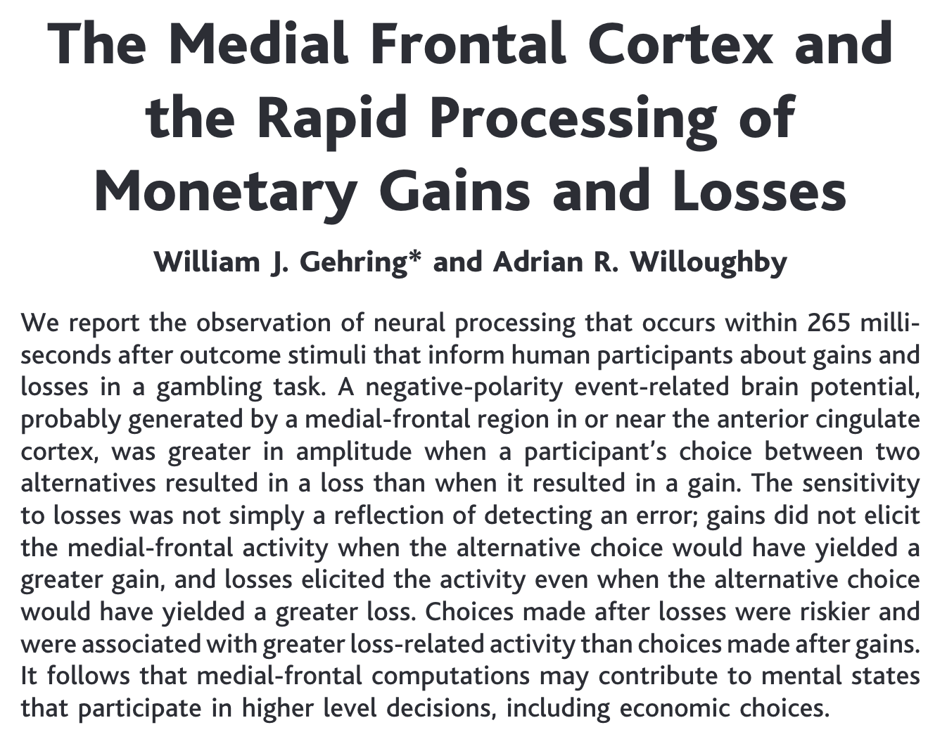
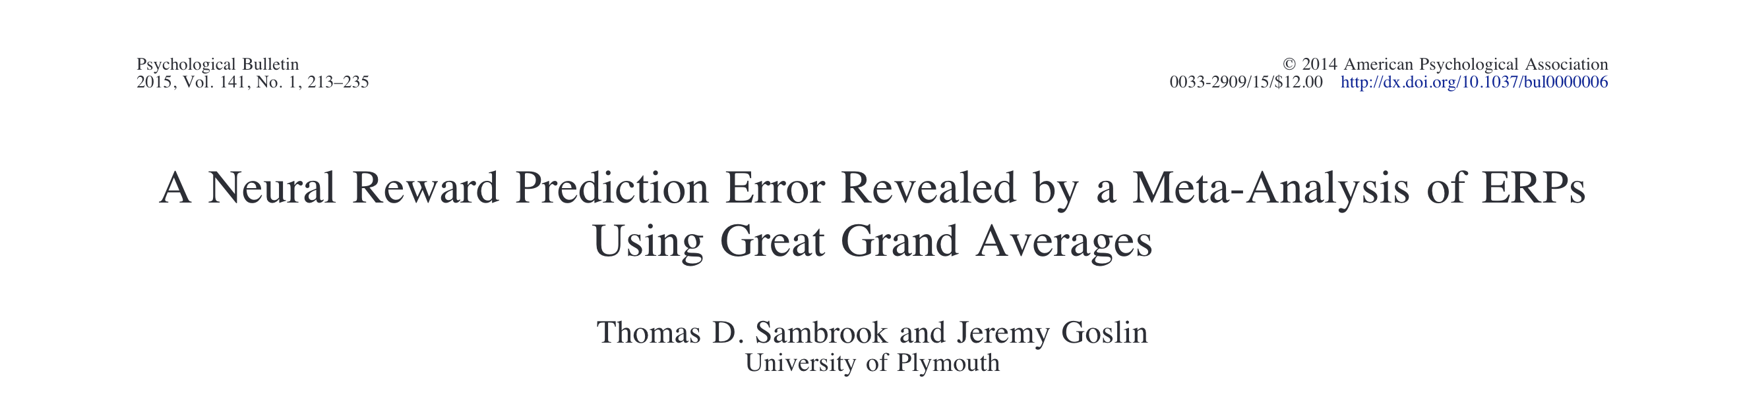
Notes:
Multiple studies have reported that this systematic deflection in amplitude is reliably and specifically sensitive to whether a participant perceives this feedback as favourable rather than unfavourable.
This includes feedback indicating monetary rewards, but also other types of rewards, information, social approval etc.
There is ongoing work in this area but the current consensus theory is that this signal is primarily the _downstream processing_ of a positive reward prediction error.
That is, something has happened that is better than expected.

Slide 21
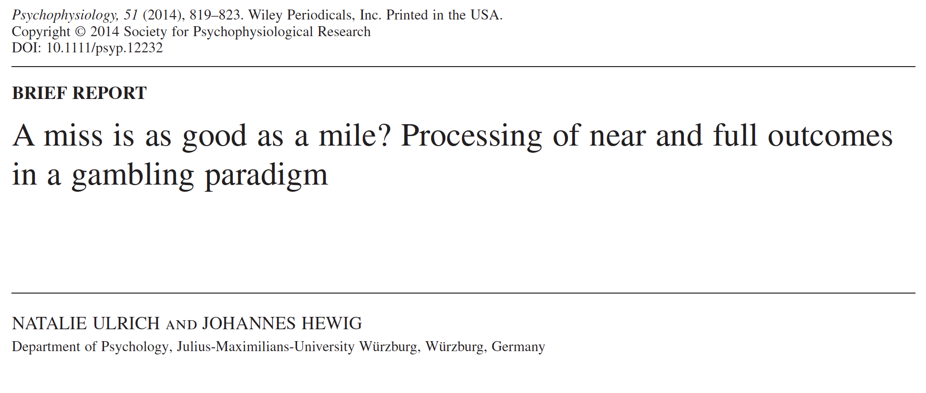
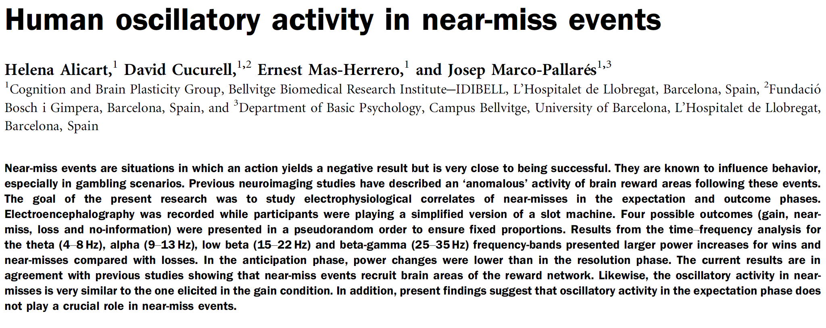
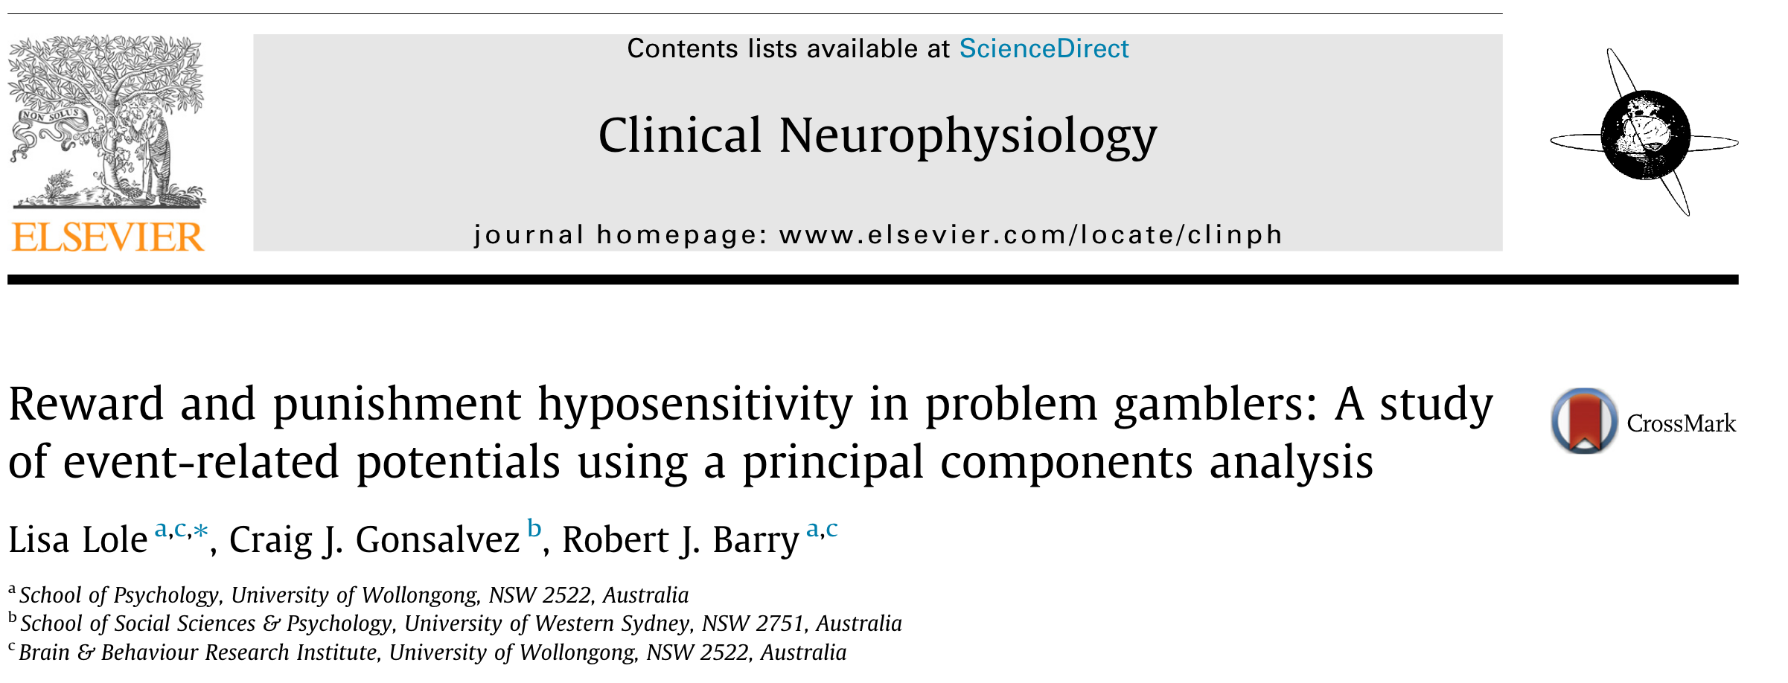
Notes:
Critically, for our purposes, numerous studies have reported that this measure is sensitive to the distinction between wins or losses in slot machine gambling task.
So if LDWs are often mistaken as gains, or are otherwise rewarding, then we should also expect that on this measure, they will look a lot like true wins and unlike clear losses.

Slide 22
Study Design
_________
Within-groups EEG ERP study
32 Participants
Participants were paid out for their winnings
Participants were presented with a gambling task that
included wins, losses and LDWs
Primary Measure:
Reward Positivity Event Related Potential
Notes:
I’m now going to walk us through the novel paradigm we designed for this study.
EEG has a number methodological requirements around minimising eye-movements that meant we have to re-design some aspects of a typical slot machine display.

Slide 23
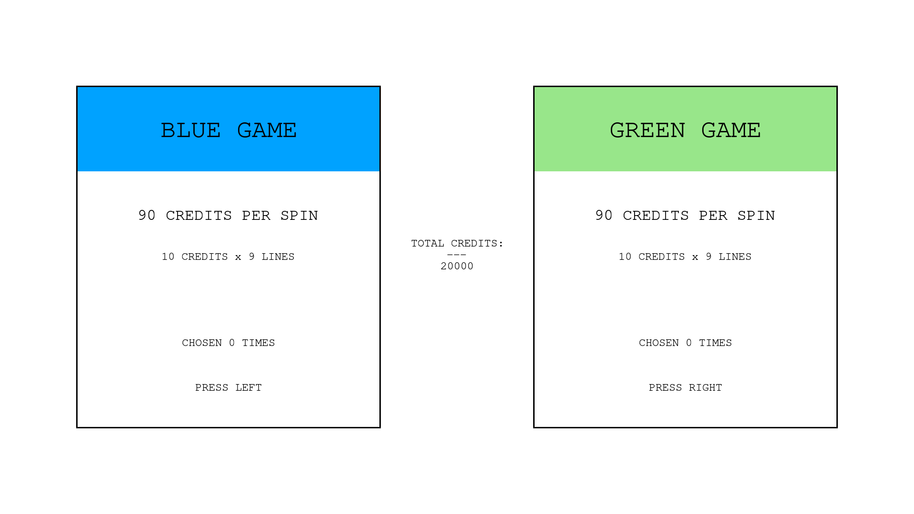
Notes:
At the start of each trial pparticipants were required to choose between two alternate gambles, labelled “Blue Game” and “Green Game”.
Any remaining credits were displayed in the centre.

Slide 24
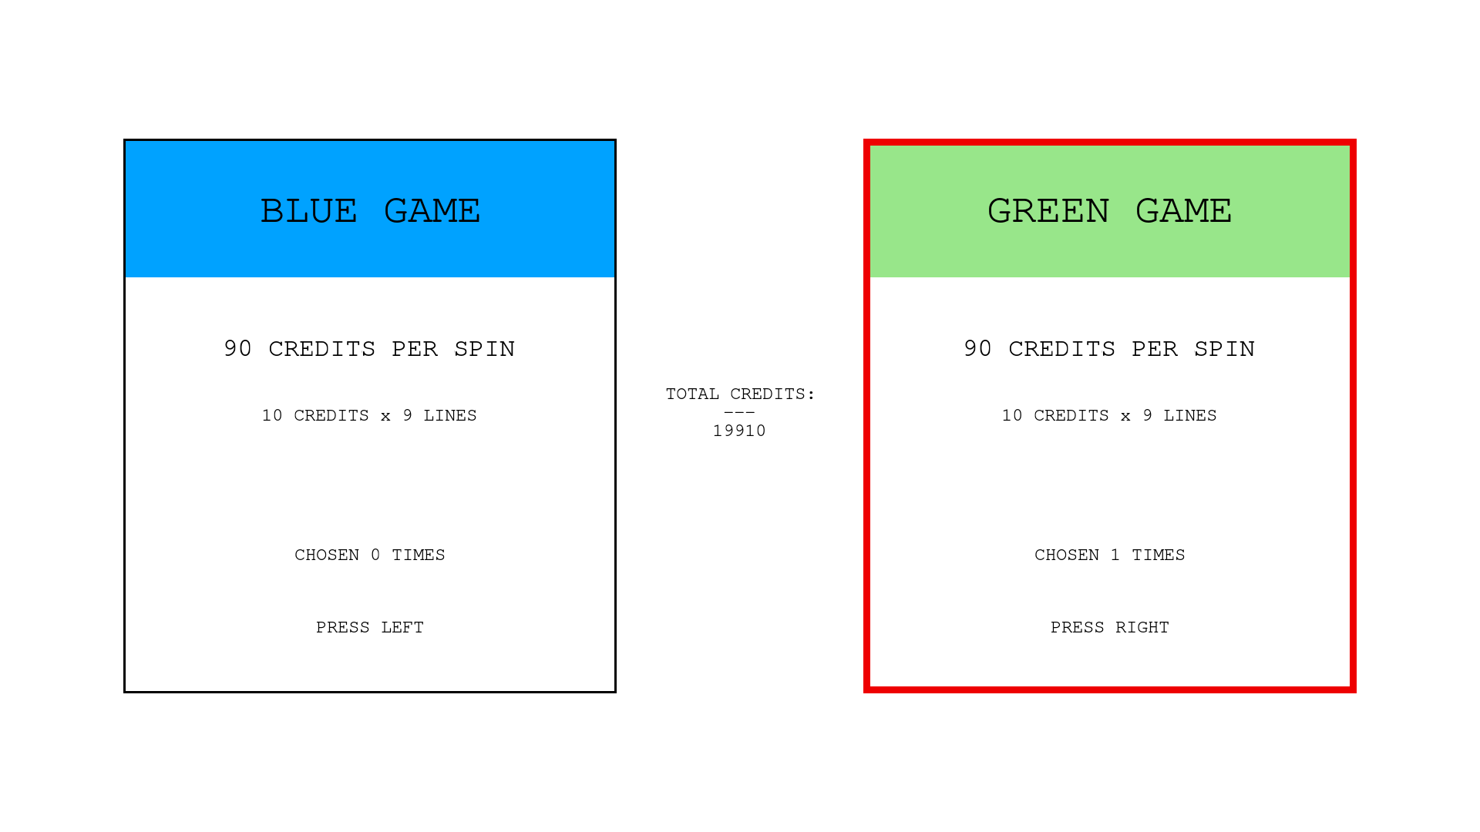
Notes:
The cost of the wager was then subtracted from this total.
The cost was always 90 credits, indicated at the top of each box.
The two gambles were identical in terms of their event frequency and expected value.
This primary purpose of this choice sequence were provide a sense of agency during the experiment as previous work has indicated that RewP amplitudes are attenuated in passive gambling tasks.
In total each participant made 360 wagers.

Slide 25
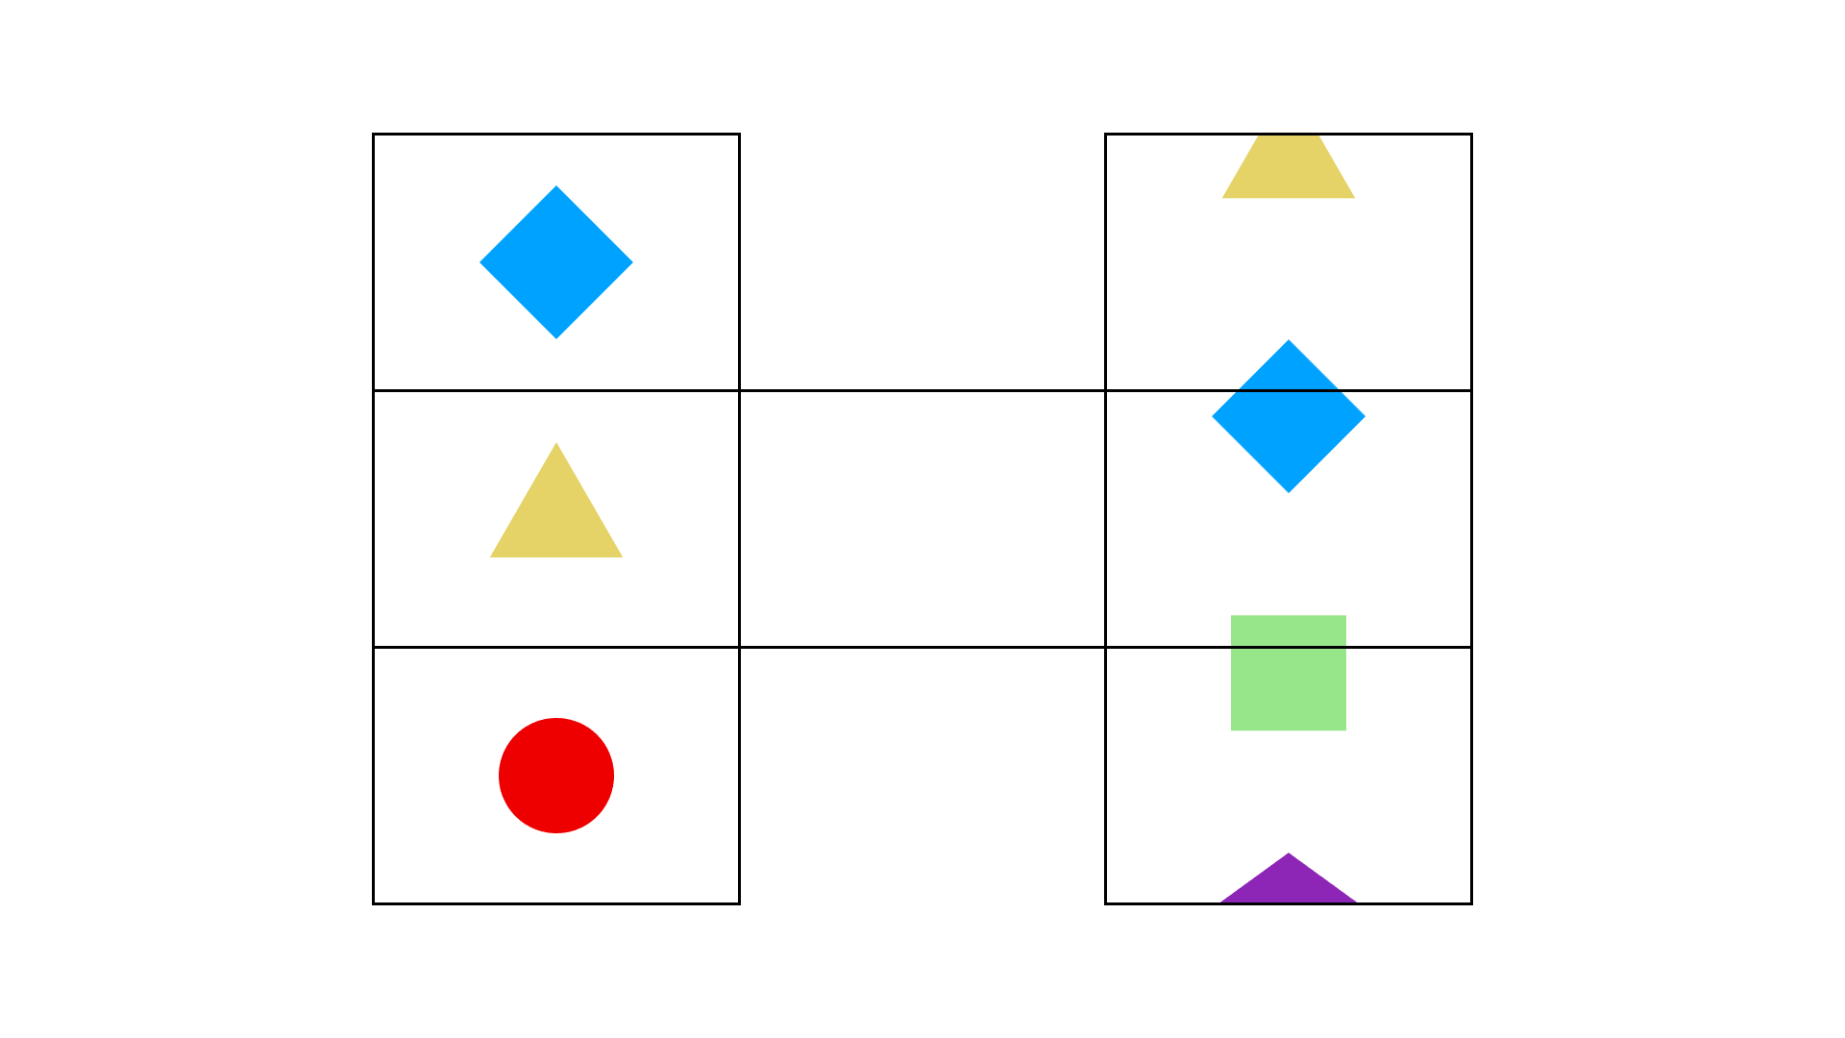
Notes:
Following the wager, the task presented an H-shaped grid.
To mimic slot machine reels an animation of spinning symbols was presented within the left and right columns
the left reel stopped first, followed by the right reel.

Slide 26
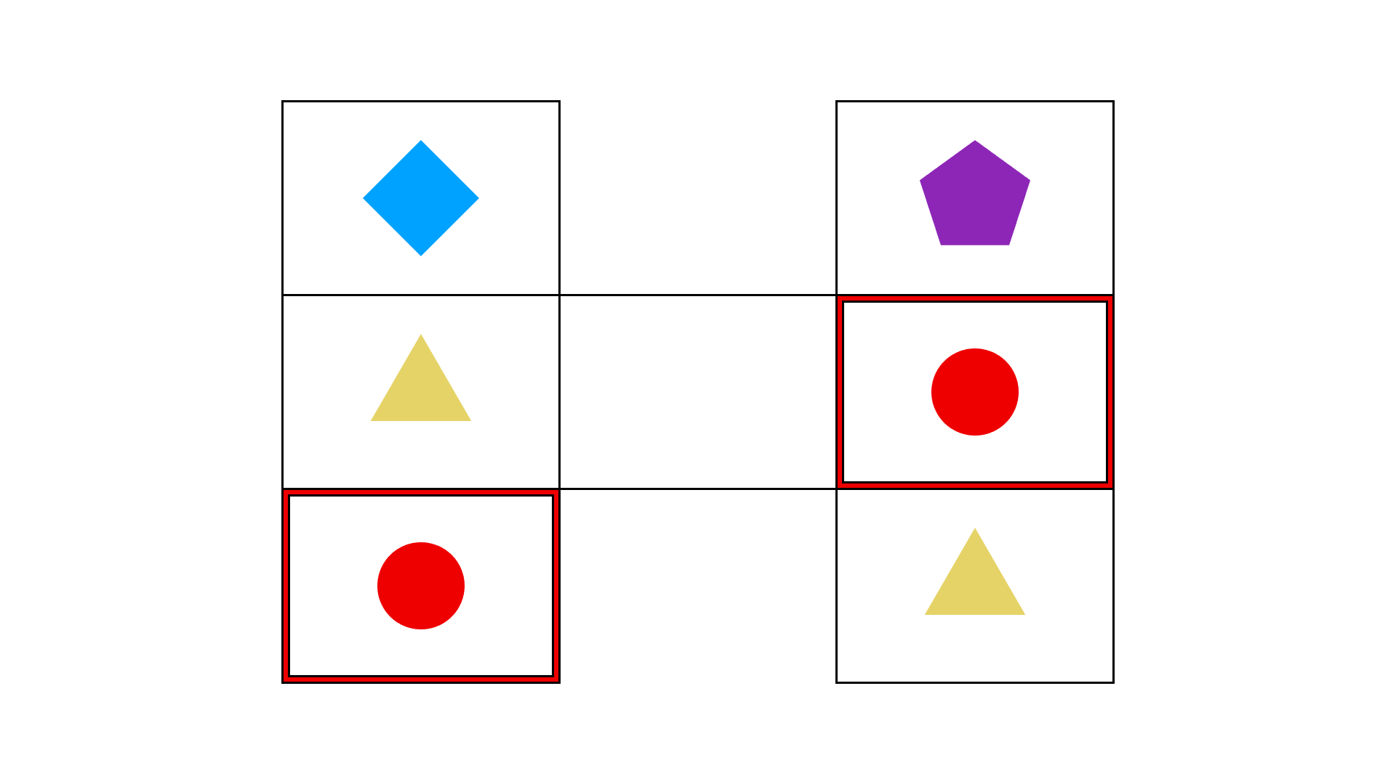
Notes:
Potential pay-line matches were then highlighted sequentially (500 ms)

Slide 27
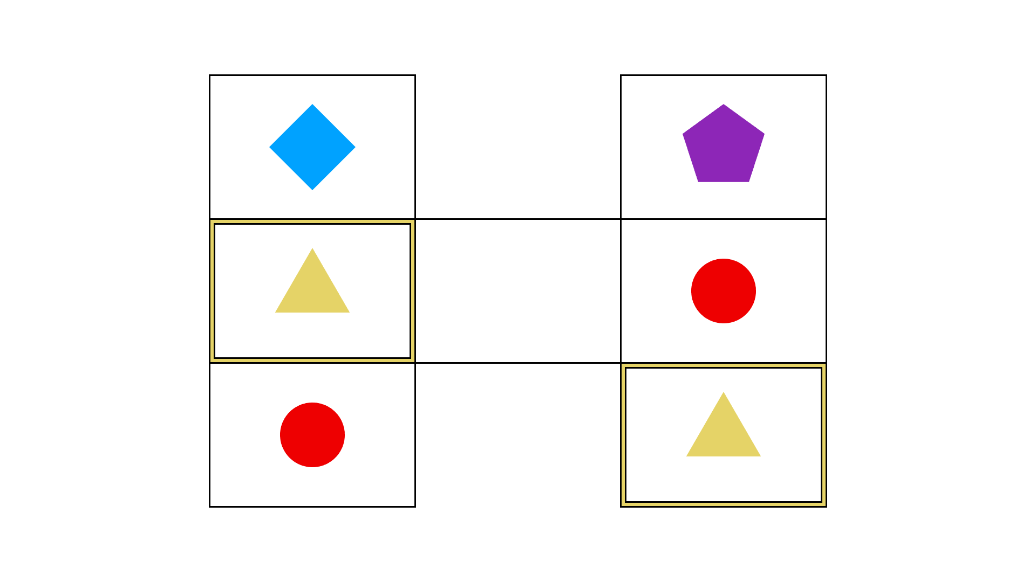

Slide 28
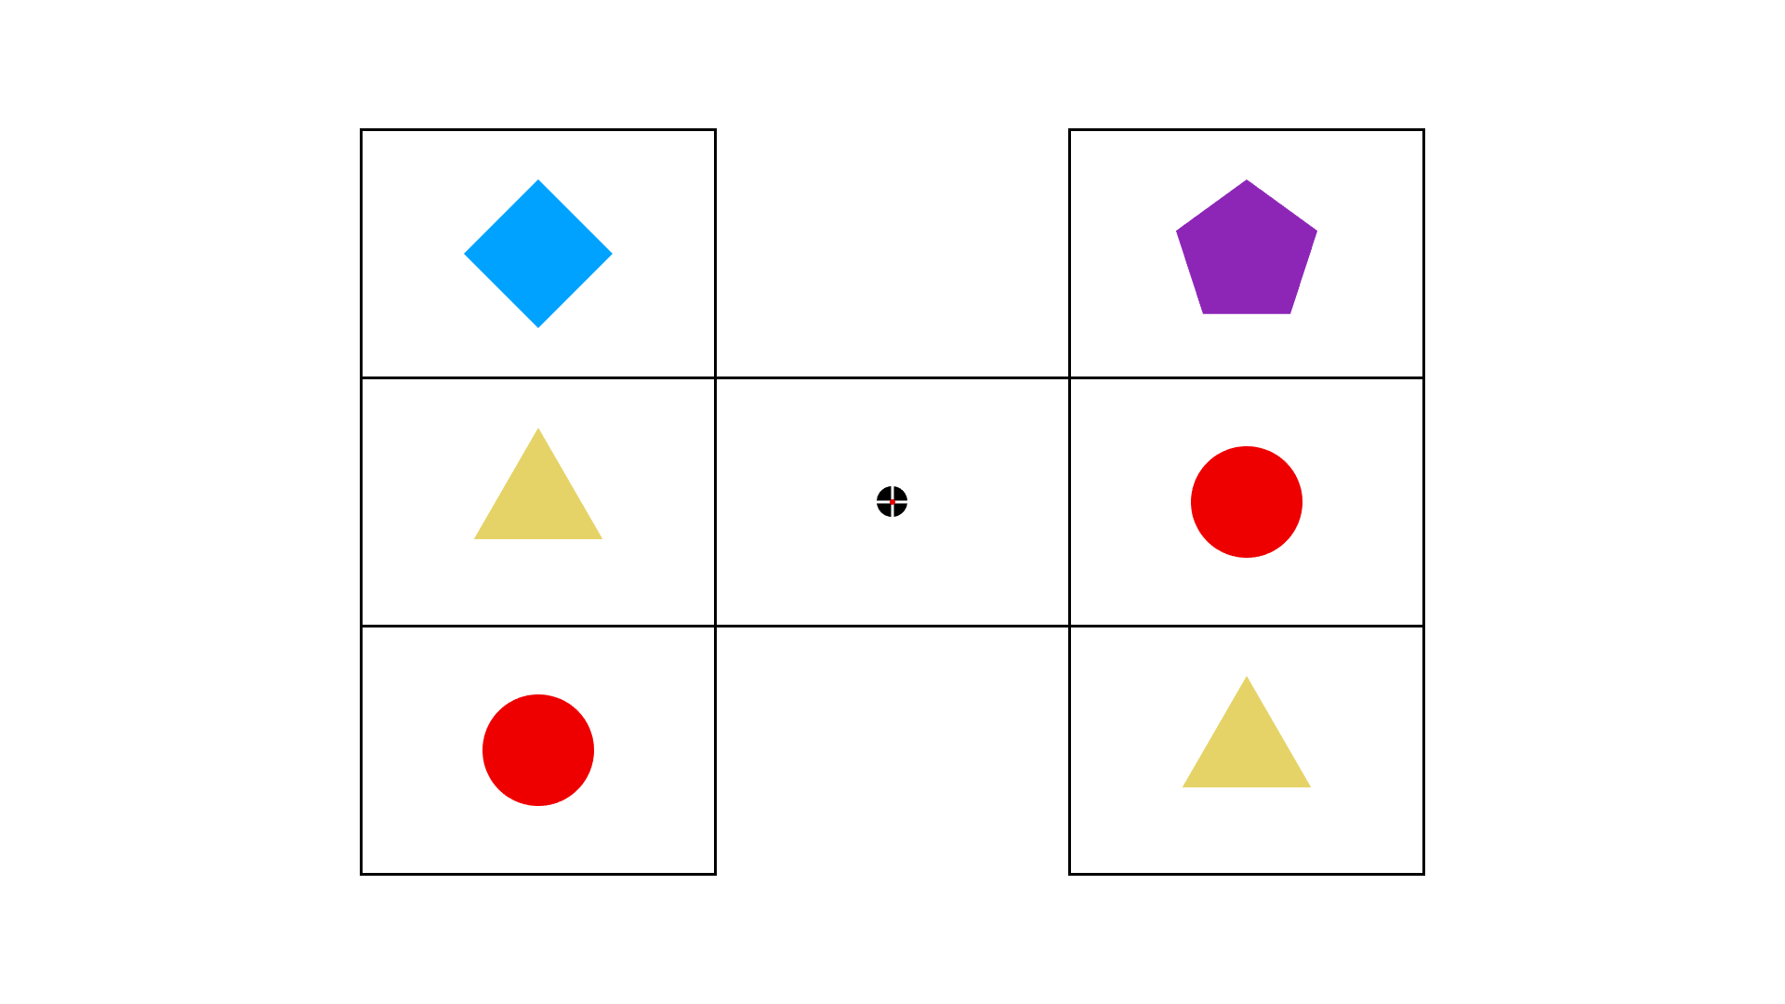
Notes:
Followed by a fixation marker displayed at the centre of the screen to reduce eye-movement during recording.

Slide 29
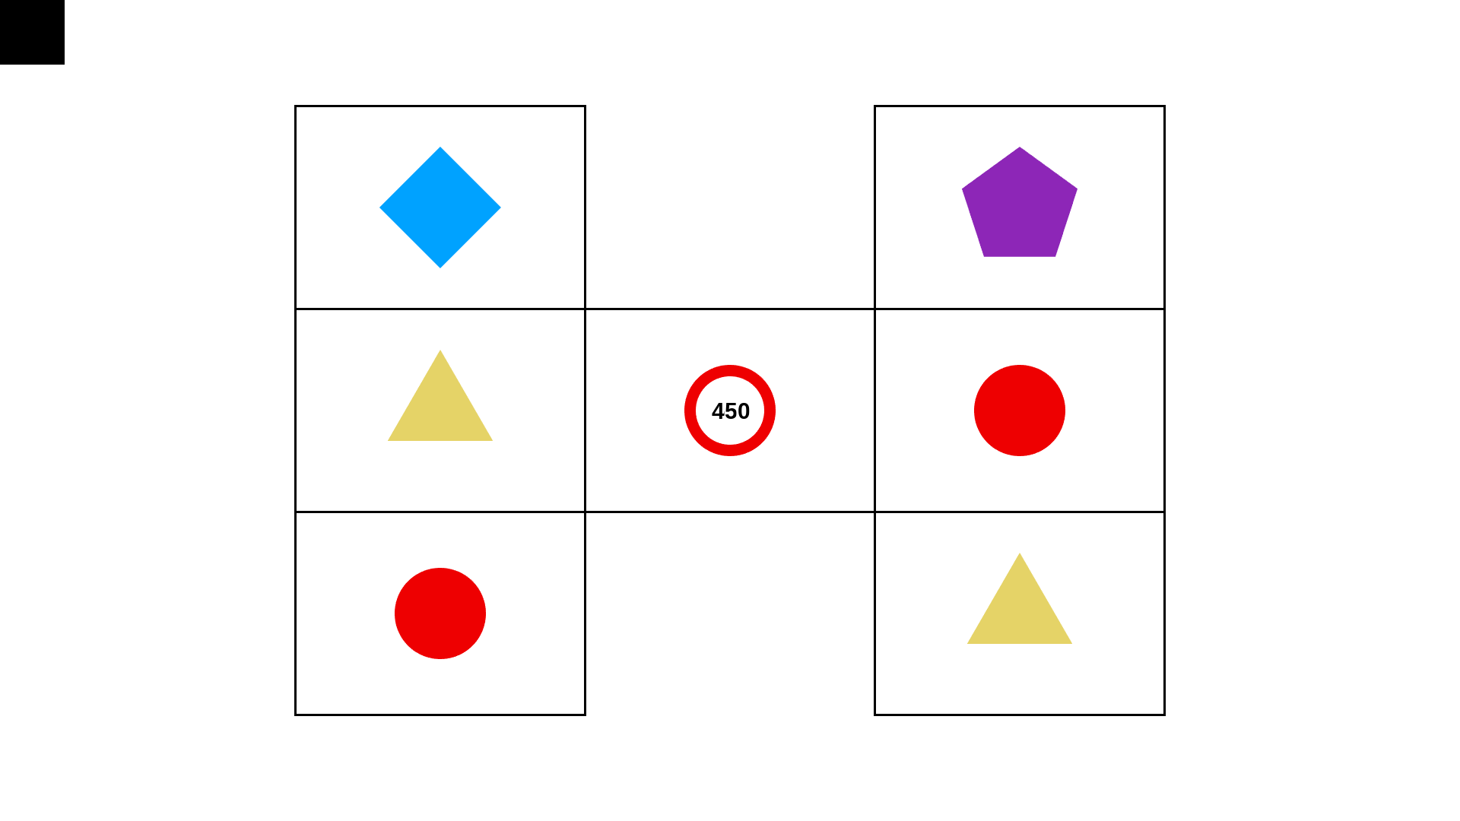
Notes:
The outcome stimulus was then displayed at this fixation point.
A payout occurred when the outcome stimulus matched symbols in both the left and right columns. The numeric payout was immediately displayed within the outcome stimulus.
This represents a payout of 450 credits on a 90 credit wager, matching that red circle

Slide 30
Notes:
The task was completely silent. No sound was paired with any stimulus.

Slide 31

Type | Payout | Net
Loss | 0 | -90
LDW | 30 | -60
LDW | 50 | -40
Small Gain | 130 | 40
Small Gain | 150 | 60
Large Gain | 450 | 390
Notes:
Finally there were 6 distinct payout magnitudes

Slide 32
Type | Payout | Net
Loss | 0 | -90
LDW | 30 | -60
LDW | 50 | -40
Small Gain | 130 | 40
Small Gain | 150 | 60
Large Gain | 450 | 390
Notes:
Non-matching or losing outcomes were indicated as 0. Here is an example:

Slide 33
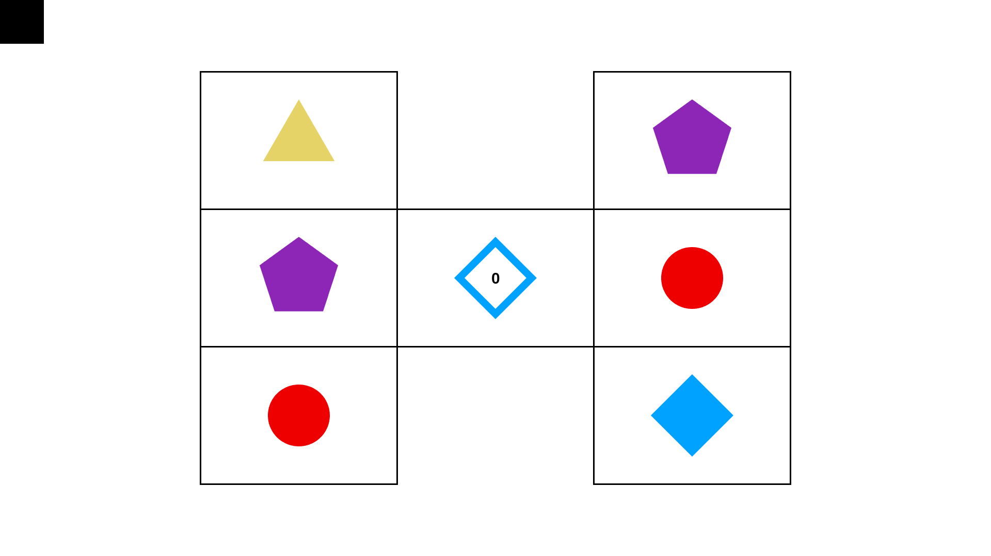
Notes:
Now recall that prior to each bet, the participant had placed a 90 credit stake [SLIDE]

Slide 35
Type | Payout | Net
Loss | 0 | -90
LDW | 30 | -60
LDW | 50 | -40
Small Gain | 130 | 40
Small Gain | 150 | 60
Large Gain | 450 | 390
Notes:
So the net outcome of a loss trial was a loss of 90 credits.

Slide 36
Type | Payout | Net
Loss | 0 | -90
LDW | 30 | -60
LDW | 50 | -40
Small Gain | 130 | 40
Small Gain | 150 | 60
Large Gain | 450 | 390
Notes:
There were also
two different LDWs of 30 or 50 credits, net outcome is in that last column

Slide 37
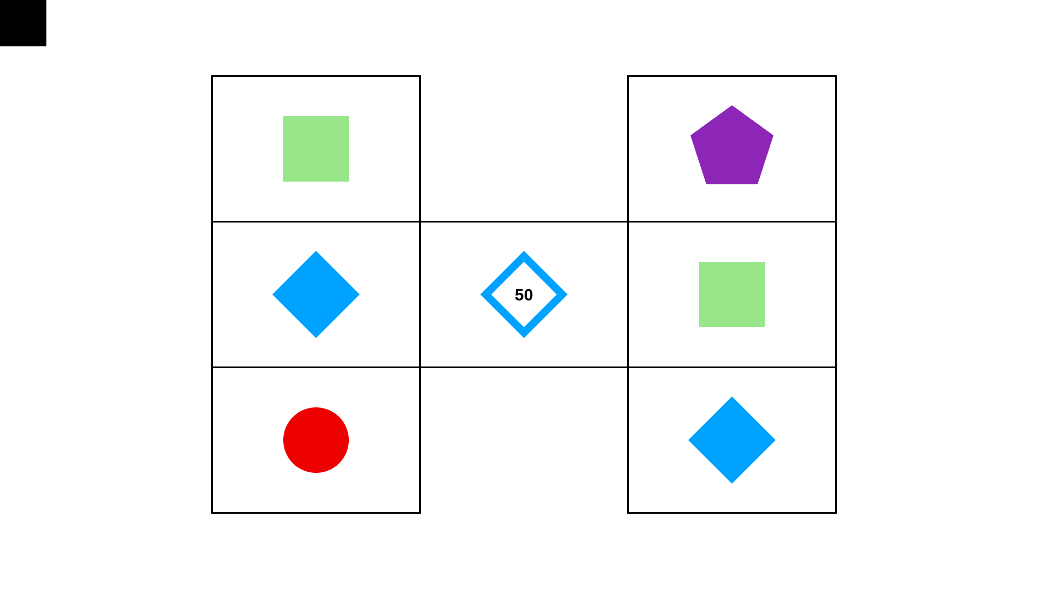

Slide 38
Type | Payout | Net
Loss | 0 | -90
LDW | 30 | -60
LDW | 50 | -40
Small Gain | 130 | 40
Small Gain | 150 | 60
Large Gain | 450 | 390
Notes:
two small genuine wins, of 130 or 150 credits.
And larger win of 450 credits.

Slide 39
Type | Payout | Net
Loss | 0 | -90
LDW | 30 | -60
LDW | 50 | -40
Small Gain | 130 | 40
Small Gain | 150 | 60
Large Gain | 450 | 390
Notes:
And larger win of 450 (net +390) credits.
RESULTS NEXT SLIDE

Slide 40
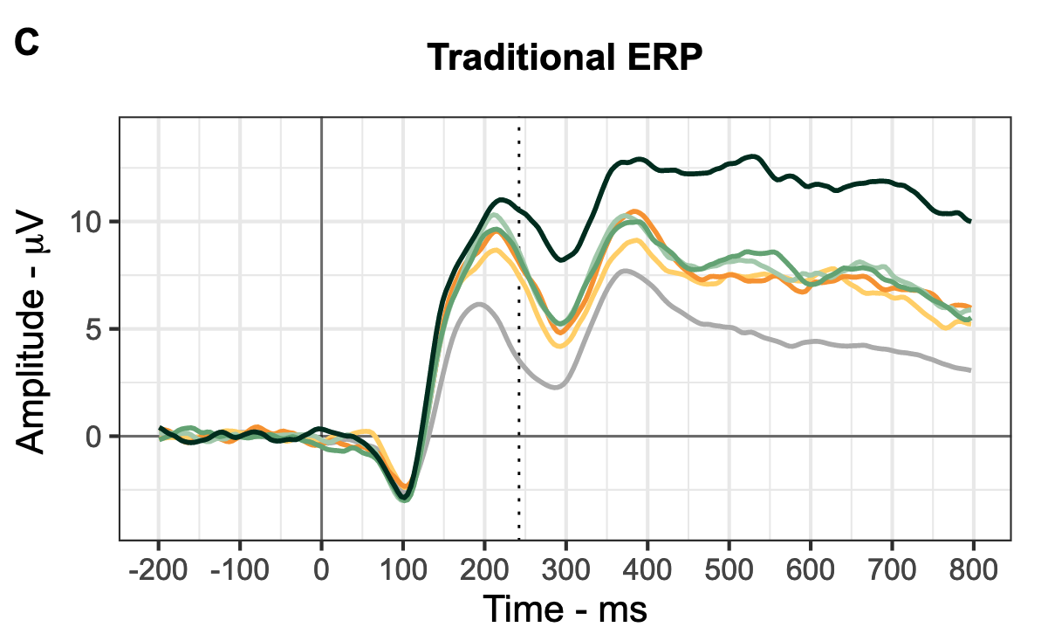
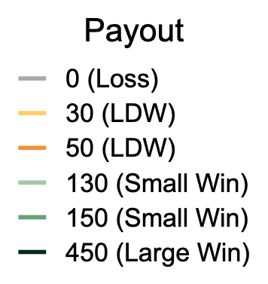
Notes:
Here we have the traditional event related potential plot.
On the vertical axis: Average amplitude at Fz which is an electrode just in front of the center of the scalp.
Amplitude is then visualised over time from stimulus presentation on the horizontal axis.
So this plots displays EEG trace that has been averaged over instances of recordings following the same payout event.
But as I mentioned the reward positivity is typically measured as a difference between winning outcomes and losses or neutral events. We can plot that as a difference wave.

Slide 41
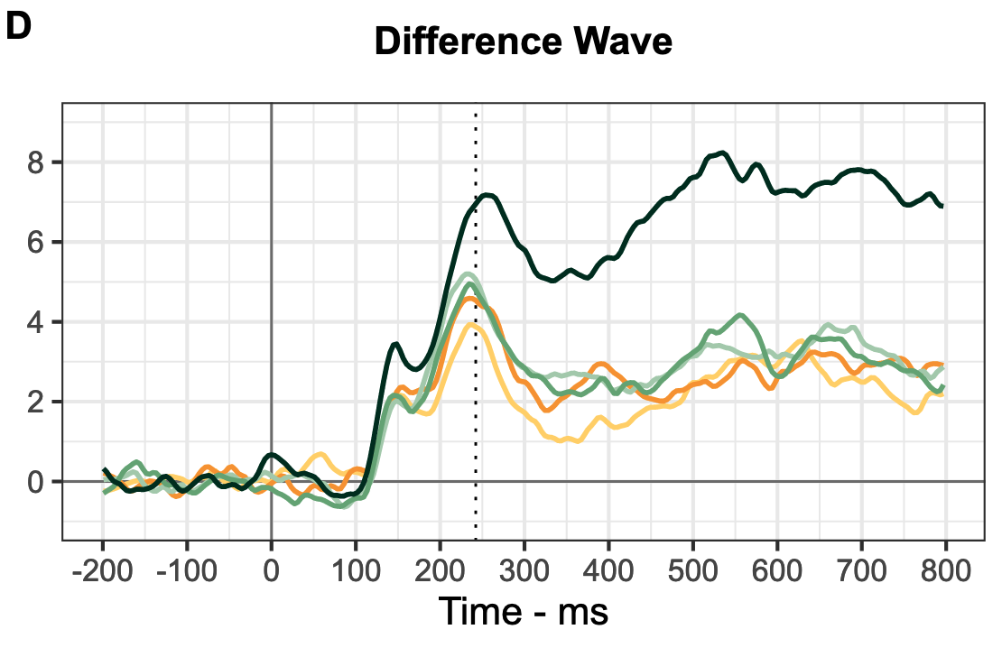
Notes:
The figure now displays the difference between each type of event and a clear loss.
This graph shows a clear peak in relative amplitude following all payouts, LDWs included, within our time window of interest 200- 350 ms.
To process these results we first conducted a principal component analysis to extract the reward positivity.
Principal components analysis is a statistical technique for reducing datasets containing a high number of dimensions or features. The technique relies on similarities in spatial and temporal characteristics of the data across participants and events. This aids interpretation and allows us to separate features of the EEG trace that aren’t associated with our intended measure.

Slide 42
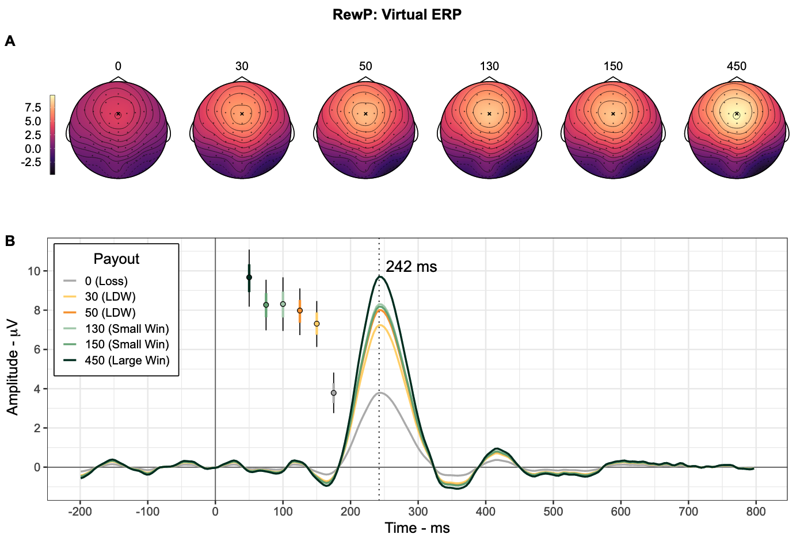
Notes:
This is the outcome of that procedure. We have now reduced the EEG trace to a single component of interest. This component was maximal at Fz, and during our window of interest. It’s this measure that we then perform our statistical analyses on.
The points to the left of the component trace display the estimates of mean amplitude derived from our statistical model of these data. For the stats minded audience members these are 95% highest density posterior intervals.
But the headline finding is this:

Slide 43
}**
Notes:
We observed clear evidence that on average, LDWs elicit a more positive RewP relative to clear losses, as predicted.
These findings are inconsistent with the proposition that LDWs are perceived as clear losses.
Conditional on our motivating theory [ancillary assumptions] these findings are consistent with the concern that LDWs may provide a source of reward while gambling despite being financial losses.
There was also a clear difference between the large win, and the small wins.
By contrast the differences between LDWs and small wins, were relatively small and compatibility intervals included null or near null differences.
***
These results support a key premise of a more general theory that LDWs, by rewarding financial losses, increase the frequency of positive reinforcers while gambling, and thereby contribute to the addictive potential of these products, without change to the financial expectation (or RTP).
Considered alongside accumulating behavioural evidence that LDWs appear to be mistaken for gains, and change betting behaviour in a manner comparable to small gains, LDWs represent a reasonable target for regulatory strategies to mitigate harmful gambling, or erroneous gambling cognition.
Given the current state of the evidence, LDWs should be treated by policymakers and regulators as though they both mislead consumers and contribute to habitual gambling behaviour.

Slide 44

Thanks
← Pre Print

