Slide 1
How do gamblers react to gambling streams on Twitch? An ‘ironic’ effect on cravings
Raymond Wu and Luke Clark
Current Advances in Gambling Research conference
29 June 2023
Notes:
15 mins

Slide 2
Disclosures
The Centre for Gambling Research at UBC is supported by the Province of BC government and the British Columbia Lottery Corporation, a Canadian Crown Corporation. The BCLC and Province of BC government had no role in the design or conduct of the research, and impose no constraints on publishing.
Dr Clark holds a Discovery Award from the Natural Sciences and Engineering Research Council of Canada (NSERC). He has received travel reimbursements from Scientific Affairs (Germany) and International Center for Responsible Gaming (US), and consulting fees from Gambling Research Exchange Ontario (Canada), GambleAware (UK), Gambling Research Australia, and International Center for Responsible Gaming (US).

Slide 3
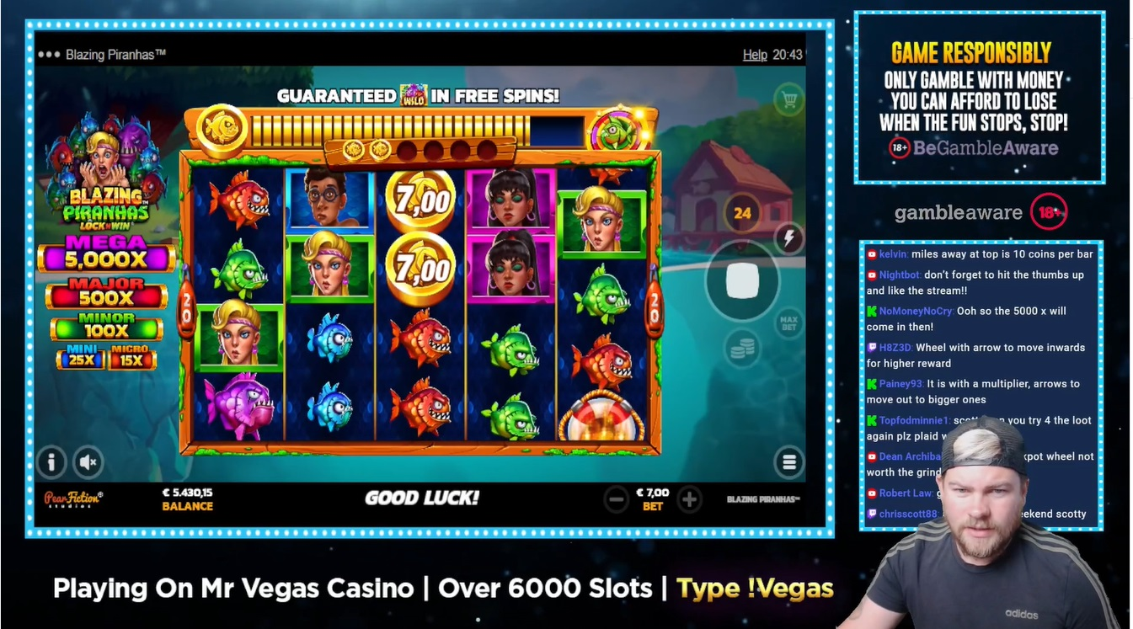
What are gambling streams? – the primer
Some RG messaging
The activity:
slots, poker… video gaming… eating food
The chat
The streamer: live webcam
Nb. Viewers are spectating gambling; there is no cost and no prize
FruitySlots (UK) on Twitch, 16 June 2023
Notes:
For a talk on streaming, I’m mindful that probably the majority of people here have never visited on these websites. This is Twitch; twitch is not the only streaming platform but it’s a good blueprint, and it’s similar to Youtube, but it’s predominantly live content : you’re watching this stuff as it’s happening. This fella from Fruity Slots is playing an online slot machine that we’re watching; in the right hand corner, there’s a webcam feed of the streamer, of course he’s talking away the whole time. There’s a panel showing the chat, where you can type in messages to each other. And above the chat, you might see some RG messaging: GambleAware, 18. Bear in mind that with gambling streams, this is just spectating. There’s no cost to this activity

Slide 4
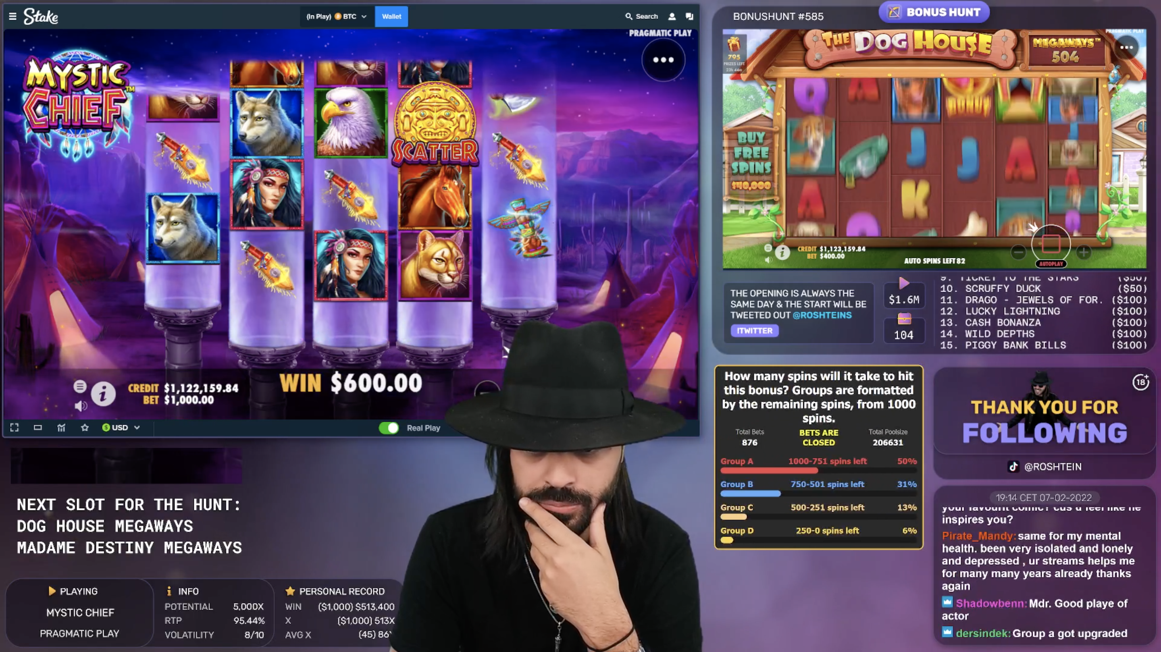
The streams and the streamers
Streamers have disclosed developing gambling problems as a result of their streaming (xQc on Twitch)
Some streamers gamble on unlicensed / illegal websites (e.g. Slovakia e-poker); crypto currencies
Sponsorship contracts appear ubiquitous, not always disclosed, to provide regular balance top-ups on specific websites
Roshtein on Twitch, 2022
Notes:
Gambling streams are a popular category on these platforms: when Twitch was the dominant platform, which I’ll say more about in a minute, there were over 150 channels broadcasting gambling, and the most popular of those streams would regularly pull in over 100,000 viewers. One set of issues is around the streamers and what they’re up to, exactly. Some of the streamers have revealed experiencing significant gambling problems from playing gambling games for many hours a day. There are some jurisdictional issues: as to whether the product or website is legal in the country where the streamer is located. Plus, a lot of the gambling streamers are sponsored by the websites that they’re playing on, where they often seem to be gambling with free balance top-ups, so that it’s not necessarily their own money that they’re losing

Slide 5
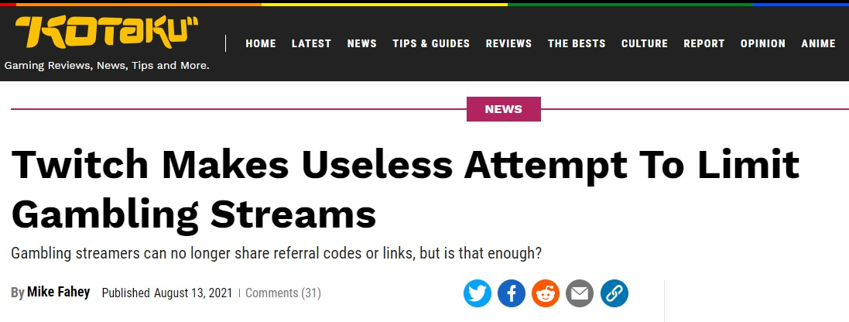
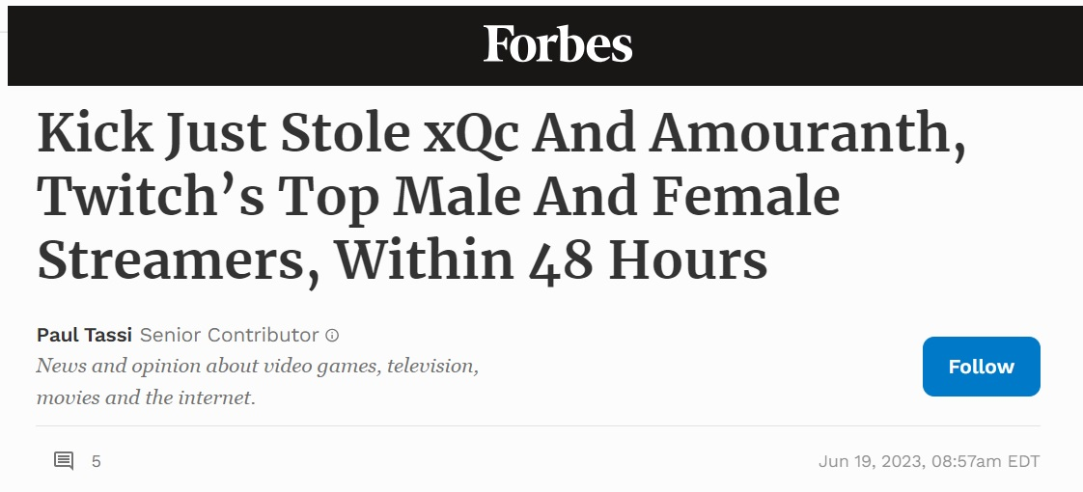
Limited Research on Gambling Streams
Limited data at the current time: Zendle (2020, UK sample) shows 4% rate of past-year involvement and correlated with PGSI
Abarbanel & Johnson (2021): side-games in the chat often borrow raffle mechanics (e.g. prize give-aways)
Twitch has been through a series of regulatory ‘crackdowns’ to curb gambling, but meanwhile, other platforms emerge (Kick)
Aug 2021 (and Oct 2022)
June 2023
See Abarbanel, Avramidis, Clark & Johnson 2021 The Conversation
Notes:
Although there’s a field of research around Twitch and streaming, there’s very limited research on gambling streams. The only prevalence data is a study by David Zendle that predates a lot of the publicity around these streams, so in Zendle’s study 4% of a UK sample reported watching live gambling streams, and this also correlated with PGSI scores. There’s an interesting paper by Brett Abarbanel and Mark Johnson, which is not about gambling streams per se, but about how some of the features in the chat rely on raffle mechanics and are effectively gamblified, even for a channel that is broadcasting video games. So the Chat has quite a lot of depth to it actually. And as with all research on emerging forms of gambling, streaming platforms are a bit of a moving target: Twitch had announced two regulatory curbs on gambling content over the past 2 years: but if you go on Twitch today, you’ll have no trouble finding slot machine to watch, but a lot of the action is moving to other less-regulated platforms especially one called Kick,.

Slide 6
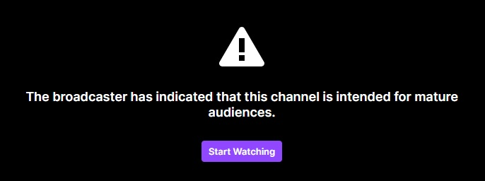
Gambling streams and youth exposure to gambling
Platforms developed for broadcasting of video gaming
Inadequate age gating
Slots streams display particularly intense forms of gambling (autoplay, high stakes, multi-screening)
See Abarbanel, Avramidis, Clark & Johnson 2021 The Conversation
Notes:
Turning to the viewers, the next set of issues is around young people being exposed to gambling content before they are legally able to gamble. Twitch in particular was a platform designed for broadcasting video gaming, and there’s a lot of young men on there. The age gating is minimalist, and the gambling that is happening is very intense: high stakes, auto-play at the fastest rate, and multi screening several games simultaneously. So these points are quite important, and definitely require research, but in the 2 studies I’ll show you today, the participants were adults, mostly aged 20 to 40, they have gambling experience, so our data do not capture this particular piece of the puzzle. What we are interested in today: how does watching this content affect people who are already involved in gambling and maybe trying to cut down

Slide 7

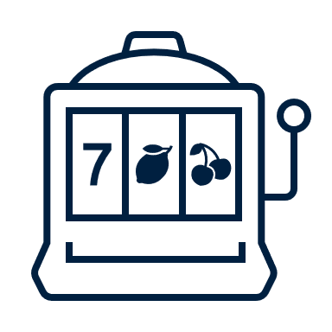
Regulation Motives vs Evoked Craving: an ironic effect?
Watching gambling to regulate cravings
Cravings triggered by watching gambling
“I intentionally watch gambling streams to help myself cope with my cravings to gamble”
“When I watch gambling online, it seems to increase my urge to gamble for real money”
Adapted from Hollingshead, Wohl et al (2020) for Social Casino Games
Notes:
Our reasoning for focusing on experienced gamblers was to look at craving, and specifically, whether these streams present a sort of delicate balancing act for people who gamble. On the one hand, people with gambling problems experience a powerful urge to gamble, we talk about this as a motive to regulate their gambling cravings, which might be met by watching a gambling stream. But of course the gambling streams themselves are intense and exciting, they’re full of learned associations that also evoke cravings thru cue reactivity. So in the second study that I’ll talk about, we developed a short scale to test these two components, you can see two of the items here, and I want to give a hat tip to Michael Wohl and Samantha Hollingshead who had already done something very similar to this in social casino games, we were simply modifying their scale.
So it’s this idea that I’m calling an ‘ironic effect’ and this is the first presentation where we’ve used this term. The simple idea is that people who gamble may be drawn to the material to satisfy an urge, but maybe that material ends up making things worse

Slide 8

Dataset and Participants
Data collected from Prolific (UK, US, Canada, Australia, Ireland, NZ) in 2022
Study 1: among people with past 3 m gambling (n = 965 after cleaning), compare gambling stream viewers vs non-viewers (n = 221 vs 642)
  c.f. Zendle (2020): 4.1% of UK survey watched live-streams, correlated with PGSI
Study 2: among gambling stream viewers (n = 271 after cleaning), do people report watching streams to regulate their desire to gamble and/or that streams evoke a craving to gamble?
  relationships with PGSI
Raymond Wu
Notes:
We ran two studies, online data collection using the Prolific platform across several countries, and in both studies we use a very quick prescreen survey to establish eligibility. For Study 1 we wanted to explore the characteristics of gamblers who watched gambling streams, so we prescreened for people who had gambled in the past 3 months, 1000 took part in the main survey, and we divided them into a group who watched gambling streams (the viewers) and another group who didn’t. Here we’re following up that Zendle prevalence that saw a link to problem gambling on the PGSI. In a targetted sample of recent gamblers, almost a quarter of them watch gambling streams. In Study 2, we modified our prescreen to just recruit people who watched gambling streams, 300 of them, 271 after cleaning, where we measured regulation motives and evoked craving from watching gambling streams.

Slide 9
Among gamblers, who watches gambling streams?
 | Viewers | Non-viewers
N | 221 (23%) | 642 (66%)
Age | 36.8 (11.0)* | 42.1 (12.5)
Gender | 45.2% men* | 29.6% men
Employment (% full time) | 65.6%* | 49.9%
Watched non-gambling content | 90% | 78.5%
Gambled before watching | 76% | -
PGSI | 4.5 (5.0)* | 1.6 (3.0)
Gambling cravings (GUS) | 11.1 (5.9)* | 7.5 (3.3)
Boredom Proneness Scale | 3.5 (1.3)* | 3.0 (1.3)
nb 11% “I have done this but not in the past year” and excluded from group comparisons
* p<.05
No diffs on education, relationship status, income
Notes:
Let’s look at some data: the vigilant folk here will be wondering how 221 viewers and 642 non-viewers sum to the total N, and that’s because we have another 11% who say they’ve watched a gambling stream at some point but not in the past year. We excluded them. In testing the group differences on each variable, the gambling stream viewers tend to be younger, they have a higher proportion of men, they’re more likely to be in full time employment. Three quarters of them say they started gambling before they ever watched a gambling stream. The bottom 3 rows here are also interesting: the viewers have higher PGSI scores, they report higher baseline cravings to gamble, and they show higher boredom proneness as a personality trait that Raymond is quite interested in

Slide 10
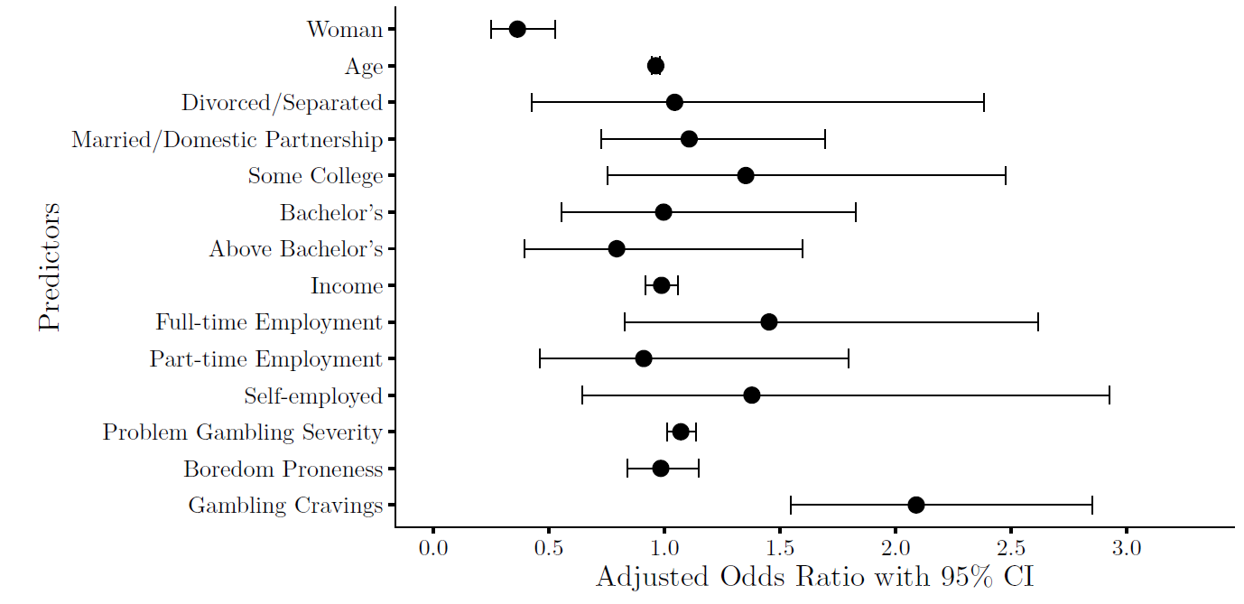
Viewers vs non-viewers: multivariate log reg
64% less likely for women, p < .001
4% less likely for every 5 years of age, p < .001
7% more likely per PGSI point, p = .021
9% more likely per craving point, p < .001
Reference groups: Men, Single, High School Education, Unemployed
Notes:
Now of course some of those predictors are cross correlated with each other, or colinear, so this is a multivariate regression entering all variables to predict whether someone watches gambling streams or not. Some of the univariate effects do drop out in the multivariate model – boredom proneness and employment status -- we’re left with 4 significant predictors: the viewers are more likely to be a man, they’re younger, higher PGSI scores, higher overall cravings. So in Study 2, all of the surveyed participants watched gambling streams, and it’s these two effecs that we’re drilling down on

Slide 11
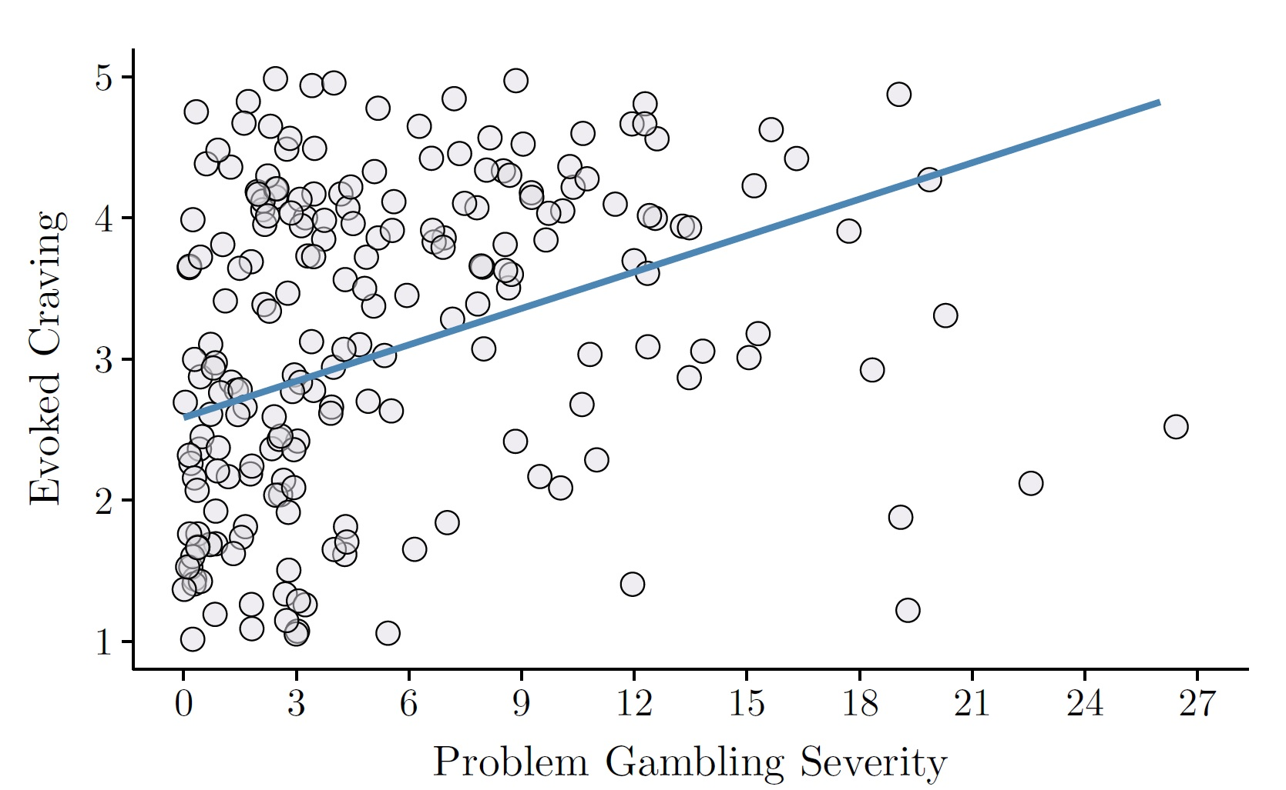
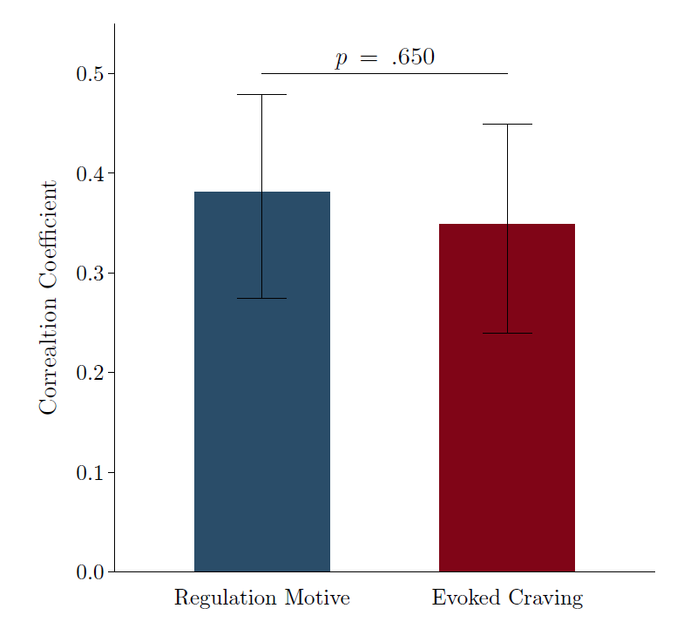
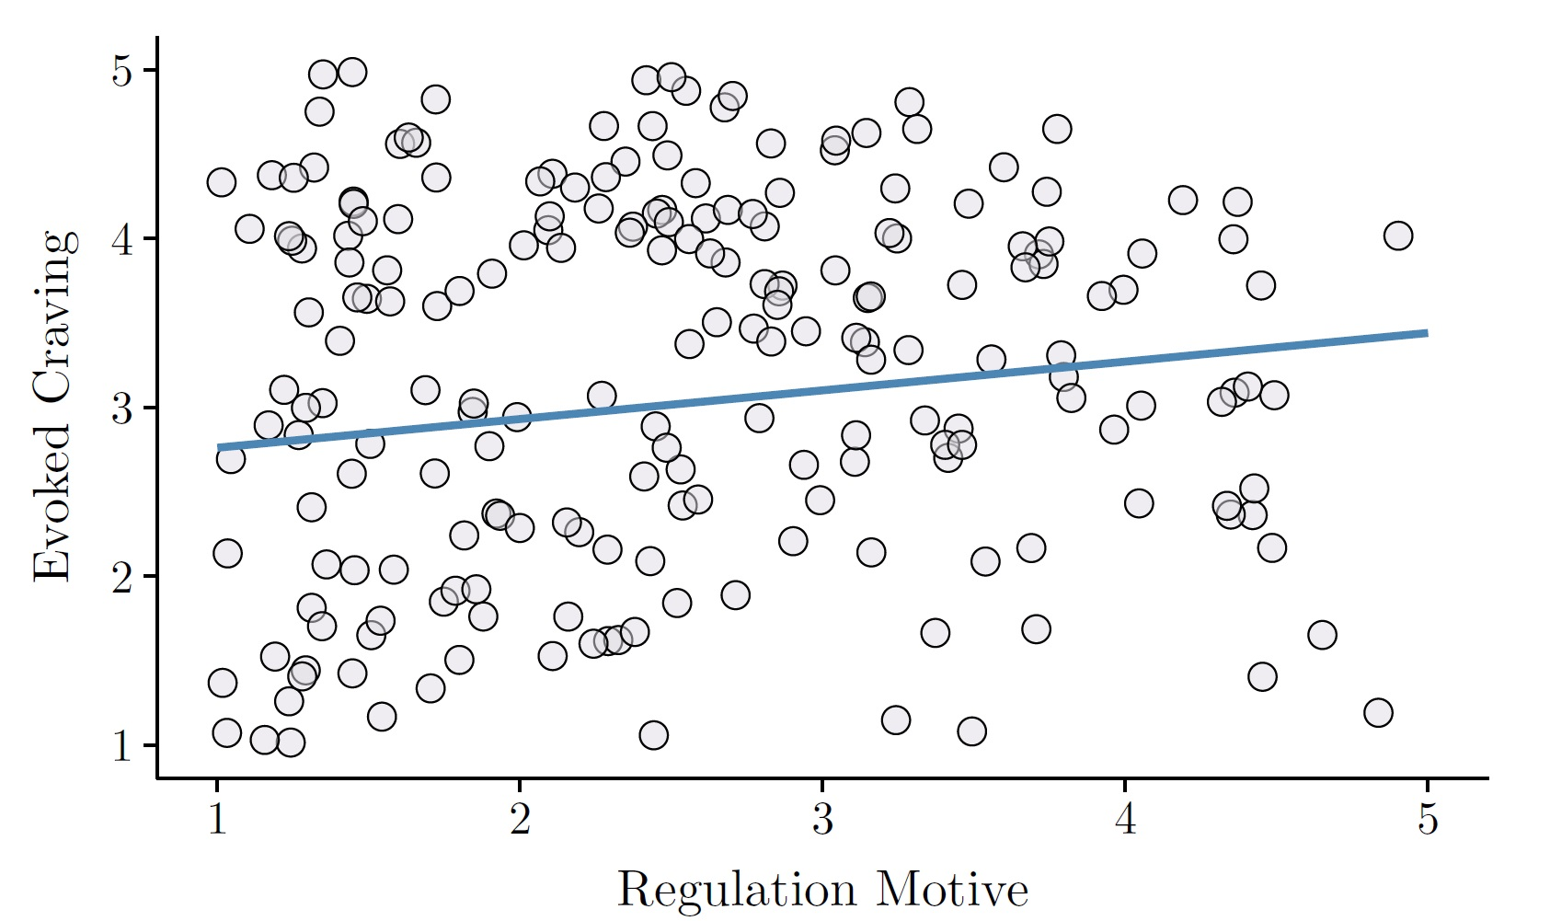
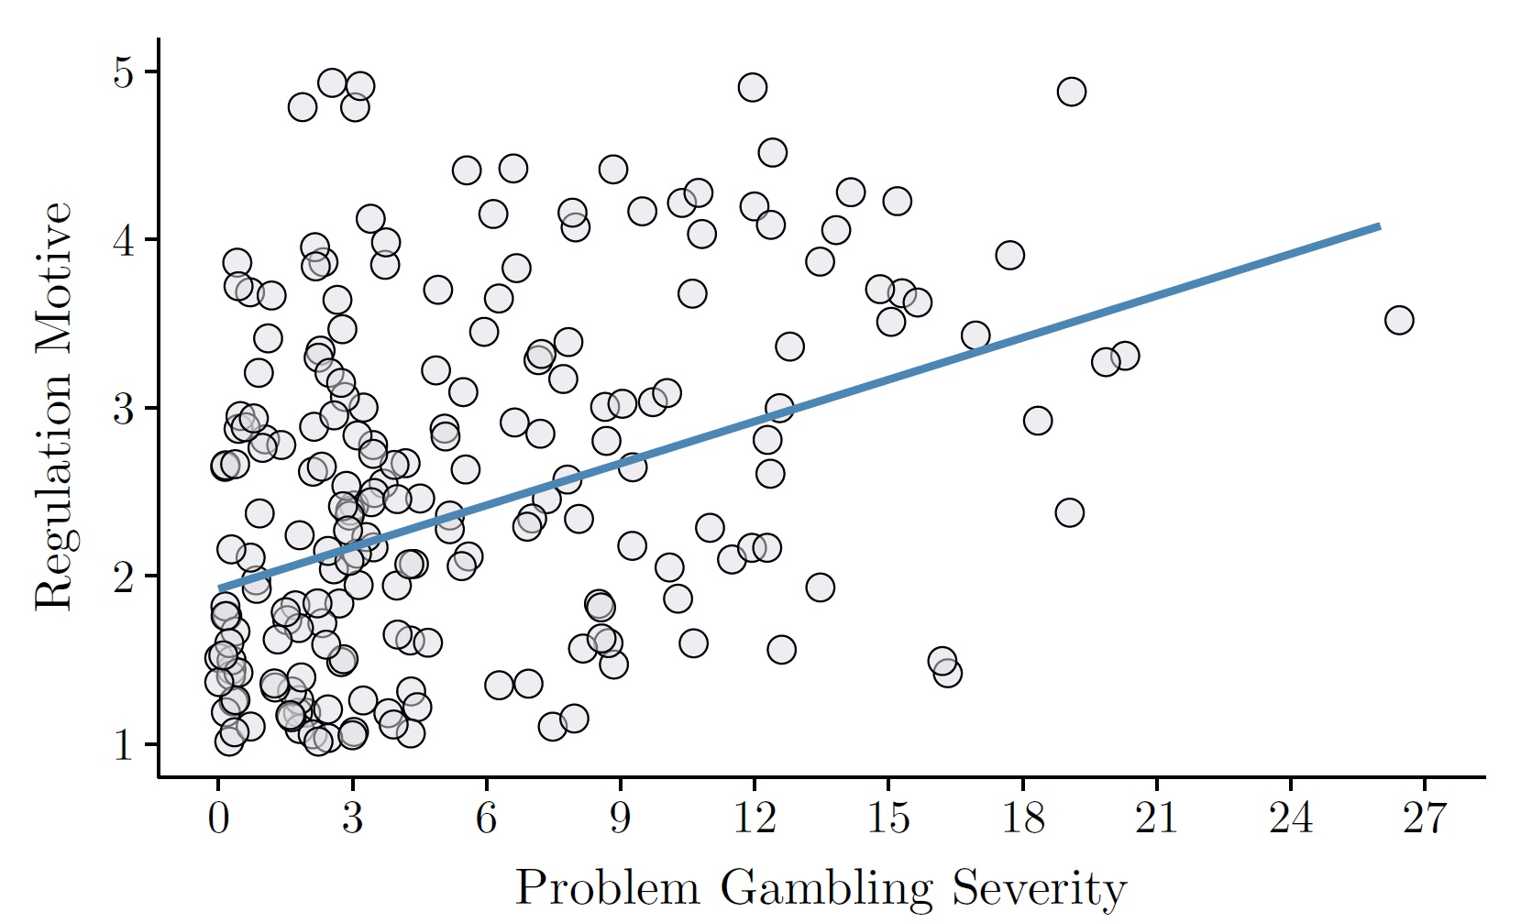
Study 2, n = 271: 92% reported past 3 m gambling, mean PGSI = 4.6
Are higher PGSI gamblers drawn to gambling streams to regulate their cravings but, ironically, experience more cravings as a result?
Notes:
In the sample of gambling stream viewers, they’re adults, most of them do report recent past 3 month real-money gambling, and the PGSI for the overall group is pretty high. In the top left, across the whole sample, higher gambling severity is associated with higher ratings of evoking craving by gambling streams , correlation approaching 0.4. Lower left: higher PGSI is also correlated with regulation motive: watching streams in order to reduce cravings. So both of these components are correlated positively with gambling severity. The two coefficients do not differ from one another, and the two responses – evoked craving and regulation motive – are weakly correlated with one another, about 0.2 which is significant but weak – the important point is that it’s not negative! If gambling streams simply met the urge in the way intended, we wouldn’t see this, so this fits with the ironic effect at a simple level

Slide 12
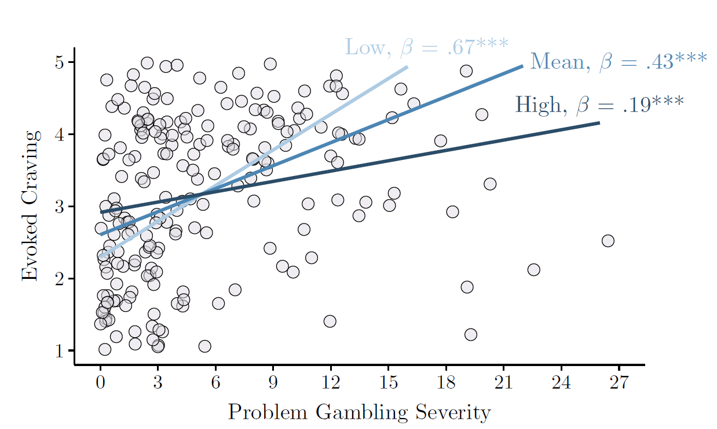
The effect of PGSI on evoked cravings depends on regulation motives
For high PGSI, the predicted mean evoked craving was 3.38 when regulation motives were high, but 3.91 when regulation motives were low, d = -.46
Low: -1 SD; High: +1 SD
Notes:
We wanted to take it one step further, this is last data slide. Is it really the case that regulation motives just backfire , or can we make sense of these relationships in other ways to inform clinical work or self management of gambling problems. This is a moderation test where we go back to the relationship between PGSI and evoked craving, but with regulation motives as a moderator – higher regulation motives do have a buffering influence, they weaken the correlation between gambling problems and evoked craving. Conversely, gamblers with low regulation motives show a stronger relationship. – and for me this makes sense but it also complicates a simple version of the ironic effect -- if you think about CBT strategies and urge surfing techniques, emotion regulation strategies are malleable, they can be practiced, and the implication here is that we might be able to enhance emotion regulation so that gambling streams become less triggering. This is something that would need to be tested with an interventional study

Slide 13
Take-home messages
Among adult gamblers, those who watch gambling streams tend to be younger men, with higher levels of gambling problems and cravings
Problem gambling is related to both using gambling streams to regulate cravings, but also experiencing cravings from watching streams
Although this effect may appear ‘ironic’, higher regulation motives buffers the relationships between higher PGSI scores and evoked cravings
Ongoing analyses to test which in-stream events drive cravings (wins, high stakes) and links with preferred products (to watch / play – not all slots!)
Notes:
Just summing up, in study 1 we looked at recent gamblers who watch gambling streams: what are they like? Well, they’re young, they’re more likely to a man, higher levels of gambling problems and gambling cravings. Many of you will recognize this risk profile with many ‘emerging forms’ of gambling (eSports betting, loot boxes etc), although in this instance, remember they are spectating, they’re not actually paying to gamble. In terms of the emotional dynamics of these streams, in Study 2 we can see that higher levels of problem gambling is related to both regulation motives and evoked craving, and on the surface we might call this an ironic effect, but in follow up models, higher levels of regulation motive actually buffers the link between PGSI and evoked craving. We’re doing a few other projects around Twitch, we’re interested in whether particular stream events drive craving, with big wins being an obvious contender ,we’re interested in which forms of gambling they play and which forms they watch – Twitch is not only about online slots, and we’re interested in some of the things that happen in the chat, which is a rich data source

Slide 14
email luke.clark@psych.ubc.ca
www.cgr.psych.ubc.ca
twitter @LukeClark01 @CGR_UBC

