Slide 1

Experiences of Gambling and Crime: Implications for Probation Practice
29th June 2023
Current Advances in Gambling Research (CAGR) Conference, London
Dr Lauren Smith

Slide 2


Funding statement
The original project upon which this presentation is based was funded by The Commission on Crime and Gambling-Related Harms (previously the Commission on Crime and Problem Gambling), led by The Howard League for Penal Reform.

Slide 3

Overview
Probation context
Research context
The Criminal Justice process
Gambling harms
Implications for probation practice
Content warning: Includes accounts of crime and gambling-related harms

Slide 4

Probation Context
Approx. 240,000 people on probation in England and Wales (Ministry of Justice, 2022)
Number of people on probation experiencing or previously experienced gambling-related harms – Nobody knows!
BUT, The Gambling Commission (2021) estimated overall rate of ‘problem gambling’ to be 0.4% with moderate risk estimated at 0.7%
2,640 people on probation potentially experiencing harms
May be higher given what we know about prison populations – highest of any population (8-40% internationally; Ramanauskas, 2020).
Yet, no systematic screening or support.

Slide 5
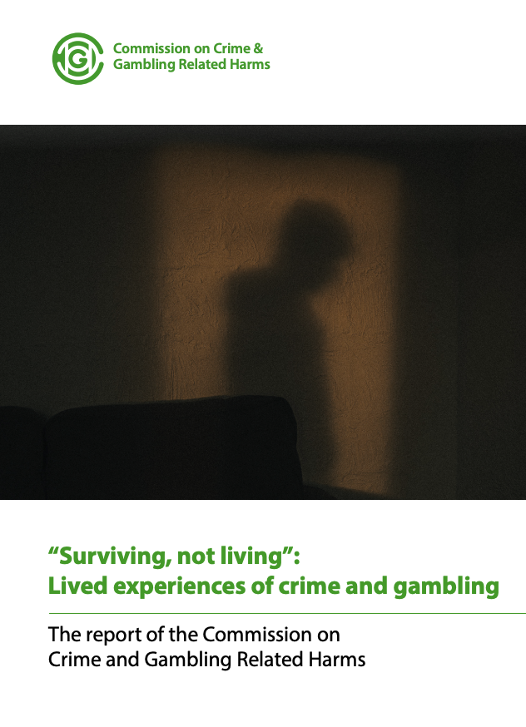
Research Context
‘Surviving not Living’: The Lived Experiences of Crime and Gambling (Smith, 2022).
Interviews covered the entire Criminal Justice Process; focus today is on probation BUT cannot be looked at in isolation
Probation involvement: pre-sentence reporting and community supervision/post-release
Qualitative interviews with 18 people directly impacted by crime and gambling harms and 4 family members (Smith, 2022).

Slide 6

Police Context
First contact often due to concerns for safety or due to handing self in. Feelings of relief when speaking to the police:
One of the overbearing emotions I had was relief. Because it was like I didn’t have to carry it around with me anymore, it’s not weighing down every aspect of my life (Paul 2).
Lack of knowledge and understanding amongst police staff:
When I went in, it was like he’s nicked half a million from [bank], it was almost a bit of a – ‘Well done mate, how did you manage to do that?’ Kind of attitude (Paul 1).
BUT no systematic screening or support for gambling:
There was no help. Gambling never got spoken about really, apart from to say where the money went, addiction was never talked about (Jordan).

Slide 7

Courts
Prior to court, increased likelihood of long periods of time on bail or under investigation > mixed experiences > liminality versus opportunities to access support:
I was fearful, I built my relationship back up with my wife, my kids, I have been in recovery and was doing voluntary work, I was trying to look for a job, I was waiting for my sentence before I committed to anything…just trying to keep myself busy, and life was beginning to reshape again, and then I was faced with this sentencing (Tony).
Lack of understanding reported amongst legal teams; impacted on ability to communicate gambling as a factor in offending, even when voluntary steps were taken to address gambling:
I don’t feel the lawyers had any clue what gambling disorder is; they didn’t understand it and they couldn’t grasp it really. They were gobsmacked by the amounts of involved – How have you managed to do this? (Dan).

Slide 8
Pre-Sentence Reporting
Mixed reports of PSR:
She [probation officer] talked about a little bit like we’ve done how it all started, talked me through what are my home life and family life, employment and all that kind of stuff, but there was no – We need to get you some help for gambling situation, no none at all (Andy).
When I went to my pre-sentence report, that was the first time I notice the notice board in the waiting area, and there was flyers and awareness galore, drugs and alcohol, domestic violence, everything except gambling (Steve).
When I had my pre-sentence report call, the lady on the phone was amazing, she completely understood the fact that gambling was forbidden in Islam, she understood that in a family dynamic. My barrister said on the day that it was one of the most positive pre-sentence reports that he’d ever read (Riaz).
Sometimes not taken into consideration in court e.g., probation liaison with a therapist for a 12-week support programme therefore recommended a community sentence but custodial sentence handed instead

Slide 9
Prison Context
Lack of screening and appropriate support across most prisons:
When you first get there, your initial, all the paperwork and assessments and things and the medical stuff, I was asked if I do drugs or if I had an alcohol problem. I answered no to both; and that was it. There was absolutely nothing for gambling. So, for the 12 weeks that I was in Leeds, I never mentioned gambling once to anybody, other than fellow inmates when they talked about what are you in for and stuff; so not once with a member of staff did I talk about gambling (Stephen).
I ended up going to AA meetings, just to have some sort of support group; but that feels a bit weird because everybody is talking about their alcohol problems, and drugs as well … and then I was the one talking to them about gambling; and it feels like weird because it feels like they’re sitting there thinking it’s not a real problem … they don’t really relate to it (Thomas).
Note, we are starting to see movement on this in some prisons in the south, in Wales, and in HMP Lincoln.

Slide 10
Probation Supervision
People were hopeful of support for gambling-related harms while on probation:
I’m kind of looking forward to it…being able to express to somebody face to face, I’ve not really been able to do that other than last week when I was sat in a courtroom, actually having this chance to talk to someone, understand and show my remorse (Riaz).
But a paucity of awareness and support:
She said ‘we don’t do anything with gambling here’, we probably have one or two staff who might know a bit about it, but the reality is that we don’t know nothing; it’s an area where we have had no training, and we can’t signpost you for anything. So, the potential support you need, we can’t offer you… She also sent me a self-assessment questionnaire, in there was a section on drugs, section on alcohol, nothing for gambling, loads of other tick boxes, so you have to tick ‘other’ and then write gambling. (Steve).
Could lead to increased/ongoing risk:
I had one probation session. I went in and did all the whatever it is, and they told me that they would put me on a scheme where I would be called every month, which I was called every month for about 10 minutes, and it was just a check in more than anything else. I think they put me as a low risk…The problem was over that period, I started to gamble more and more money (Jordan).

Slide 11
Proceeds of Crime Act (POCA; 2002)
POCA hearings and large orders are common amongst people convicted of theft and fraud offences, despite no direct financial gain from crimes:
Although the amount was £374,000, they’ve added interest to and rounded it up to £400,000; so that is this confiscation amount should you come into any money in the future (Emma).
I didn’t have any proceeds. [Gambling operators] had the proceeds (Matt).
I had absolutely nothing at that point, not a penny to my name (John).
Proceedings while in prison caused additional difficulty:
It was really difficult. And I couldn’t contact people in prison, it was expensive on the phone, and all that sort of stuff. Again, I was in work in prison and during the day, every time I had lunch or was back on the wing, the solicitors are on their lunch, and by the time I got on the wings again at 5:00 o’clock, the solicitors had gone home (Rob).

Slide 12
Proceeds of Crime Act (POCA; 2002)
Disproportionately affected families:
They wanted to take everything basically. They wanted the house, the savings, my car was in his name, so they wanted that, so I had a POCA come through for about £280,000 is what they assessed our assets to be…it took a year and lots of hearings, to try and sort that, so this is where it is a nightmare. Because he was in prison, he got legal aid, so the victim was represented by the CPS, and me I was entitled to nothing. I had to go and represent myself basically, all he [husband’s barrister] kept saying was, ‘you need to accept that you’re going to lose your house, there is no way that you are going to get to keep your house’ (Claire).
Impacted on prison progression:
I had to have sorted my POCA before I could move to open conditions (Steve).
Lasting impact, even after sentence completed and original offences spent under the Rehabilitation of Offenders Act (1974, amended 2014):
They’re not allowing people to get on with their lives, so if [husband] is a totally reformed man, and he wants to buy a house and move on with his life, he can’t because that house is going to be an asset. (Mary).

Slide 13

Crime and gambling-related harms
Mental and physical health: neglect, shame and stigma; double burden of addiction and crime; high prevalence of suicidal ideation and intent.
Employment: loss of job as a result of addiction and commission of crime then disclosure of offences to future employers.
Finances: large amounts; harm from gambling but additional burden of Proceeds of Crime Act hearings (POCA).
Accommodation: linked to financial harms/POCA; exacerbated by prison and relationship breakdown.
Family: relationship breakdown, unable to see children, impact on children, partners left to carry on and deal with issues such as POCA; very little support.

Slide 14
Implications for Probation Practice
1. Understanding of gambling as an addiction: Whilst gambling is a behavioural rather than substance addiction, awareness and support needs to be on par with that for drugs and alcohol.
2. Language: Avoid (e.g.) ‘problem gambler’; person first language and ‘gambling-related harms’.
3. Have the conversation: It might be the first time the person has been able to talk about it, either because they have not been asked or because they have not felt able to disclose, or both
4. Create a safe space for disclosure: specifically ask about gambling; supportive rather than punitive; seeing literature on noticeboards can help too.

Slide 15
Implications for Probation Practice continued
Probation staff awareness of referral pathways and support
Specialist support cannot exist in isolation:
context of understanding and ongoing support;
practical support to address broader harms: financial, relationships, health, accommodation, employment;
support to families;
ongoing aftercare support;
peer-led support.
A whole system approach (Inc. prisons, courts, police, health, voluntary sector)
Research and Evaluation

Slide 16
Conclusions
There is still relatively little awareness and support available across each stage of the criminal justice system, but this is improving
Gambling has a widespread impact on people directly affected and their family/friends
POCA is particularly difficult for people who have orders in place
Signposting and support to encompass this wider and long-term impact including families, practical support, aftercare and peer-led support.
A need for screening, referral and support at all stages, including probation pre-sentencing and post-sentencing

Slide 17
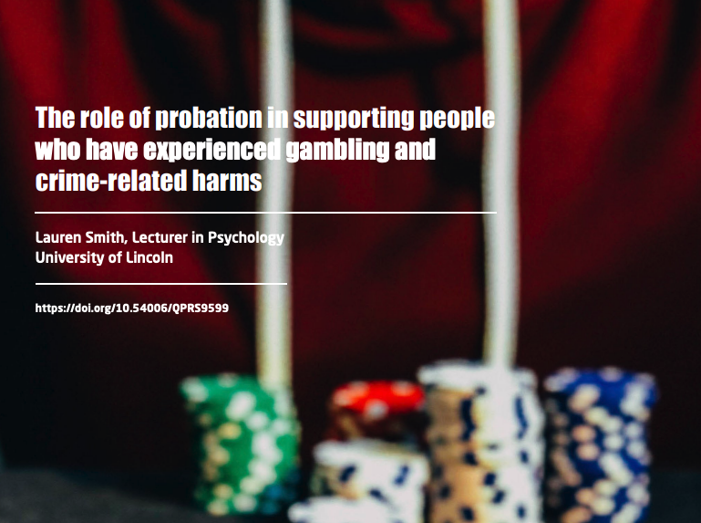
Thank you
Laurensmith@lincoln.ac.uk
https://static1.squarespace.com/static/5ec3ce97a1716758c54691b7/t/6392f6b3d8ea806a80cba27f/1670575823823/PQ26.pdf.

