Slide 1
Exploring gambling and its role within prison culture: “You can be flying high, then fighting”
Dr Sarah Lewis
Sarah@penalreformsolutions.com

Slide 2


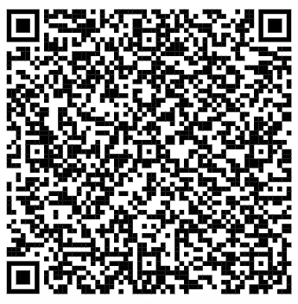
Introductions

Slide 3
Exploring people's experience of gambling in prison
The aims of the research are:
To understand how gambling is conceptualised in prison by prisoners and staff.
To understand how gambling is experienced within the cultural context of a prison by prisoners and staff.
To understand the role of gambling in prison.
To understand the impact of gambling in prison on prisoners, staff and affected others and the support needed to address associated harm.
To assess how aware staff and prisoners are of the role gambling plays within prison culture and its impact on the rehabilitative environment.

Slide 4
Summary of Sample
PRS interviewed 24 members of staff and carried out 10 in depth interviews with members of the community, who have lived prison experience.
The Families team within prison supported 17 questionnaires for friends and families of those currently residing in the prison.
Peer researchers conducted 90 assisted questionnaires with residents.

Slide 5
Three key parts
Awareness and Experience
Role
Impact (including rehabilitation)

Slide 6
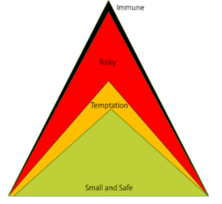
Awareness and Experience
Currency
Gambling is culturally normal
Visibility –it depends where you are
  Gambling- The best kept secret
  Turn a blind eye -Wilful Blindness
  No one Cares
  Subcultures – it depends who you are
Small and ‘safe’ gambling
A transition through temptation
‘Risky’ Business
‘Immune’ Gambling

Slide 7
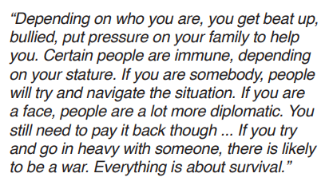
The role of gambling in prison
The need to feel
  Stimulation
  Meaning
Engineering freedom
Survival
Meaning relationships
Validation

Slide 8

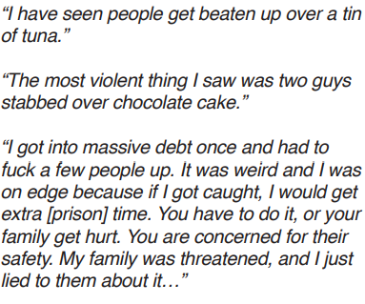
Impact of Gambling (including rehabilitation)
Community
Harm and Vulnerability
Loss
  Ruptures
  Powerlessness
Mental Harm
Growth

Slide 9
Recommendations
Co-production research around culture with collaborative review
Awareness and training
Focusing on relationships
Greater awareness of the issues
Signposting for families
A response
Harm reduction
Person-centred education
Invest in Culture

Slide 10
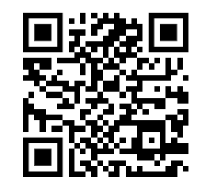
Contact us!
Penal Reform Solutions- Linked In, Instagram, Facebook and Twitter
Grow Transform Belong CIC- the same!
Twitter: Sarah_lewis30
Linkedin-
Sarah@penalreformsolutions.com

