Slide 1
Exploring the impact of slot game adverts on gambling behaviour
June 2023
Lauren Leak-Smith

Slide 2
Outline
About our Gambling Policy & Research Unit
Part 1: Content analysis of 100 slot game adverts to identify common features [complete]
  Methodology
  Key findings
Part 2: Online RCT to measure the impact of features on behaviour [ongoing]
  Methodology

Slide 3
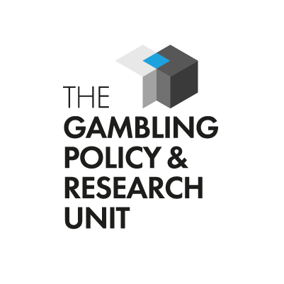
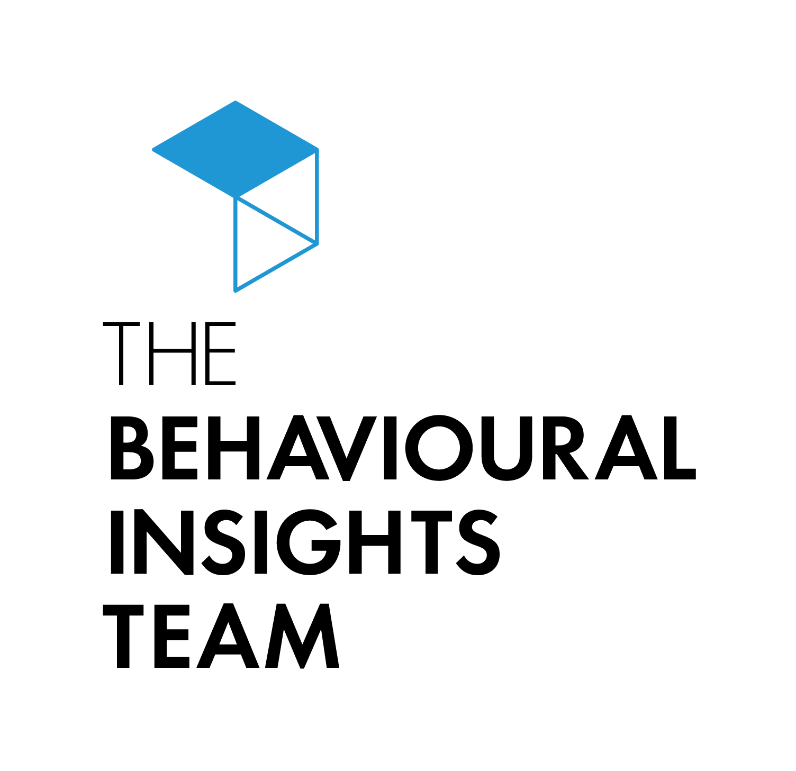
Founded in 2021, BIT’s Gambling Policy and Research Unit aims to discover, test and scale ways to minimise gambling harm.
We generate and apply behavioural insights to inform policy, improve public services and deliver results for citizens and society.
Strong commitment to and experience with causal evaluation through methods like randomised controlled trials - to develop evidence and identify “what works”.
Mission: Discover, test and scale ways to minimise gambling harm.
Ambition:
Hundreds of thousands of fewer people harmed by gambling through universally implemented evidence-based tools, policy, and other interactions.
Database of ‘what works’ that can be replicated and iterated globally.
Britain at the forefront of regulatory excellence when it comes to gambling harm prevention globally.
Funding: through regulatory settlements from the gambling commission for 4 years.
3

Slide 4
Exploring the role of adverts in gambling harms
Overview of our 3-part study

Slide 5
We’re running a 3-part study to determine the impact of advert features on harm.
The existing evidence suggests that advertising encourages gambling, and that exposure may lead to more frequent and riskier gambling.¹ But, there is limited quality evidence for:
The relationship between advertising and harmful gambling.
Exactly what features of adverts may or may not be contributing to gambling harm.
1 Hanss, D., Mentzoni, R. A., Griffiths, M. D., & Pallesen, S. (2015). The impact of gambling advertising: Problem gamblers report stronger impacts on involvement, knowledge, and awareness than recreational gamblers. Psychology of addictive behaviors, 29(2), 483.; Newall, P. W., Moodie, C., Reith, G., Stead, M., Critchlow, N., Morgan, A., & Dobbie, F. (2019). Gambling marketing from 2014 to 2018: A literature review. Current Addiction Reports, 6(2), 49-56.; Bouguettaya, A., Lynott, D., Carter, A., Zerhouni, O., Meyer, S., Ladegaard, I., ... & O’Brien, K. S. (2020). The relationship between gambling advertising and gambling attitudes, intentions and behaviours: a critical and meta-analytic review. Current Opinion in Behavioral Sciences, 31, 89-101.; Ipsos MORI. (2020). Final Synthesis Report: The impact of gambling marketing and advertising on children, young people and vulnerable adults. Gambling Commission. (2021). Understanding how consumers engaged with gambling advertising in 2020. BIT. (2022). Comprehension of gambling odds. McGrane, E., Wardle, H., Clowes, M., Blank, L., Pryce, R., Field, M., Sharpe, C., &#38; Goyder, E. (2023). What is the evidence that advertising policies could have an impact on gambling-related harms? A systematic umbrella review of the literature. Public Health, forthcoming.

Slide 6
We’re running a 3-part study to determine the impact of advert features on harm.
The existing evidence suggests that advertising encourages gambling, and that exposure may lead to more frequent and riskier gambling.¹ But, there is limited quality evidence for:
The relationship between advertising and harmful gambling.
Exactly what features of adverts may or may not be contributing to gambling harm.
Our three-part study aims to address this evidence gap:
Part 1 (published) Content analysis to identify advert features. | Part 2 (in progress) Online RCT to measure the impact of these features on gambling behaviour. | Part 3 (planned) Online RCT to further test the impact of features, or resolve issues identified in part 2.
1 Hanss, D., Mentzoni, R. A., Griffiths, M. D., & Pallesen, S. (2015). The impact of gambling advertising: Problem gamblers report stronger impacts on involvement, knowledge, and awareness than recreational gamblers. Psychology of addictive behaviors, 29(2), 483.; Newall, P. W., Moodie, C., Reith, G., Stead, M., Critchlow, N., Morgan, A., & Dobbie, F. (2019). Gambling marketing from 2014 to 2018: A literature review. Current Addiction Reports, 6(2), 49-56.; Bouguettaya, A., Lynott, D., Carter, A., Zerhouni, O., Meyer, S., Ladegaard, I., ... & O’Brien, K. S. (2020). The relationship between gambling advertising and gambling attitudes, intentions and behaviours: a critical and meta-analytic review. Current Opinion in Behavioral Sciences, 31, 89-101.; Ipsos MORI. (2020). Final Synthesis Report: The impact of gambling marketing and advertising on children, young people and vulnerable adults. Gambling Commission. (2021). Understanding how consumers engaged with gambling advertising in 2020. BIT. (2022). Comprehension of gambling odds. McGrane, E., Wardle, H., Clowes, M., Blank, L., Pryce, R., Field, M., Sharpe, C., &#38; Goyder, E. (2023). What is the evidence that advertising policies could have an impact on gambling-related harms? A systematic umbrella review of the literature. Public Health, forthcoming.

Slide 7
Content analysis of 100 slot game adverts to identify common features
Part 1

Slide 8
Part 1 of the study – a content analysis – aimed to understand what advert features are used by slot game operators.
Research questions
What are the features of online slot game adverts in the UK and how are they used?
What incentives do online slot game adverts in the UK adopt?
How are terms and conditions (T&Cs) presented in online slot game adverts?
Are any features within online slot game adverts used in a way that could cause harm?
Image from: https://www.figma.com/community/file/1013016345365359930/Facebook-Advert-Post-Template

Slide 9
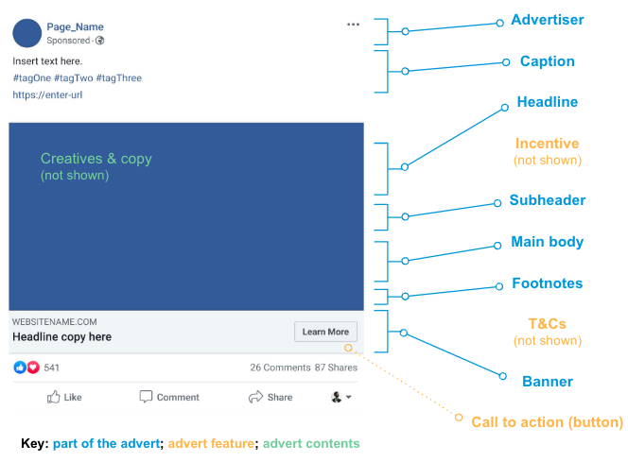
Part 1 of the study – a content analysis – aimed to understand what advert features are used by slot game operators.
Research questions
What we measured
What are the features of online slot game adverts in the UK and how are they used?
What incentives do online slot game adverts in the UK adopt?
How are terms and conditions (T&Cs) presented in online slot game adverts?
Are any features within online slot game adverts used in a way that could cause harm?
Image from: https://www.figma.com/community/file/1013016345365359930/Facebook-Advert-Post-Template

Slide 10
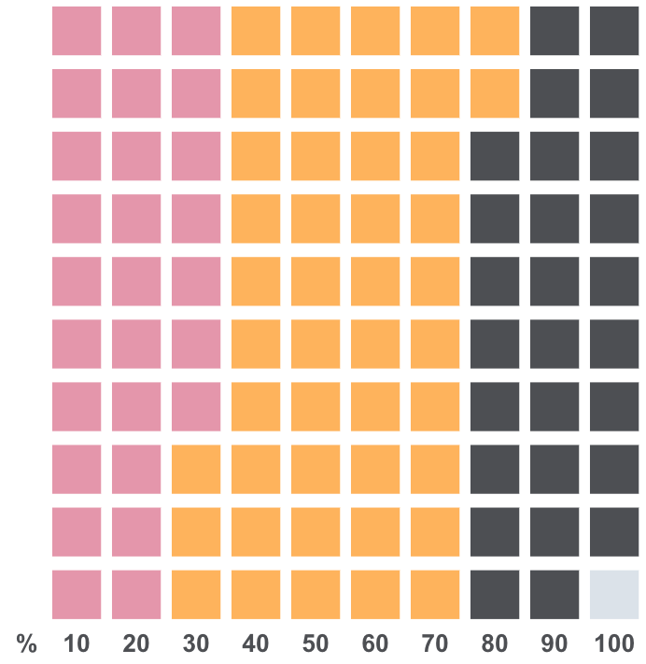
Our sampling strategy was based on an estimation of advert content, channel, and the feasibility of accessing the data.
Our sampling criteria was informed by three factors:
What our sample looked like:
Over 1 in 4 (27%) of our advert sample were animated – included video graphics/text. The rest were static.
Most (72%) of our sample were adverts posted in September. We reviewed adverts shown between March and September 2022
The majority (99%) were sponsored adverts, meaning the advertiser has paid to show the advert to a specific audience.
Estimation of what gambling products are advertised most frequently.¹
Estimating which advertising channels operators use most.²
Feasibility of accessing and collecting data.
Key: 1% = 1 block = 1 Ad
¹ The Gambling Commission. (2022). Gambling Industry Statistics. ² The Gambling Commission. (2021). Understanding how consumers engaged with gambling advertising in 2020; Gainsbury, S. M., King, D. L., Russell, A. M., Delfabbro, P., Derevensky, J., & Hing, N. (2016). Exposure to and engagement with gambling marketing in social media: Reported impacts on moderate-risk and problem gamblers. Psychology of Addictive Behaviors, 30(2), 270.

Slide 11
Our final sample of 100 slot game adverts were predominantly sponsored, static and posted in September.
Our sampling criteria was informed by three factors:
What our sample looked like:
Over 1 in 4 (27%) of our advert sample were animated – included video graphics/text. The rest were static.
Most (72%) of our sample were adverts posted in September. We reviewed adverts shown between March and September 2022
The majority (99%) were sponsored adverts, meaning the advertiser has paid to show the advert to a specific audience.
Estimation of what gambling products are advertised most frequently.¹
Estimating which advertising channels operators use most.²
Feasibility of accessing and collecting data.
Key: 1% = 1 block = 1 Ad
¹ The Gambling Commission. (2022). Gambling Industry Statistics. ² The Gambling Commission. (2021). Understanding how consumers engaged with gambling advertising in 2020; Gainsbury, S. M., King, D. L., Russell, A. M., Delfabbro, P., Derevensky, J., & Hing, N. (2016). Exposure to and engagement with gambling marketing in social media: Reported impacts on moderate-risk and problem gamblers. Psychology of Addictive Behaviors, 30(2), 270.

Slide 12
Our final sample of 100 slot game adverts were predominantly sponsored, static and posted in September.
Our sampling criteria was informed by three factors:
What our sample looked like:
Over 1 in 4 (27%) of our advert sample were animated – included video graphics/text. The rest were static.
Most (72%) of our sample were adverts posted in September. We reviewed adverts shown between March and September 2022
The majority (99%) were sponsored adverts, meaning the advertiser has paid to show the advert to a specific audience.
Estimation of what gambling products are advertised most frequently.¹
Estimating which advertising channels operators use most.²
Feasibility of accessing and collecting data.
Key: 1% = 1 block = 1 Ad
¹ The Gambling Commission. (2022). Gambling Industry Statistics. ² The Gambling Commission. (2021). Understanding how consumers engaged with gambling advertising in 2020; Gainsbury, S. M., King, D. L., Russell, A. M., Delfabbro, P., Derevensky, J., & Hing, N. (2016). Exposure to and engagement with gambling marketing in social media: Reported impacts on moderate-risk and problem gamblers. Psychology of Addictive Behaviors, 30(2), 270.

Slide 13
Our final sample of 100 slot game adverts were predominantly sponsored, static and posted in September.
Our sampling criteria was informed by three factors:
What our sample looked like:
Over 1 in 4 (27%) of our advert sample were animated – included video graphics/text. The rest were static.
Most (72%) of our sample were adverts posted in September. We reviewed adverts shown between March and September 2022
The majority (99%) were sponsored adverts, meaning the advertiser has paid to show the advert to a specific audience.
Estimation of what gambling products are advertised most frequently.¹
Estimating which advertising channels operators use most.²
Feasibility of accessing and collecting data.
Key: 1% = 1 block = 1 Ad
¹ The Gambling Commission. (2022). Gambling Industry Statistics. ² The Gambling Commission. (2021). Understanding how consumers engaged with gambling advertising in 2020; Gainsbury, S. M., King, D. L., Russell, A. M., Delfabbro, P., Derevensky, J., & Hing, N. (2016). Exposure to and engagement with gambling marketing in social media: Reported impacts on moderate-risk and problem gamblers. Psychology of Addictive Behaviors, 30(2), 270.

Slide 14




Our content analysis comprised of a four-step methodology, to identify patterns in advert features.
Data collection, cleaning, and random sampling
(n = 100)
Codebook development
Data coding
Analysis

Slide 15
Our content analysis comprised of a four-step methodology, to identify patterns in advert features.
Data collection, cleaning, and random sampling
(n = 100)
Codebook development
Data coding
Analysis

Slide 16
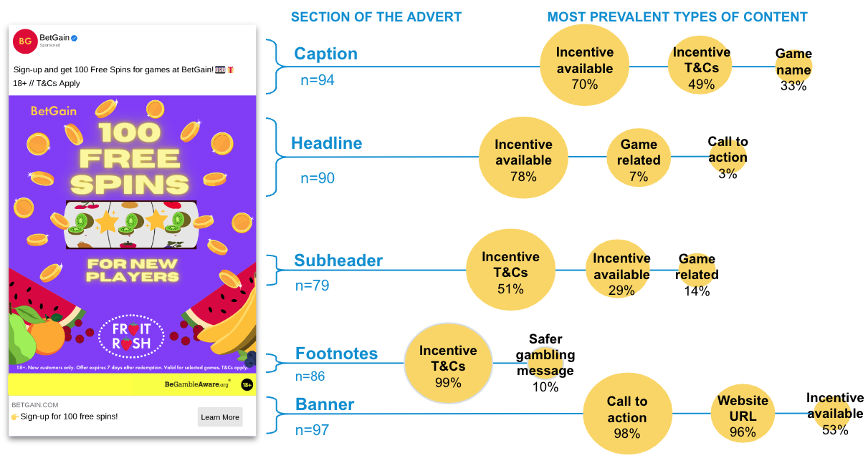
We found when a typical advert is broken down into its parts, the most prevalent type of content throughout relates to the incentive.
Source: N=100 Meta ads collected by BIT between August-September 2022.

Slide 17


Next, we applied a behavioural lens to determine which of the advert features could be potentially harmful.
We identified features which are currently permitted under existing regulation, which we predict to have greater potential to cause harm than other features, by
a) misleading, and/or
b) encouraging harmful gambling.
Our predictions were informed by an assessment as to whether advert features leveraged behavioural biases¹.
¹ Systematic errors in decision making resulting from memory, attention (cognitive biases) and/or reasoning based on feelings (emotional biases).

Slide 18
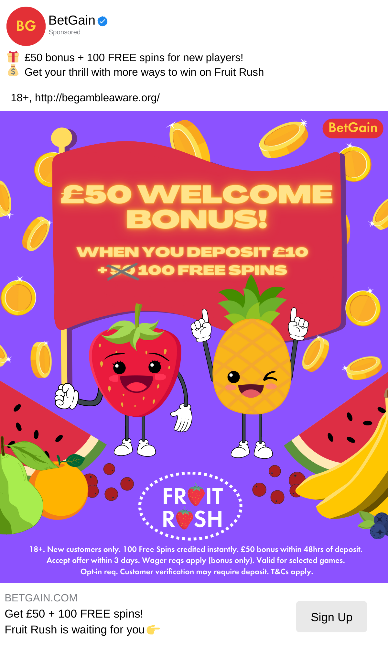
Our behavioural analysis identified 3 themes of risky features.
Theme 1: Important information was sometimes listed in parts of the advert that were easy to overlook.
Risky features
Wagering requirements were only listed in footnotes
T&Cs that do not apply are more salient than those that do
Behavioural biases leveraged
Salience

Slide 19
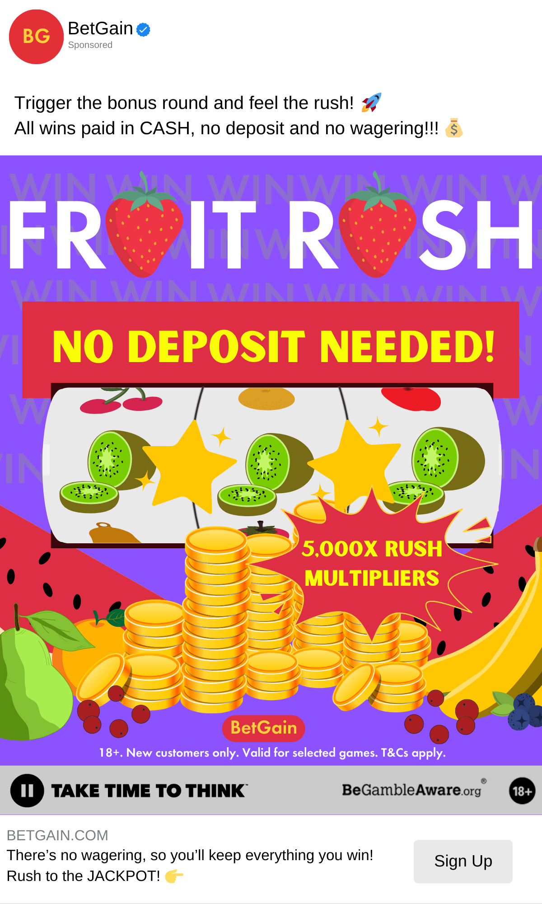
Our behavioural analysis identified 3 themes of risky features.
Theme 1: Important information was sometimes listed in parts of the advert that were easy to overlook.
Risky features
Wagering requirements were only listed in footnotes
T&Cs that do not apply are more salient than those that do
Behavioural biases leveraged
Salience
Framing
Risk aversion

Slide 20
Our behavioural analysis identified 3 themes of risky features.
Theme 2: The nature and risks associated with the slot game is not always made clear.
Risky features
No explicit references to gambling
No odds information
Behavioural biases leveraged
Risk aversion
Confirmation bias

Slide 21
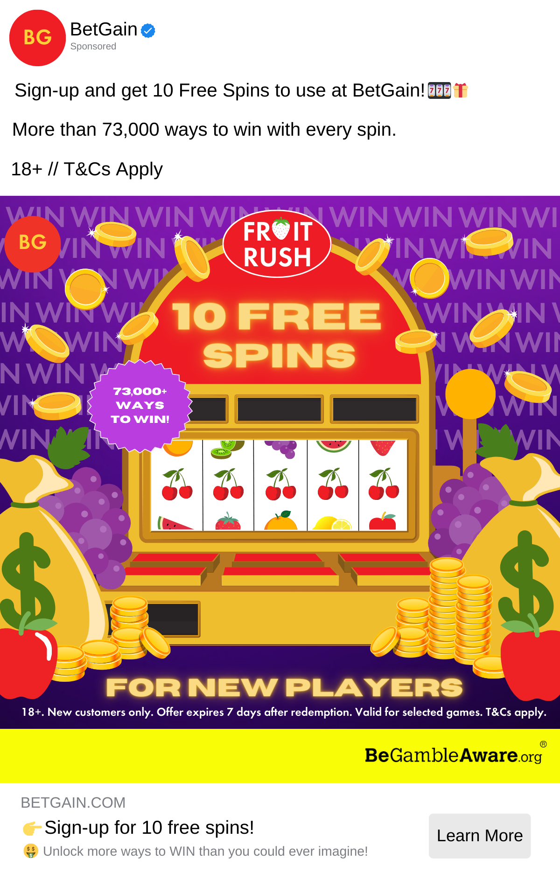
Our behavioural analysis identified 3 themes of risky features.
Theme 3: Other features may downplay the risk associated with the slot game.
Risky features
Specific reference to the number of ways individuals can win
Cash-back offers
Behavioural biases leveraged
Risk aversion
Confirmation bias

Slide 22
We’re now conducting an experiment with UK adults, to measure the impact of advert features
Part 2

Slide 23
We aim to measure the impact of adverts features on comprehension of the advertised product, as well as on gambling behaviour.
Primary
Do specific features affect comprehension of the advertised product, and how?
Do specific features affect attitudes towards the advertised slot game?
Do specific features affect gambling behaviour, and how?
Secondary
Do specific features have disproportionate effects (RQ1-3) on different subgroups?
  Age (18-34, 35-54, 55+)¹
  Risk of gambling harms (none or low, moderate or high)
Exploratory
Do specific advert features affect engagement and recall?
¹ Carcelén-García, S., Díaz-Bustamante Ventisca, M., & Galmes-Cerezo, M. (2023). Young People’s Perception of the Danger of Risky Online Activities: Behaviours, Emotions and Attitudes Associated with Their Digital Vulnerability. Social Sciences, 12(3), 164.

Slide 24
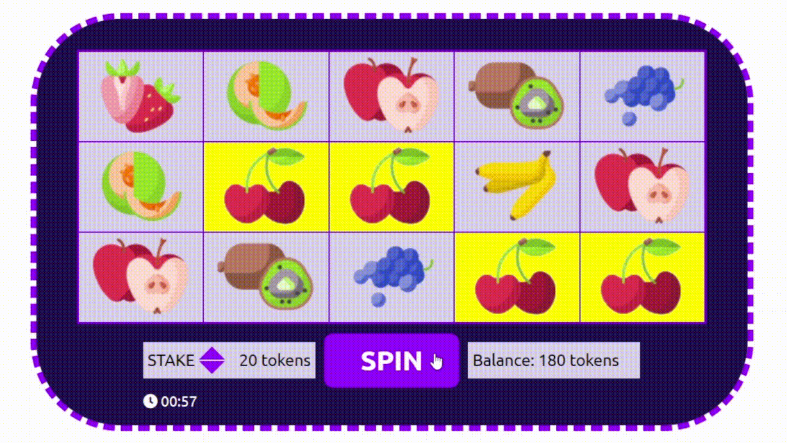
To measure gambling behaviour, participants were invited to play ‘Fruit Rush’, BIT’s inhouse slot game, using funds they earned from an endowment task.

Slide 25
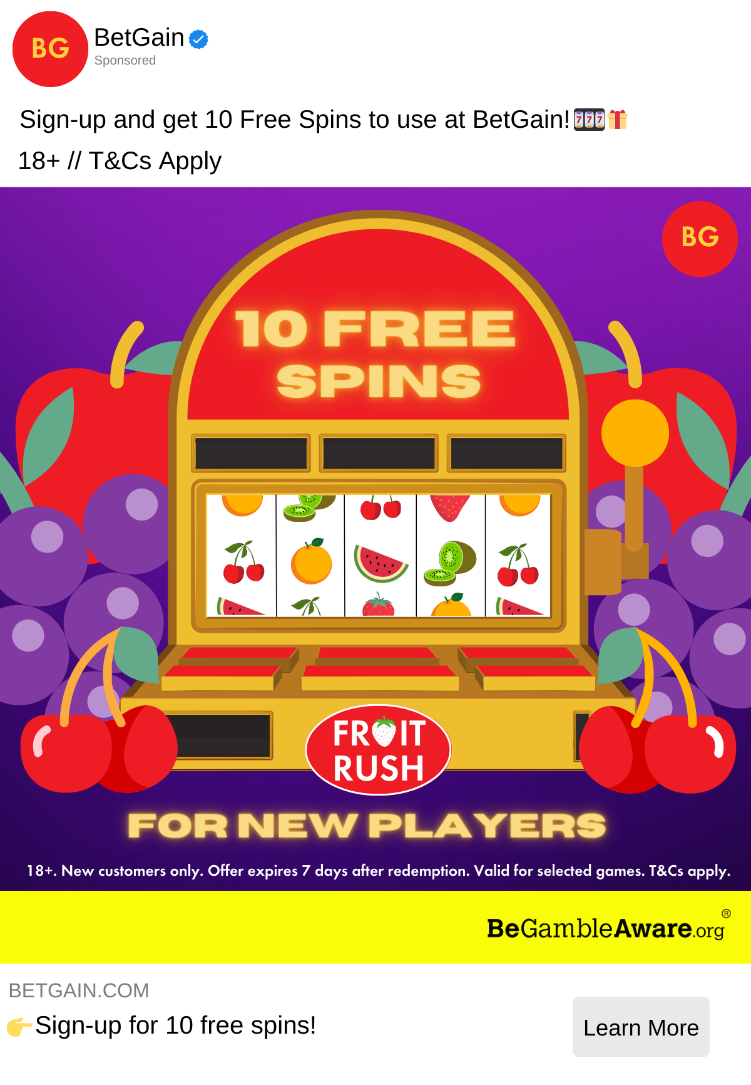
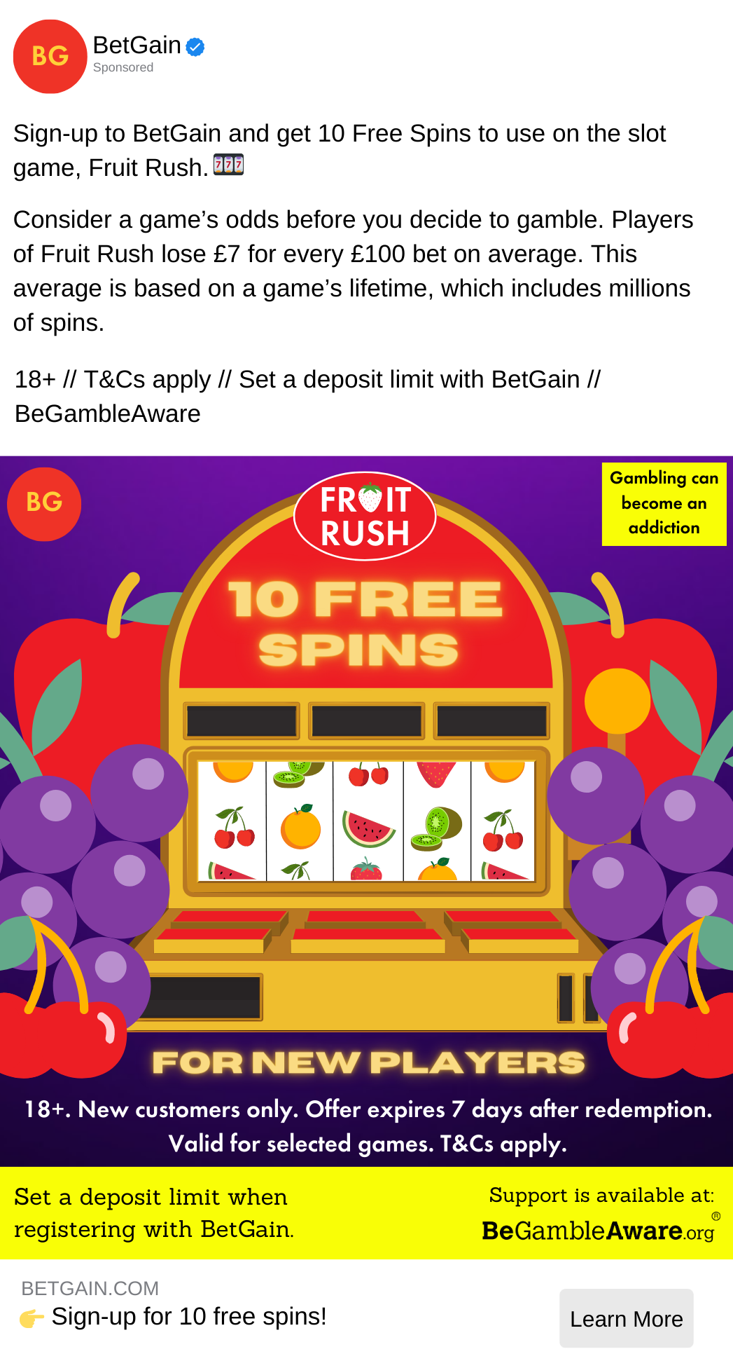
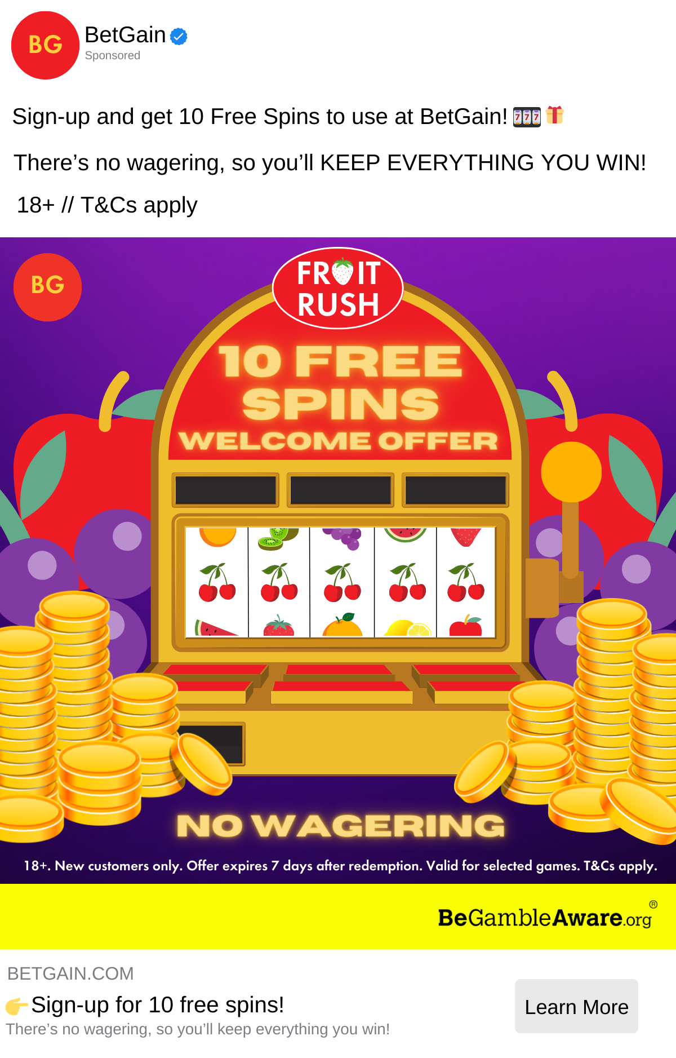
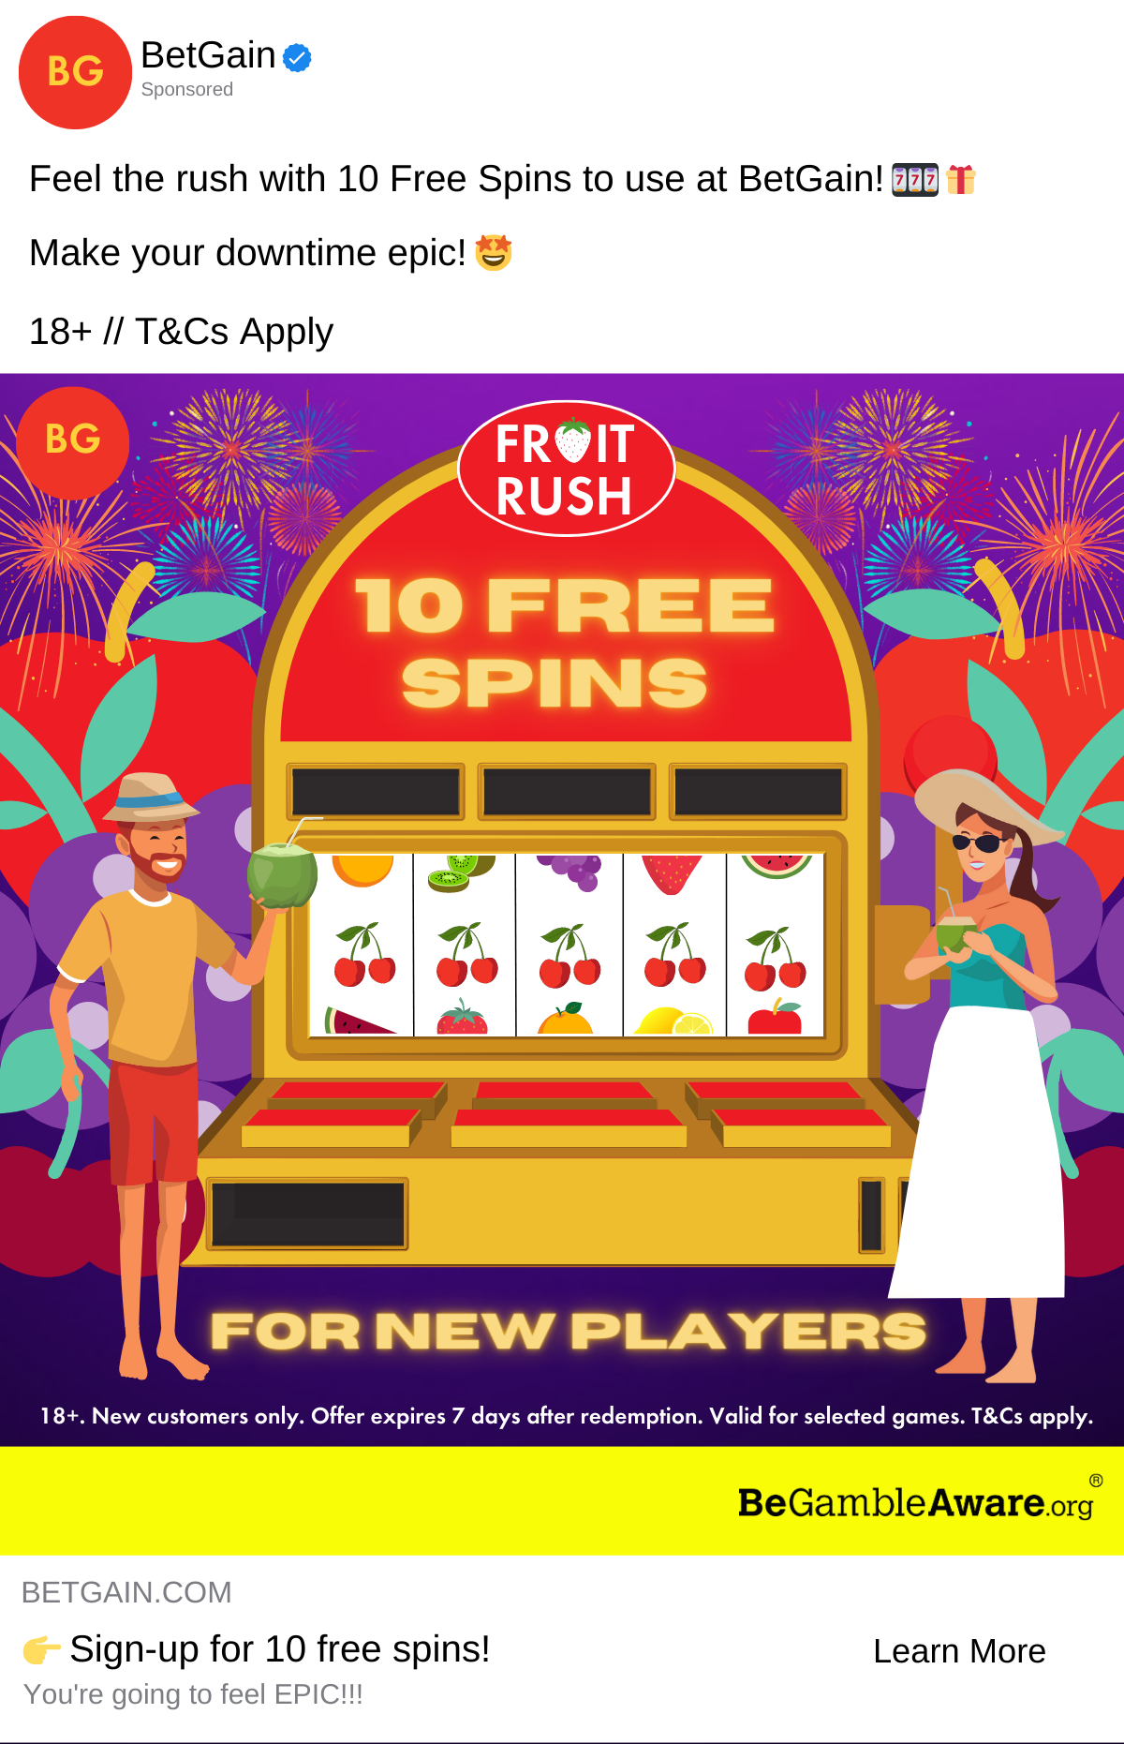
We have created 5 versions of a slot game advert to measure the impact of different features against a no advert condition.
No advert N = 500 | BAU (control) N = 1,000 | Good practice N = 1,000 | Low risk to potential reward N = 1,000 | Ease of winning N = 1,000 | Fun-framing N = 1,000

Slide 26
We have created 5 versions of a slot game advert to measure the impact of different features against a no advert condition.
No advert N = 500 | BAU (control) N = 1,000 | Good practice N = 1,000 | Low risk to potential reward N = 1,000 | Ease of winning N = 1,000 | Fun-framing N = 1,000

Slide 27
We have created 5 versions of a slot game advert to measure the impact of different features against a no advert condition.
No advert N = 500 | BAU (control) N = 1,000 | Good practice N = 1,000 | Low risk to potential reward N = 1,000 | Ease of winning N = 1,000 | Fun-framing N = 1,000

Slide 28
We have created 5 versions of a slot game advert to measure the impact of different features against a no advert condition.
No advert N = 500 | BAU (control) N = 1,000 | Good practice N = 1,000 | Low risk to potential reward N = 1,000 | Ease of winning N = 1,000 | Fun-framing N = 1,000

Slide 29
We have created 5 versions of a slot game advert to measure the impact of different features against a no advert condition.
No advert N = 500 | BAU (control) N = 1,000 | Good practice N = 1,000 | Low risk to potential reward N = 1,000 | Ease of winning N = 1,000 | Fun-framing N = 1,000

Slide 30
We have created 5 versions of a slot game advert to measure the impact of different features against a no advert condition.
No advert N = 500 | BAU (control) N = 1,000 | Good practice N = 1,000 | Low risk to potential reward N = 1,000 | Ease of winning N = 1,000 | Fun-framing N = 1,000

Slide 31
We plan to publish results in August 2023.

Slide 32
lauren.leak-smith@bi.team

