Slide 1
Initial development of a low-risk gambling guideline intervention for the United Kingdom
John Cunningham
Nat and Loretta Rothschild Chair
in Addictions Treatment and Recovery Studies
King’s College London

Slide 2
Disclosures
Funding sources:
  Nat and Loretta Rothschild Chair in Addictions Treatment and Recovery Studies
  NIHR Maudsley BRC
  GREO Evidence Insights - Academic Forum for the Study of Gambling (AFSG)

Slide 3
Initial Development
Interested in developing brief interventions
  Target audience people with risky gambling who are unlikely to show up in treatment
Designing intervention for UK setting
  Any possibility of normative comparison elements for the intervention?
    Some relevant population data available in the UK
  Canadian low-risk gambling guidelines
    Based on analyses of multiple countries
    Concrete recommendations

Slide 4
Canadian Low-risk guidelines
How much – no more than 1% of household income before tax per month
How often – gamble no more than 4 days per month
How many – avoid regularly gambling at more than 2 types of games.

Slide 5
UK data employed
Analyses of frequency and number of different types of gambling activities as relates to risk
  2016 Household Survey for England
  Replicated with 2018 HSE
  Risk defined as a score of 1 or more on the PGSI
Other normative feedback
  comparing number of different gambling activities to general population of same gender

Slide 6
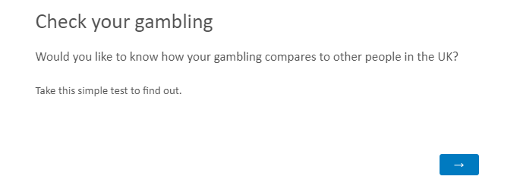

Slide 7
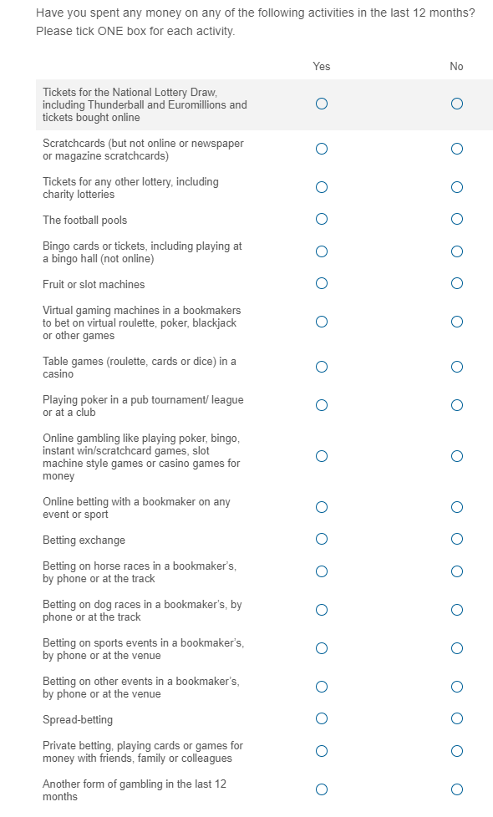
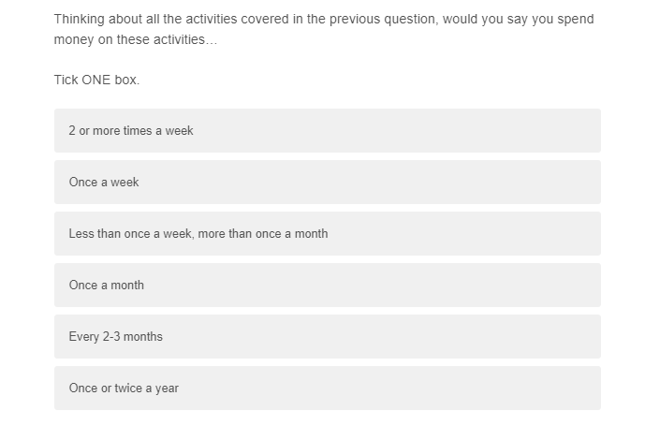
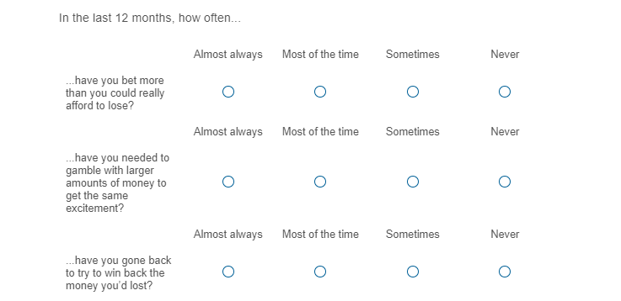

Slide 8
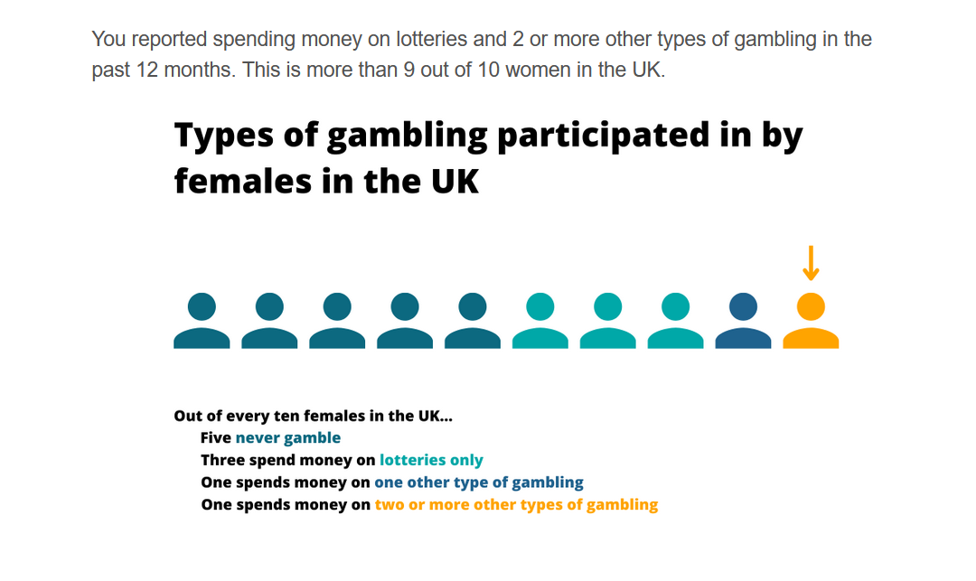

Slide 9
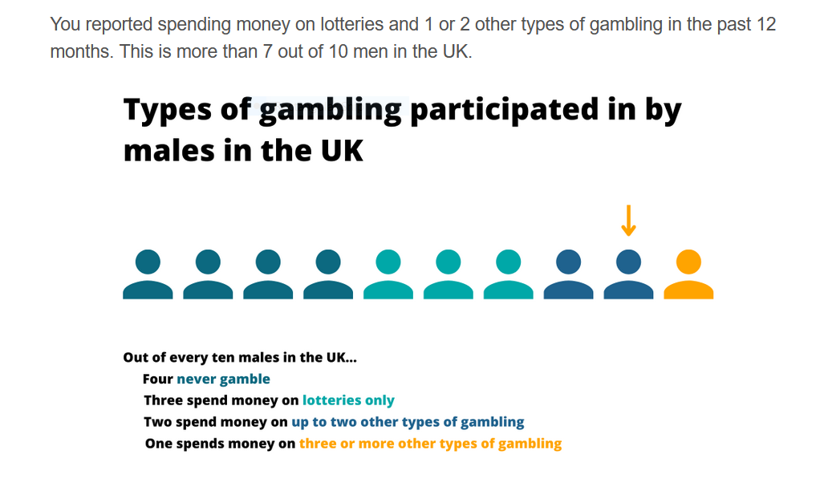

Slide 10
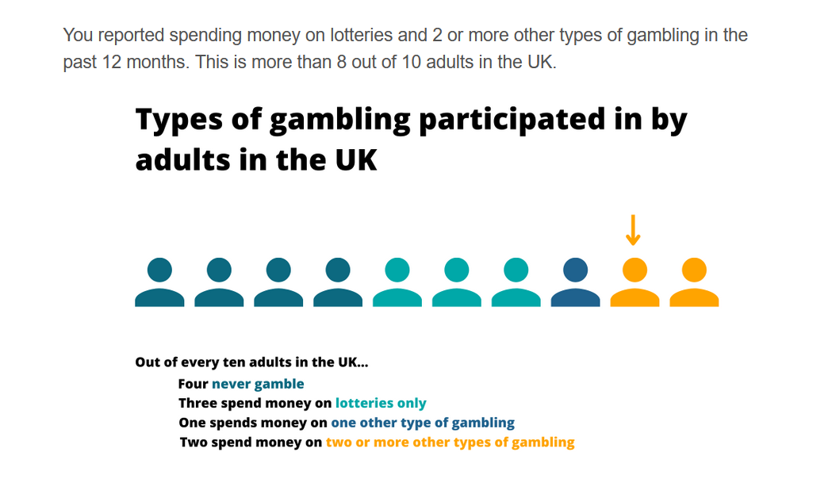

Slide 11
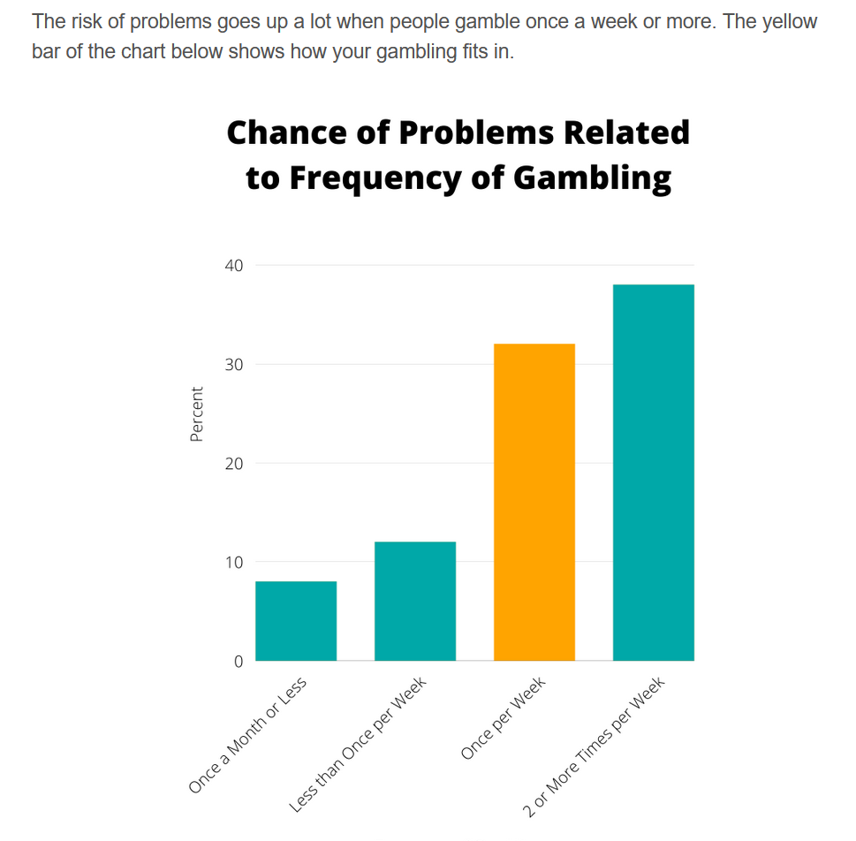

Slide 12
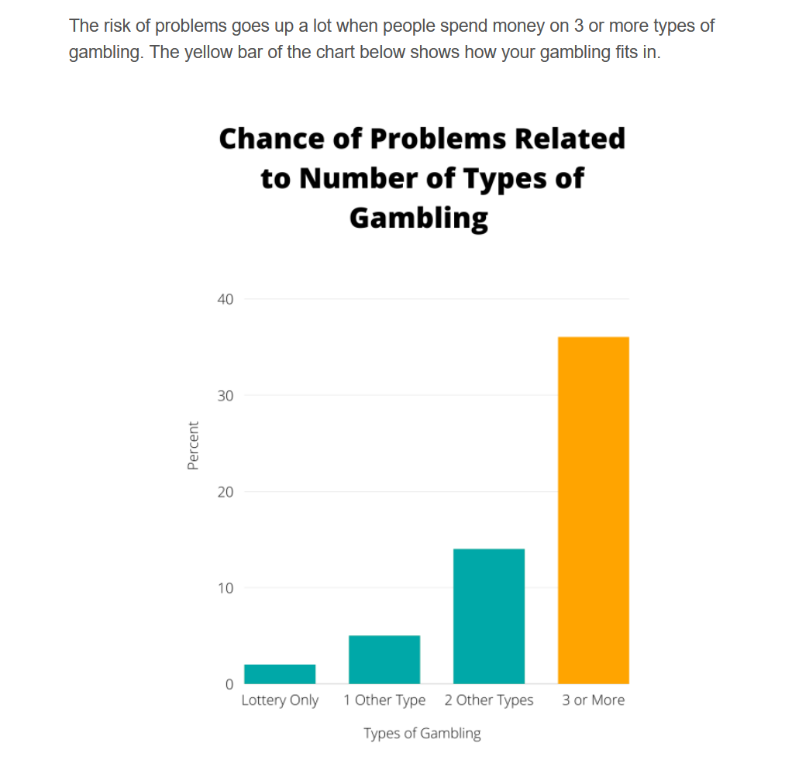

Slide 13
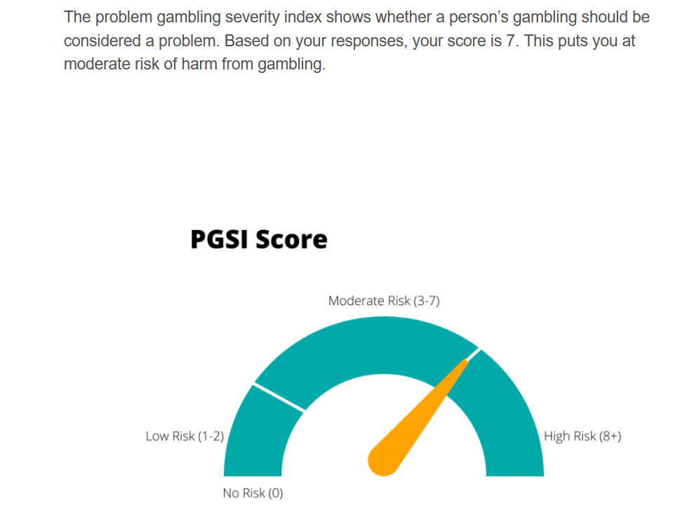

Slide 14
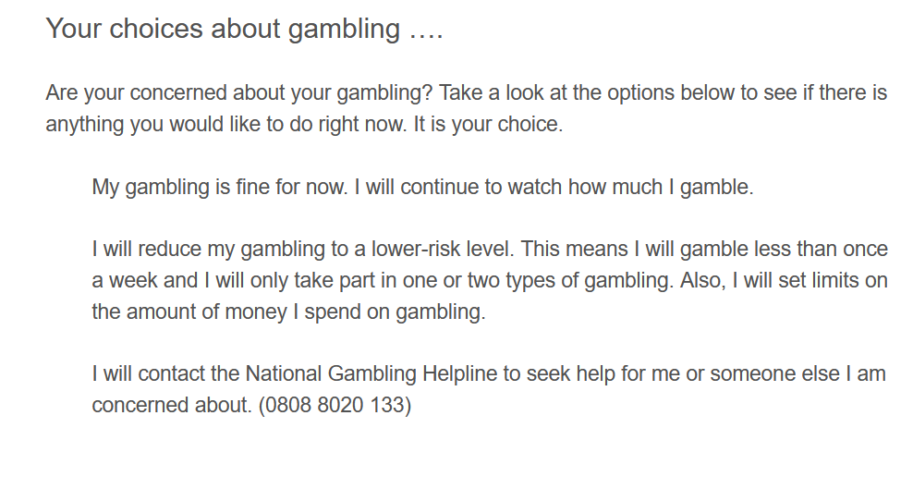

Slide 15
Next Steps
Thanks to GREO Evidence Insights - Academic Forum for the Study of Gambling (AFSG)
Continue development of online intervention
  Use online panel to identify 1,000 people with at-risk gambling
  Get their feedback on the content of the intervention
  Pilot RCT of 3-month impact of intervention on frequency of gambling and experience of harm

Slide 16
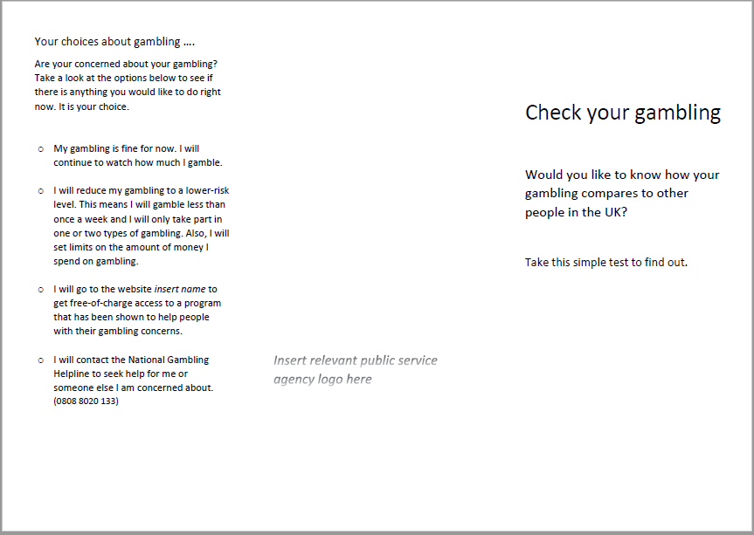
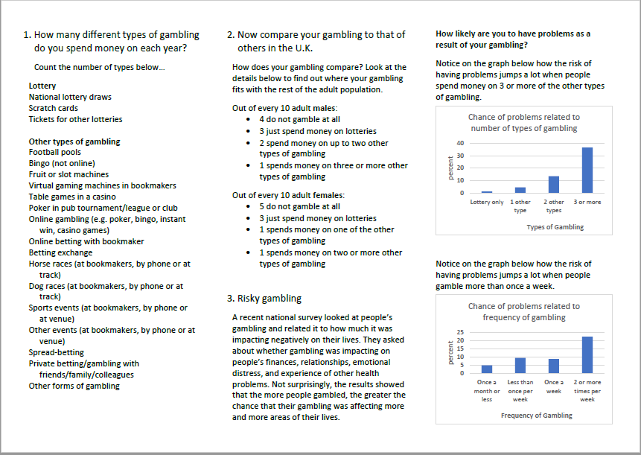

Slide 18
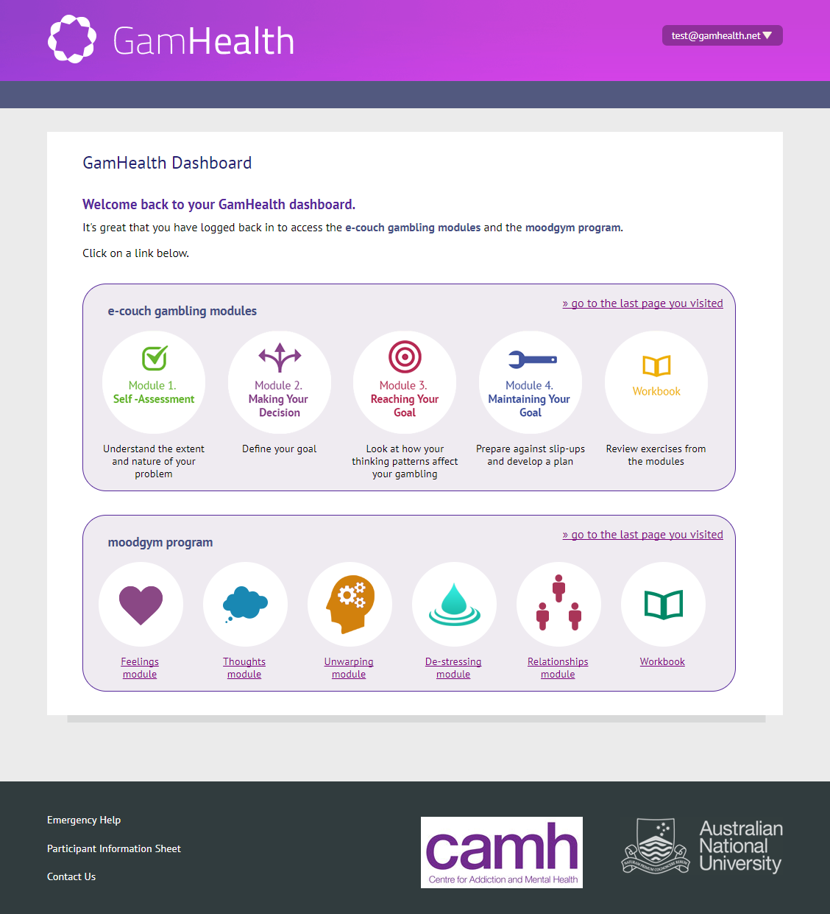

Slide 19
Questions?
Email: John.Cunningham@kcl.ac.uk

