Slide 1
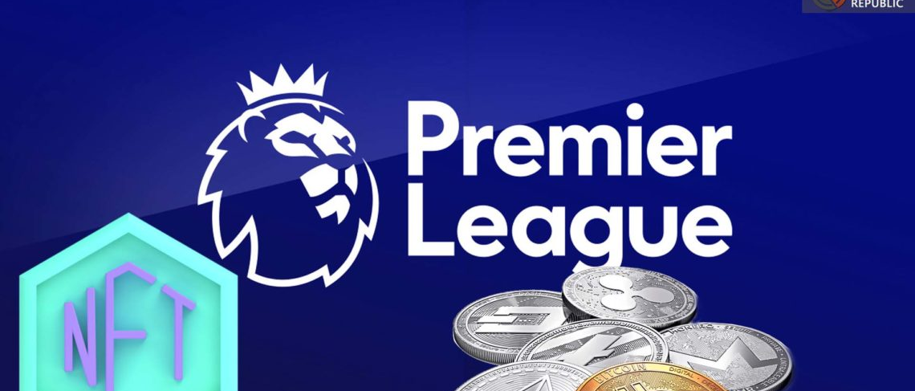
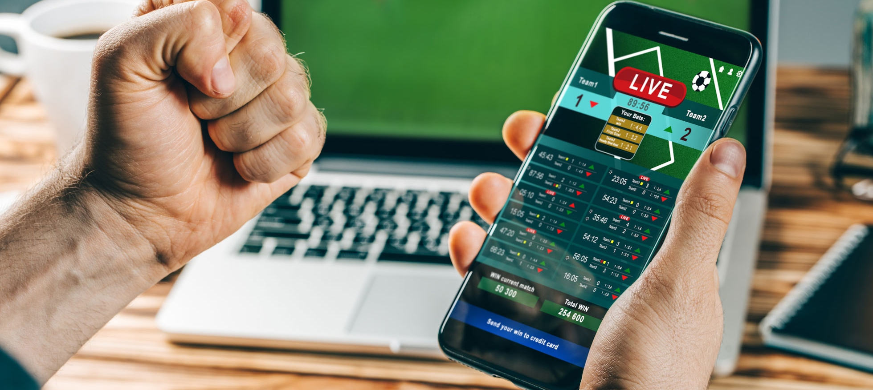



Gambling, Cryptocurrency, and Financial Trading Marketing in English Premier League Football: a Frequency Analysis of In-game Visual References
Jamie Torrance, Conor Heath, Maira Andrade, & Philip Newall

Slide 2
Declaration of Interest
This study was funded by an internal QR grant through the University of Chester.
None of the authors have any conflicts of interest to declare.

Slide 3
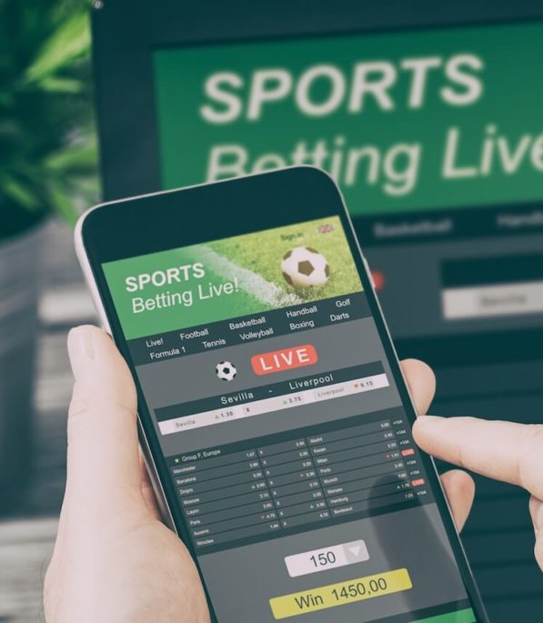
Introduction
Since the Gambling Act in 2005, gambling marketing has become ever-present in the United Kingdom (Davies, 2022, Newall et al., 2019; Torrance et al., 2021).
It is most noticeable in football, with viewers comprising of both adults and children (Goulding, 2022; Roderique-Davies et al., 2020; Sharman, 2022).
There is a positive association between gambling marketing exposure, intentions to gamble, and gambling participation (Bouguettaya et al., 2020; Syvertsen et al., 2022).
With such marketing and the ‘gamblification’ of English Premier League (EPL) football becoming a public health concern (McGee, 2020; van Schalkwyk et al., 2021).
This Photo by Unknown Author is licensed under CC BY-ND

Slide 4
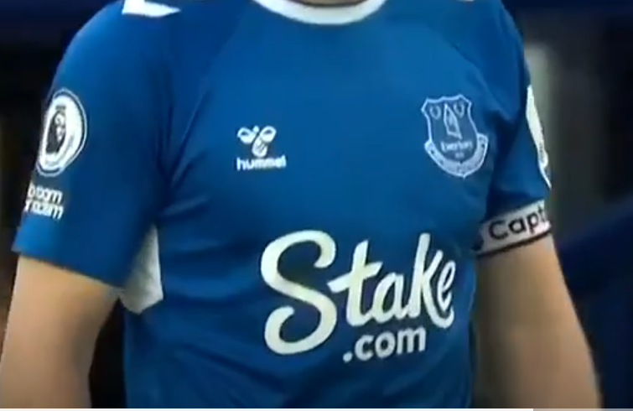
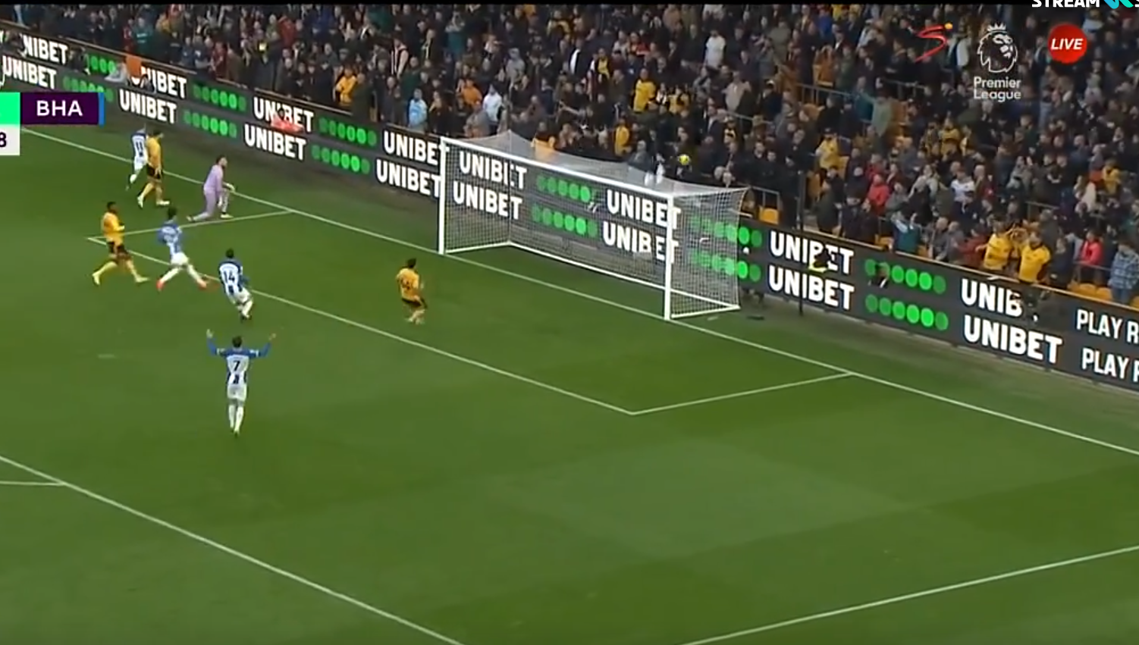
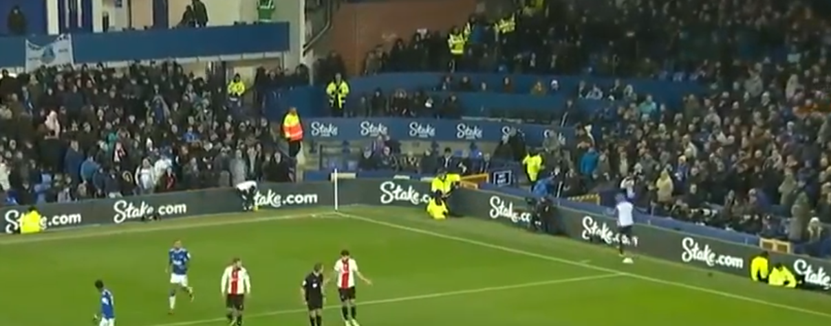
Marketing Locations in the EPL
EPL games are saturated with marketing via:
  Front of shirt/sleeve
The EPL recently volunteered to ban front of shirt gambling sponsorship (by 2026), but there is no additional plan for other areas such as shirt sleeves, around the pitch, or stadium structure.
The Department for Culture Media and Sport (DCMS) have announced no additional measures (DCMS, 2023).
Additionally, from the increased gamblification of football, the marketing of gambling-like products such as cryptocurrency and financial trading are becoming increasingly visible.
Dynamic pitch-side hoardings
The stadium structure

Slide 5
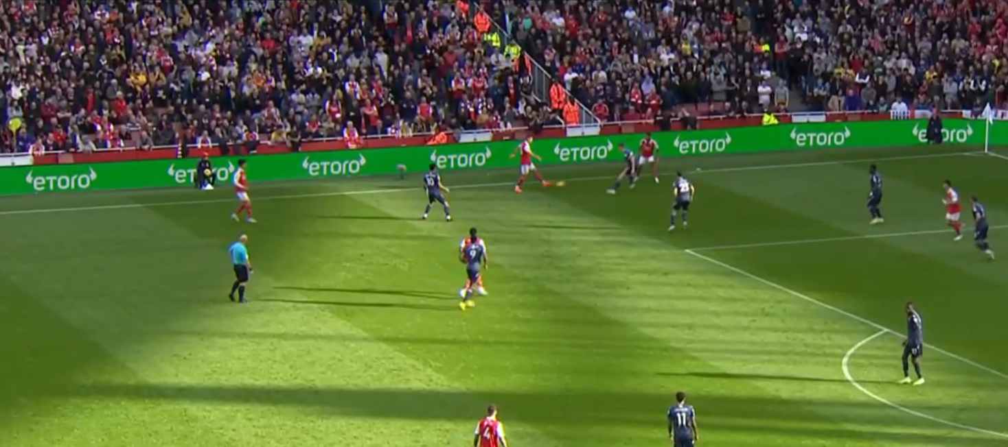
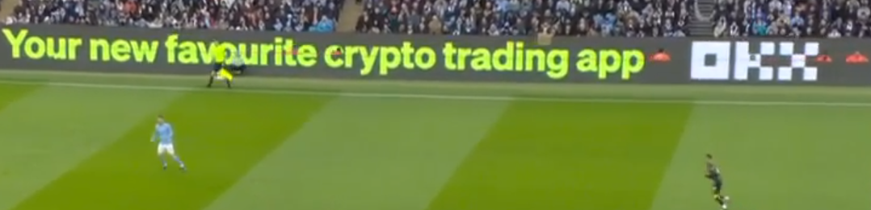
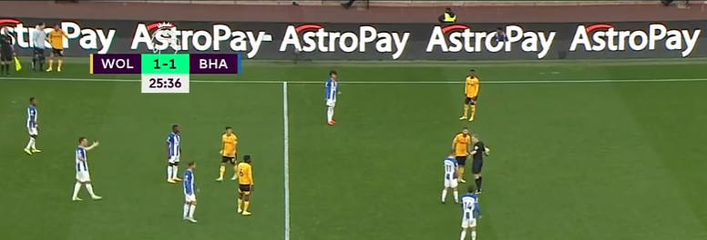
Gambling-Like Products
Cryptocurrencies are decentralized digital assets and operate as mediums of exchange that are known for their volatility (Conrad et al., 2018).
Financial Trading (FT) involves the buying and selling of financial assets such as stocks, bonds, or foreign currencies with the aim of making a profit. Some also allow the trading of cryptocurrencies.
Both cryptocurrency and FT are positively correlated with problem gambling and negative impacts on mental health (Delfabbro et al., 2021; Grégoire et al., 2023; Johnson et al., 2023; Mosenhauer et al., 2021; Oksanen et al., 2022).
Bettors can also use cryptocurrencies to make wagers on some gambling sites, otherwise known as cryptocasinos (Andrade & Newall, 2023).
Therefore, the marketing of FT and cryptocurrency within football should be of equal concern compared to gambling (Guglielmo et al., 2016; Newall & Xiao, 2021).

Slide 6
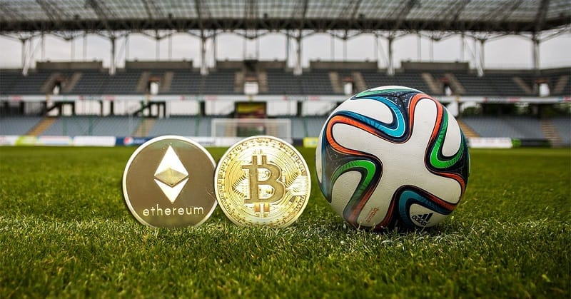

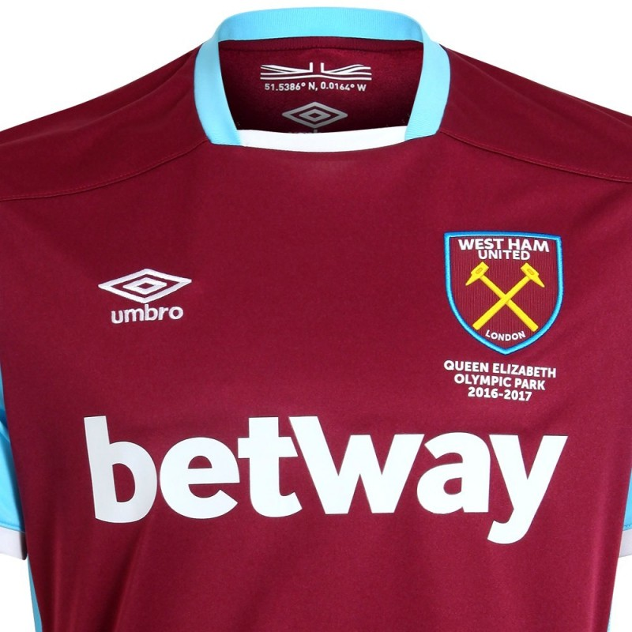
Study Aims
Previous research on the promotion of harmful products in UK sports indicated that approximately 81% came from gambling brands and can occur 2.7 times per broadcast minute (Cassidy & Ovenden, 2017; Ireland, 2021; Purves et al., 2020)
To date, no empirical research into the topic of gambling, cryptocurrency and FT (collectively) in sports has been conducted.
This study aimed to examine:
  The total number of gambling, cryptocurrency, and financial trading visual references in English Premier League football.
  The proportional number of these references excluding front of shirt gambling sponsorship to assess the practical utility of the voluntary measure made by the EPL.

Slide 7
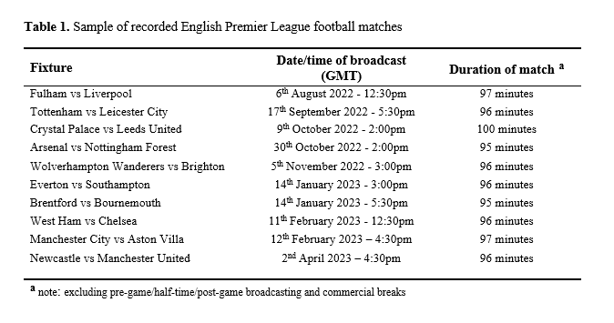
Method
Design
  A frequency analysis of visual in-play references to gambling, cryptocurrency and FT in the EPL.
Broadcasts
  Ten EPL matches from the 2022/2023 season (Table 1).
  From kick-off to the final whistle.
Procedure and Codebook
  Any visual marketing or sponsorship reference in-play (> one second).
  References were counted each time they appeared on-screen.

Slide 8
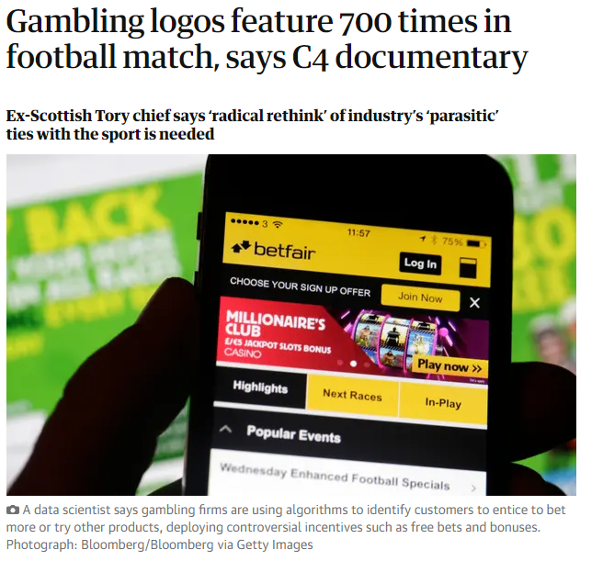
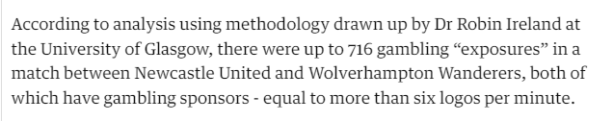
Method
  Previous studies did not count individual logos.
  When multiple identical logos were visible in the same location, they were all counted as one ‘exposure’ or ‘shot’ of gambling marketing.
  In the present study, we also counted the number of shots, but we advanced the methodology by also counting individual logos.

Slide 9
Method
Data Analysis
  Each broadcast had its own dataset, which was later merged.
  Percentages, means and frequencies for each variable.
  Average of individual logos per broadcast minute across the 10 matches.
  Total shirt-front gambling references subtracted from total of all other relevant references.
Variables
Fixture
Shot (instance) number
Product referenced
Location
Format
Logos per shot
Duration of reference
Brand references
Brand name or logo referenced
Harm reduction or age warning

Slide 10
Results
Across the 10 EPL matches:
Gambling, Cryptocurrency and FT references combined:
There were 3,023 visible shots. Which included 20,941 relevant logos.
A total of 1,073 front-of-shirt gambling logos. 7% of all gambling logos and 5% of all relevant logos.
22 logos per minute (one every 2.72 secs)
Pitch-side hoardings (52%)
Full-coverage dynamic displays (49%)
30 different brands
betway (24%)

Slide 11
Results
Gambling
There were 2,336 shots, with 15,652 gambling logos (271 associated with cryptocurrency).
4% contained harm-reduction content.
Cryptocurrency
There were 673 shots, with 4,353 cryptocurrency logos (3,750 were associated with FT).
0% contained harm-reduction content.
Financial Trading
There were 623 shots, with 4,946 financial trading logos.
16 logos per minute (one every 3.75 secs)
5 logos per minute (one every 12 secs)
5 logos per minute (one every 12 secs)
Pitch-side hoardings (51%)
Pitch-side hoardings (53%)
Pitch-side hoardings (59%)
Full coverage dynamic displays (48%)
Full coverage dynamic displays (44%)
Full coverage dynamic displays (51%)
0% contained harm-reduction content.

Slide 12
Discussion
This was the first study to examine gambling, cryptocurrency, and FT in EPL broadcasts.
Results indicated that gambling marketing appeared the most and was highly prevalent.
Although to a lesser degree, cryptocurrency and FT marketing also has a noticeable presence in EPL broadcasts.
Gambling front of shirt sponsorship only accounted for 5% of relevant logos and pitch-side hoardings were the most common.
Which means, 95% of all other relevant logos do not fall under that ban.
Exclusively imposing bans upon gambling marketing may create perceived legitimacy and space for cryptocurrency and FT marketing (Newall & Xiao, 2021).
EPL voluntary ban
Limitations
Only 10/380 matches.
Sponsorships often change.

Slide 13
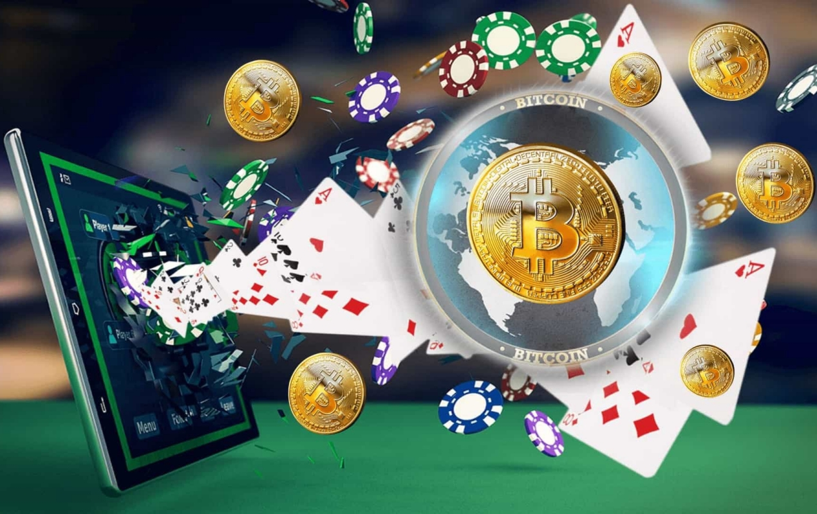
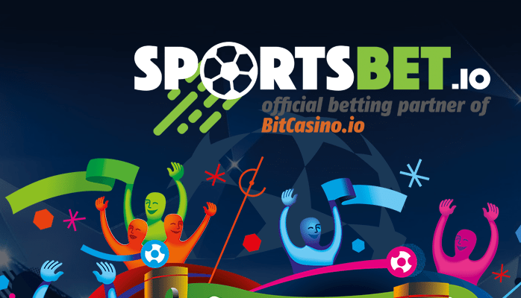
Conclusions
The EPL’s voluntary ban on front of shirt sponsorship will do little to reduce exposure to gambling marketing in-play.
Although less frequent, gambling-like products such as cryptocurrency and FT are increasingly noticeable.
These products are beginning to overlap.
Given the lack of understanding and preventative measures towards these products, future research is needed in this area.
This study and the associated dataset will be published soon!

Slide 14
References
Andrade, M., & Newall, P. W. (2023). Cryptocurrencies as Gamblified Financial Assets and Cryptocasinos: Novel Risks for a Public Health Approach to Gambling. Risks, 11(3), 49. https://doi.org/10.3390/risks11030049
Bouguettaya, A., Lynott, D., Carter, A., Zerhouni, O., Meyer, S., Ladegaard, I., Gardner, J., & O’Brien, K. S. (2020). The relationship between gambling advertising and gambling attitudes, intentions and behaviours: a critical and meta-analytic review. Current Opinion in Behavioral Sciences, 31, 89-101. https://doi.org/10.1016/j.cobeha.2020.02.010
Cassidy, R., & Ovenden, N. (2017). Frequency, duration and medium of advertisements for gambling and other risky products in commercial and public service broadcasts of English Premier League football.
Cooke, D. (2023). A beginner’s guide to betting on football 2023 [Online Image]. The Telegraph. https://www.telegraph.co.uk/betting/sports-guides/football-betting-guide/
Conrad, C., Custovic, A., & Ghysels, E. (2018). Long-and short-term cryptocurrency volatility components: A GARCH-MIDAS analysis. Journal of Risk and Financial Management, 11(2), 23. https://doi.org/10.3390/jrfm11020023
Davies, R. (2022). Jackpot: How gambling conquered Britain. Faber & Faber.
Delfabbro, P., King, D., Williams, J., & Georgiou, N. (2021). Cryptocurrency trading, gambling and problem gambling. Addictive Behaviors, 122, 107021. https://doi.org/10.1016/j.addbeh.2021.107021
Department for Culture Media and Sport. (2023). High Stakes: Gambling Reform for the Digital Age. Retrieved from https://assets.publishing.service.gov.uk/government/uploads/system/uploads/attachment_data/file/1153228/1286-HH-E02769112-Gambling_White_Paper_Book_Accessible1.pdf
Goulding, S. (2022). Gambling advertising within professional football in the United Kingdom and the emotional impacts it has on adult male football fans [Dublin, National College of Ireland].
Grégoire, P., Dixon, M. R., Giroux, I., Jacques, C., Goulet, A., Eaves, J., & Sévigny, S. (2023). Gambling on the stock market: the behavior of at-risk online traders. Review of Behavioral Finance (ahead-of-print).
Ireland, R. (2021). Commercial determinants of health in sport. The example of the English Premier League University of Glasgow]
Johnson, B., Stjepanović, D., Leung, J., Sun, T., & Chan, G. C. (2023). Cryptocurrency trading, mental health and addiction: a qualitative analysis of reddit discussions. Addiction Research & Theory, 1-7. https://doi.org/10.1080/16066359.2023.2174259
Knott, C. (2023). ‘Incoherent’: Premier League proposals for gambling sponsors ignore hoardings [Online Image]. The Guardian. https://www.theguardian.com/football/2023/apr/10/incoherent-premier-league-gambling-sponsor-proposals-ignore-hoardings

Slide 15
References
McGee, D. (2020). On the normalisation of online sports gambling among young adult men in the UK: a public health perspective. Public Health, 184, 89-94. https://doi.org/10.1016/j.puhe.2020.04.018
Mosenhauer, M., Newall, P. W., & Walasek, L. (2021). The stock market as a casino: Associations between stock market trading frequency and problem gambling. Journal of Behavioral Addictions, 10(3), 683-689. https://doi.org/10.1556/2006.2021.00058
Newall, P., Moodie, C., Reith, G., Stead, M., Critchlow, N., Morgan, A., & Dobbie, F. (2019). Gambling marketing from 2014 to 2018: A literature review. Current Addiction Reports, 6(2), 49-56. https://doi.org/10.1007/s40429-019-00239-1
Newall, P. W., & Xiao, L. Y. (2021). Gambling marketing bans in professional sports neglect the risks posed by financial trading apps and cryptocurrencies. Gaming Law Review, 25(9), 376-378. https://doi.org/10.1089/glr2.2021.0027
Oksanen, A., Hagfors, H., Vuorinen, I., & Savolainen, I. (2022). Longitudinal perspective on cryptocurrency trading and increased gambling problems: a 3-wave national survey study. Public Health, 213, 85-90. https://doi.org/10.1016/j.puhe.2022.10.002
Purves, R., Critchlow, N., Morgan, A., Stead, M., & Dobbie, F. (2020). Examining the frequency and nature of gambling marketing in televised broadcasts of professional sporting events in the United Kingdom. Public Health, 184, 71-78. https://doi.org/10.1016/j.puhe.2020.02.012
Roderique-Davies, G., Torrance, J., Bhairon, T., Cousins, A., & John, B. (2020). Embedded gambling promotion in football: an explorative study of cue-exposure and urge to gamble. Journal of Gambling Studies, 36(3), 1013-1025. https://doi.org/10.1007/s10899-020-09949-y
Sharman, S. (2022). Gambling in football: How much is too much? Managing sport and leisure, 27(1-2), 85-92. https://doi.org/10.1080/23750472.2020.1811135
Smith, A. (2022). The English Premier League (EPL) Files two Cryptocurrency & NFT trademarks in the U.S [Online Image]. The Coin Republic. https://www.thecoinrepublic.com/2022/06/07/the-english-premier-league-epl-files-two-cryptocurrency-nft-trademarks-in-the-u-s/
Syvertsen, A., Erevik, E. K., Hanss, D., Mentzoni, R. A., & Pallesen, S. (2022). Relationships between exposure to different gambling advertising types, advertising impact and problem gambling. Journal of Gambling Studies, 38(2), 465-482. https://doi.org/10.1007/s10899-021-10038-x
Torrance, J., Roderique-Davies, G., Thomas, S. L., Davies, N., & John, B. (2021). ‘It’s basically everywhere’: young adults’ perceptions of gambling advertising in the UK. Health Promotion International, 36(4), 976-988. https://doi.org/10.1093/heapro/daaa126
van Schalkwyk, M. C., Petticrew, M., Cassidy, R., Adams, P., McKee, M., Reynolds, J., & Orford, J. (2021). A public health approach to gambling regulation: countering powerful influences. The Lancet Public Health, 6(8), e614-e619. https://doi.org/10.1016/S2468-2667(21)00098-0
Williams, J. (2019). eToto becomes biggest Premier League club sponsor for second year running [Online Image]. Mirror. https://www.mirror.co.uk/sport/football/news/etoro-becomes-biggest-premier-league-18833812

