Slide 1


Exploring the links between gambling and problem debt: A UK perspective
Professor Sharon Collard
CAGR Conference, June 2023

Slide 2
Funding disclosure
This research study was funded by Regulatory Settlement funds from the GB Gambling Commission.
Regulatory Settlements are a payment in lieu of the financial penalty the Gambling Commission might otherwise impose for breach of a licence condition by a gambling operator.
The Gambling Commission had no role in the study and the authors have no known competing financial interests or personal relationships that could have influenced the work reported in this presentation.

Slide 3
About StepChange Debt Charity
Provides debt advice (debt counselling) by telephone and online across the UK
In 2022:
580,913 clients contacted StepChange seeking debt advice or guidance with their problem debt.
The website received over 6 million visits.
187,278 clients completed full debt advice
  151,182 through the online channel
  36,096 through the telephony channel.

Slide 4
Context for the research
“We identified gambling-related debt as a crucial harm that can lead to other harms such as relationship problems, physical and mental health problems, and crime.
The financial difficulties and debt experienced by gamblers and affected others were often severe. Several studies reported that gambling led to bankruptcy and housing problems including homelessness. Financial harms also affected the children of gamblers.”
GOV.UK/Public Health England, 2021. Gambling-related harms evidence review: Summary.
“Gambling-related debt is an important driver of harm and should be a focus for future policy.”
GOV.UK/Public Health England, 2021. Gambling-related harms evidence review: An abbreviated systematic review of harms

Slide 5
Research aims and methods
Analysis of data for 206,241 StepChange debt advice clients for the period Q3 2019 to Q2 2021, 4,195 with a gambling flag (2%) meaning they had disclosed gambling problems
Qualitative interviews with 30 StepChange clients affected by gambling, including 8 affected by someone else’s gambling, conducted in late 2021-early 2022
Cross-sector stakeholder round table to consider the findings and their implications
What role does gambling play in the production of problem debt in households where there is gambling?
Does the presence of gambling impact on seeking help with problem debt?
Are there ways to reduce the harm caused by gambling-related problem debt?

Slide 6
Client data analysis

Slide 7
Summary of client data analysis
Clients with gambling flags have different profiles to those without:
  More likely to be male (71% vs 40% of all clients)
  Higher income (median salary £18,000 vs £15,470 non-gamblers)
  Higher unsecured debts (£1,250 higher in Q1-2 2021)
  Lower arrears (£2,178 in arrears vs £2,791 non-gamblers)
  Less enforcement action (5.5% faced bailiff action vs 9.2% all clients)
Differences between gamblers and other clients who disclose vulnerable situations. Not a ‘one-size fits all’ approach?

Slide 8
Depth interviews with clients affected by gambling

Slide 9
Two main patterns that seem heavily gendered
Gambling as an habitual activity throughout adulthood
  Pattern seen mainly among men
  Gambling starts socially but escalates, often online
  Gambling and debt ebb and flow depending on income, life events, access to credit, engagement with debt advice and/or gambling support services
  Sub-set of interviewees with co-occurring substance abuse
Short, sharp gambling escalation
  Pattern seen mainly among women
  Rapid escalation to harmful gambling in a short space of time
  Often online bingo and slots
  Motivations included ‘escape from real life’, loneliness, having a win or seeing others win
Common factor is that gambling is facilitated by taking on consumer credit debt

Slide 10
Barriers to seeking debt advice
Barriers for clients who gambled
  Not ready to stop gambling
  Overwhelmed by combination of problem debt and gambling addiction
  Concern that creditors would demand a payment that they didn’t have
  Only offered short term solutions by creditors - so concerns about being able to reach a longer term, sustainable solution
Barriers for clients affected by someone else’s gambling
  Debt in partner’s name so unable to deal with creditors
  Concern over impact of partner’s fraudulent behaviour
  Lack awareness of partner’s gambling

Slide 11
Triggers to seeking help
Debt feels unmanageable
  Unable to pay even the minimum
  Start missing payments
  Unable to borrow any more money
No money for basics
Creditor action – letters, phone calls
Telling friends/family about debt and gambling problems, or friends/family finding out
Wanting to sort out debts, part of a ‘fresh start’
Stress, anxiety, sleeplessness; feeling suicidal

Slide 12
How found out about StepChange
Online search
Told about StepChange by a creditor
Told about StepChange by a gambling treatment/support service
Word of mouth or prior experience

Slide 13
Outcomes
Most interviewees felt their debt was now under control:
On a Debt Management Plan with StepChange
Successfully applied for a Debt Relief Order through StepChange
Used the advice they received from StepChange to successfully negotiate arrangements with creditors themselves
Set up an Individual Voluntary Arrangement with a provider other than StepChange
Where interviewees did not feel their debt was under control:
Changes in circumstance or new information disrupted the debt solution they initially selected
Overwhelmed by prospect of self-negotiation or felt it was pointless
In process of pursuing a different debt solution to the one suggested by StepChange
Most of the clients we interviewed had self-excluded from gambling and/or received gambling treatment or support, often before contacting StepChange
Notes:
IVA is a legally-binding arrangement to pay an agreed amount off debts over a set period. Any unpaid parts of the debts that were included in the IVA are written off when the arrangement is completed.
DRO – described as ‘bankruptcy lite’ aimed at people who can’t afford to pay much if anything to their debts and have few/no assets.
DMP – debt repayment plan, where you pay less than the normal payments each month and creditors usually freeze interest

Slide 14
Three illustrative journeys

Slide 15
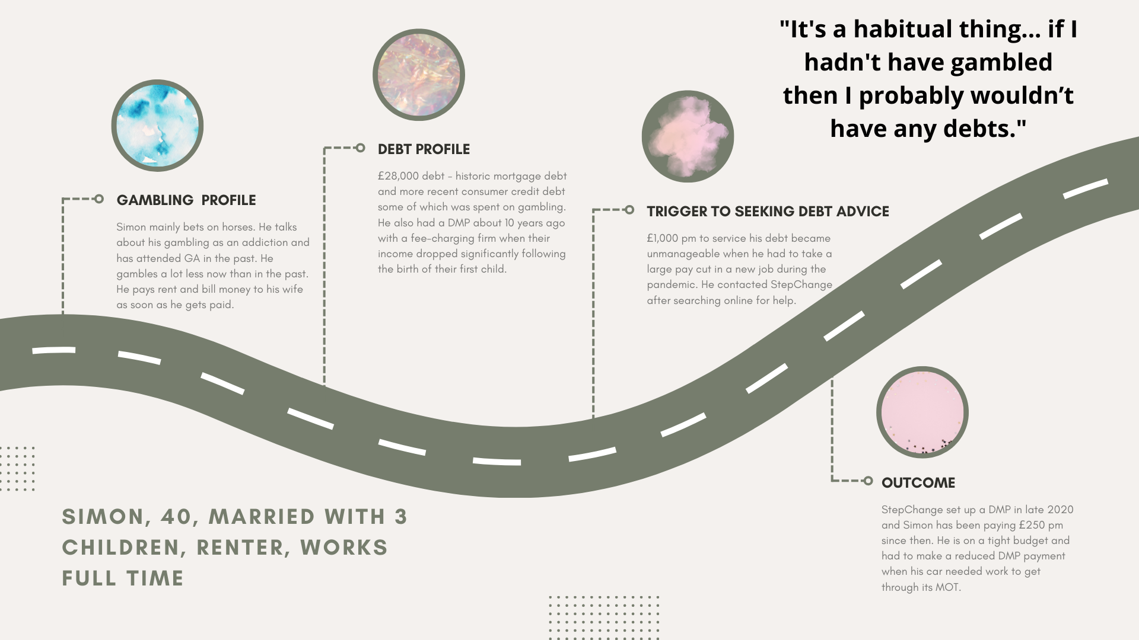
Summary of client data analysis

Slide 16
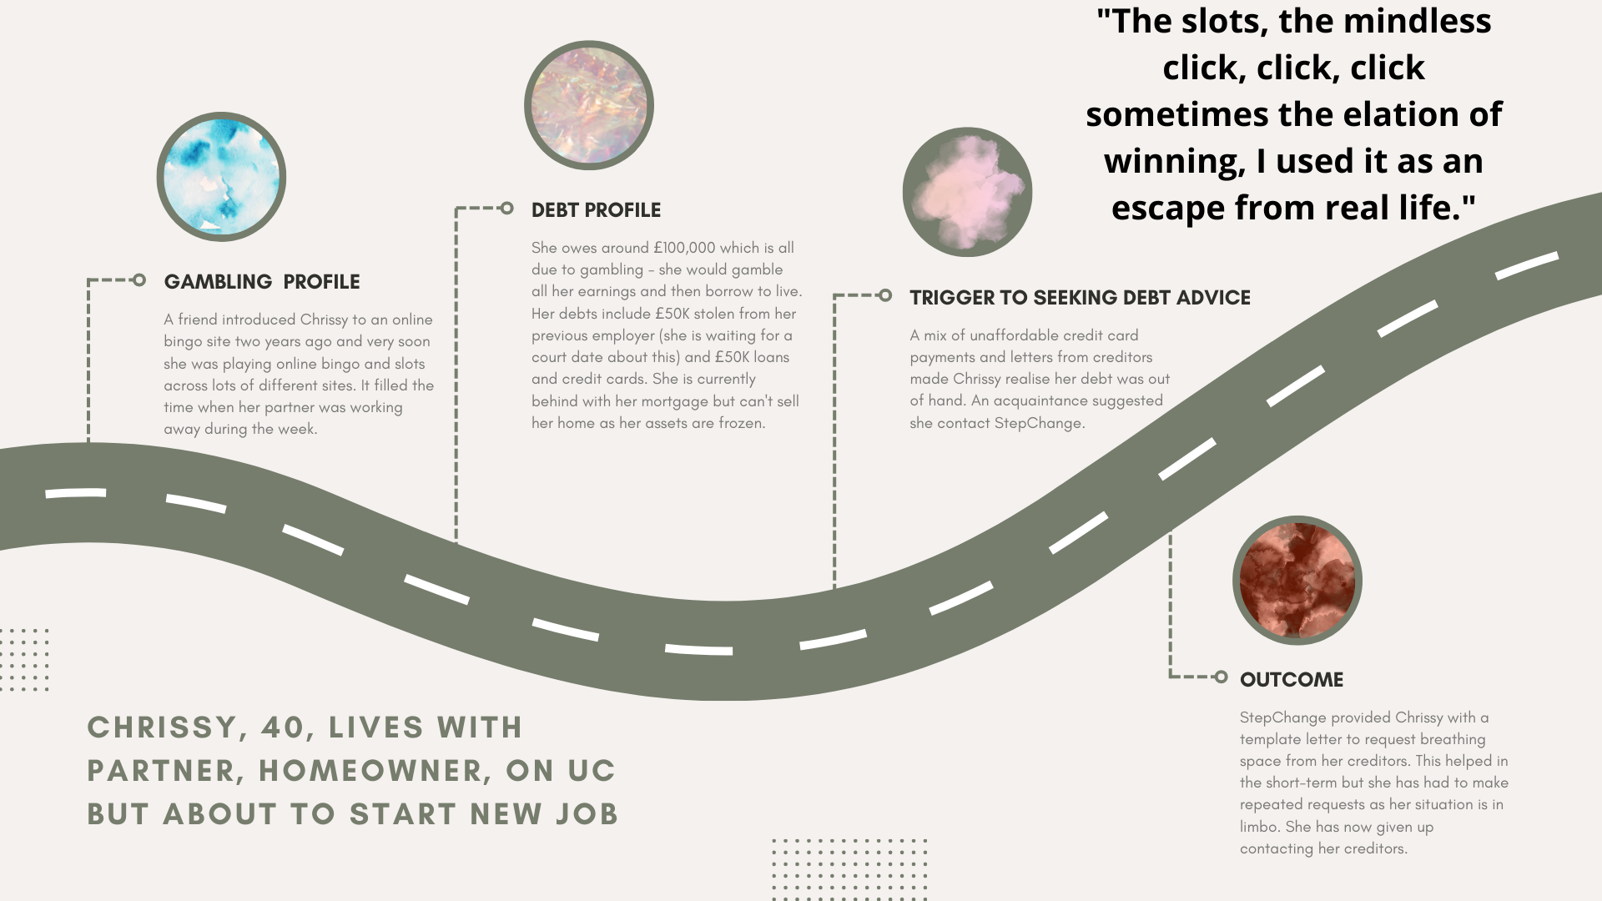
Summary of client data analysis

Slide 17
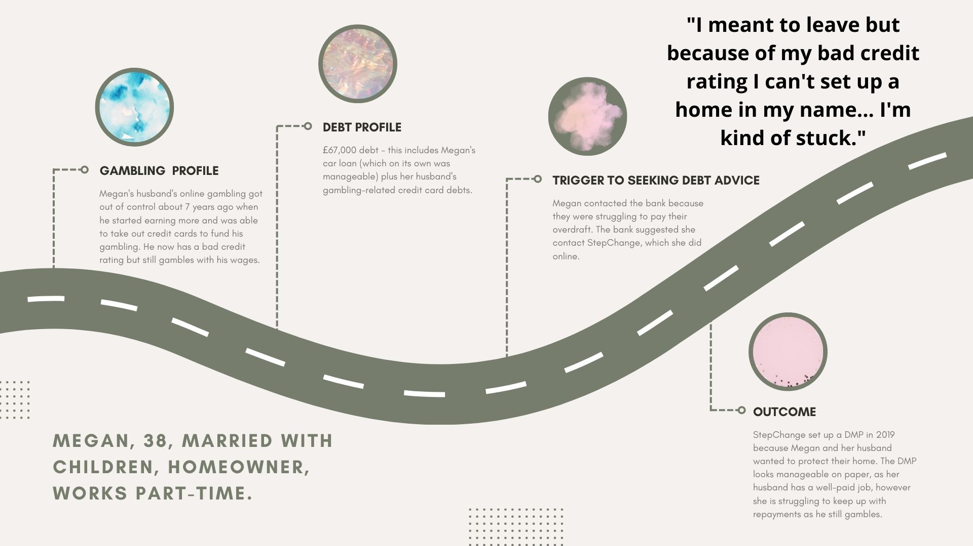
Summary of client data analysis

Slide 18
Summary of key insights and ideas for change

Slide 19
Key insights
The intersection between harmful gambling and access to consumer debt can lead to extremely complex situations. While debt advisors cannot be expected to be experts on harmful gambling (or other non-financial vulnerabilities), they do need to consider it when interacting with clients, in line with the FCA’s guidance on the fair treatment of vulnerable customers and the new Consumer Duty.
If harmful gambling is not addressed, then any debt resolution is likely to be temporary. Debt advisors and creditors should therefore routinely signposting people at risk of gambling harm to a range of different sources of help (including things they can activate themselves like gambling blocks), as our findings show there is no ‘one size fits all’ answer.
Affected others are the unseen casualties of gambling-related debt. More can be done to support people harmed by someone else’s gambling and gambling-related debt in a timely way, including to protect their own finances and recognize signs of financial or economic abuse.

Slide 20
Ideas for change from the Round Table event
More consistent cross-sector partnership working between debt advice services, gambling treatment and support services and other addiction and mental health support services.
Is it time to consider whether debt advice should be routinely funded as part of gambling treatment and support interventions and programmes?
Greater efforts by financial services firms around proactive early identification of potential gambling problems, for example using transaction data analysis.
Action by gambling regulator to prevent or reduce harm, e.g.
  Introduce consistent indicators for operators to identify harms
  Thresholds for the assessment of significant unaffordable losses over time.

Slide 21
Thank you for listening
Research report available here:
https://tinyurl.com/2wbe9jfm
sharon.collard@bristol.ac.uk
@SharonBCollard

Slide 22
Exploring the links between gambling and problem debt: A UK perspective
Professor Sharon Collard
CAGR Conference, June 2023

