Slide 1
Female gambling in an evolving landscape and UK treatment-seeking women’s distinct presentation
Dr Venetia Leonidaki
Consultant Clinical Psychologist
National Problem Gambling Clinic

Slide 2
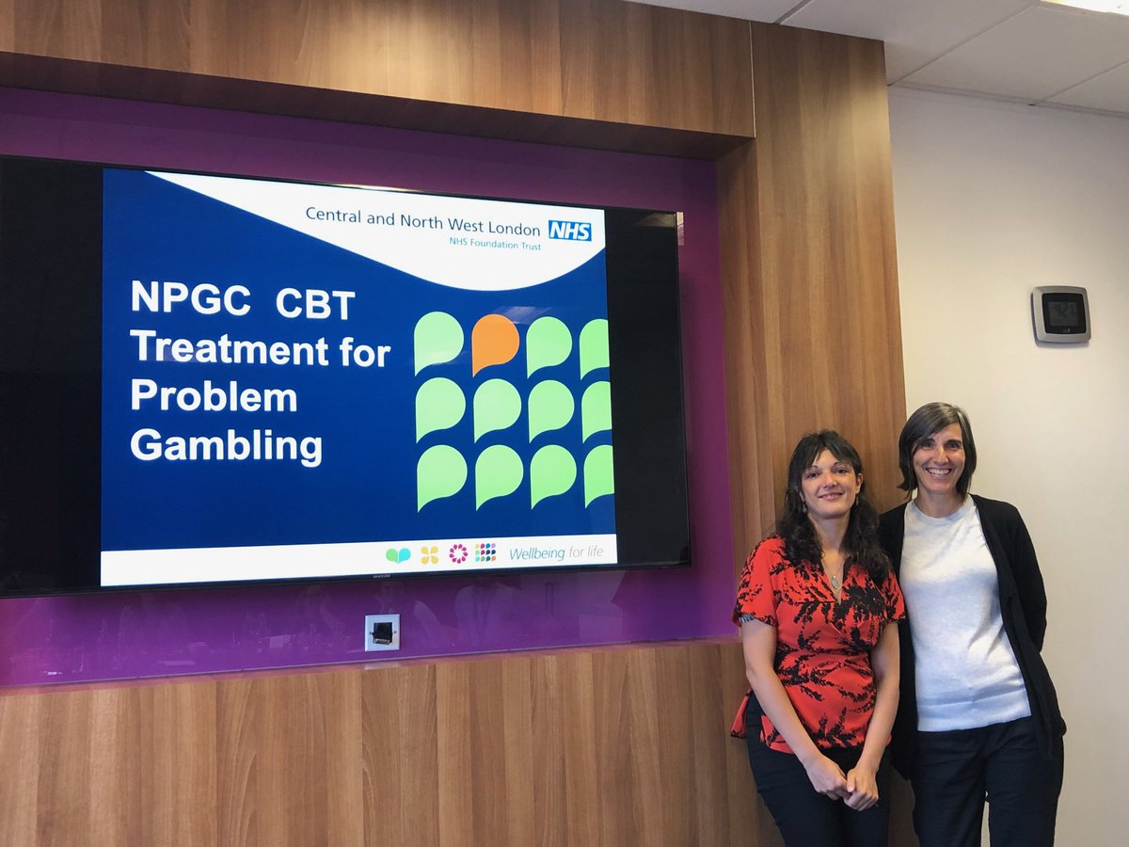
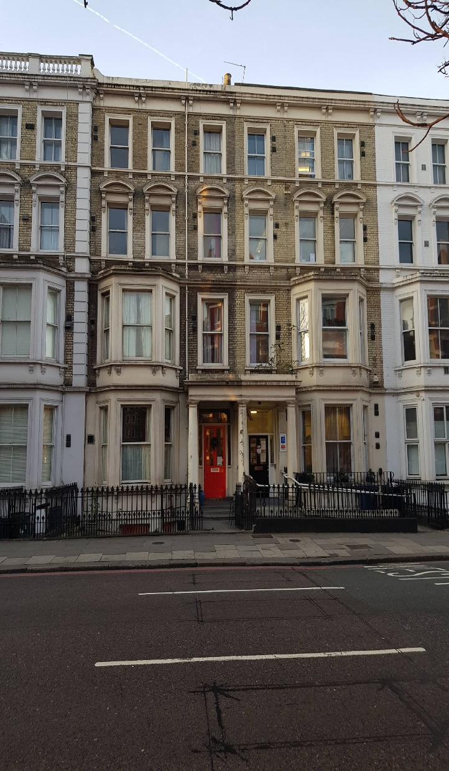
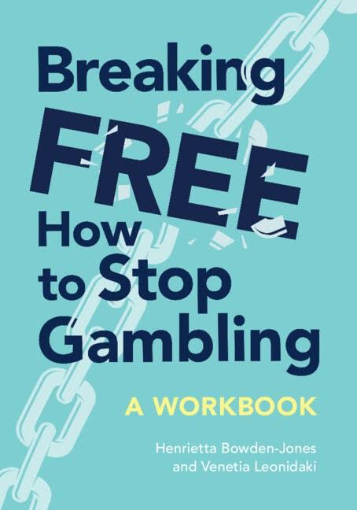
A little bit about me…
Counselling Approaches for Gambling Disorder
Thanks to Prof A Roberts &Prof H Bowden-Jones

Slide 3
Overview
Upward trends in women’s gambling and gambling disorder
Female gamblers’ increased vulnerability to gambling-related harms
Differences in gambling activity between genders
Female gamblers’ distinct clinical presentations
UK data on women seeking treatment

Slide 4
A male-based model of gambling limits the applicability of existing knowledge
Being male is a risk factor for gambling disorder and gambling-related harms (Dowling et al., 2017)
On the other hand….
Gambling participation rates have increased in females (McCarthy et al.,2019)
Women appear more vulnerable to gambling-related harms (Sharman et al., 2019)
Female gamblers present a more distinct clinical and psychological profile than men (Andronicos et al., 2015)

Slide 5
Women not immune to gambling related harms
Women comprise roughly one third of the population gambling pathologically in the UK (National Centre for Social Research, 2020), Brazil (Carneiro et al., 2020), Australia (Hare, 2015), Germany (Wejbera et al., 2021 and Canada (Izutsu & Suzuki, 2021)
There has been an upward trend in women’s gambling and gambling disorder in the UK (National Centre for Social, Research 2008; Wardle et al., 2011), France (Costes et al., 2011; Costes et al., 2015), and Australia (Hare, 2015)
45% of gambling population in the UK are women (National Centre for Social Research, 2023)
Rates of men and women gambling are broadly equal in NZ (Abbott et al., 2014) and Canada
(Kairouz et al., 2011)

Slide 6
Impact of an evolving gambling landscape on women
Change in gender-roles and expectations
The ‘feminisation’ of certain forms of gambling
Gambling being more socially acceptable
Online gambling
Changes in gambling technology and marketing-strategies targeting women (McCarthy et al., 2019)

Slide 7
Gender differences in gambling activity
Onset & career -telescoping effect
Preferences- chance-based forms of gambling
Motivation- coping & socialising

Slide 8
Female gamblers’ clinical presentations
Female gamblers present with higher rates of psychological comorbidity when drawing on clinical samples and older research conducted with national samples (Andronicos et al., 2015; Getty et al.,2000; Petry et al., 2005a; 2005b)
Picture more mixed when comparisons made between male and female gamblers in the community (Bonnaire et al., 2016; Hodgins et al., 2010; Venne et al, 2020; Wejbera et al., 2021)
Female gamblers are at increased risk of being a victim of relational violence compared to non-gambling women or male gamblers (Roberts et al., 2018; Zhai et al., 2020)

Slide 9
Research on treatment in female samples
Men have been over-represented in treatment outcomes –Monash Guidelines made no recommendations about female gamblers
Research on treatment specifically designed to meet the needs of female gamblers is scarce
Individual & group CBT (Dowling et al., 2007); CBT and MI using a good gender balance (Bellringer et al., 2022); 10-week mindfulness-based group intervention (van der Tempel et al., 2020)
Barriers to treatment are well-documented; stigma; childcare; lack of signposting (Kim et al.,2016; Mooney & Kaufman, 2017; Rogers et al., 2019
Women feel uncomfortable in treatment settings because they are male dominated (Althaus et al., 2019).

Slide 10
Data on gender differences from a treatment-seeking sample
UK NHS treatment clinic
Referrals received between April 2020 & March 2022
Comparisons between genders at the intake
Comparing attendance rates between genders
Tested the null hypothesis using z test for comparing % and t-test for means

Slide 11
Average age |  | Significance test*
Women | 40.6 | t(790)=0.00 p<0.05
Men | 36.7
Average age of first gambling experience |  | Significance test*
Women | 31.1 | t(467) = 0.00 p <0.05
Men | 22.8
Average months of gambling career |  | Significance test*
Women | 77.4 | t(753) = 0.0004 p <0.05
Men | 133.1

Slide 12
Initial PGSI
Women | 20.6
Men | 19.4
Initial CORE |  | Significance test*
Women | 23.2 | t(335) = 3.94 p = 0.05
Men | 18.8
Initial PHQ-9 |  | Significance test*
Women | 16.8 | t(290) = 3.47, p <0.05
Men | 13.4
Employment Status | Employed | Significance Test*
Men | 46% | z = 31.0, p = 0.05
Women | 64.70%

Slide 13
Referrals April 2020-March 2022
Referrals
N=792
Attended Ax
Attended initial treatment app
Completed treatment
Offered treatment app
(N=506)

Slide 14
Referrals (N=792) | N | %
Women | 188 | 23.7
Men | 604 | 76.3

Slide 15
Attended initial assessment (N=792) | N | %
Women | 135 | 71.8
Men | 398 | 65.9
DNAed initial assessment (N=792) | N | %
Women | 12 | 6.38
Men | 52 | 8.61

Slide 16
Attended initial treatment appointment (N=792) | N | %
Women | 106 | 56.4
Men | 3oo | 49.7
DNAed initial treatment appointment (N=792) | N | %
Women | 16 | 8.5
Men | 61 | 10.1

Slide 17
Attended initial group CBT app (N=792) | N | % | Significance test*
Women | 12 | 6.4% | z = 2.96, p = 0.05
Men | 88 | 14.6%
Completed treatment (N=506)* | N | %
Women | 74 | 60.7
Men | 197 | 51.3
*of the patients offered a treatment appointment

Slide 18
Clinical Observations
Distinct presentations
Relational topics & Higher emotions
When women access therapy, they tend to attend sessions and move forward with their treatment journey
Individual therapy

Slide 19
Conclusions
Continue to investigate women’s distinct presentations
Expect a rise in numbers & more women coming forward for treatment
When women seek treatment, they are not more likely to drop out from treatment than men
No research-based knowledge on specific treatment ingredients that work well for women

Slide 20

Thank you
Venetia.Leonidaki@nhs.net

