Slide 1




Within-session Loss-chasing in Online Gambling: A replication and extention study
Nilosmita Banerjee
PhD researcher
FNRS FRESH Fellow
(Affiliated to ULB and Ugent)

Slide 2

Declaration of Interests
Research Funding
Data access
Currently Funded - Le Fonds de la Recherche Scientifique (FNRS) FRESH Doctoral Fellowship – 4years
(Funding acquired by Nilosmita Banerjee)
Data Access from Belgian Gambling operators facilitated by the Technology and Knowledge Transfer (Research and Industry division) department ULB

Slide 3
What is Loss-chasing?
Loss-chasing is the tendency to continue and/or intensify gambling, in the face of losses (Zhang & Clark, 2020)
Key clinical symptom in diagnosis of gambling disorder (Nigro et al., 2019a)
Facilitate the transition from re-creational to problem gambling (Zhang & Clark, 2020)

Slide 4
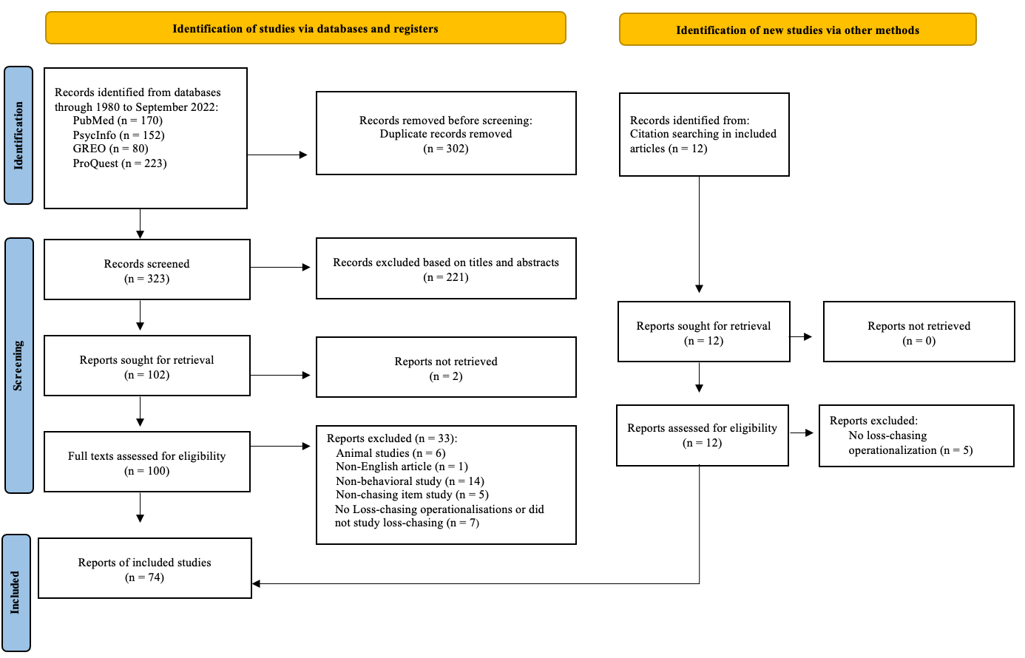
Behavioural Expressions of Loss-chasing
Banerjee et al., (2023; preprint)

Slide 5
Behavioural Expressions of Loss-chasing
Between-session loss-chasing
Within-session loss-chasing
Banerjee et al., (2023; preprint)

Slide 6




Behavioural Expressions of Loss-chasing
Within-session loss-chasing
Chasing losses within a continuous session of gambling
Intensification
Continuing
(i.e., persistence)
Intensifying gambling behaviour following losses
Continuing gambling in the face of losses
Changing Stake sizes
Increasing Risk Taking
Chasing losses by
increasing stake
sizes
Chasing losses by
increasing risk taking
Increasing
Speed of Play
Chasing losses by
increasing speed of playing the next gamble
Banerjee et al., (2023; preprint)

Slide 7


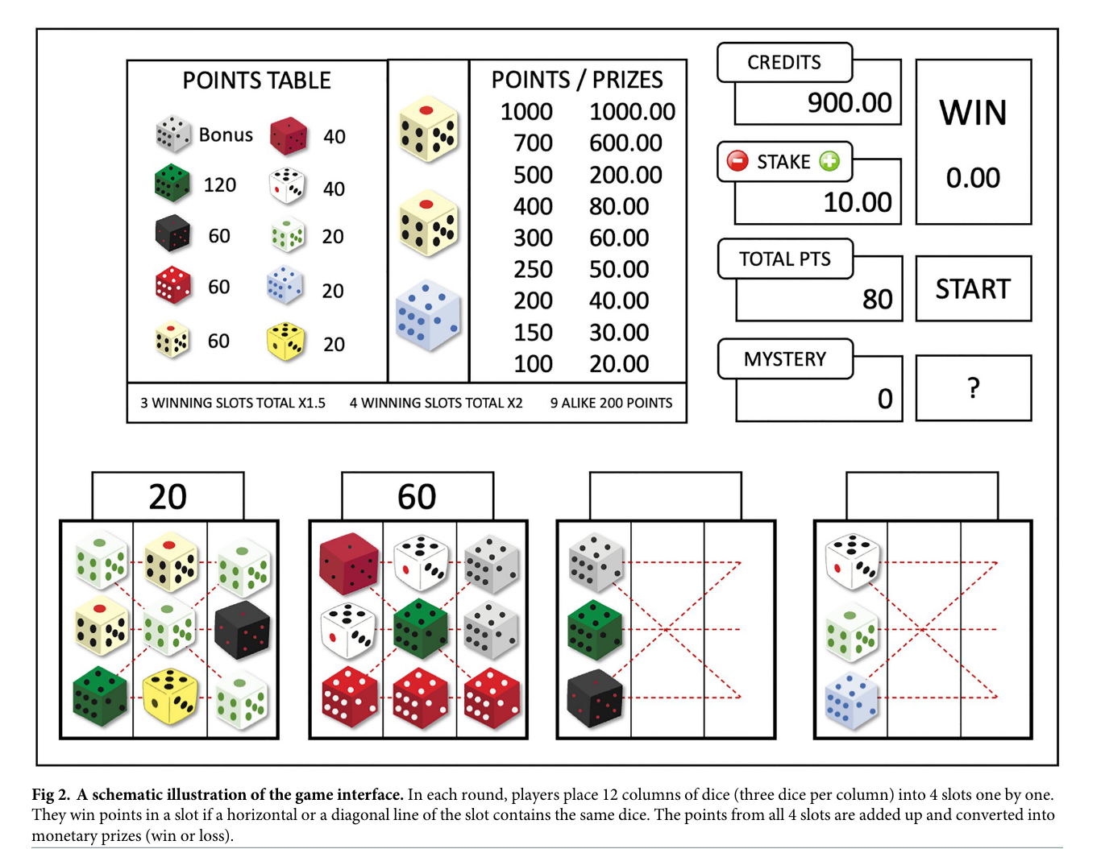

Chen et al., (2022)
Within-session loss-chasing
Gaming1 2023
Decisions of when to stop (Continuation)
Changing Stake sizes
Increasing
Speed of Play
Chasing losses by
increasing stake
sizes
Chasing losses by
increasing speed of playing the next gamble
Continuing in the face of losses
N ≈ 10 million rounds
N = >2500 players
High-involvement players
(addiction score > = 3)
N = 1803
Low-involvement players
(addiction score < 3)
N = 910

Slide 8
Chen et al., (2022)
Within-session loss-chasing
Chasing losses within a continuous session of gambling
Decisions of when to stop (Continuation)
Changing Stake sizes
Increasing
Speed of Play
Chasing losses by
increasing stake
sizes
Chasing losses by
increasing speed of playing the next gamble
Continuing in the face of losses
High- & Low-involvement players stopped after losses and increased stake-sizes after wins.
After losing both groups played more quickly.
Thus, captured win-chasing instead of loss-chasing
Thus, captured loss-chasing

Slide 9
Current Study
Data
N = 4308 players
N ≈ 71 million rounds
SPLIT/ANALYSE/META-ANALYSE APPROACH
(Cheung & Jak, 2016)
Study 1
Study 4
N = 1078 players
Study 2
Study 3
N = 1078 players
N = 1076 players
N = 1076 players
N ≈ 19 million rounds
N = 407 High-involvement players
N = 617 Low-involvement players

Slide 10
Within-session loss-chasing
Change in Stake sizes
Increase in speed of play

Slide 11
Within-session loss-chasing
Outcome streaks
L = Loss
W = Win
Streak Length = 1
Streak Length >2
Streak Length = 2
L-W-L-W
LLLL-W-LLLLL-WWW
LL-W-LL-WW
(e.g., Croson & Sundali, 2004; Ayton & Fischer, 2004; Studer et al., 2015)

Slide 12
Change in Stake sizes

Slide 13
Within-session loss-chasing - Stake Size Changes
Research Question: Do high (low) involvement players change stake sizes as a function of previous outcome across varying streak lengths?
Variables:
  Independent Var (IV): 1.) Previous round outcome and
  2.) Streak length
  Dependent Var (DV): Mean Stake size change

Slide 14
Within-session loss-chasing - Stake Size Changes
Analyses: Mixed Anova – 2x2x3 design
  Between-group factor:
    Involvement Levels – a.) High and b.) Low involvement
  Within-group factor:
    Previous round Outcome – a.) Loss and b.) Win
    Streak Length – a.) 1 , b.) 2 , and c.) >2

Slide 15
Within-session loss-chasing - Stake Size Changes
Table 4. Anova Model
Effect | df | MSE | F-value | Partial Eta² | p-value
Group Level | 1, 1018 | 0.00 | 3.33 | <.001 | .068
Streak Length | 1.85, 1881.65 | 0.00 | 1.30 | <.001 | .272
Interaction: Grp * Streak len | 1.85, 1881.65 | 0.00 | 0.70 | <.001 | .485
Prior Outcome | 1, 1018 | 0.00 | 16.43 | .004 | <.001
Interaction: Grp * Prior Outcome | 1, 1018 | 0.00 | 1.26 | <.001 | .262
Interaction: Streak len * Prior Outcome | 1.93, 1960.94 | 0.00 | 24.75 | .007 | <.001
Interaction: Grp * Streak len * Prior Outcome | 1.93, 1960.94 | 0.00 | 5.31 | .002 | .006

Slide 16
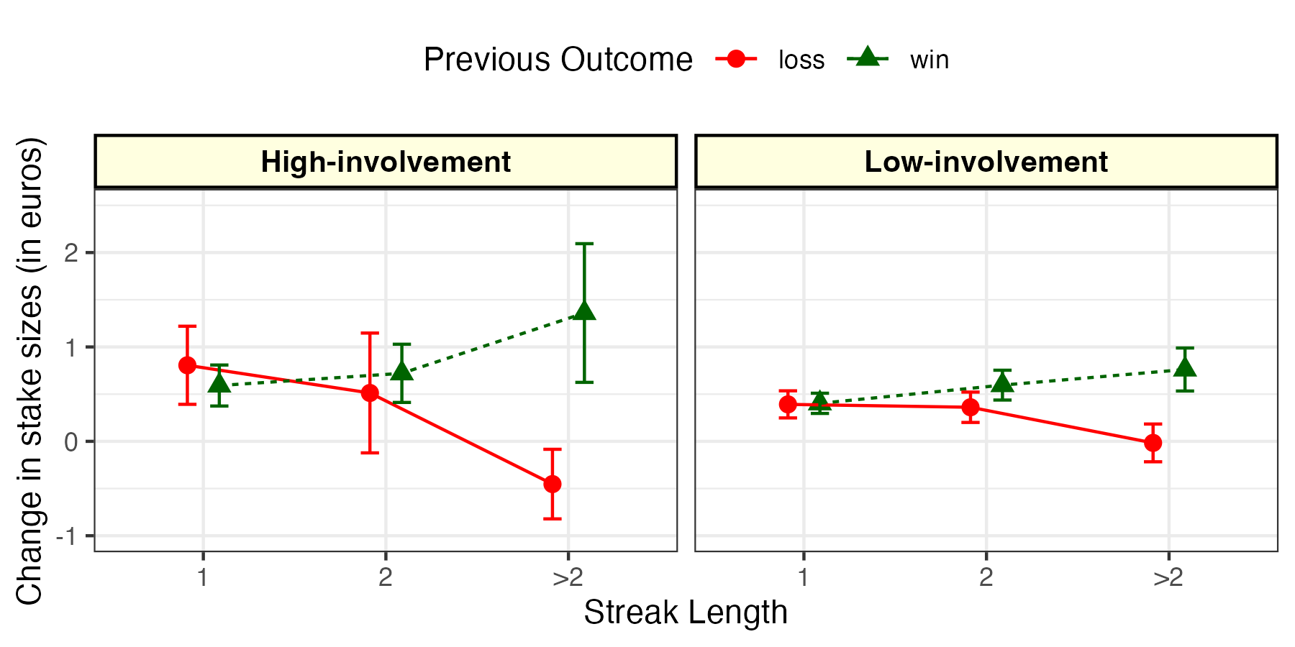
Within-session loss-chasing - Stake Size Changes
Pairwise Bonferroni corrected Post-hoc t-tests
High-involvement players significantly decreased their stake sizes following a losing streak of > 2 losses as compared to low involvement players [high-involvement, m = -0.0045 euros, SD = 0.0241; low-involvement, m = -0.00016 euros, SD = 0.0248, t(1,814.9) = -2.8, p = 0.050].

Slide 17
Increase in speed of play

Slide 18
Within-session loss-chasing – Speed of Play
Research Question: Do high (low) involvement players increase (decrease) their speed of play as a function of previous outcome across varying streak lengths?
Variables:
  Independent Var (IV): 1.) Previous round outcome and
  2.) Streak length
  Dependent Var (DV): Mean z-scores Reaction Time

Slide 19
Within-session loss-chasing – Speed of Play
Analyses: Mixed Anova – 2x2x3 design
  Between-group factor:
    Involvement Levels – a.) High and b.) Low involvement
  Within-group factor:
    Previous round Outcome – a.) Loss and b.) Win
    Streak Length – a.) 1 , b.) 2 , and c.) >2

Slide 20
Within-session loss-chasing – Speed of Play
Table 5. Anova Model
Effect | df | MSE | F-value | Partial Eta² | p-value
Group Level | 1, 1018 | 0.04 | 0.02 | <.001 | .897
Streak Length | 1.45, 1473.09 | 0.03 | 2.75 | <.001 | .082
Interaction: Grp * Streak len | 1.45, 1473.09 | 0.03 | 2.89 | <.001 | .073
Prior Outcome | 1, 1018 | 0.09 | 829.20 | .252 | <.001
Interaction: Grp * Prior Outcome | 1, 1018 | 0.09 | 0.79 | <.001 | .374
Interaction: Streak len * Prior Outcome | 1.45, 1471.26 | 0.03 | 1.18 | <.001 | .297
Interaction: Grp * Streak len * Prior Outcome | 1.45, 1471.26 | 0.03 | 2.92 | <.001 | .071

Slide 21
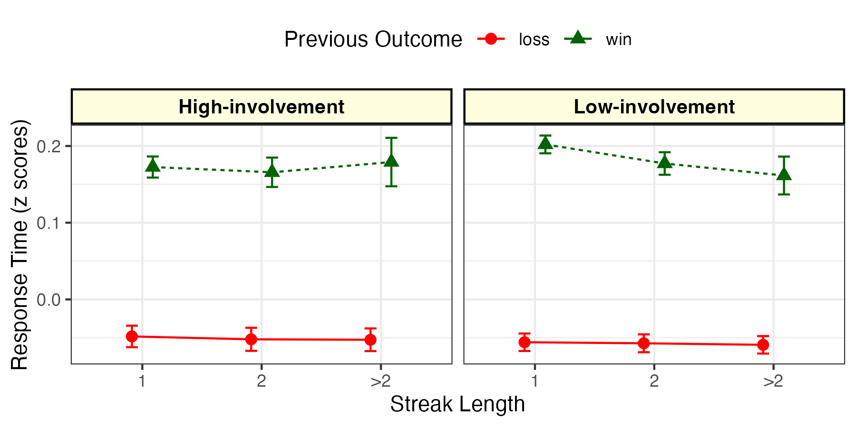
Within-session loss-chasing – Speed of Play
Pairwise Bonferroni corrected Post-hoc t-tests
High-involvement players significantly decreased their speed of play following losses as compared to wins across all outcome streak lengths (streak length 1 [t(1,380) = -19.7 ,p <.001], streak length 2 [t(1,380) = -15.5, p <.001] and streak length >2 [t(1,380) = -11.5, p <.001]).
Low-involvement players significantly decreased their speed of play following losses as compared to wins across all outcome streak lengths (streak length 1 [t(1,638) = -28.2, p <.001], streak length 2 [t(1,638) = -22.1, p <.001] and streak length >2 [t(1,638) = -14.2, p <.001]).

Slide 22

Summary
Replication and Extension
Replication
Within-session loss-chasing
Changing stake size
Within-session loss-chasing was not observed in changes in stake sizes (e.g., Chen et al., 2022; Abe et al., 2021)
Win-chasing was observed instead (e.g., Abe et al., 2021)
Increase in Speed of Play
Within-session loss-chasing was observed in increases in speed of play (e.g., Chen et al., 2022; Ferrari et al., 2022).

Slide 23
Next steps…?
Study 1 dataset
Assess Continuation within-sessions
Assess the impact of outcome magnitude on loss-chasing
Assess the correlation between between- and within-session chasing facets
Pre-register the protocol of study 1
All other datasets
Analyse the 3 other datasets and undertake meta-analysis of all 4 data-sets

Slide 24
References
Abe, N., Nakai, R., Yanagisawa, K., Murai, T., & Yoshikawa, S. (2021). Effects of sequential winning vs. losing on subsequent gambling behavior: Analysis of empirical data from casino baccarat players. International Gambling Studies, 21(1), 103–118. https://doi.org/10.1080/14459795.2020.1817969
Auer, M., & Griffiths, M. D. (2022). An Empirical Attempt to Operationalize Chasing Losses in Gambling Utilizing Account-Based Player Tracking Data. Journal of Gambling Studies. https://doi.org/10.1007/s10899-022-10144-4
Auer, M., & Griffiths, M. D. (2023). The relationship between structural characteristics and gambling behaviour: An online gambling player tracking study. Journal of Gambling Studies, 39(1), 265–279. https://doi.org/10.1007/s10899-022-10115-9
Ayton, P., & Fischer, I. (2004). The hot hand fallacy and the gambler’s fallacy: Two faces of subjective randomness? Memory & Cognition, 32(8), 1369–1378. https://doi.org/10.3758/BF03206327
Banerjee, N., Chen, Z., Clark, L., & Noël, X. (2023, June 9). Behavioural expressions of loss-chasing in gambling: A systematic scoping review. https://doi.org/10.31234/osf.io/7tc35
Chen, Z., Doekemeijer, R. A., Noël, X., & Verbruggen, F. (2022). Winning and losing in online gambling: Effects on within-session chasing. PloS One, 17(8), 1. MEDLINE®. https://doi.org/10.1371/journal.pone.0273359
Cheung, M. W. L., & Jak, S. (2016). Analyzing big data in psychology: A split/analyze/meta-analyze approach. Frontiers in psychology, 7, 738.
Croson, R., & Sundali, J. (2005). The Gambler’s Fallacy and the Hot Hand: Empirical Data from Casinos. Journal of Risk and Uncertainty, 30(3), 195–209. https://doi.org/10.1007/s11166-005-1153-2
Ferrari, M. A., Limbrick-Oldfield, E. H., & Clark, L. (2022). Behavioral analysis of habit formation in modern slot machine gambling. International Gambling Studies, 0(0), 1–20. https://doi.org/10.1080/14459795.2022.2088822
Forrest, D., & McHale, I. (2016). Tracked play on B1 gaming machines in British casinos. Report prepared for the Responsible Gambling Trust. London: Responsible Gambling Trust.
Kainulainen, T. (2021). Does Losing on a Previous Betting Day Predict How Long it Takes to Return to the Next Session of Online Horse Race Betting? Journal of Gambling Studies, 37(2), 609–622. https://doi.org/10.1007/s10899-020-09974-x
Nigro, G., Matarazzo, O., Ciccarelli, M., D’Olimpio, F., & Cosenza, M. (2019). To chase or not to chase: A study on the role of mentalization and alcohol consumption in chasing behavior. Journal of Behavioral Addictions, 8(4), 743–753. https://doi.org/10.1556/2006.8.2019.67
Studer B, Limbrick-Oldfield EH, & Clark L. (2015). ‘Put Your Money Where Your Mouth Is!’: Effects of Streaks on Confidence and Betting in a Binary Choice Task. Journal of Behavioral Decision Making, 28(3), 239–249. https://doi.org/10.1002/bdm.1844
Zhang, K., & Clark, L. (2020). Loss-chasing in gambling behaviour: Neurocognitive and behavioural economic perspectives. Current Opinion in Behavioral Sciences, 31, 1–7. https://doi.org/10.1016/j.cobeha.2019.10.006

