Slide 1
The Effect of Television Advertising on Gambling Behaviour: A Quasi-Experimental Study during the 2022 Qatar FIFA World Cup
Ellen McGrane, Rob Pryce, Matt Field, Luke Wilson, Elizabeth Goyder
The university of sheffield

Slide 2
Funding Declaration
This project was funded by EM’s Wellcome Trust Doctoral Training Grant [224852/Z/21/Z]
The funders were not involved in the study
The authors declare no conflicts of interest

Slide 3
Introduction
Advertising is noted as a risk factor for gambling harms (PHE, 2021)
Literature suggests a positive relationship between advertising and behaviour (McGrane et al., 2023; Killick & Griffiths, 2022; Bouguettaya et al., 2020)
There is a lack of evidence for the effect of TV advertising on behaviour, and a more general lack of causal evidence for the effect of advertising on betting behaviour in real-world settings

Slide 4
Context
Controlling for exposure to advertising is challenging
  Observational studies: issues with reverse causality and selection bias
  Experimental studies: able to establish causality but might lack contextual factors that may be important to betting
Natural experiments are a form of quasi-experimental study which identify a source of external (“exogenous”) variation in the explanatory variable which influences the outcome variable

Slide 5




Aim
This research aims to fill the evidence gap using a quasi-experiment to estimate the impact of TV gambling advertising on gambling behaviour using:
  Longitudinal betting surveys during the group stages of the 2022 Qatar FIFA World Cup
  The exogenous variation in advertising between ITV (adverts) and BBC (no adverts)

Slide 6
Design (1)
TV rights to the World Cup games were awarded to ITV and BBC
Allocation of matches is pseudo-random
This study uses ITV as a proxy for gambling advertising in the model to isolate its impact on behaviour
ITV (channel)
Gambling Advertising
Betting Behaviour
Error

Slide 7
Design (2)
Inclusion criteria: males, 18-45, currently living in England, have bet on football at least once in the last 12 months, planning to watch the games, have never been treated for gambling disorder
Recruitment in Prolific
Surveys in Qualtrics
Reimbursement ranged £1.50-£3.50 per survey
13 daily surveys covering 48 matches
Betting diary
N=365

Slide 8
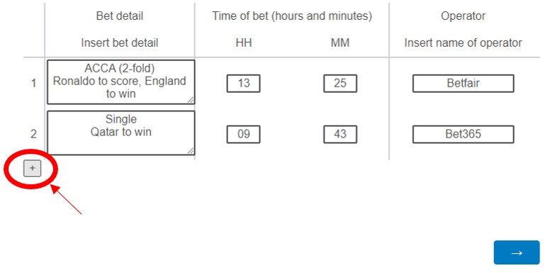
Example Survey

Slide 9
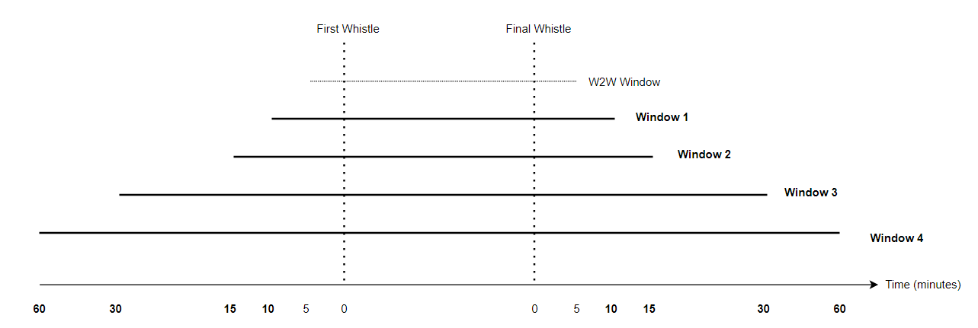
Statistical Methods
Dependent variable: Number of football bets placed “during the game” (categorised as 60, 30, 15 and 10 minutes around the live game)
Independent variable: ITV
Controls: 9 match-level controls
Fixed Effects
Poisson/Logistic regression
Coefficients are ratios

Slide 10
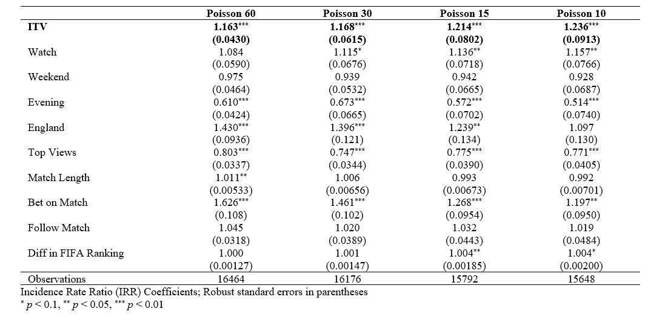
Poisson Results: Frequency of Bets

Slide 11
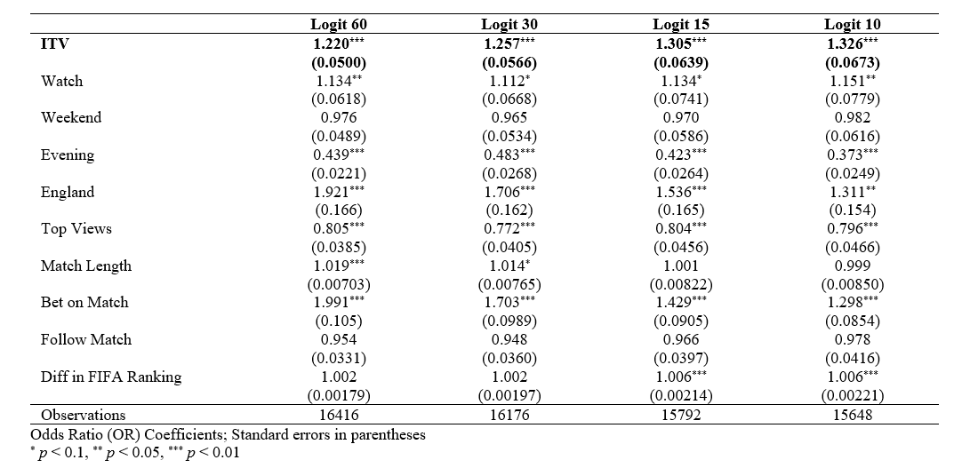
Logistic Results: Probability of Placing a Bet

Slide 12
Exploratory Analysis
Mixed results for a dose-response effect
  Positive coefficients on 60 (insignificant) and 30 (significant) minute window
  Negative insignificant coefficients on 10/15
When looking at the presence of at least one advert in the specified window, all coefficients were positive and significant
Inclusion of safer gambling adverts increase most coefficients

Slide 13
Discussion
The consistent, robust, positive effects on the frequency, and probability of betting on football during live games shown on ITV indicate that TV gambling advertising is influencing football betting behaviour in the moment
Gambling advertising may be exacerbating harms by increasing the overall frequency of football betting in the population, rather than simply moving market share between gambling companies

Slide 14
Strengths and Limitations
To our knowledge, this is the first study to use a pseudo-randomised quasi-experiment in this context
Generalisability
  Purposive sampling methods
  Use of a panel to recruit participants
Bias
  Self-reported data
  Exploratory analysis using frequency of adverts (measurement bias and endogeneity)

Slide 15
Implications
Advertising restrictions might be a valuable part of a wider public health strategy to tackle gambling-related harms
Future research should replicate this study on larger samples, potentially using identical games televised on ITV and BBC at the same time e.g. FA Cup Final, or the Euros

Slide 16
References
Bouguettaya A, Lynott D, Carter A, Zerhouni O, Meyer S, Ladegaard I, et al. The relationship between gambling advertising and gambling attitudes, intentions and behaviours: a critical and meta -analytic review. Current Opinion in Behavioral Sciences. 2020;31:89-101.
Public Health England (PHE). Harms associated with gambling: an abbreviated systematic review. 2021. [Available from : https://assets.publishing.service.gov.uk/government/uploads/system/uploads/attachment_data/file/1020652/Gambling-evidence-review_harms-report.pdf].
Killick E, Griffiths M. Impact of Sports Betting Advertising on Gambling Behavior: A Systematic Review. ADDICTA: The Turkish Journal on Addictions. 2022;8:201-14.
McGrane E, Wardle H, Clowes M, Blank L, Pryce R, Field M, et al. What is the evidence that advertising policies could have an impact on gambling-related harms? A systematic umbrella review of the literature. Public Health. 2023;215:124-30.
Icons by Icons8: https://icons8.com/

Slide 17

Thanks for listening!
Any questions?

