Slide 1



Unrecognisable? Gambling, content marketing, social media and children. A worrying combination.
Dr Raffaello Rossi
raffaello.rossi@bristol.ac.uk
@Raffaello_Ro

Slide 2
Financial Disclosure
We have not received any funding for this study. Participants were paid through my personal research budget provided by the University of Bristol.

Slide 3
1. BACKGROUND

Slide 4
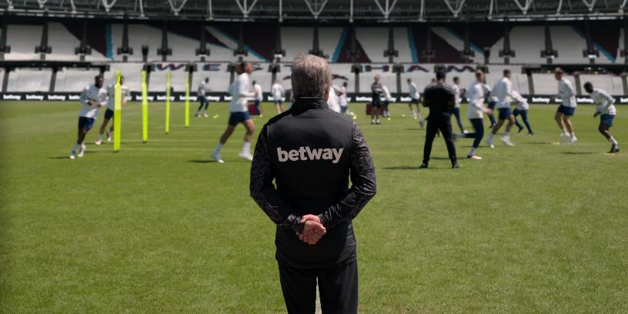
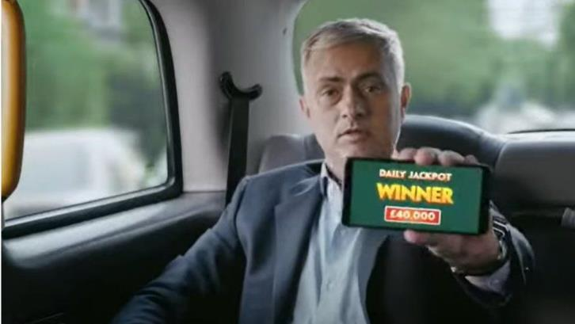
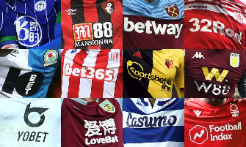
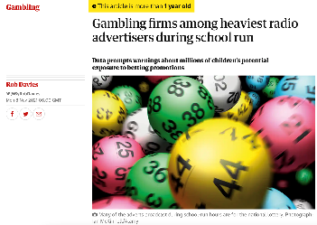

Gambling Ads are Ubiquitous

Slide 5
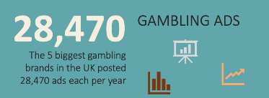

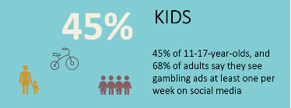
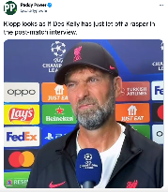
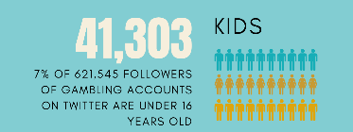
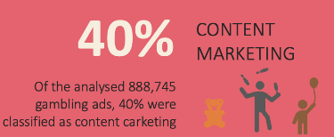

Gambling Ads are Ubiquitous
Rossi et al., 2021

Slide 6
Content marketing is about
“developing stories that inform and entertain and compel customers to act – without actually telling them to”.
Aims at eliciting emotions and does not have a call to action.
A distinguishing feature of social media content marketing is shareability.
Usually, no clear link or relationship to the brand, product or service.

Slide 7
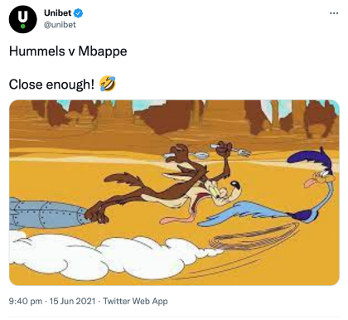
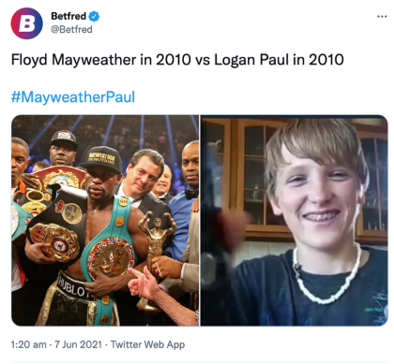
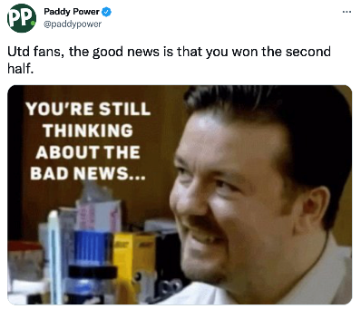
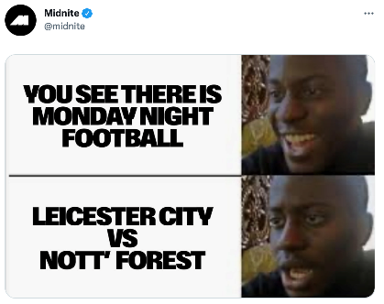
Content Marketing

Slide 8
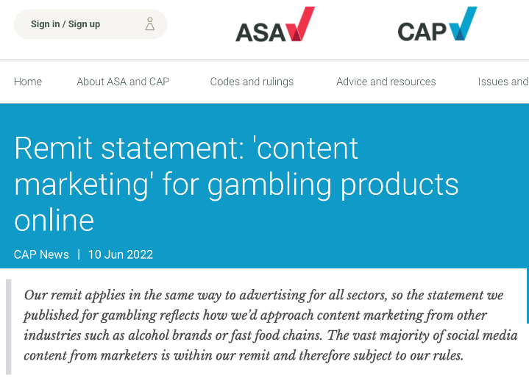
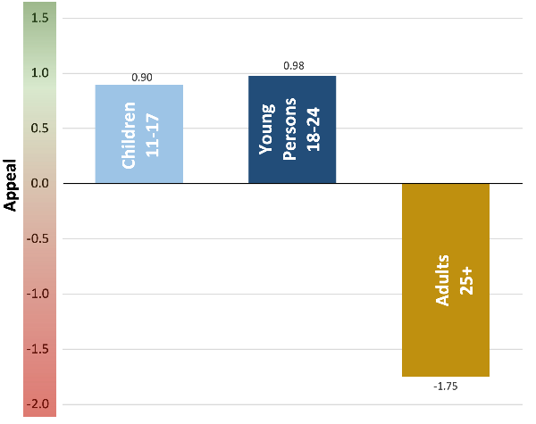
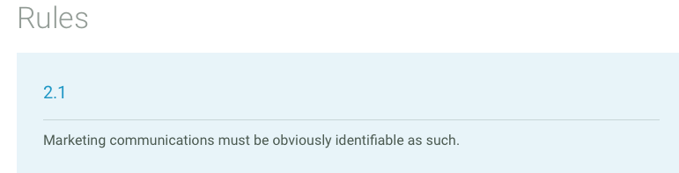
So, what’s the problem?
Isn’t it just contemporary advertising?
No specific advertising regulations.
Can further normalise gambling.
Are highly emotionally appealing.
Potentially breach a key advertising regulation.
They potentially bypass advertising protections.

Slide 9
Advertising Literacy
Increasing advertising literacy is seen as part of the solution for reducing susceptibility to advertising (e.g. An & Stern, 2011)
Includes a broad range of knowledge, attitudes, and skills needed to critically process advertising messages (Wright, Friestad, and Boush 2005; Brucks, Armstrong, and Goldberg 1988).
Changing advertising landscape reduces ability to activate advertising literacy (Livingstone and Helsper, 2006; Nairn and Fine, 2008)
-> Advertising literacy only works if its being activated – ie ads are recognised as such

Slide 10
Do social media users recognise gambling content marketing as advertising?

Slide 11
2. METHODS

Slide 12
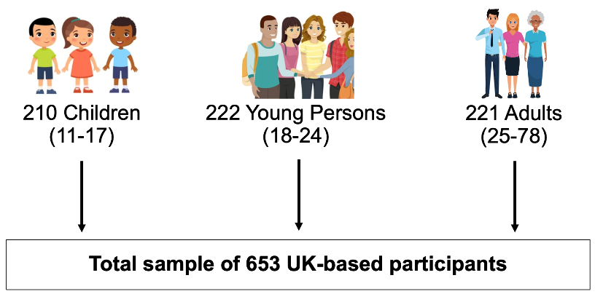
Methodology
- Online experiment with 650 participants

Slide 13
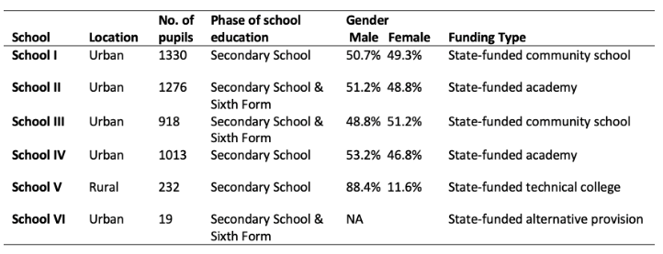
Methodology
Online experiment with 650 participants
Recruitment via secondary schools in England (for u18)

Slide 14
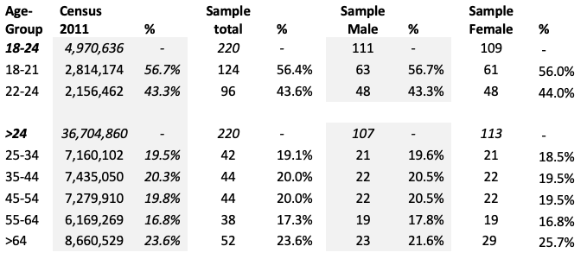
Methodology
Online experiment with 650 participants
Recruitment via secondary schools in England (for u18)
For >18-year-olds, recruitment via Prolific

Slide 15
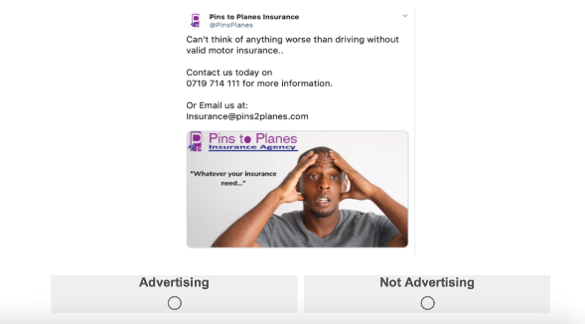
Procedure
In the following task you will see a variety of screenshots taken from social media.
Your task is to decide whether the post is “Advertising” or “Not Advertising”.

Slide 16
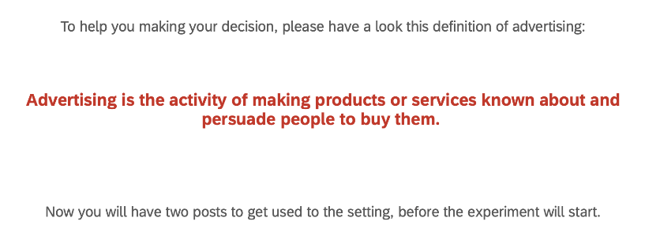
Procedure
You only have 6 seconds to make your decision before the screenshot disappears.

Slide 17
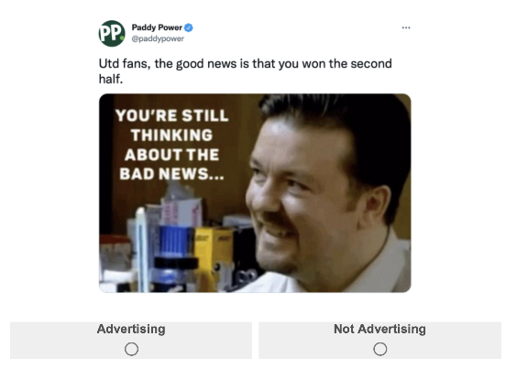
Procedure

Slide 18
Materials
 | Gambling | Insurance (control group) | Private Social Media Posts
Content Marketing | 6 ads | 6 ads | 18 posts
Conventional Advertising | 6 ads | 6 ads

Slide 19
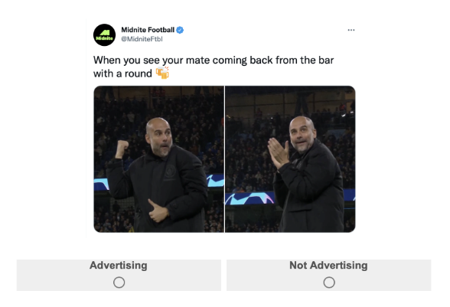
Procedure

Slide 20
Materials
 | Gambling | Insurance (control group) | Private Social Media Posts
Content Marketing | 6 ads | 6 ads | 18 posts
Conventional Advertising | 6 ads | 6 ads

Slide 21
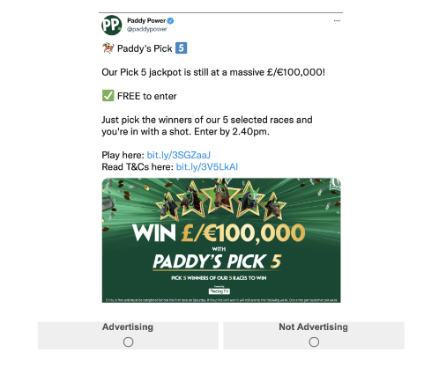
Procedure

Slide 22
Materials
 | Gambling | Insurance (control group) | Private Social Media Posts
Content Marketing | 6 ads | 6 ads | 18 posts
Conventional Advertising | 6 ads | 6 ads

Slide 23
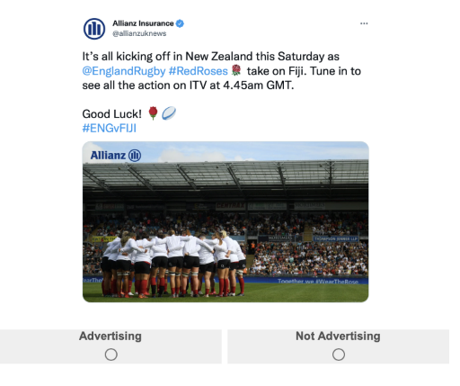
Materials

Slide 24
Materials
 | Gambling | Insurance (control group) | Private Social Media Posts
Content Marketing | 6 ads | 6 ads | 18 posts
Conventional Advertising | 6 ads | 6 ads

Slide 25
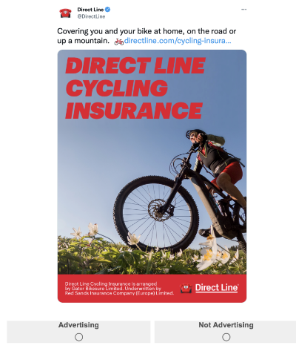
Materials

Slide 26
Materials
 | Gambling | Insurance (control group) | Private Social Media Posts
Content Marketing | 6 ads | 6 ads | 18 posts
Conventional Advertising | 6 ads | 6 ads

Slide 27
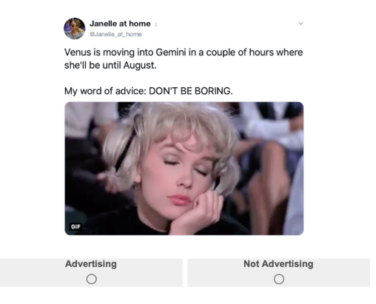
Materials

Slide 28
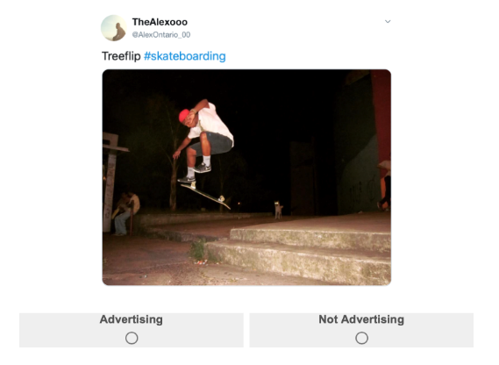
Materials

Slide 29
3. RESULTS

Slide 30
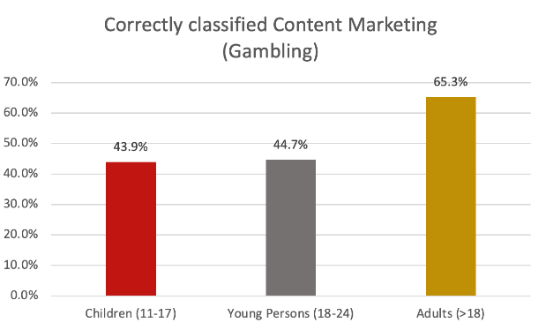
Results
1. Gambling Content Marketing is very hard to recognise as advertising

Slide 31
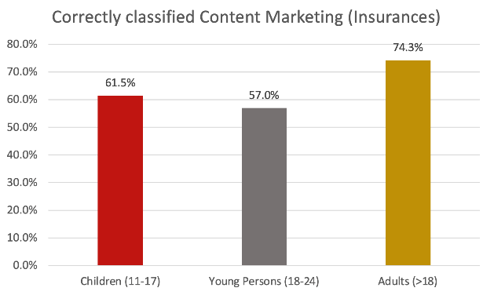
Results
Gambling Content Marketing is very hard to recognise as advertising – for all age groups.
Insurance Content Marketing is also hard to recognise – but participants were much better here – especially children.

Slide 32
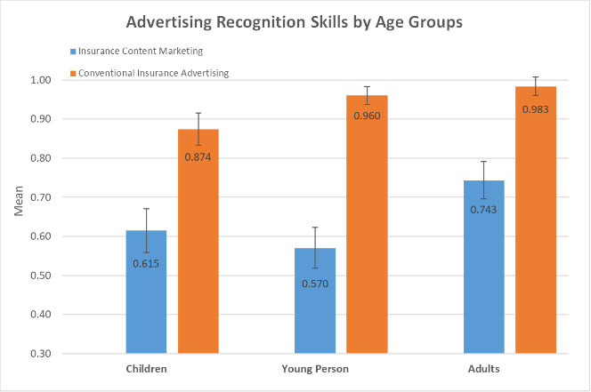
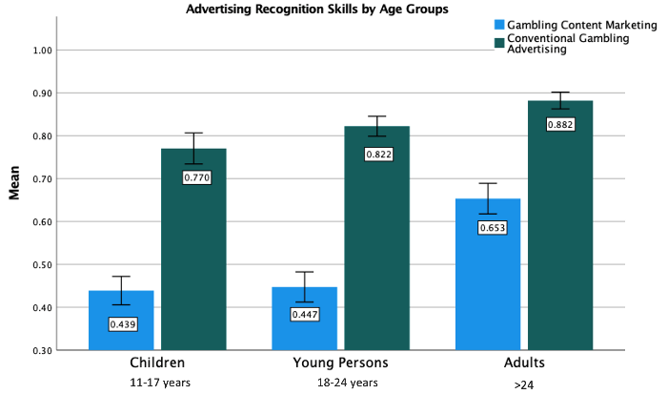
Results
Gambling Content Marketing is very hard to recognise as advertising – for all age groups.
Insurance Content Marketing is also hard to recognise – but participants were much better here – especially children.
Content marketing was much harder to spot than conventional advertising

Slide 33
Results
Gambling Content Marketing is very hard to recognise as advertising – for all age groups.
Insurance Content Marketing is also hard to recognise – but participants were much better here – especially children.
Content marketing was much harder to spot than conventional advertising
Children and young persons are similarly bad at recognizing content marketing as advertising

Slide 34
Results
Gambling Content Marketing is very hard to recognise as advertising – for all age groups.
Insurance Content Marketing is also hard to recognise – but participants were much better here – especially children.
Content marketing was much harder to spot than conventional advertising
Children and young persons are similarly bad at recognizing content marketing as advertising
-> Content Marketing is really hard to recognise as advertising – meaning that advertising literacy protections may not be activated.
Ads might hit them fully unprotected.

Slide 35
4. IMPLICATIONS & RECOMMENDATIONS

Slide 36
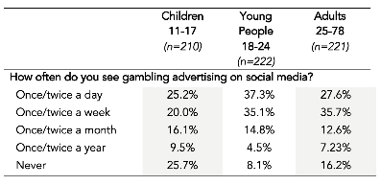
Implications
Content marketing bypasses protections, making them incredibly dangerous.
Around 40% of all gambling ads on social media (ie content marketing) seems to be in breach of CAP code 2.1.
Potential explanation why content marketing is highly appealing to all age groups.
Most self-reported exposure data might substantially underreport
Source: Rossi & Nairn, 2021

Slide 37
Recommendations
Ban gambling content marketing.
Include an advertising labeling (eg “This is advertising”
Extend advertising protections to 18-24-year-olds.

Slide 38
Thank you for your attention.
Dr Raffaello Rossi
raffaello.rossi@bristol.ac.uk
@Raffaello_Ro

