Slide 1
Mobile push-notifications by the Belgian betting industry: a content analysis
Niels Bibert, Eva Grosemans,
Bieke Zaman, Rozane De Cock
Institute for Media Studies (IMS)
KU Leuven, Leuven (Belgium)
niels.bibert@kuleuven.be

Slide 2
Problem statement
The “Mediatization of Communication” (Lundby, 2014, Hepp, 2020) means new possibilities for gambling companies to promote their products and ideas
The worldwide emergence of betting apps has brought new forms of gambling marketing to the fore, such as mobile push-notifications (Rawat et al., 2020).
Most sports betting marketing research has overlooked this type of direct marketing, despite its known / assumed influence on app re-use, overspending, riskier and impulsive betting (Killick & Griffiths, 2022; Rawat et al., 2020; McGrane et al., 2023).
If available, research is Anglo-Saxon in nature and deploys a relatively short study timeframe.

Slide 3
Objectives
Exploring the production of mobile push-notifications
by bookmakers licensed in Belgium.
  RQ 1: Bookmaker provenance
  RQ 2: Targets (& volume)
  RQ 3: Promotional strategies
Evaluating a grounded theory of sports betting advertising (Lopez-Gonzalez et al., 2018)
  Control versus risk balance hypothesis
  UK-oriented, focus on television advertisements
Anticipated contributions
Insight in ‘Belgian’ gambling marketing efforts
Informing gambling policy at local level
Advancing theory development

Slide 4
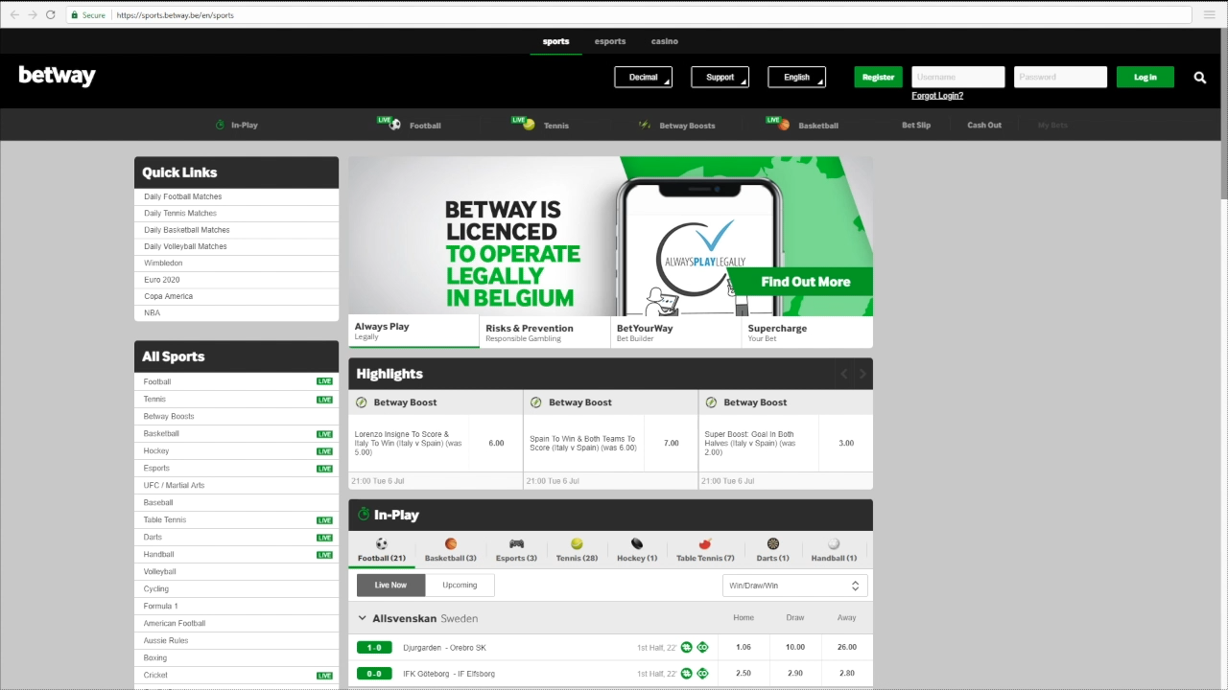
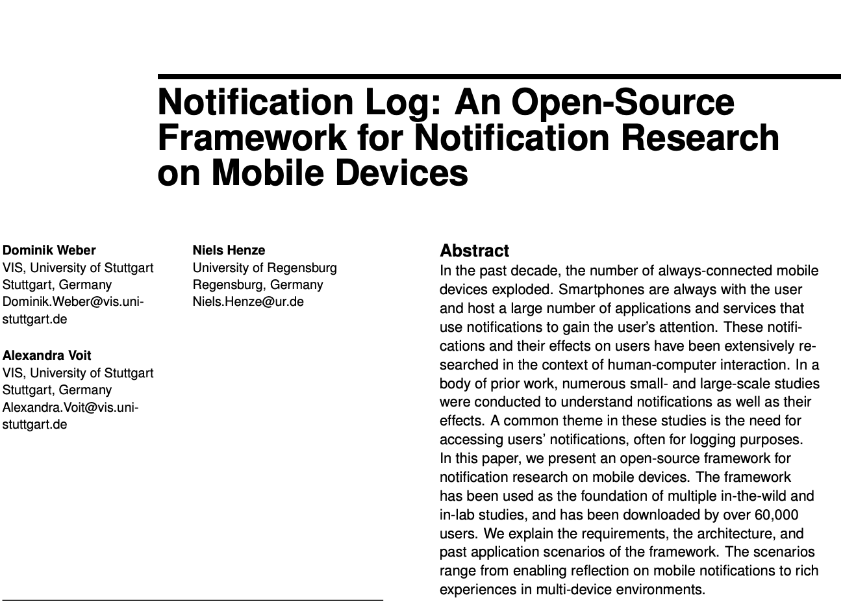
Methodology (1)
PREPARATIONS (July 2021)
Create an account on all licensed online betting
plaforms in Belgium (N = 24)
Add money to your accounts
to make them appear ‘real’.
Search for the bookmaker’s app, install, log in and opt-in
to all promotions (N = 15)
Install Notification Log to
track mobile notifications
(only for Android)

Slide 5
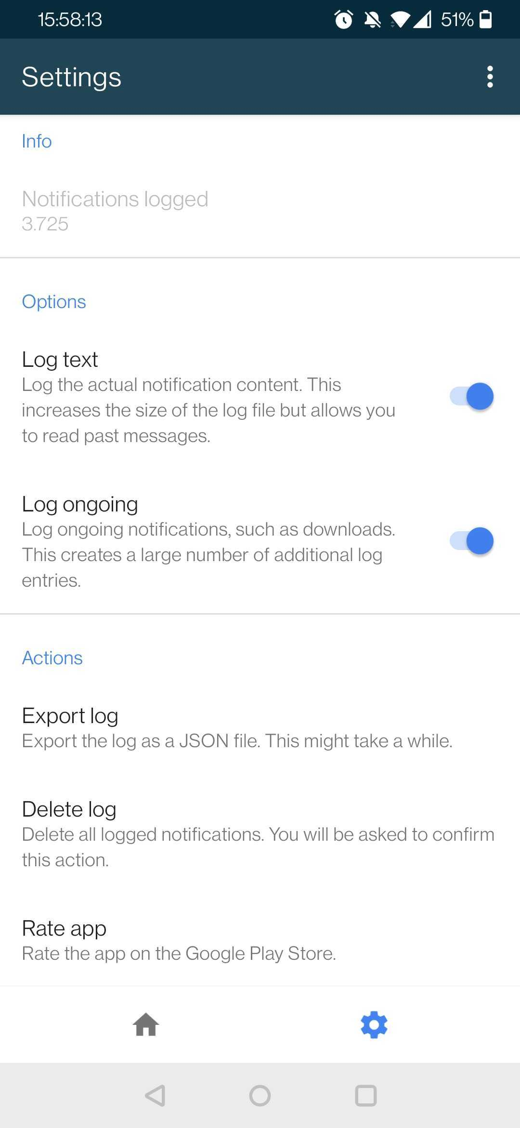
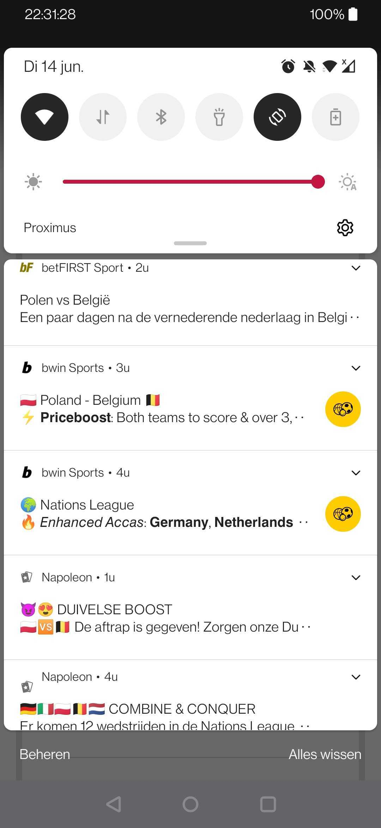
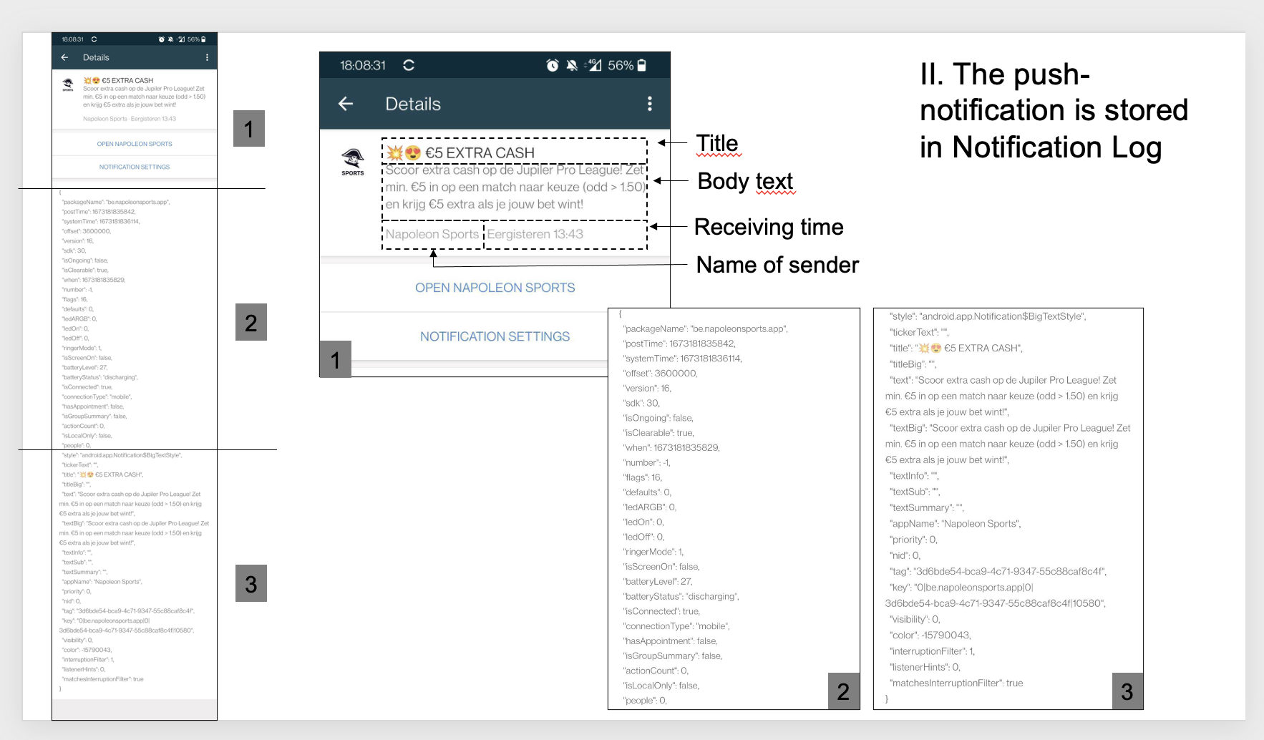
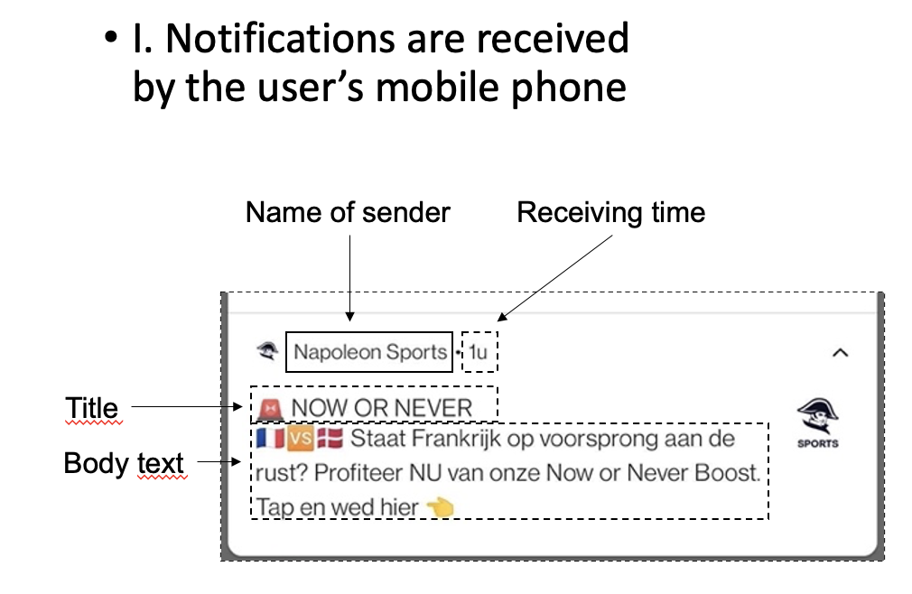
Methodology (2)
DATA COLLECTION
(July 2021-December 2022)
Keep your phone charged and connected to the internet at all times (as much as possible)
Don’t gamble, see what happens, but visit the app regularly (e.g., monthly basis)
Although the Notification Log tool tracks everything,
take some screenshots too.
Export the data soon enough, in order to avoid big JSON-files

Slide 6
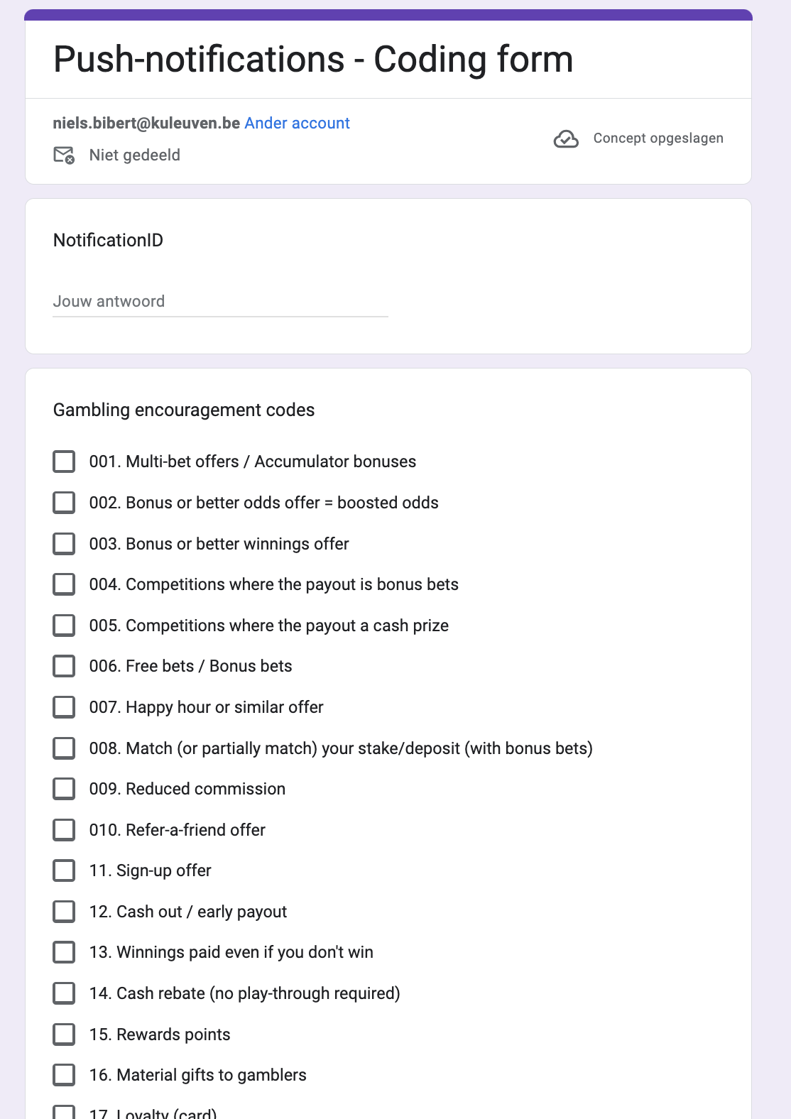
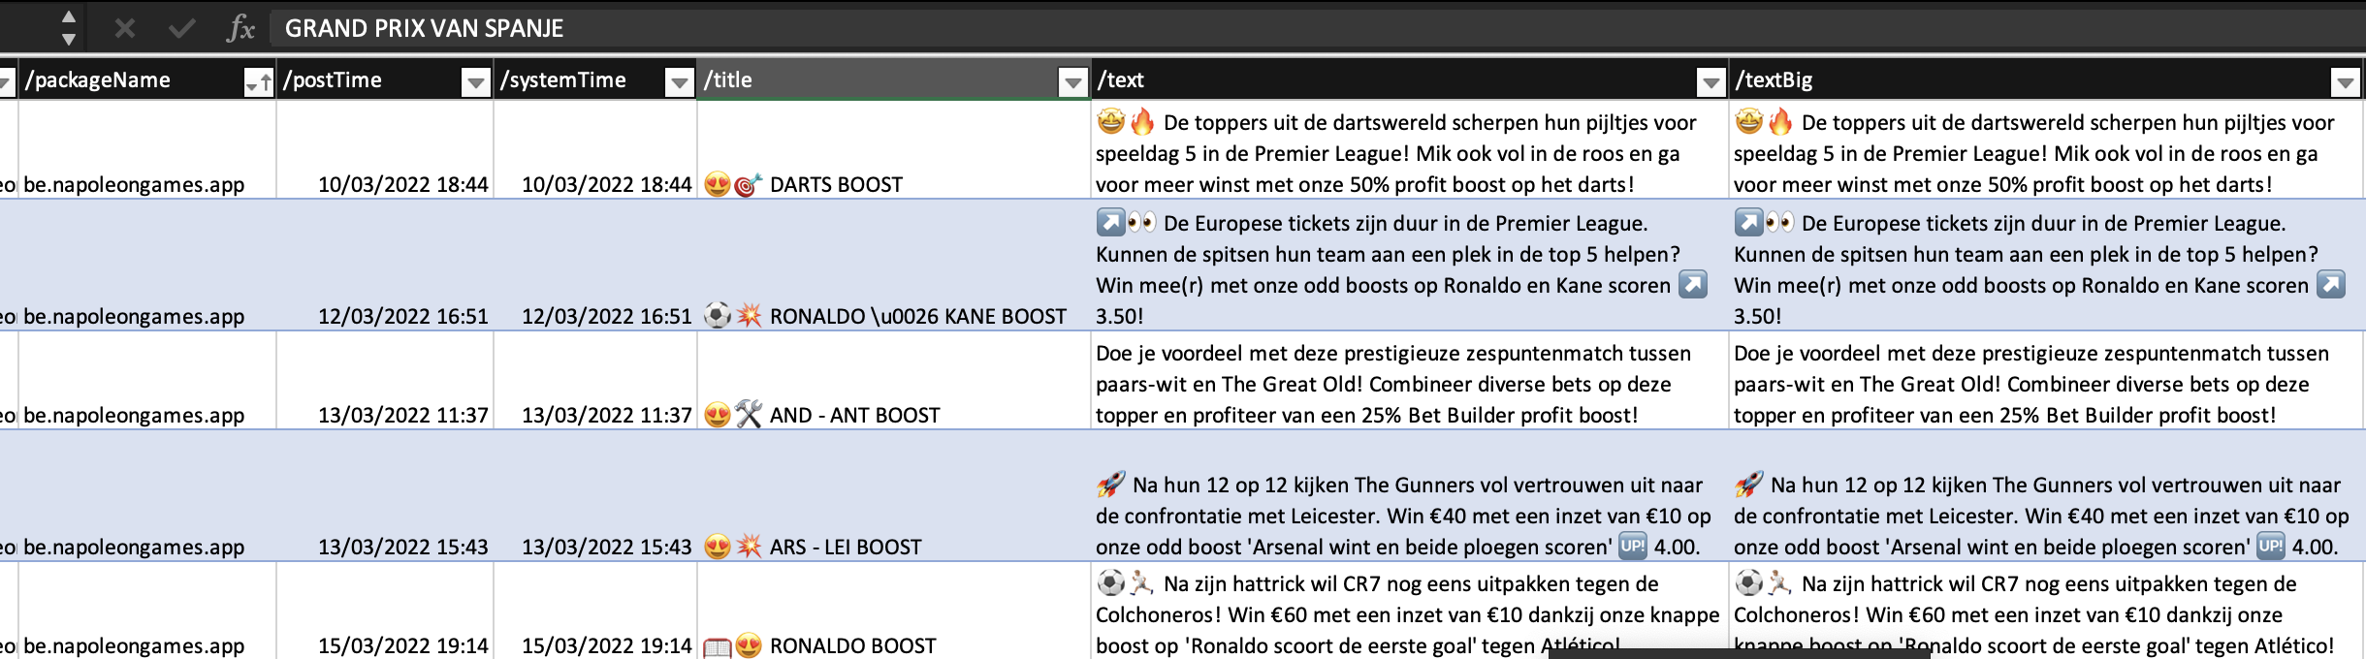
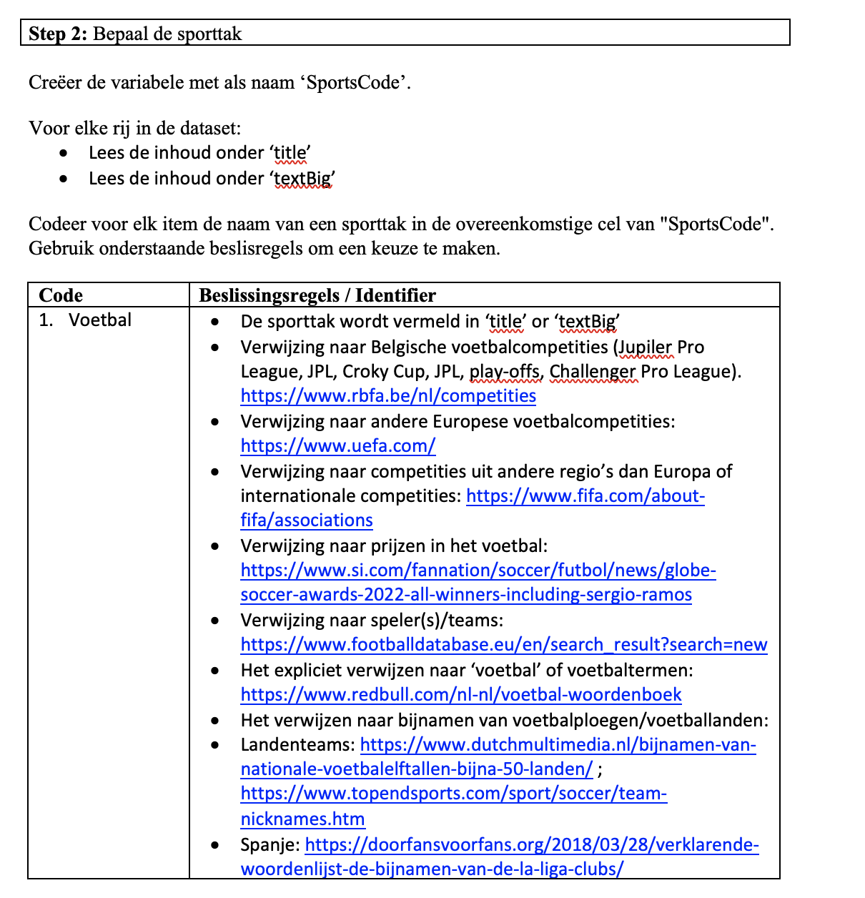
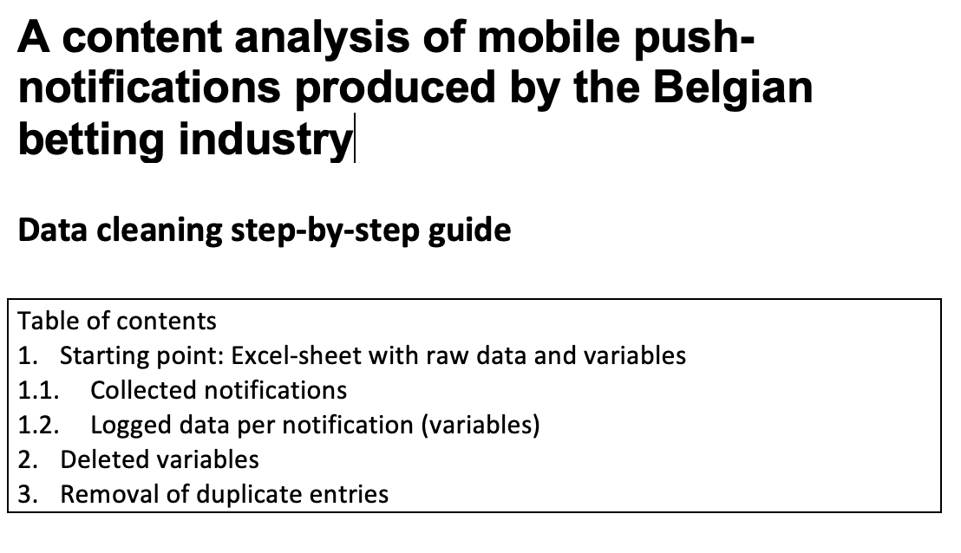
Methodology (3)
DATA ANALYSIS
(February-July 2023)
Data cleaning with Excel
(takes time), described in
a step-by-step logbook
Develop a detailed data
analysis protocol per RQ
  1. Provenance (= name)
  2. Targets
  (time & date, sports & bet type)
  3. Strategies
  (gambling encouragement)

Slide 7
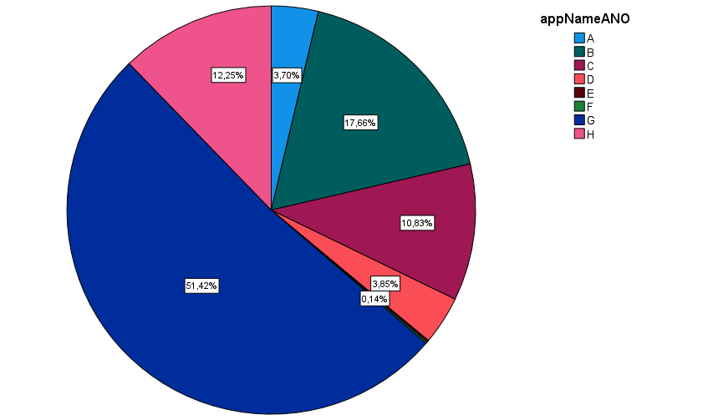
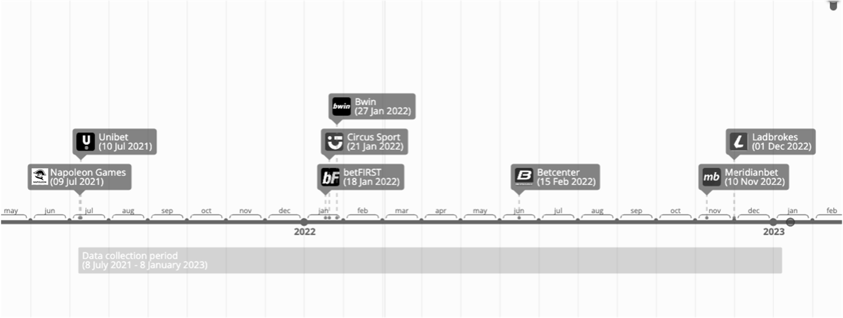
Results – RQ1: Provenance
DIFFERENT PRIORITIES?
App-supported notifications | App, but no notifications | License, but no app
Napoleon Games Unibet Bwin Circus Sport betFIRST Betcenter Ladbrokes Meridianbet | ZEbet Blitz Bet777 Betway Stanleybet Magic Betting Scooore (app since Dec 2022) | Eurotiercé ZEbet Starcasino Golden Palace Bingoal FootFoot Vivatbet Golden Vegas Family Sports
First notification

Slide 8
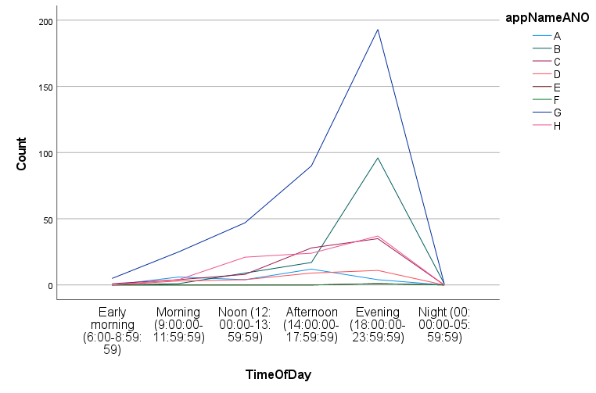
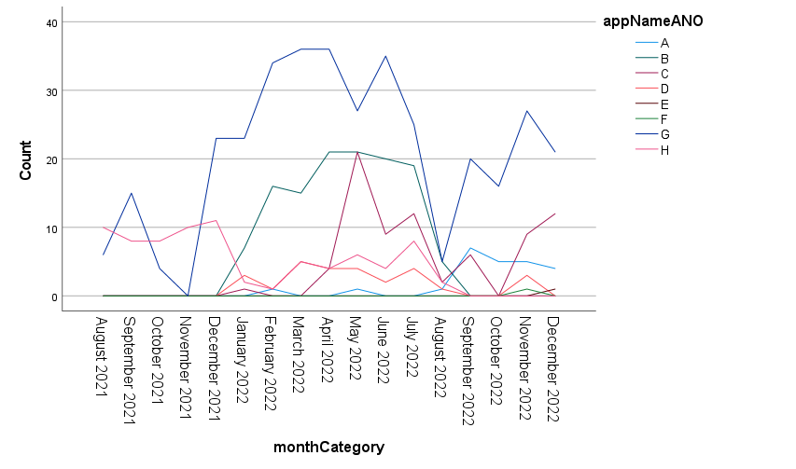
Results – RQ 2: Targets
TIME AND DATE
Time patterns
Evening peaks
+/- 1-2h before the start of
one or more sports events
Day before an event
March-May 2022: UEFA cups KO stage;
Belgian PO; Africa Cup; Flanders classics; Formula 1 & Darts PL
June 2022 : Nations League, WC Darts, Tennis RL, Basketball PO
Nov-Dec 2022: WC Soccer

Slide 9
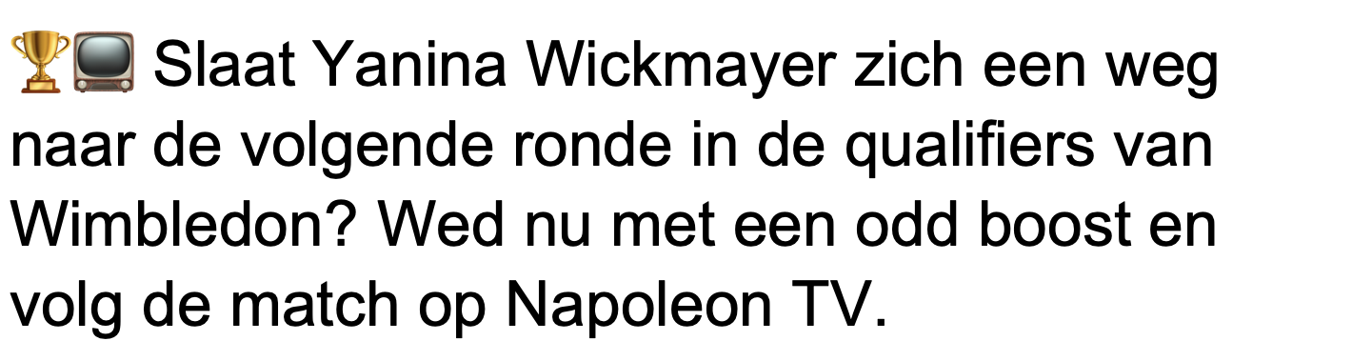
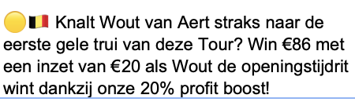
Results – RQ 2: Targets
SPORTS EVENTS
11 different sports
  Soccer (77.7%), Tennis (5.8%)
  Cycling (4.2%), Basketball (2.5%)
  American Football, Darts, F1, Horseracing, V-sports, Hockey
Mostly about:
  The most prestigious competition(s) (e.g., Tour De France, Tennis Grand Slams)
  Best-performing players
  or teams or participating Belgians

Slide 10
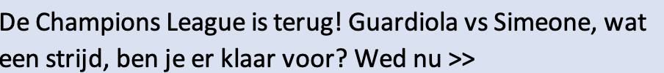
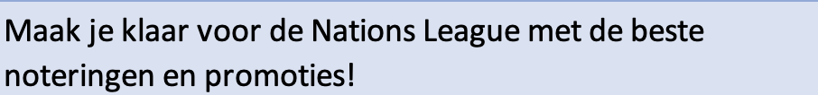
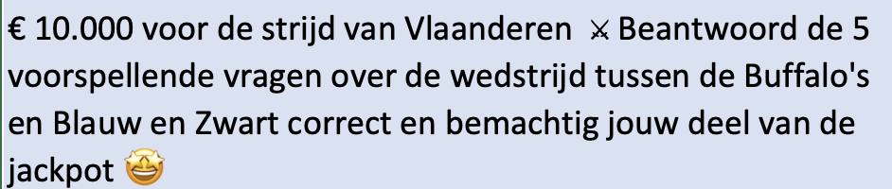
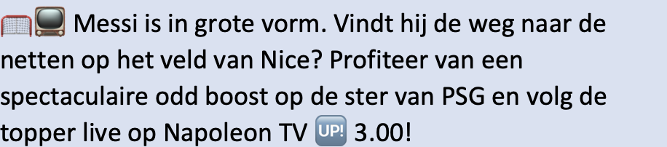
Results – RQ 2: Targets
SOCCER EVENTS
Promoted most (77.7% of total)
In most diverse ways
  national and international
  club- and country-level
Club-national and UEFA-organized tournaments
Primarily focused on
  male-only games
  (rival) Belgian, English teams
  clubs from well-known (Belgian) players
  (De Bruyne, Messi, …)

Slide 11
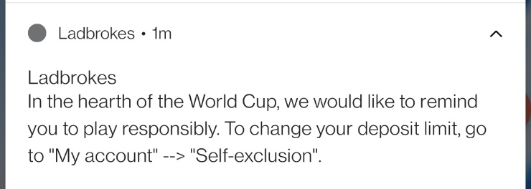
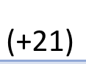
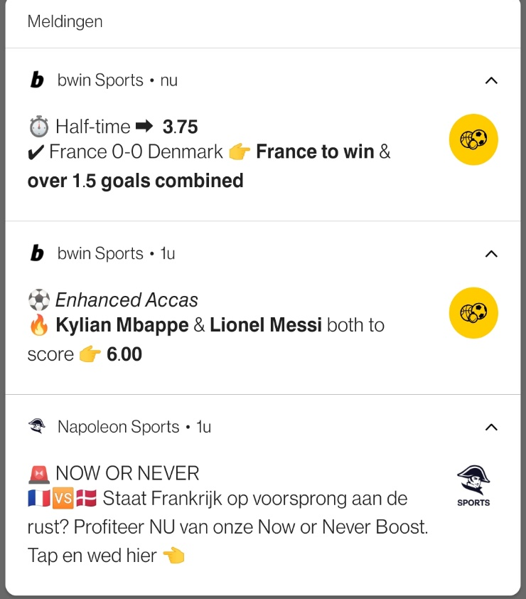
Results – RQ 2: Targets
BET TYPES
Encouragement (99.5%)
vs. Responsible Gambling. (< 0.5%)
Pre-game bets (78.1%)
vs. Live betting (19.1%)
vs. Both (2.8%)
Combo (47,5%)
vs. Single (30%)
vs. Not specified (22,5%)
Game-level (64.2%)
vs. Competition (27.2%)
vs. ‘Betting in general’ (2.7%)
No odds (72.8%) vs. Odds (27.2%)

Slide 12
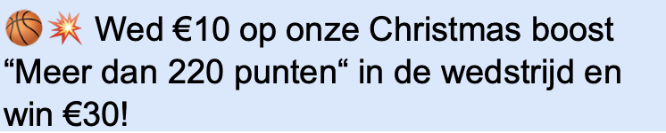
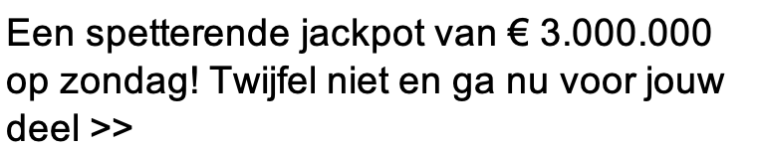
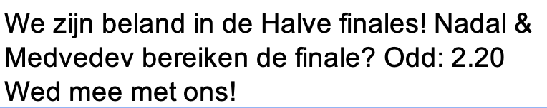
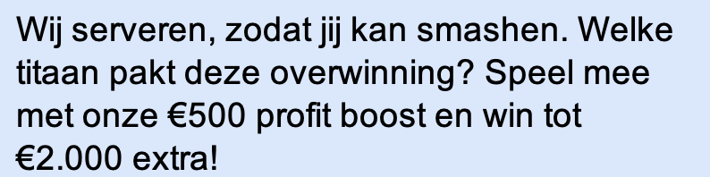

Results – RQ 3: Strategies
RISK-REDUCING (R)
Financial incentives / nudges
(odds boosts, FREE bets / gifts,
FREE betting competitions)
Betting glamorization (status, amusement, excitement, jackpots)
Betting normalization
(stressing sentimental bonds with,
or love for: others, sport, bookmaker)
Winning overestimations (winning guaranteed, easy to win, being lucky)
Endorsements (sports personality)
Humour (satire, parody)

Slide 13

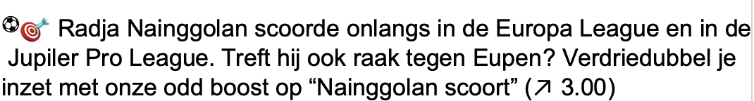
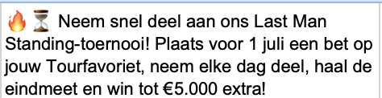
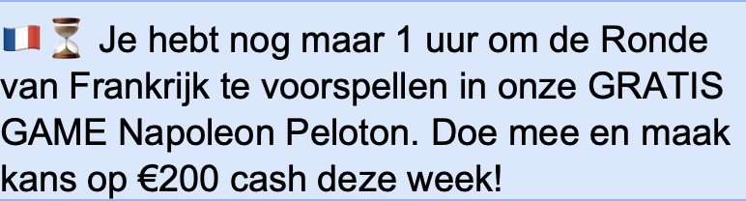
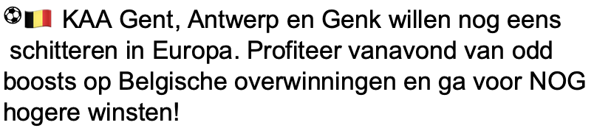

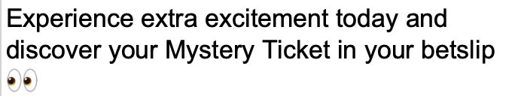
Results – RQ 3: Strategies
CONTROL-ENHANCING (C)
SENSE OF URGENCY (U)
Platform usability
(ease of use, superiority)
Betting assistance (odds & stats, betting tips, sports news)
Gender stereotypes
(“Last Man Standing”)
Scarcity of betting time
(bet NOW!)
Game-start reminders
Exclusiveness
(top topicals, one-time bets)

Slide 14
Discussion
Differential adoption and nature of mobile push-notifications within the Belgian betting industry
Extending the grounded theory (?)
Limitations
Opted-in vs. ‘pushed’
Only one researcher
(Android phone)
No platform-interaction
Removing barriers
Increasing pressure
  (R) Don’t worry! (Be happy)
  (C) You can do it! (Yes, you can)
  (U) Do it quick! (Before you regret)
Future research
Audience studies
Mobile vs. TV vs. Billboard
Placing bets (funding?)

Slide 15

Any questions?
Niels Bibert
PhD Candidate, KU Leuven
Teaching Assistant, UHasselt
niels.bibert@kuleuven.be
Funded by KU Leuven,
Faculty of Social Sciences
No conflicts of interests

