Slide 1



Presentation by Sarah Page (Senior Lecturer Sociology & Criminology / Action Against Poverty and Hardship and Co-Director of the Staffordshire University Crime and Society Research Group at Staffordshire University)
Current Advances in Gambling Research Conference (CAGR) June 2023
Title: Criminal Justice Treatment Pathway Need in England and Wales

Slide 2

Presentation Outline
This presentation will explore:
Info on research projects and research teams.
Gambling harms and mental health considerations for sentencing.
Sentencers’ understanding and awareness of problem gambling and gambling related crime.
Examples of sentencing practice in magistrates’ courts in England and Wales when problem gambling is raised as a contextual factor to the crime and suggestions for future practice.
An understanding of ‘what next’ for underpinning the new/planned national HMPPS gambling strategy.

Slide 3





Research Context/Partners
Commission on Crime and Gambling-Related-Harms (previously known as the Commission for Crime and Problem Gambling) has been chaired by Lord Peter Goldsmith KC since 2019. Staffordshire University was commissioned from 2020 to 2021 by the Howard League for Penal Reform in partnership with the Magistrates Association, to undertake research for the wider Commission on Crime and Gambling-Related-Harms.
GamCare commissioned Staffordshire University as a Learning Partner regarding gambling harms and the CJS in 2022 and we are continuing this work.
HMPPS commissioned Staffordshire University in 2023 to undertake a national HMPPS survey in prisons and with those on probation and we are continuing this work.
Notes:
It aimed to investigate links between crime and gambling-related harms, what impact they have on communities and wider society, and what steps could be taken to reduce crime and make people safer. This was the UK’s first-ever inquiry into crime linked to gambling. (The Howard League for Penal Reform, 2023)

Slide 4



Research Team members:
Acknowledging the Research Team:
Sentencers Understanding:
Staffordshire University (Sarah Page, Associate Professor Dr Jo Turner, Sarah Plimley, Simon Bratt, Kathryn McFarlane & Laura Bailey).
Howard League for Penal Reform (Anita Dockley & Dr Helen Churcher) & the Magistrates Association (Jon Collins, Dr Jo Easton & Hattie Stair).
Gambling Harms and the CJS
GamCare: Chris Walker, Dominque Webb
HMPPS: Caroline Bonds
Staffordshire University: Sarah Page, Associate Professor Jo Turner, Sarah Plimley and research assistant Bob Ticknall.
Additional acknowledge to Eartha Heptinstall for survey construction work

Slide 5
Sentencers Understanding of Gambling-Related-Crime
Online Questionnaire (Phase 1) to MA members (total 656 participants)
Online Focus Groups (Phase 2a) with Magistrates x 6 Groups (total 26 participants)
Online World Café (Phase 2b) with Stakeholders (21 delegates) with E-Question Follow Up
Underpinned by a ‘Collaborative Model’ and Participatory Ethos – connecting to Commissioners & the Sector
Themed Analysis & SPSS/Excel Statistical Analysis

Slide 6
Gambling Harms and CJS
Questionnaire to offenders via prisons and probation in England and Wales (sample so far 201 out of 216 submitted)
Online World Café and Focus Groups with offenders on probation and probation staff TBC
In custody world café and focus groups with prisoners and prison staff in 2 prisons TBC
Focus Groups and 1 x World Café (Lived experience experts and Affected Others N = 12; Professionals N = 9)
Themed Analysis & SPSS/Excel Statistical Analysis

Slide 7
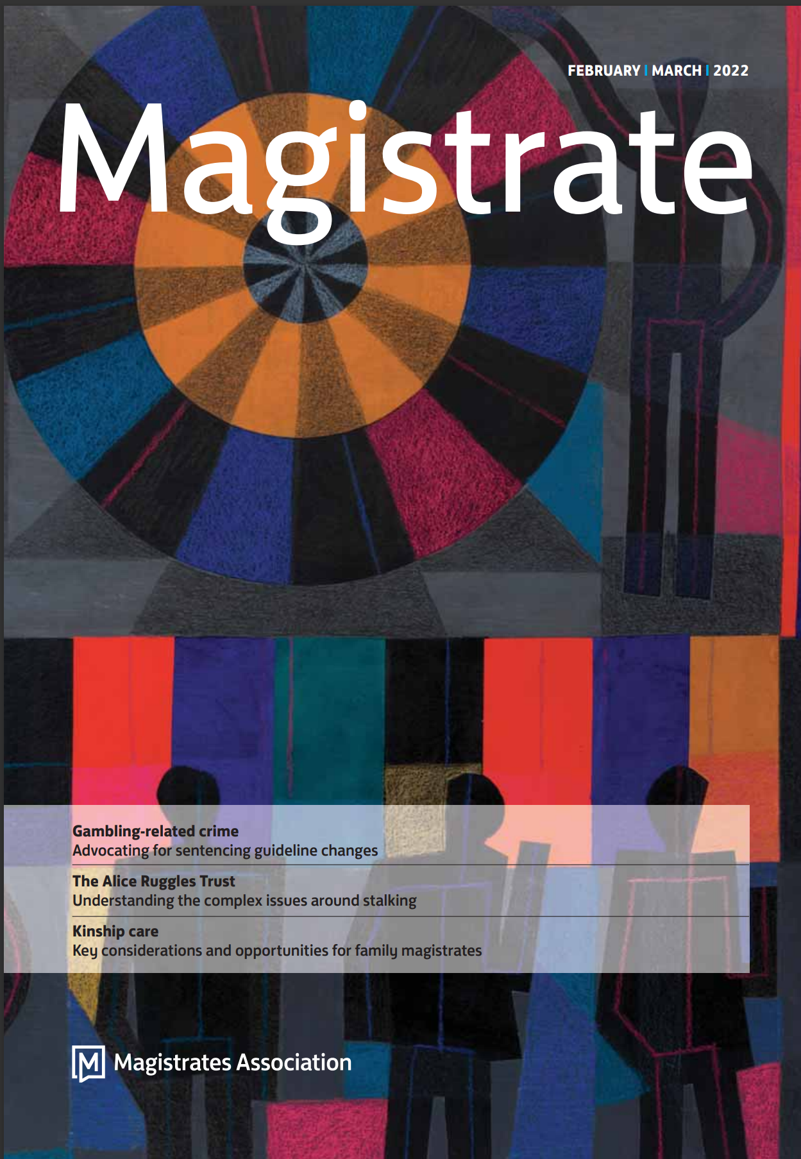
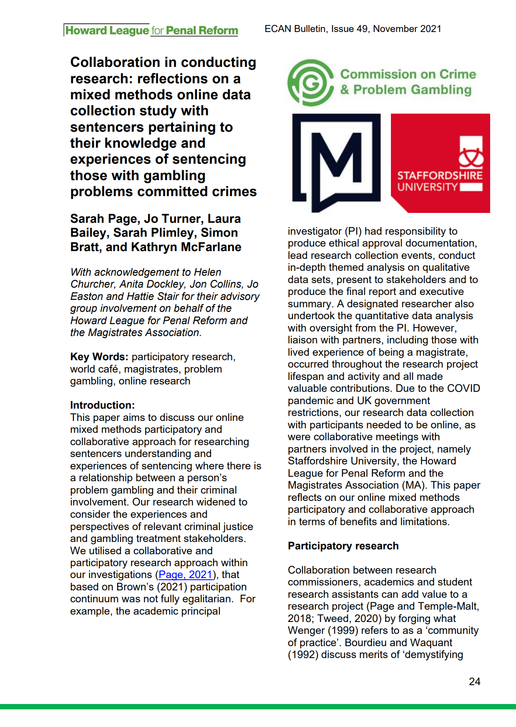
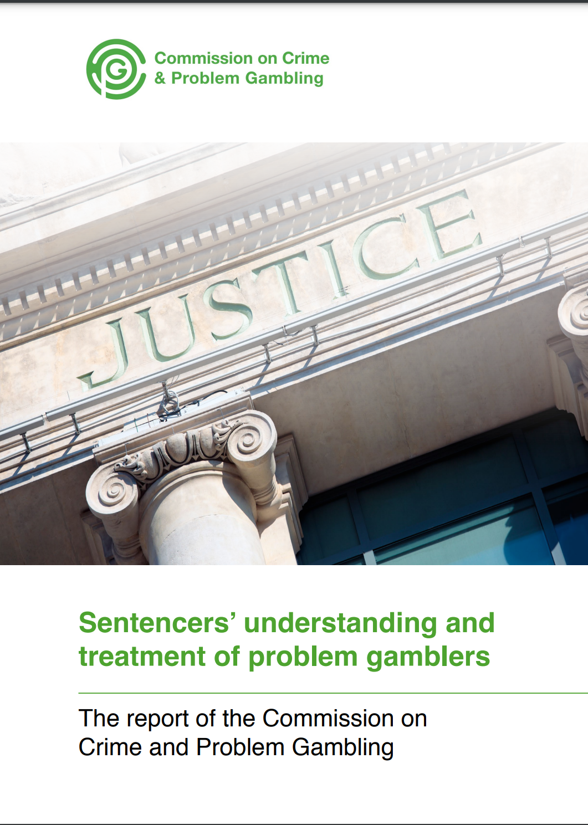
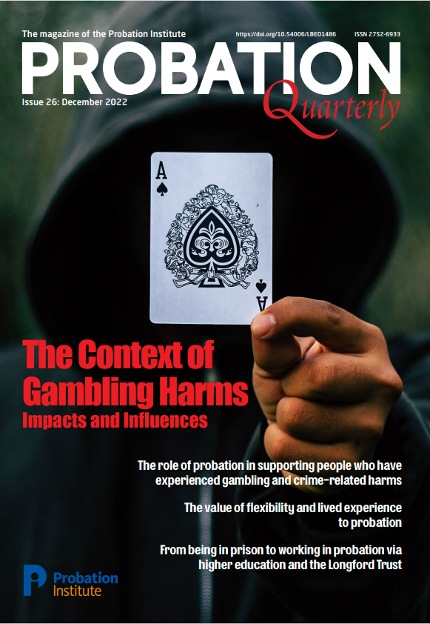
Our Research Publications

Slide 8
Gambling Harms
Whilst people gamble and do not experience high levels of harm, many do.
Problem Gambling is a mental health disorder noted in both the Diagnostic and Statistical Manual of Mental Disorders (DSM-V) and the World Health Organisation’s International Classification of Diseases (WHO ICD, 2021). It is regarded as an addiction, with similar cognitive and mental health impacts to substance misuse addiction (Page, 2021; Page et al, 2022). 93% of magistrates saw the likeness to drug and alcohol addiction (Page, 2021).
Problem Gambling is a public health concern (Abbott, 2020). Gambling prevalence data in Great Britain from 2016 estimates ‘… somewhere between 200,000 and 410,000 adults’ experience problem gambling based on DSM VI criteria (Conolly et al, 2018: 71).
3% of the population is considered at risk of experiencing gambling related harms (Critchlow et al, 2020: 79).
Gambling harms include financial, relational, emotional, psychological, health and employment issues (Langham et al, 2016) and significant mental health decline including higher rates of suicide (Wardle et al, 2020). Those with lived experience in our current GamCare study have talked about mental health decline and suicidal thoughts.
Problem Gambling can also lead to crime and/or crime victimisation (Smith and Simpson, 2014; Zhang and Clark, 2020; Page, 2021). However, prevalence in criminal court is low (54% of magistrates said it never came up in court), but prevalence in family courts is more apparent (Page, 2021).
Current Sentencing Guidance in England and Wales does allow for mitigation pertaining to mental health (Page, 2021) and this needs utilising more (Commission on Crime and Gambling-Related-Harms, 2023). Evidence could come from a psychiatric/medical reports (ibid), or an expert witness as per Canadian practice (Smith and Simpson, 2014). Our recommendations include Sentencing Guidance amendments to incorporate mitigation for gambling addiction (Page, 2021).

Slide 9
Evidence of Gambling Addiction for Court
Chasing losses tends to happen when neuro-cognitive functioning has been altered and gambling addiction is present (Smith and Simpson, 2014; Zhang and Clark, 2020). People will still gamble despite being in debt (Leeman and Potenza, 2012; Zhang and Clark, 2020; Goudrian, 2020).
Being compelled to gamble usually leads to debts spiralling out of control and people with previous good character engaging in acquisitive crime. Magistrates acknowledges the ‘spiral out of control’ when sentencing (Page, 2021).
The evidence indicates that ‘rational choice’ in relation to crime decisions is hindered when someone is addicted to gambling (Page, 2021). The issue of ‘culpability’ also needs attention due to gambling operator and banking practices (Commission on Crime and Gambling-Related-Harms, 2023; 40).
In England and Wales, ideally, we need evidence captured in the PSR and treatment recommendations and magistrates would welcome information on the extent of issue and likelihood of re-offending (Page, 2021). HMPPS are working on a question(s) about gambling being added to the current assessment tool(s). Defence lawyers are less likely to raise gambling addiction without mitigation being added to sentence guidance (Page, 2021). Defendants do not always perceive their gambling as an addiction or problematic, despite being charged with an offence (Page, 2021).
Some Sentencers in England and Wales were concerned that people might pretend to have a gambling addiction to get a ‘softer’ sentence (Page, 2021). Psychiatric/medical reports could be used as evidence (Commission on Crime and Gambling-Related Harms, 2023; 40) and banking details (Smith and Simpson, 2014).

Slide 10
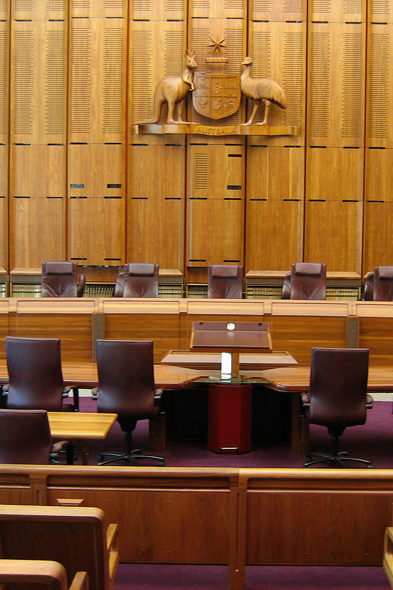
Court Room Considerations
Stakeholders explained that pockets of Probation/Police/Liaison and Diversion staff have been trained in Gambling Screening, treatment referrals, gambling harms and links between gambling and crime by GamCare and Beacon (Page, 2021). Training needs to become mainstream practice to achieve consistency.
A Whole Systems Approach has been used in a pilot in Hertfordshire led by GamCare (Page, 2021).
In Wales, CJS staff training webinars are being co-ordinated by HMPPS/MOJ and delivered by ARA.
This Photo by Unknown Author is licensed under CC BY-SA

Slide 11



Awareness from Court Experience – The Defendants
Those presenting in court (mainly males) were recalled as having the following issues (Survey data):-
Financial Issues e.g. Debt (56.7%)
Alcohol Addiction (31.2%)
Relationship Breakdown (29.9%)
Drug Addictions (21.5%)
Job Loss (20.5%)
Poor Mental Health (17.4%)
Adverse Childhood Experiences (5.7%)
This Photo by Unknown Author is licensed under CC BY-SA-NC
This Photo by Unknown Author is licensed under CC BY
This Photo by Unknown Author is licensed under CC BY-NC

Slide 12
Court Experiences: The Defendants
In Page (2021) most of the sentencing examples provided by Magistrates related to acquisitive crime and breaches of trust in the workplace:
“… he was a boiler engineer, and he had … taken about £3,000 off… a couple, to replace their boiler… he didn’t turn up for work, and the money had gone towards, to fund his gambling addiction… It was part of his, sort of mitigation if you like… he was incredibly remorseful… think he got a community order and he had some RAR days. But it was difficult to pinpoint help for him… That’s where the hole is (pause). The couple were awarded compensation to get their money back…” (Magistrate P3, focus group 6)
“…the one case that I can recall, that involved gambling was to do with a … lady who was doing theft from a shop to fund her habit of … purchasing the lottery scratch cards… it was causing issues at home, and this was raised you know in mitigation… I think eventually we did manage a community disposal… I don’t think there was anything specific [gambling therapeutic support] … it was just things probation would have to organise through the supervision element of the community order…” (Magistrate P6, focus group 2)
In both examples above, criminal justice system treatment for problem gambling was not available and it was believed that a community order was issued.

Slide 13
Court Experience – Deviance, Crimes & Upstreaming
Most common crimes in court were: Theft 25.7%, Unauthorised Credit Cards 14.6.%, Domestic Violence 11.4%, Assault 3%, Street Robbery 2.7%, Public Order Offences 1.7% & Child Abuse 0.6% (Page, 2021)
Most financial crime cases were up-streamed to Crown Court (Focus Groups). Magistrates Courts could deal with such first-time offender cases, if Sentence Guidance permitted (Focus Groups).
“…she had been involved in Theft of breach of trust...from an employer… she did work in the payroll department… had got access to the payment card to erm, you know, pay extra through people’s bacs or PAYE and she had helped herself to that… she had managed to divert, I think something like £25,000… she had spent it on the horses, as well. So, there was nothing to be recovered… I don’t remember any other addictions, erm. It was striking really, because it was so much money and this is a woman with previous good character. It was quite astonishing really... Anyway, I think that we declined a jurisdiction in view of the amount of money which she had stolen…” (Participant 3, Focus Group 4).
CJS Stakeholders and Magistrates talked about cases where up to £500K had been stolen from workplaces.

Slide 14

Core Findings – Sentencing Options
Fines and Prison sentences were perceived by Magistrates as detrimental to addiction recovery. Prison was considered last resort (Page, 2021).
Survey Data – 99.6% wanted a treatment package option for sentencing similar to drug/alcohol addiction that could contribute to RAR days (Focus Groups & Stakeholders). Magistrates would prefer Probation to commission existing expertise and want holistic options e.g. mental health support and debt management.
In Gambling-Solving-Courts in the US treatment is offered alongside a suspended sentence and finance and whereabouts is heavily monitored (tagging) and recidivism is reduced (Turner et al, 2017; Malkin, 2023). In Australia, treatment can include online-sessions (Adophe et al, 2019).
This Photo by Unknown Author is licensed under CC BY

Slide 15
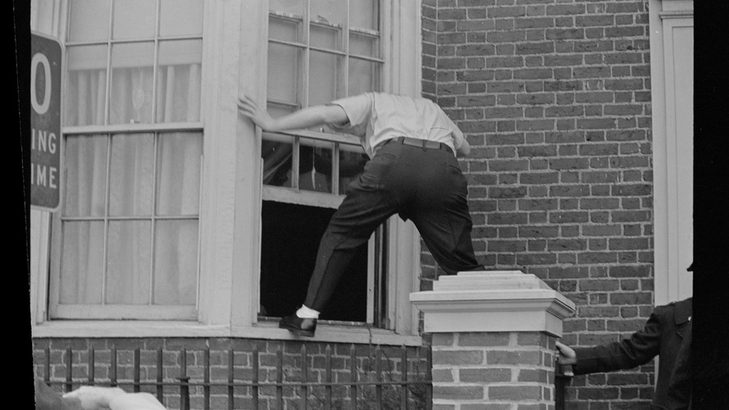
In Closing….
There is some sufficiency to Sentence under current Guidance, but more clarity on Problem Gambling as mitigating / aggravating factors would be welcomed to allow for standardisation (Page, 2021).
Current Guidance allows for mitigation for defendants voluntarily taking steps to address gambling addictions and also for mental health disorder.
Community Sentence Treatment Requirements (CSTRs) to address mental health needs could be used to address gambling disorder (Commission on Crime and Gambling-Related-Harms, 2023; 41).
Rehabilitation Activity Requirements (RAR) could include structured interventions to to facilitate an individual’s rehabilitation (Page, 2021; Commission on Crime and Gambling-Related-Harms, 2023).
Parole or post-sentence licence conditions for a treatment requirement is viable (Commission on Crime and Gambling-Related-Harms, 2023).
Consider bans from geographical and online spaces (Page, 2021).
This Photo by Unknown Author is licensed under CC BY-NC-ND

Slide 16
References
Abbott, M.W. (2020), ‘Gambling and gambling related harm: recent World Health Organization initiatives’, Public Health, 184:56–59.
Adolphe, A., Van Golde, C. and Blaszczynski, A. (2019) Examining the potential for therapeutic jurisprudence in cases of gambling-related criminal offending in Australia. Current Issues in Criminal Justice. Vol 31(2), PP.236-254
Commission on Crime and Gambling Related Harms (2023) Final Report.. Howard League for Penal Reorm, London. ISBN 978-1-911114-80-2 accessed online April 2023 https://howardleague.org/wp-content/uploads/2023/04/Final-report_Commission-on-Crime-and-Gambling-Related-Harms_Howard-League-for-Penal-Reform_26-April-2023.pdf
Connolly. A., Davies, B., Fuller, E., Hienze, N., and Wardle, H., (2018) Gambling behaviour in Great Britain in 2016: evidence from England, Scotland and Wales. London: NatCen Social Research; https://www.gamblingcommission.gov.uk/PDF/survey-data/Gambling-behaviour-in-Great-Britain-2016.pdf (accessed online 15/04/2021)
Critchlow, N. Moodie, C., Stead, M., Morgan, A., Newall, P.W.S. and Dobbie,F. (2020), ‘Visibility of age restriction warnings, harm reduction messages and terms and conditions: A content analysis of paid-for gambling advertising in the United Kingdom’, Public Health, 184:79–88.
Forward Trust (2020). Gambling Harm and Offenders: A survey of prisoners’ experiences. Available at: https://s34767.pcdn.co/wp-content/uploads/theforward-trust-gambling-report-with-summary-final.pdf (accessed online 20/06/2023)
Goudriaan, A. (2020), ‘Integrating neurocognition from bench to bedside in gambling disorder: from neurocognitive to translational studies’, Current Opinion in Behavioral Sciences, 31:83–88.
Langham, E., Thorne, H., Browne, M., Donaldson, P., Rose, J. and Rockloff, M. (2016), ‘Understanding gambling related harm: A proposed definition, conceptual framework, and taxonomy of harms’, BMC Public Health, 16:80.
Leeman, R.F.,and Potenza, M.N. (2012), ‘Similarities and differences between pathological gambling and substance use disorders: A focus on impulsivity and compulsivity’, Psychopharmacology, 219: 469–490
May-Chahal, C., Clifton, A., Anderson J. and Humphreys, L. (2015) The OffGam Pilot: Towards the Development of Gambling Awareness and Problem Gambling Interventions in English Prisons. Available at: DOI:10.13140/RG.2.1.4572.0801
Malkin, M, (2023) Problem Gambling, General-Strain Theory, and Gender The 18th International Conference on Gambling and Risk Taking, Las Vegas. Thursday 25th May 2023
McGee, D. (2020) On the normalisation of online sports gambling among young adult men in the UK: a public health perspective. Public Health. Vol 184, PP.89-94
Page, S. (2021) Sentencers’ understanding and treatment of problem gamblers: The report of the Commission on Crime and Problem Gambling. Howard League for Penal Reform, London ISBN 978-1-911114-59-8.
Page, S., Turner, J.,and Plimley, S. (2022) Identifying gambling-related harms earlier to inform sentencing and treatment pathways. Probation Quarterly. Issue 26, ISSN 2752-6933 pp 55-60
Purves, R., Critchlow, N., Morgan, A, Stead, M. and Dobbie, F. (2020) Examining the frequency and nature of gambling marketing in televised broadcasts of professional sporting events in the United Kingdom. Public Health. Vol 184, PP.71-78
Smith, G. and Simpson, R. (2014) Gambling Addiction Defence on Trial: Canadian Expert Witness Perspectives. International Journal of Criminology and Sociology. Vol 3, PP.319-326
Turner, N.E., McAvoy, S., Ferentzy, P., Matheson, F.I., Myers, C., Jindani, F., Littman-Sharp, N. and Malat, J. (2017), ‘Addressing the Issue of Problem Gambling in the Criminal Justice System: A Series of Case Studies’, Journal of Gambling Issues, 35:74–100.
Wardle, H., John, A., Dymond, S. and McManus, S. (2020), ‘Problem gambling and suicidality in England: secondary analysis of a representative crosssectional survey’, Public Health, 184:11–16.
Zhang, K. and Clark, L. (2020) Loss-chasing in gambling behaviour: neurocognitive and behavioural economic perspectives. Current Opinion in Behavioral Sciences. Vol 31, PP.1-7
Notes:
In relation to mitigation, there are two potential elements which in our view the Sentencing Council must consider. First, whether the defendant has a gambling addiction and secondly, the implications for culpability of a gambling operator or bank’s failure to safeguard people who had become vulnerable because of their gambling. For example, there is an opportunity to consider these matters in offence specific guidelines and to revise the overarching sentencing guideline which covers mental disorders to include gambling disorder alongside substance use disorders (Sentencing Council, 2020). Similarly, the equalities guidance for sentencers makes numerous references to substance use but does not mention gambling (Sentencing Council, 2021). Related to this, we found that defence lawyers are currently unlikely to raise gambling in court in mitigation. Changes to guidelines would automatically generate greater attention by legal professionals to gambling-related harms (Page, 2021). In recognition that there was uncertainty amongst sentencers of their powers in respect of gambling-related cases, the Sentencing Council could also provide guidance on appropriate assessment— including obtaining psychiatric or medical evidence of gambling addiction—and sentencing options. It stands to reason that fines should not be considered as appropriate sanctions in such cases, indeed the sentencers involved in our research themselves saw them as problematic and wished to see therapeutic interventions instead being made available to the courts (Page, 2021). An example of this are drug and alcohol treatment requirements which can be attached to community sentences. We have identified a range of other sentencing options which could usefully be applied to crimes related to gambling within the scope of existing sentencing powers: • Deferral of sentencing for up to six months to enable addiction or mental health treatment prior to sentencing (Powers of the Criminal Courts (Sentencing) Act, 2000). • Use of suspended sentences as alternatives to immediate custodial sentences to enable addiction or mental health treatment. • Use of requirements attached to community sentences or suspended sentences could be tailored to support people experiencing gamblingrelated harms to access treatment and support programmes. – Community Sentence Treatment Requirements (CSTRs) are currently available to address mental health needs which could be used to address gambling disorder. The Commission on Crime and Gambling Related Harms: Final Report 41 – Rehabilitation Activity Requirements (RAR) can provide time for structured interventions designed to meet a need identified to facilitate an individual’s rehabilitation. • Inclusion of treatment within parole or post-sentence licence conditions for people under probation supervision following release from custody. Recommendations • The Ministry of Justice should pilot and evaluate the use of existing sentencing options for gambling-related crime to examine their benefits and examine whether the existing legislation is sufficient to recognise and support gambling-related harms. • The Sentencing Council should consider what improvements could be made to sentencing guidelines to ensure that gambling disorder is appropriately dealt with by the courts, including on culpability (and related mitigation), mental disorders, and in relation to appropriate sentencing options. • The Judicial College should consider revising the Equal Treatment Benchbook to ensure that it is reflective of differential experiences of gambling disorder, alongside its current consideration of drug and alcohol use. • HMPPS policy framework should include guidance on appropriate pathways for people experiencing gambling-related harms to support probation officers who provide advice to court on sentencing options. The assets confiscation regime Alongside the sentencing process, gambling crimes related to misappropriation of funds are subject to proceeds of crime considerations. The Proceeds of Crime Act 2002 currently treats people whose gambling is instrumental in their offence—who typically exhaust all the resources they have acquired through crime on their gambling—and those who make large criminal financial gains through drug crime or people trafficking, for example, in the same way. In our interim report State of Play, we summarised our evidence on this and drew attention to the fact that this can result in individuals and/or their families having to find money which does not exist to repay the estimated gains, over long periods of time, and the potential for such significant debts to have perverse impact on prospects of rehabilitation by limiting the capacity to earn and the issue of further sanctions, including imprisonment, if the payments are not maintained (Commission on Crime and Gambling Related Harms, 2021d. See also; Smith, 2022). 42 At that time, we had submitted evidence to the Law Commission’s review of the relevant legislation about the potential unfairness of the regime for the small number of confiscation proceedings that are applied to cases related to gambling and called on the Law Commission to consider whether there is scope for greater discretion to be exercised (Howard League for Penal Reform, 2021). In particular we highlighted: • the lack of material benefit of such offences as stolen funds are typically ploughed straight back into gambling or to pay off existing debts which arose from gambling; • the impact of the confiscation regime on secondary victims—because there are no other realisable assets—which in effect places the financial penalties on the families until the ‘debts’ are paid, which may well be lifelong; • the risk that having significant, seemingly insurmountable debts to pay in cases of gambling addiction would incite further offending, contrary to the legislation which places an obligation on prosecution authorities to exercise their powers in a way “best calculated to contribute to the reduction of crime”; and • the fact that there is wider culpability for gambling-related crimes reflected in expectations about the social responsibility of gambling operators and banks and their legal obligations to detect and prevent money laundering which are investigated separately and seemingly not taken into account in confiscation proceedings, partly due to differences in the timings of the various processes. In November 2022, the Law Commission made various recommendations to seek to ensure the fairness of the confiscation regime, some of which may have relevance to cases related to gambling disorder and which we welcome. These include, for example, alterations to the statutory objectives of confiscation including removing punishment as an objective, measures to ensure earlier resolution of confiscation proceedings, confiscation amounts which better reflect the benefit gained, greater judicial discretion to the application of ‘criminal lifestyle’ assumptions, and measures to address the ‘life-sentence’ of judgments including making them time-limited or providing for them to be “put into abeyance” (Law Commission, 2022). There appears to us to remain a challenge with the relationship between the Gambling Commission’s proceedings to investigate failures by gambling operators where crime has occurred which includes the recovery of stolen money and the confiscation regime which the Law Commission proposes speeding up. The former process typically takes time, and it is therefore unlikely that the liability of the operators and amount of compensation owed to the victim will be determined prior to decisions about asset confiscation or judicial decision-making on sentencing. If the outcome of the Commission’s investigation is that the operator was even partially at fault, then this may be a mitigation for sentencing. If the outcome was that the operator was in receipt The Commission on Crime and Gambling Related Harms: Final Report 43 Recommendations • Specialist support is required for families who are affected by POCA hearings. This should include readily available free of charge legal services. • When considering the Law Commission’s proposals on the Proceeds of Crime Act and drafting any resulting legislation to change the confiscation regime, the Home Office should consider the distinct complexities of applying POCA to gambling-related crimes. • The Home Office and the Gambling Commission should monitor annually the impact of any changes which are adopted in legislation on those affected by gambling-related harms. • The Crown Prosecution Service should create guidance for prosecutors on the use of POCA in cases where the offence stems from gambling-related harms. • The Gambling Commission must review how its processes account for compensation having already been paid to victims through the statutory process of confiscation following criminal proceedings and should ensure that compensatory funds from operators are allocated to support for people experiencing gambling harms related to crime.

