Slide 1



Examining gambling and gambling-related harms in the LGBTQ+ community
Dr Reece Bush-Evans
reecebushevans
Notes:
.

Slide 2
Declaration of Interest
This pilot study was funded by QR funding at Bournemouth University (March 2023)
The findings presented are currently unpublished

Slide 3
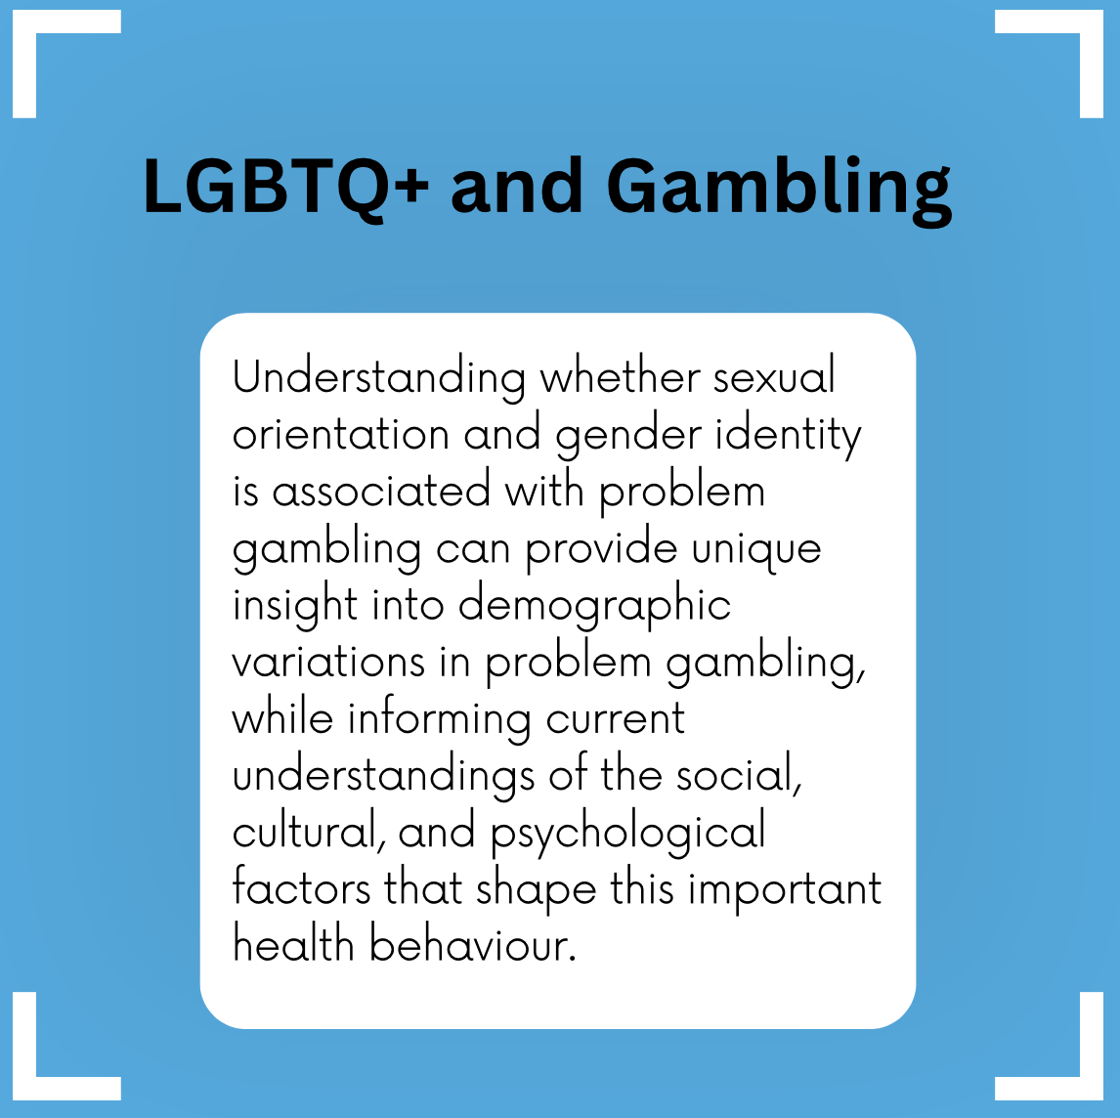

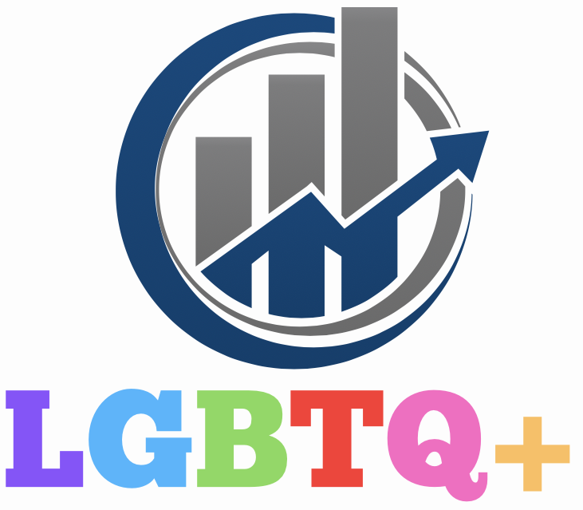

Slide 4

Theoretical Perspectives
Minority stress framework¹:
  Individuals from marginalised populations are at greater risk of discrimination and mental health issues, which are linked to greater engagement in risky behaviours^{2,3}
  Discrimination is associated with drinking and/or drug use⁴
  Similar deficits in coping processes are also found in those with gambling problems⁵
Many of the mental health problems associated with problem gambling are also more prevalent among LGBTQ+ populations⁶
Pathways model⁷:
  There may be specific subtypes of gamblers with unique predisposing factors.
  Some gamblers present comorbid depression and other vulnerabilities and turn to gambling to modulate their affective state / alleviate stress⁸
LGBTQ+ individuals experience higher levels of stressors due to discrimination, stigma, and marginalisation than cisgendered heterosexual individuals⁹

Slide 5

Gambling Harms and LGBTQ+ Communities
Very limited empirical evidence thus far…
Gay/lesbian and bisexual women report ‘disordered gambling’ scores 2.57 times higher than heterosexual women¹
Gay and bisexual men are 7 times more likely to experience the most severe forms of gambling harms than heterosexual men⁸
Grey literature – support services / quotes
Yet, despite these findings, research on the impact of gambling and gambling-related harms among LGBTQ+ communities remains limited and without a clear picture of the causes of those harms.

Slide 6
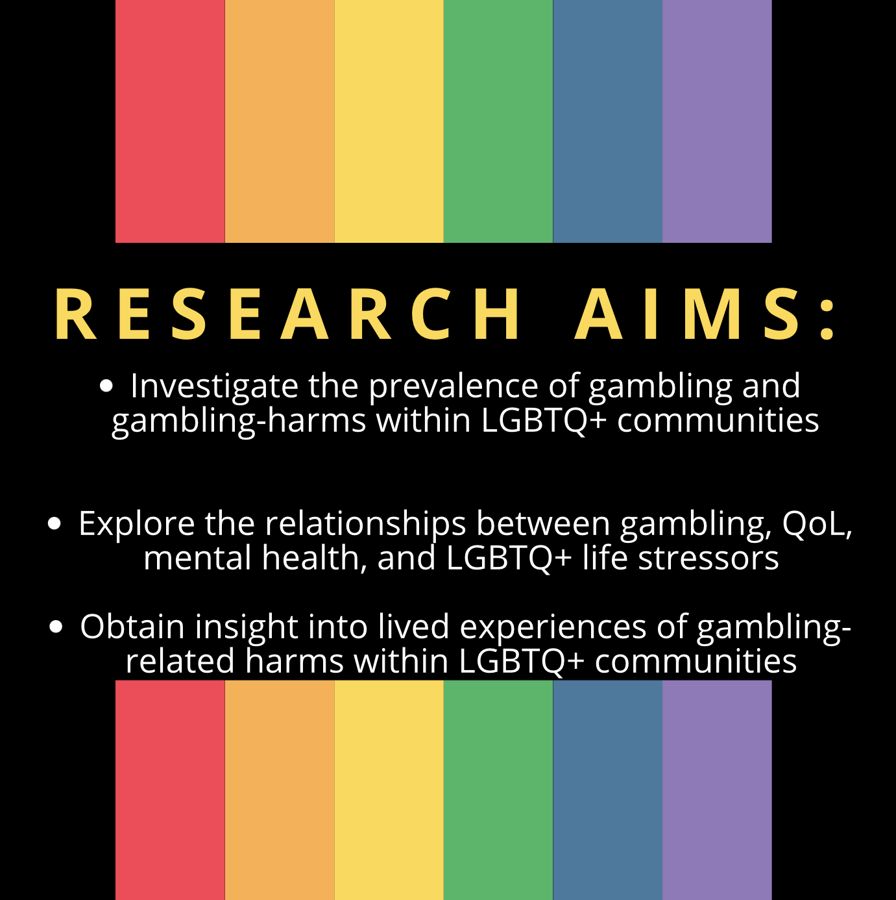

Slide 7
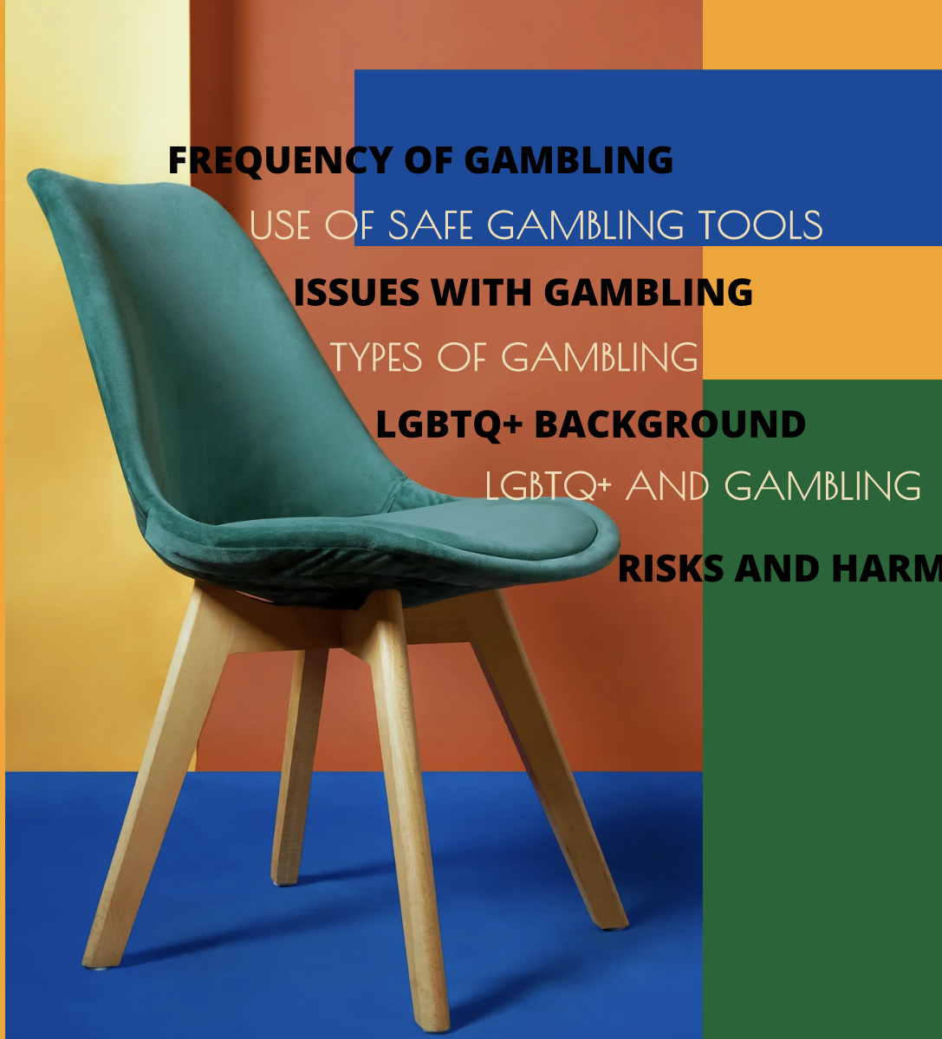
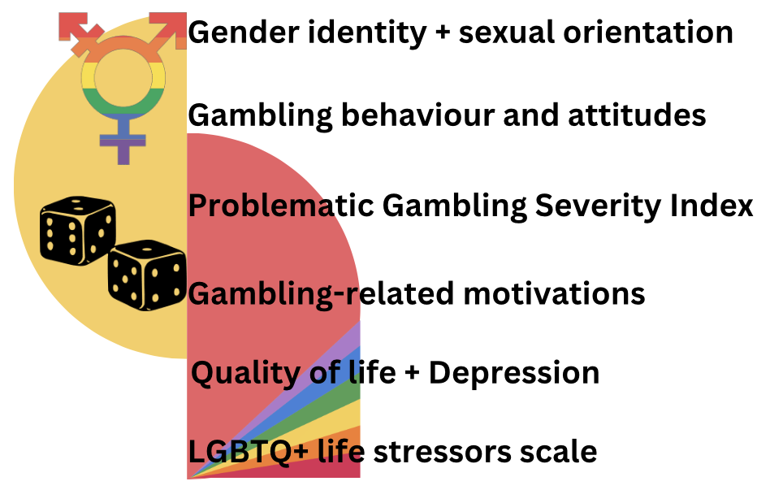
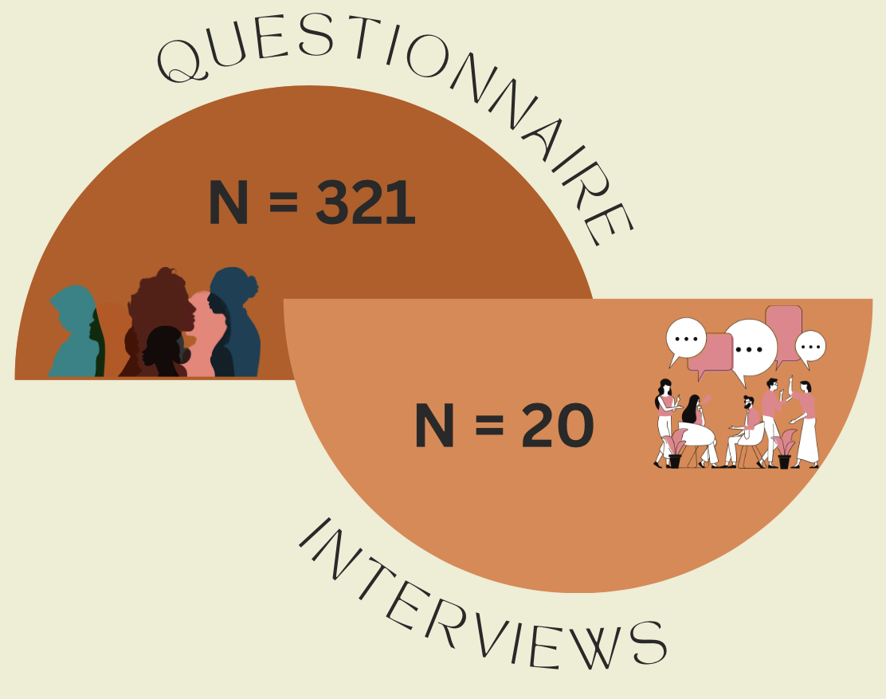
Method

Slide 8
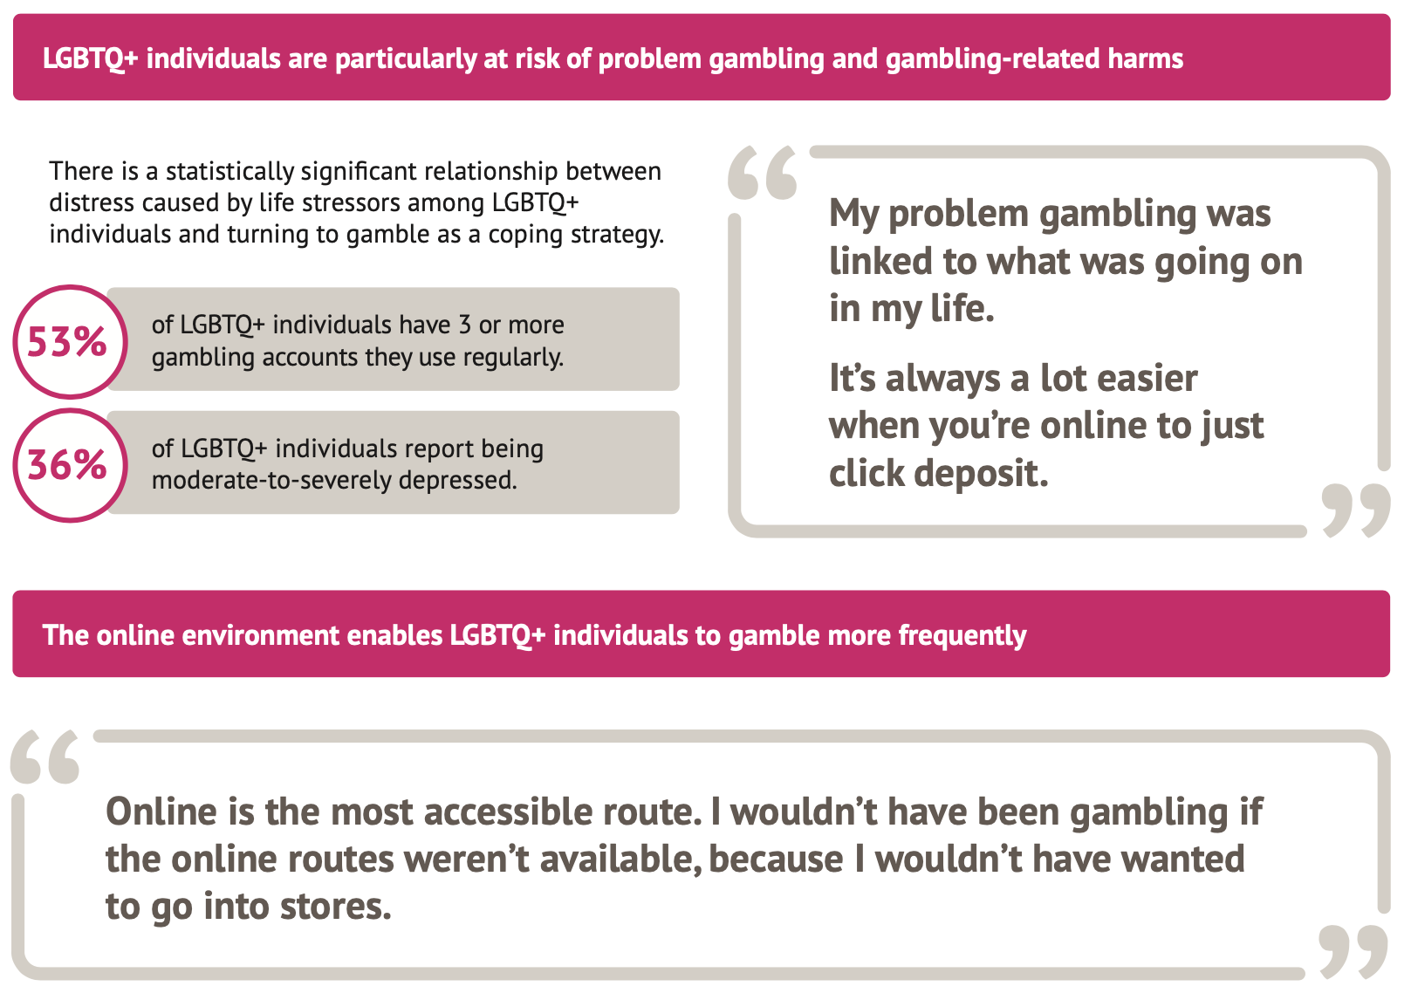
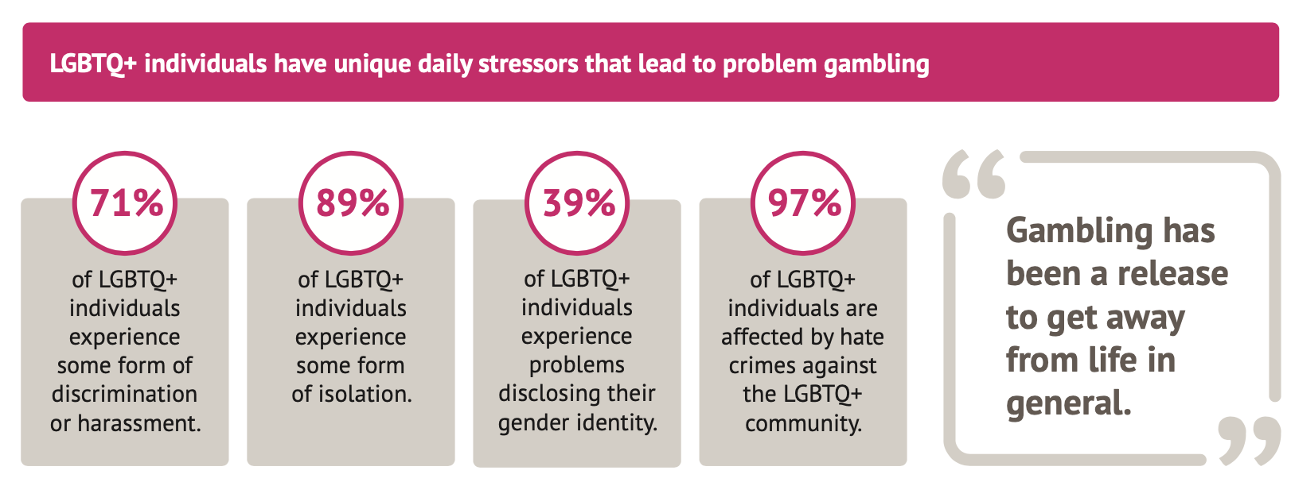
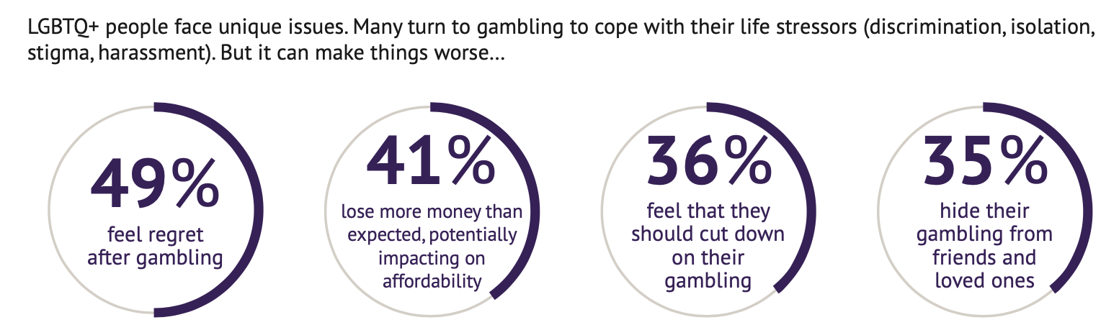
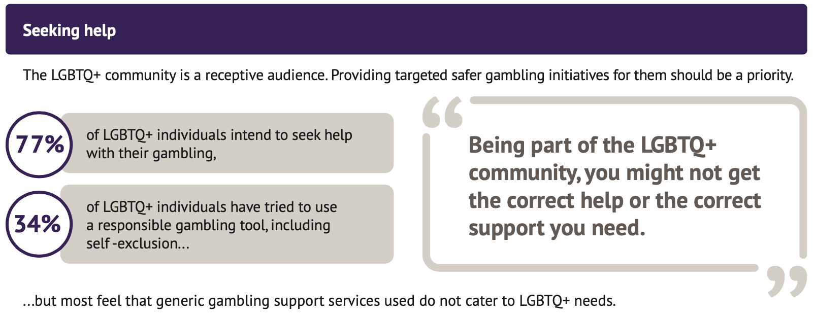

Slide 9
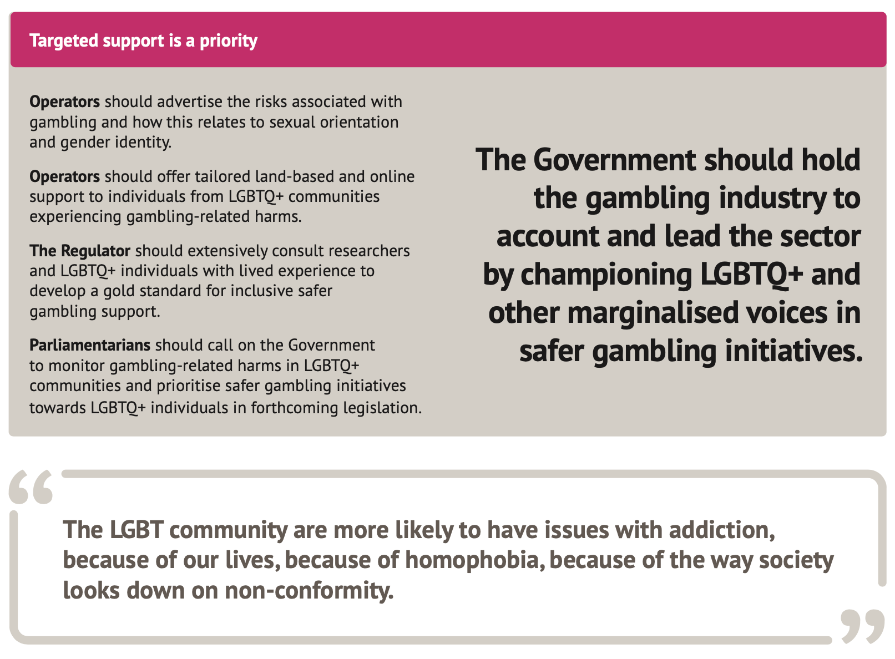
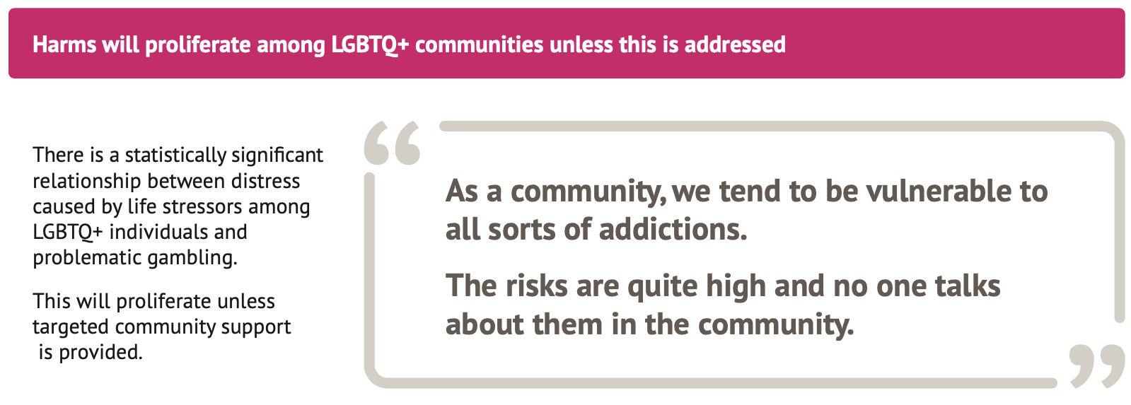
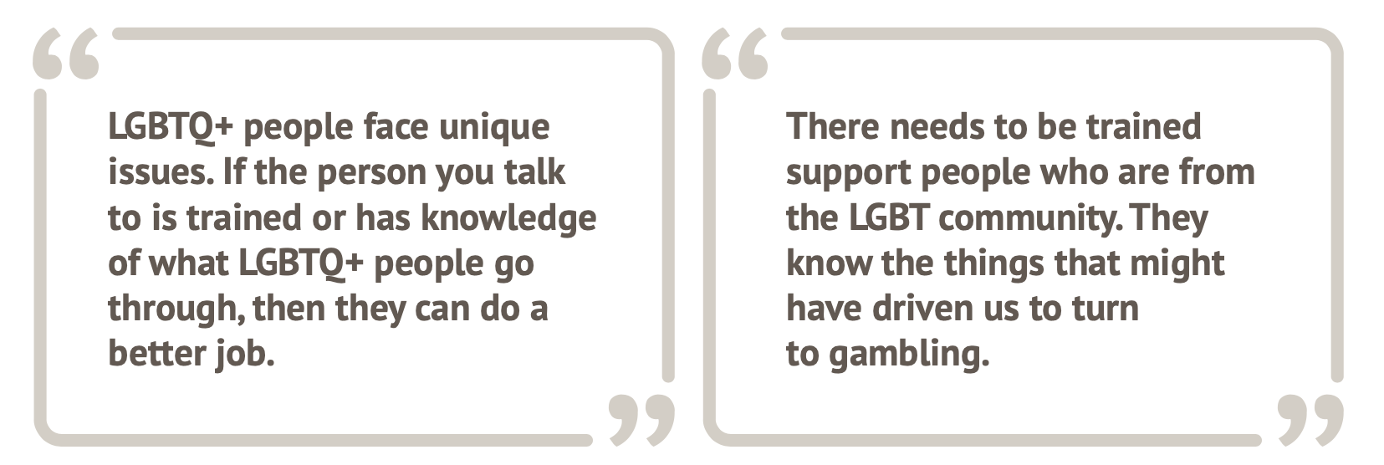

Slide 10
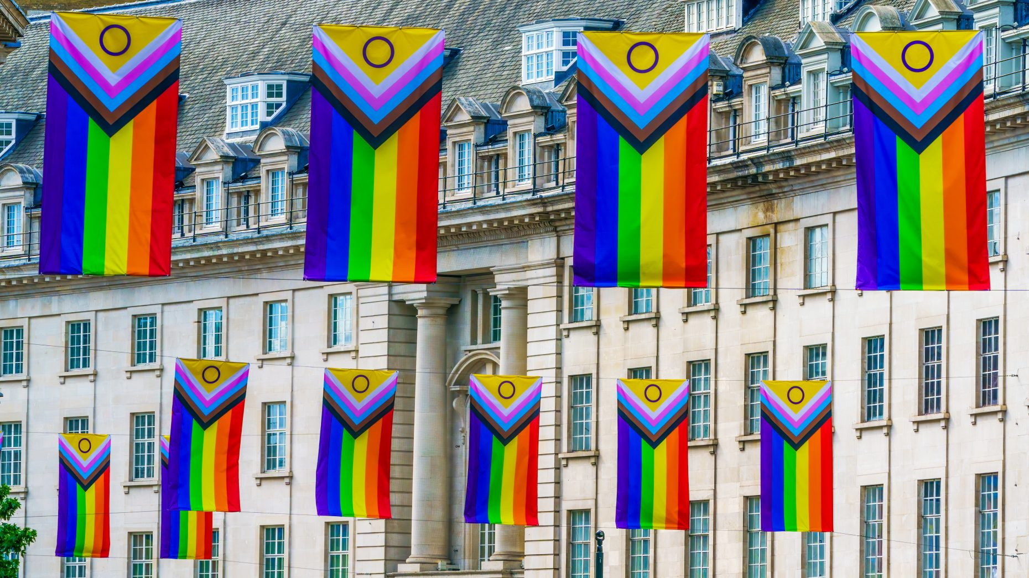

Next Steps
LGBTQ+ Events – Public engagement
Future steps:
  LGBTQ+ Youth and gambling
  Transgender and gambling
  Tailored and inclusive interventions/support

Slide 11
References
Meyer, I. H. (2003). Prejudice, social stress, and mental health in lesbian, gay, and bisexual populations: Conceptual issues and research evidence. Psychological Bulletin, 129(5), 674-697. https://doi.org/10.1037/0033-2909.129.5.674
Green, K. E., & Feinstein, B. A. (2012). Substance use in lesbian, gay, and bisexual populations: An update on empirical research and implications for treatment. Psychology of Addictive Behaviors, 26(2), 265-278. https://doi.org/10.1037/a0025424
Newcomb, M. E., Heinz, A. J., & Mustanski, B. (2012). Examining risk and protective factors for alcohol use in lesbian, gay, bisexual, and transgender youth: A longitudinal multilevel analysis. Journal of Studies on Alcohol and Drugs, 73(5), 783.
HatzenBuehler, M. L. (2009). How does sexual stigma ‘get under the skin’? A psychological mediation framework. Psychological Bulletin, 135(5), 707-730. https://doi.org/10.1037/a0016441
Brezing, C., Derevensky, J. L., & Potenza, M. N. (2010). Non-substance-addictive behaviors in youth: Pathological gambling and problematic internet use. Child and Adolescent Psychiatric Clinics of North America, 19(3), 625-641. https://doi.org/10.1016/j.chc.2010.03.012
Fish, J. N., Hughes, T. L., & Russell, S. T. (2018). Sexual identity differences in high-intensity binge drinking: Findings from a US national sample. Addiction, 113(4), 749-758. https://doi.org/10.1111/add.14041.
Blaszczynski, A., Nower, L. (2002). A pathways model of problem and pathological gambling. Addiction, 97(5), 487-499.
Richard, J., Martin-Storey, A., & Wilkie, E. (2019) Variations in gambling disorder symptomatology across sexual identity among college student-athletes, Journal of Gambling Studies, 35, 1303-1316. https://doi.org/10.1007/s10899-019-09838-z
Veldhuis, C. B. (2022). Doubly marginalized: Addressing the minority stressors experienced by LGBTQ+ researchers who do LGBTQ+ research. Health Education & Behaviour, 49(6), 960-974. https://doi.org/10.1177/10901981221116795
Grant, J. E., & Potenza, M. N. (2006) Sexual orientation of men with pathological gambling: prevalence and psychiatric comorbidity in a treatment-seeking sample, Comparative Psychiatry 47(6), 515–518.

Slide 12
Any Questions?
Dr Reece Bush-Evans
rbush@bournemouth.ac.uk

