Slide 1


Current Advances in Gambling Research conference
June 29, 2023
The availability of a ‘cash-out’ option increases wager amounts in an experimental gambling task
Daniel Bennett
School of Psychological Sciences, Monash University
image: detail from Germany Baden-Baden Casino (2009) by Yuriy Shevchuk

Slide 2

Declaration of interests
This research was wholly funded by internal seed funding from Monash University and Warwick University
  Strategic Project Grants scheme, Turner Institute for Brain and Mental Health
  Activation Fund, Monash-Warwick Alliance
I do not have any competing interests, and do not accept industry funding for my research

Slide 3
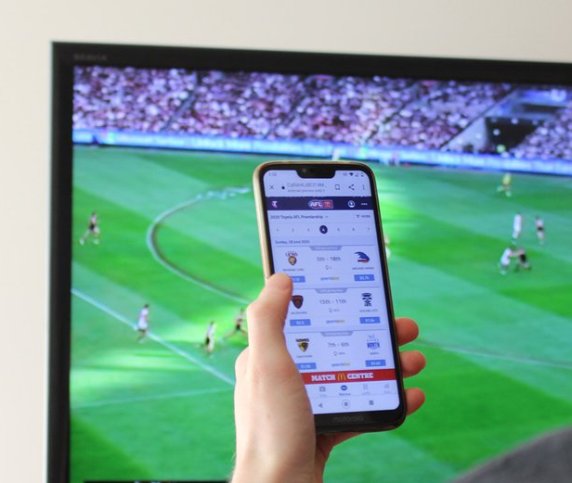
Long-term changes in usage of gambling products
Hill et al. (2021)
In the last 10 years, the incidence of problem gambling has doubled in Australia
  From 0.6% of population to 1.2%
Coincides with the rise of interactive and online gambling
  Online gambling has increased 2x in general population, 3x in gamblers
Online gambling has many unique structural characteristics
Lopez-Gonzalez et al. (2019)

Slide 4
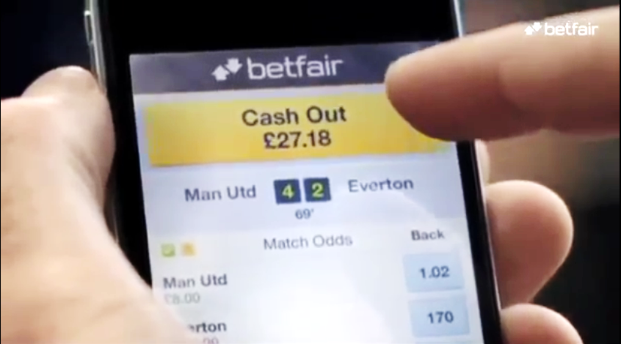

What is cash-out?
Bettors can ‘cash out’ of a bet before the result is known
  Our bettor has backed Manchester United to win
  After 69 minutes, Man U are winning 4 - 2
  If he wants, he can ‘cash out’ of his bet, forgoing his original stake in exchange for an instant payment of £27.18
Cash-out is typically offered at disadvantageous odds
  This increases the expected per-bet losses for bettors who consistently cash out
Cashing-out is a popular feature of sports betting apps
  One possible reason: it increases perceived control over bet outcomes

Slide 5
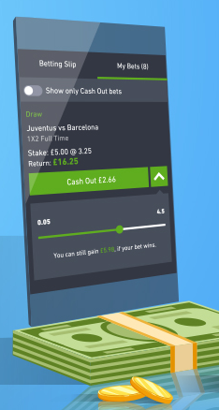
Cash-out and policy/regulation
Regulatory and policy responses to new structural characteristics like cash-out are still evolving
Do the novel features increase the risk of gambling-related harm, or are they risk-neutral?
Those who study judgement and decision making are well placed to help answer this question
  Our approach: via controlled experiments using behavioural tasks that simulate gambling in the lab

Slide 6
Essential features of cash-out decisions
The starting point for this project is to build a cognitive task that will allow us to measure cash-out behaviour in a controlled laboratory setting
The essential features of cash-out
An individual makes a prediction about an uncertain future event, and how a financial stake in the outcome of this prediction
There is a delay prior to finding out whether the prediction is correct, and
The individual is offered the chance to cash out during the delay

Slide 7
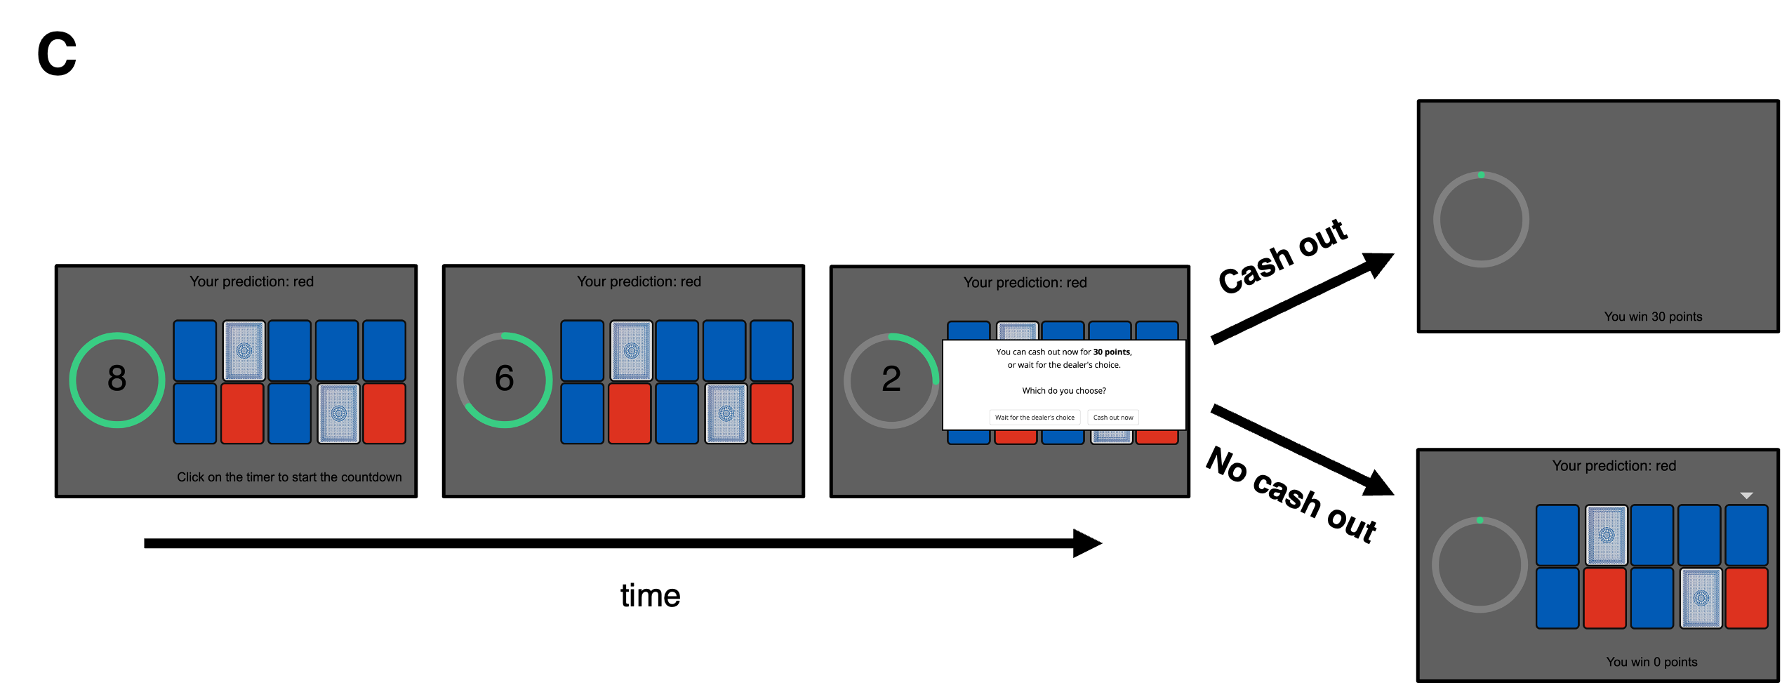
The uncertain future event
Participants shown an array of ten blue and red cards and a countdown timer
At the end of the timer, one of the ten cards will be picked at random
Participants make a prediction about the colour of the card that will be chosen (blue or red)

Slide 8
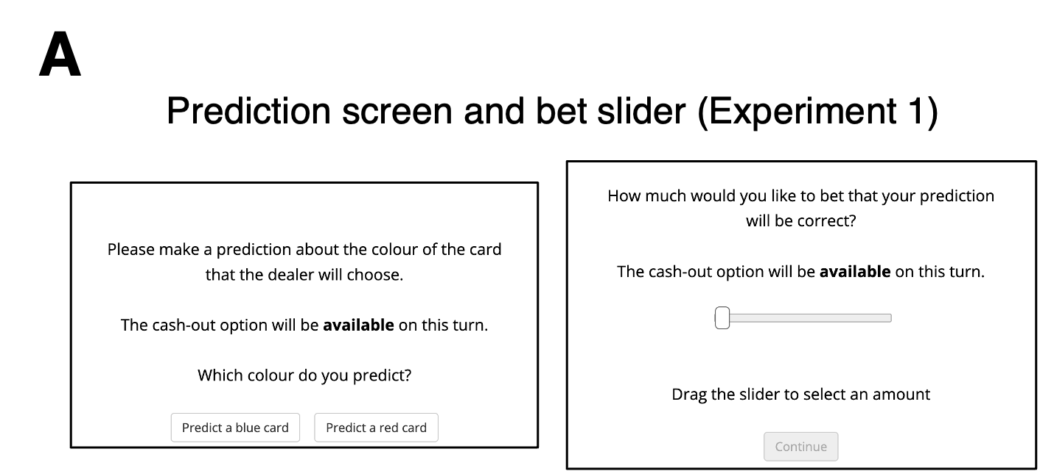
The bet
5 points
50 points
Participants were endowed with 3000 points at the beginning of the task
Points were converted to a monetary bonus (between $0 and $2) at the end of the task

Slide 9
The cash-out offer
Cash out was offered once per waiting period:
Trials varied in terms of:
The participant’s probability of ‘winning’ the bet (30%, 50%, or 70% likelihood of winning)
The ambiguity around these probabilities (there were either 2 or 6 face-down cards)
When the cash-out offer was made available (after 2/4/6 seconds)
The value of the cash-out offer the participant received (either 90% of true value or 100% of true value)

Slide 10
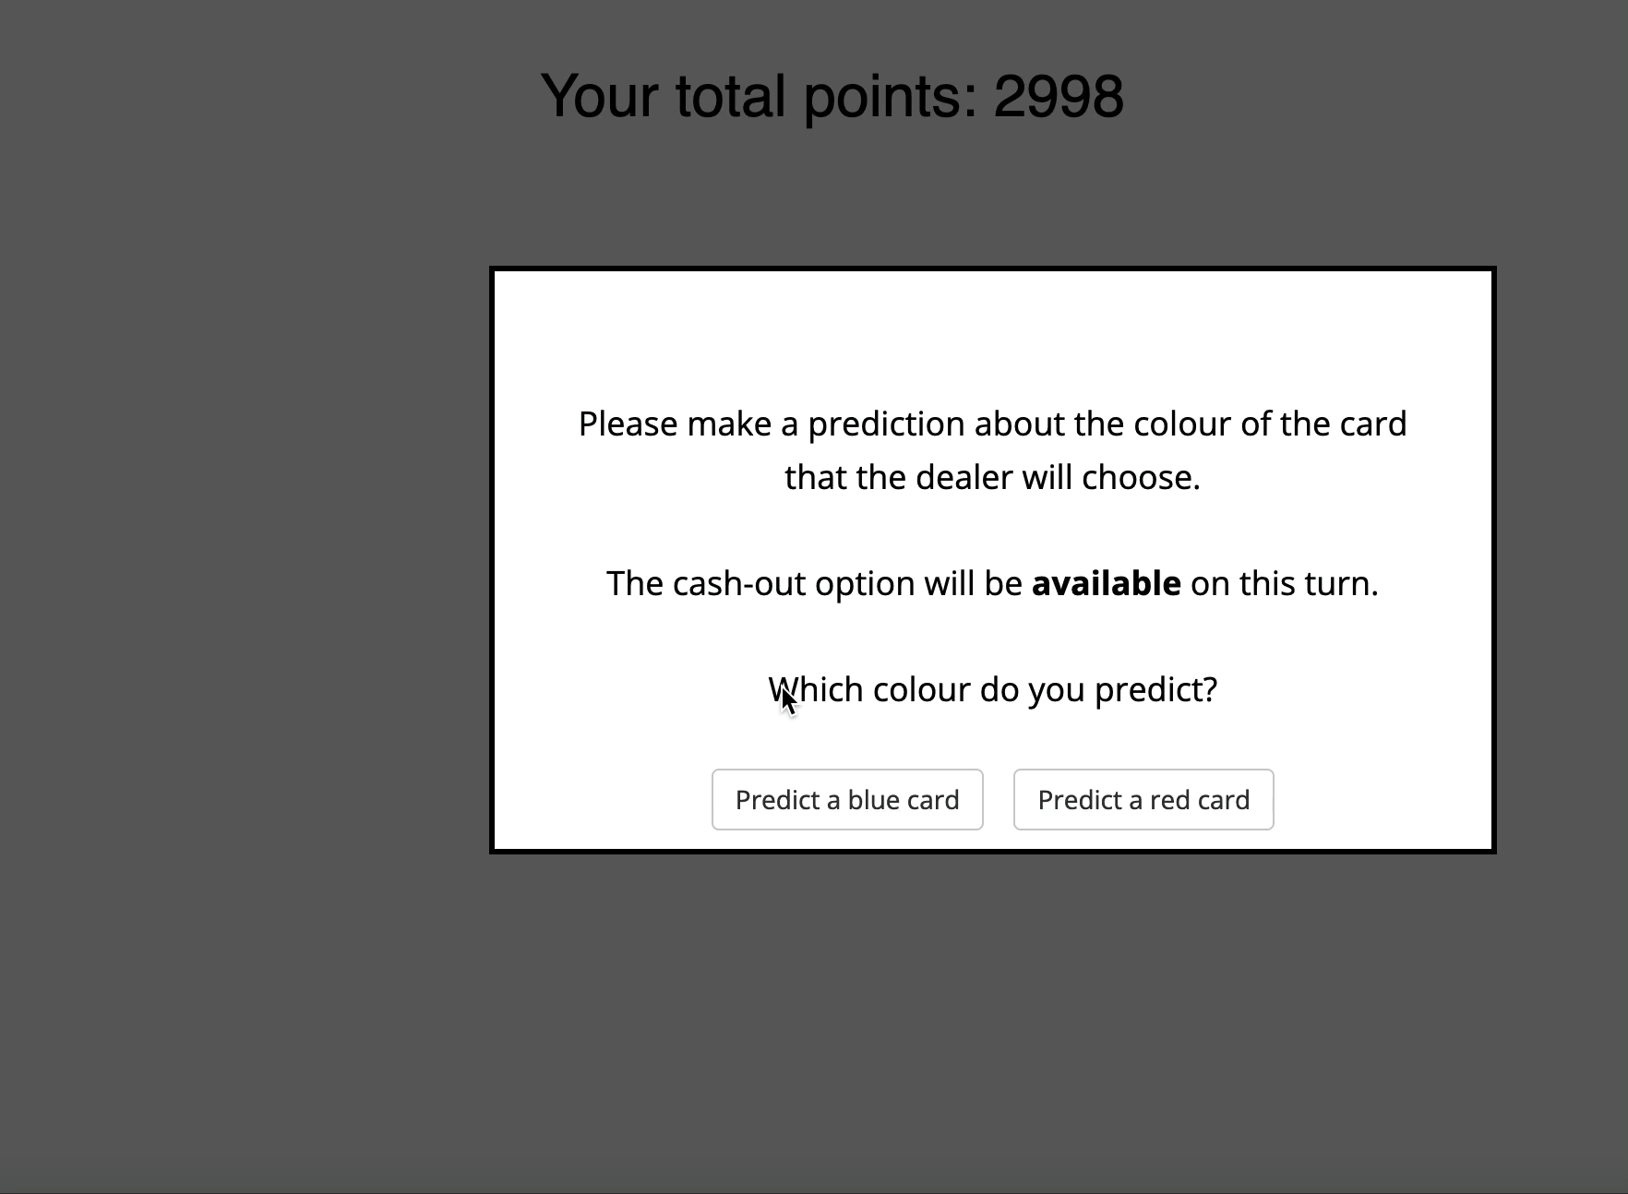
The cash-out task

Slide 11
Does the mere availability of a cash-out option
change individuals’ betting behaviour?

Slide 12
Study design
Sample
N = 60 (35 women, 23 men, 2 not endorsing a binary gender) recruited via Prolific
Age: M = 39.2, range 20 to 65
Country: 13 Australia, 15 Canada, 6 New Zealand, 20 UK, 6 USA
8 excluded following attention checks
Task
80 trials in total (40 with cash-out available, 40 with cash-out unavailable)
Total duration approximately 20 minutes
Independent variable
Cash-out availability (either available or unavailable)
Dependent variable
Amount of points bet

Slide 13
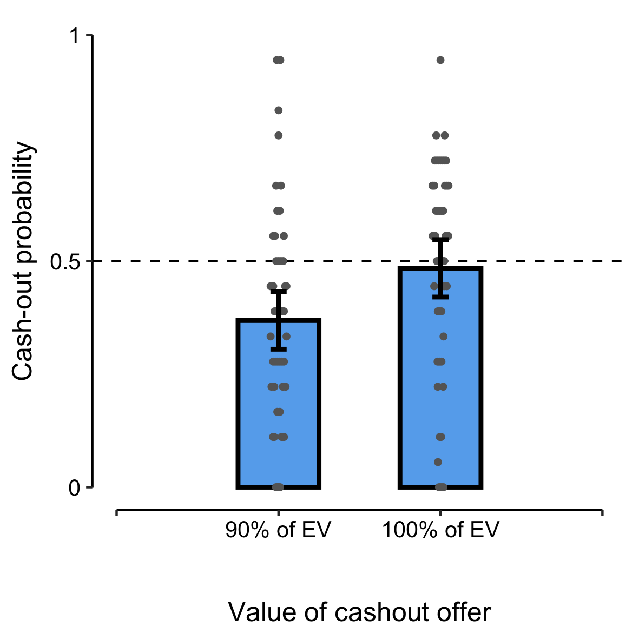
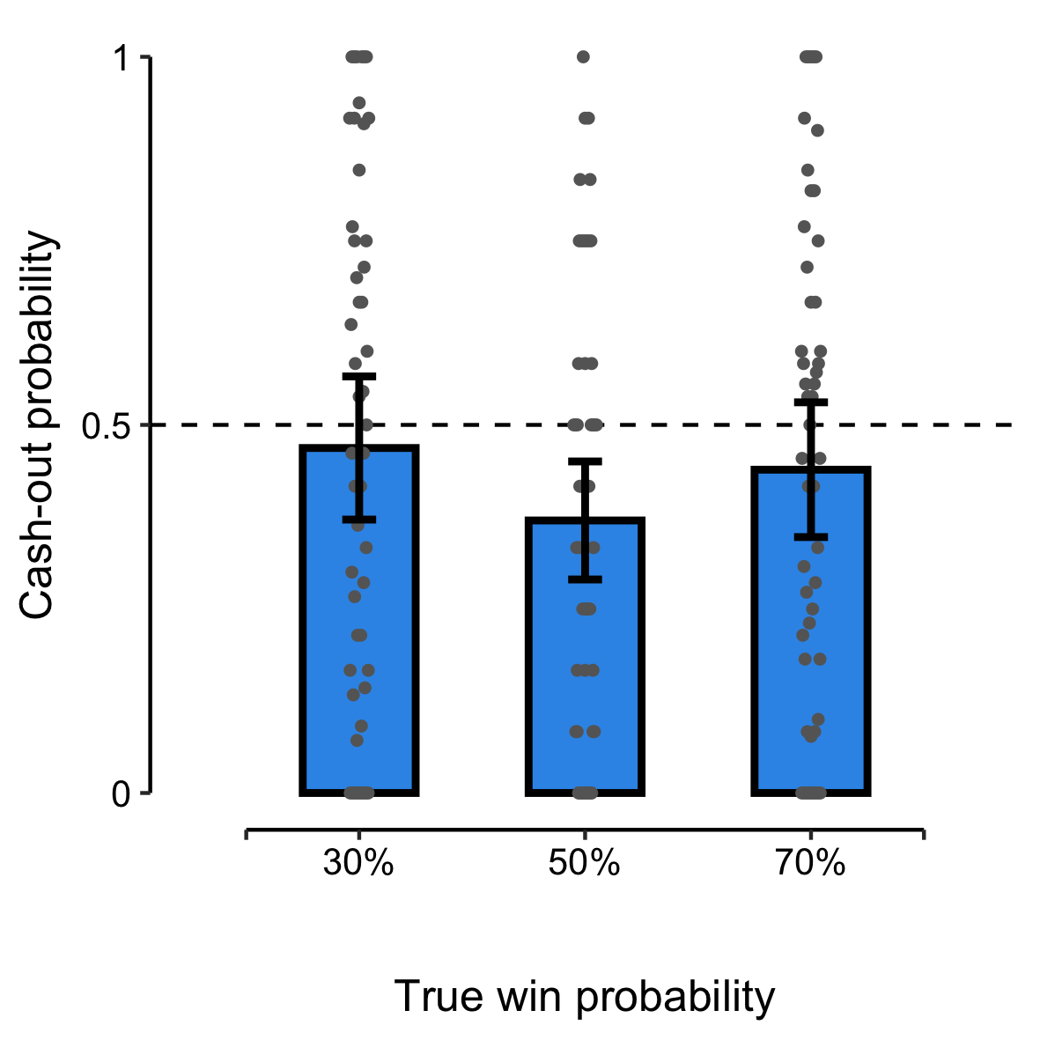
Proof-of-concept results
Participants were more likely to cash out when the cash-out offer was more generous
The probability of ‘winning’ the bet did not affect probability of cashing out (on average)
β = 0.53, p < .001
β = -0.03, p = .66

Slide 14
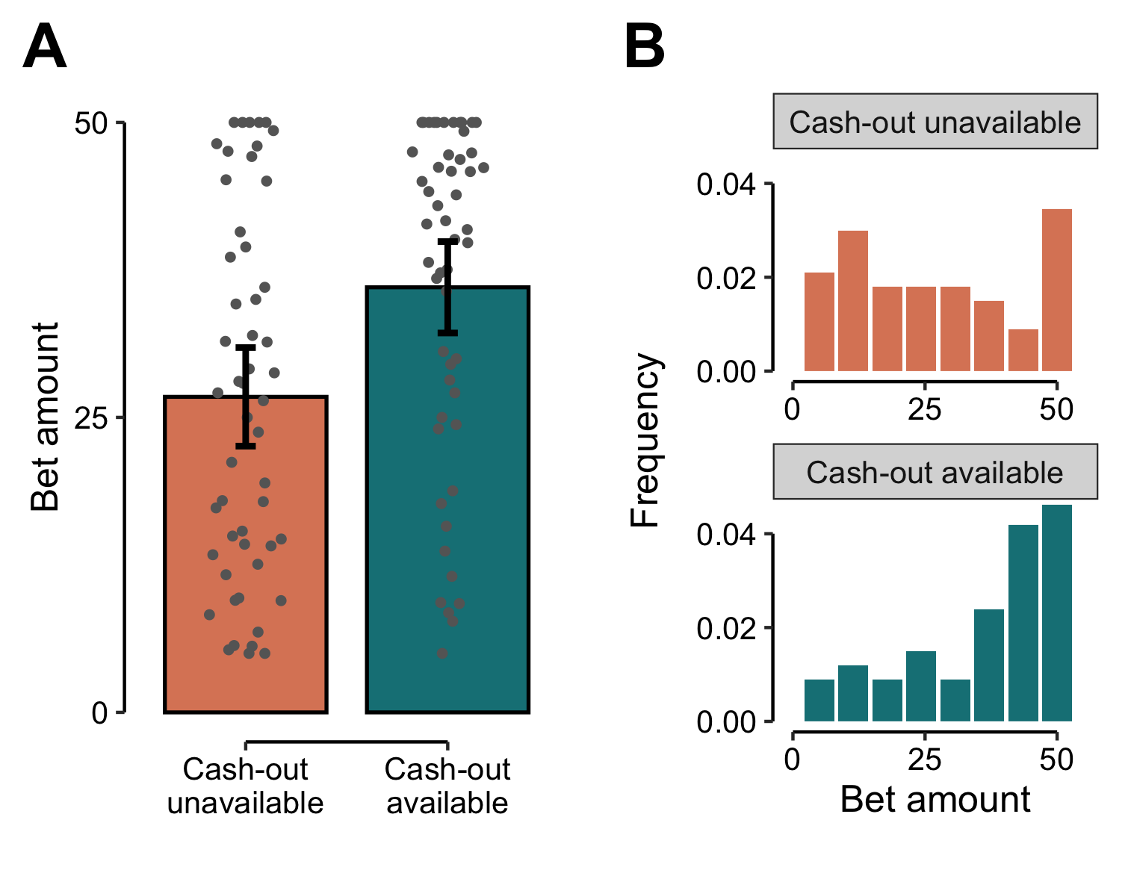
Cash-out availability produces large increases in bet amounts

Slide 15
Cash-out availability produces large increases in bet amounts

Slide 16
Cash-out availability produces large increases in bet amounts
Mann-Whitney U = 914, p < .001
30% increase in mean bet size
(Cohen’s d = 0.75)

Slide 17
Cash-out availability produces large increases in bet amounts
Mann-Whitney U = 914, p < .001
30% increase in mean bet size
(Cohen’s d = 0.75)

Slide 18
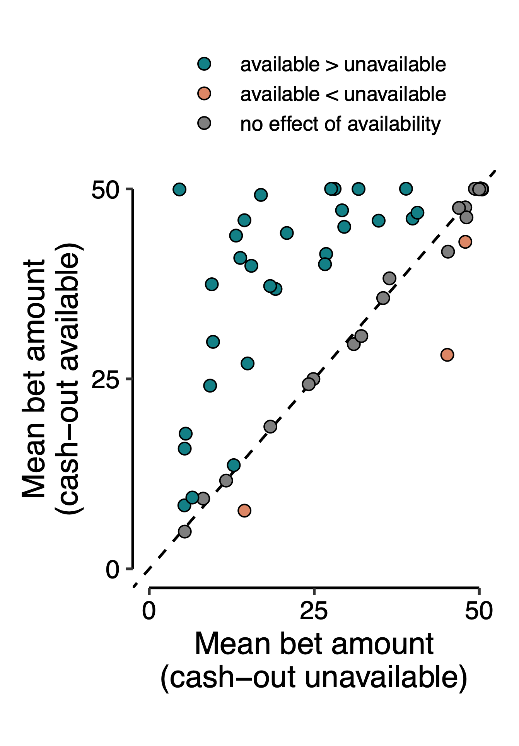
Cash-out availability produces large increases in bet amounts

Slide 19
Cash-out availability produces large increases in bet amounts
More than half of all participants showed a significant within-person effect

Slide 20
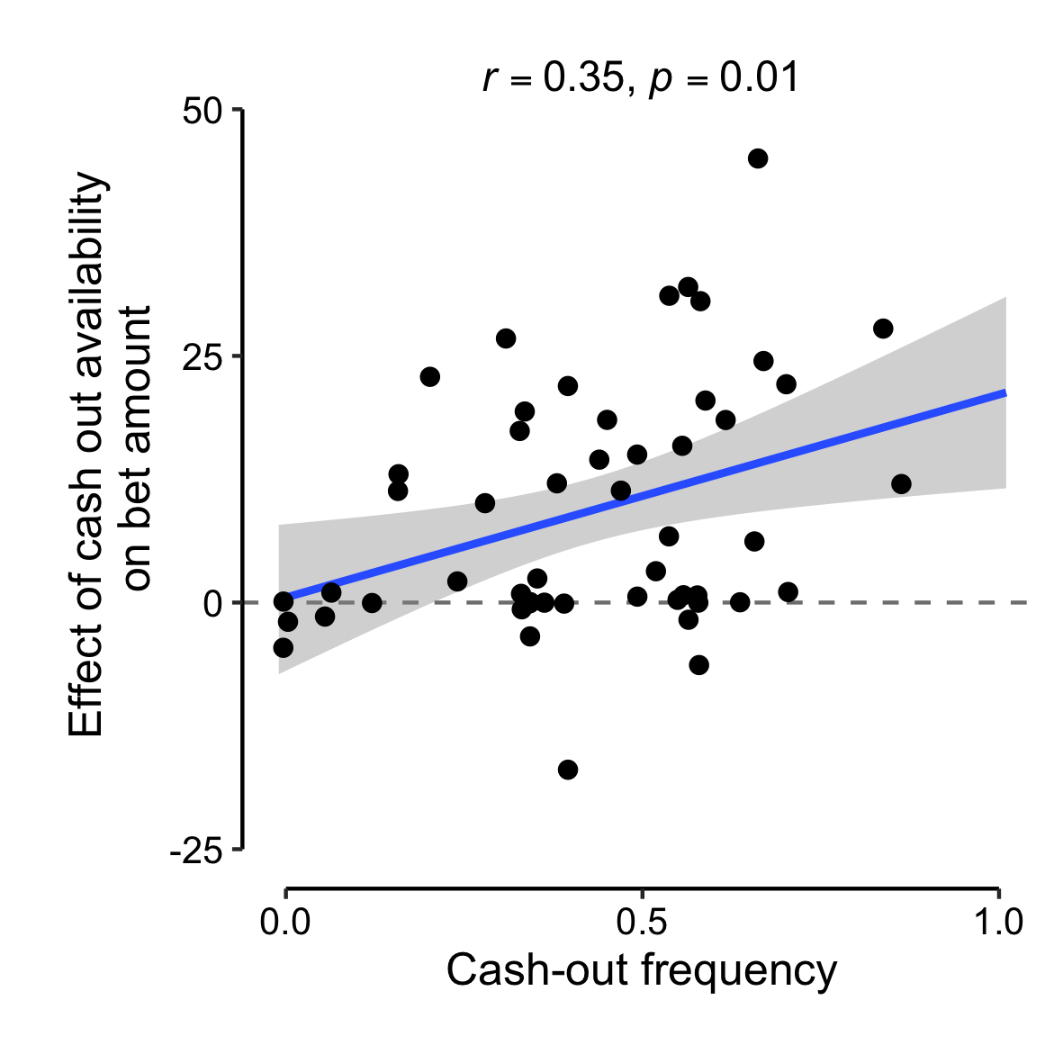
Cash-out availability produces large increases in bet amounts
More than half of all participants showed a significant within-person effect

Slide 21
Cash-out availability produces large increases in bet amounts
More than half of all participants showed a significant within-person effect
Effects were strongest among those who used cash-out most frequently

Slide 22
Replication results
We next conducted a preregistered replication (N = 180):
Between-participants manipulation of cash-out availability
Increased upper limit for bet amounts (100 points)
No ‘fair’ cash-out offers (offers were 80% or 90% of true EV)

Slide 23
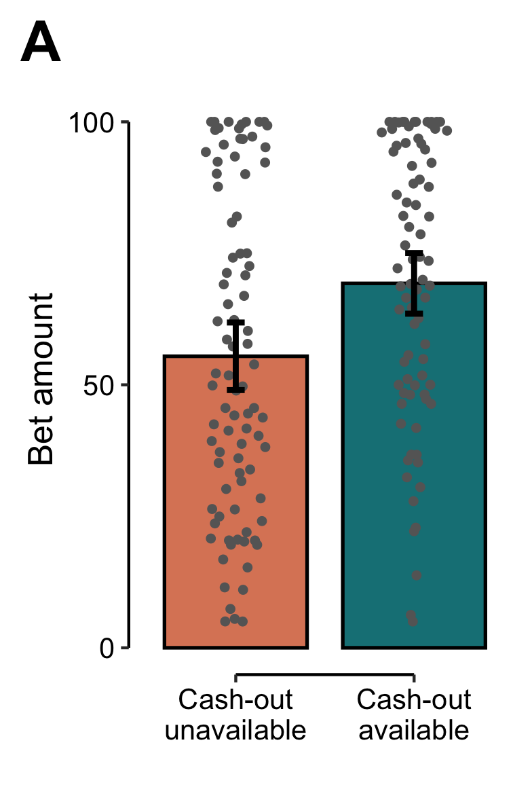
Replication results
Mann-Whitney U = 4432, p < .01
25% increase in mean bet size
(Cohen’s d = 0.48)
We next conducted a preregistered replication (N = 180):
Between-participants manipulation of cash-out availability
Increased upper limit for bet amounts (100 points)
No ‘fair’ cash-out offers (offers were 80% or 90% of true EV)
Results replicated from the within-participants version

Slide 24
Take-away messages
The mere availability of a cash-out option induces people to make larger bets
  Participants made bets that were a quarter to a third larger when cash-out was available
  This effect was prevalent across the sample and replicated in a separate between-participants experiment
  The largest increases in bet size were among those who used cash-out most frequently
Since larger bets are a risk factor for the development of problem gambling, cash-out could be a contributing factor to gambling-related harm
Experimental studies of the feature allow us to investigate cash-out in a controlled setting
  Including experimental manipulation of cash-out availability in a way that would not be possible in observational data
  Of course, the trade-off is a less naturalistic betting environment

Slide 25
Thanks for your attention!
Contact: daniel.bennett@monash.edu
Other investigators on this project:
  Lucy Albertella (Monash University)
  Ty Hayes (University of Warwick)
  Elliot Ludvig (University of Warwick)
  Antonio Verdejo-Garcia (Monash University)
  Lukasz Walasek (University of Warwick)
Funding sources:
  Monash-Warwick Alliance
  Turner Institute for Brain and Mental Health, Monash University
image: detail from Germany Baden-Baden Casino (2009) by Yuriy Shevchuk

Slide 26
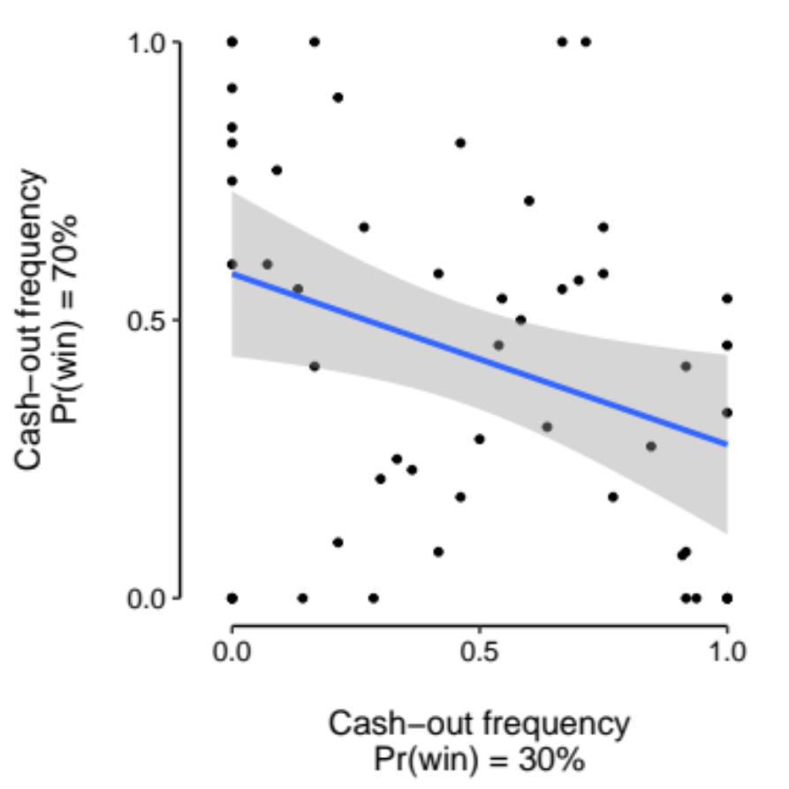
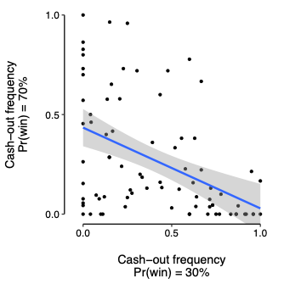
Cashing out and risk aversion
There was a negative correlation between cash-out frequency when a win is likely and cash-out frequency when a loss is likely
Within-participants version
Spearman 𝜌 = -.33, p = .02
Between-participants version
Spearman 𝜌 = -.46, p < .001

Slide 27
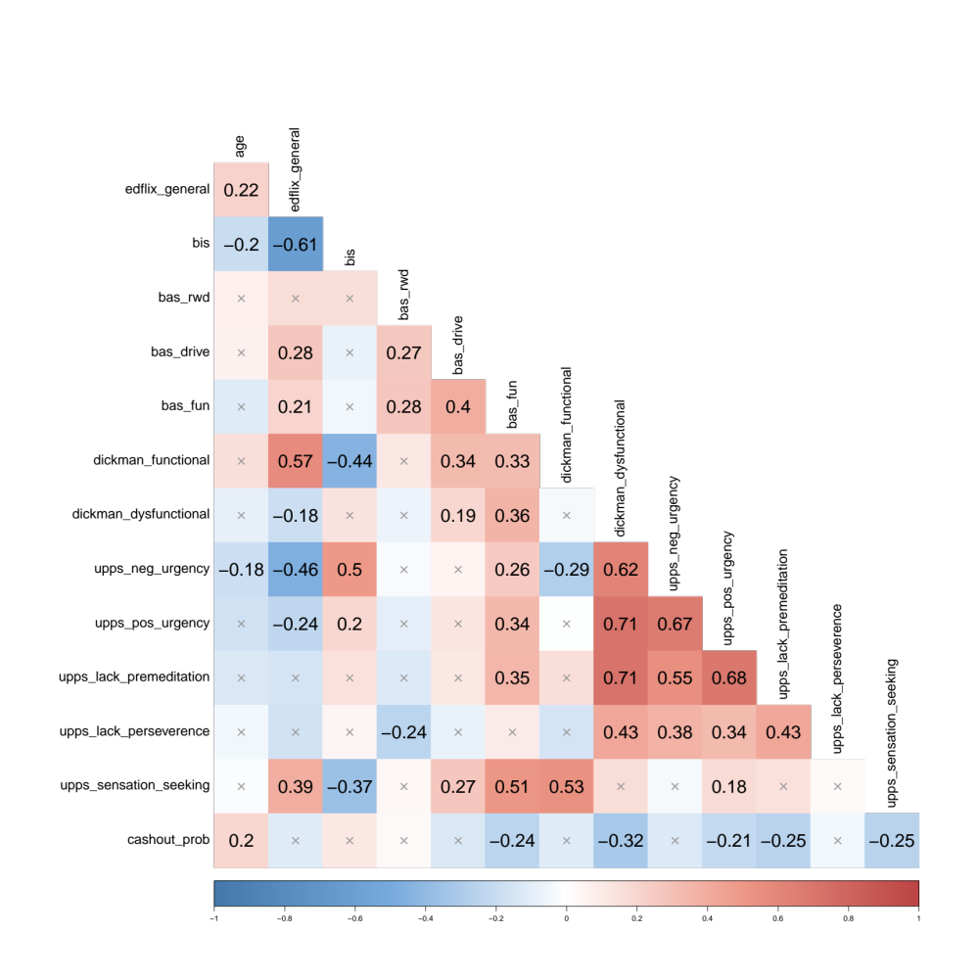
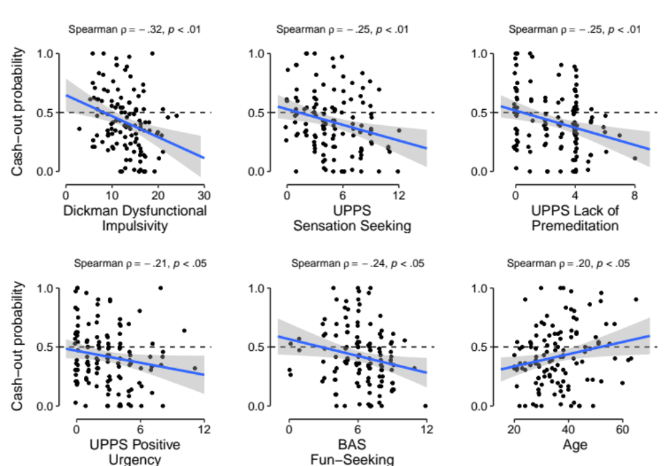
Results

Slide 28
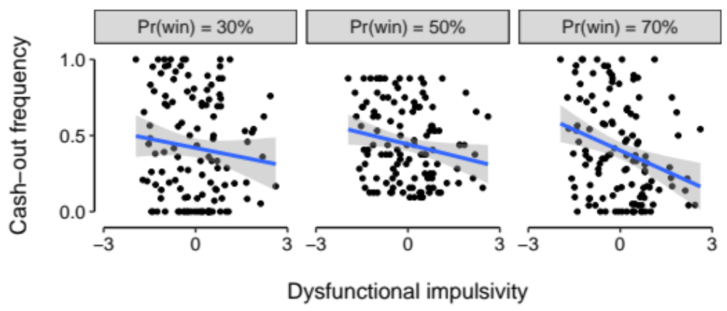
Factor analysis regression results
Greater dysfunctional impulsivity is associated with lower use of the cash-out feature
  “I often get into trouble because I don’t think before I act”

Slide 29
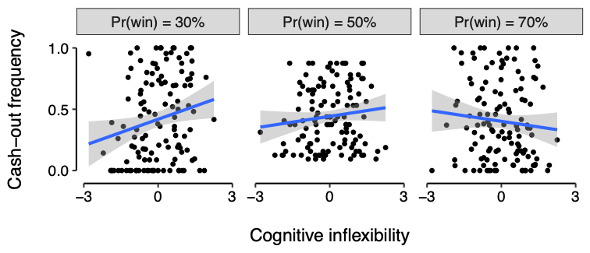
Factor analysis regression results
Greater cognitive inflexibility is associated with greater use of the cash-out feature, specifically when a loss is likely
  “It bothers me when things don’t go exactly as planned”
  “I find it difficult when something unexpected happens”

